Slide 1
Team Software Project
Getting started
Let's Not Do Waterfall Projects

Slide 2
How to Get Started?

Slide 3
You Already Have a [Partial] Plan
Your project proposal is a partial project plan:
- development approach
- initial time line with goals & deliverables
- technical approach
- some tools you will use

Slide 4
Each Iteration
Must do this each iteration:
1. short iteration plan
  goal
  major tasks to perform
  work product to produce
2. create a task board
  tasks consistent with your plan
  may have more tasks or breakdown big tasks
3. Retrospective & short summary
  Retrospective is about process not the product
4. TA Meeting & Demo

Slide 5
How to Find Things?
1. Project Hub (Information Hub)
one place where someone can learn everything about your project.
typically a wiki or project management site (like Assana or Trello)
2. Github Repository - for code, issues, build status

Slide 6
Milestone
Milestone:
an indicator that shows tangible progress toward completing a project, along with objectively verifiable criteria that show the milestone has been achieved (or not).
A milestone usually shows you achieved some goal or major work of the project. The milestone criteria are how to verify that the work has been satisfactorily done.

Slide 7
Define a Milestone
Each iteration, include at least one milestone in your Iteration Plan.
Milestone is usually related to the goal for the iteration.
The milestone is something that objectively shows you achieved a goal or made significant progress.

Slide 8
Not Objectively Verifiable Criteria
These are bad milestones:
[ ] Study Django [when is it "done"? how does it show progress toward finishing the project?]
[ ] Write User Stories [when are they done?]
[ ] Team meeting [so what? how did it help project?]
[ ] Task Board [this isn't a work product or activity]

Slide 9
Binary Milestones
A milestone is either done or not done.
There are no "90% done" milestones.
-- Steve McConnell, Software Project Survival Guide

Slide 10
Milestones According to Agile
"Working software is the primary measure of progress."
They are not fans of documentation as milestones.

Slide 11
Create Your Own Milestones
Create milestones that are specific to your project plan & work.
Not a copy of examples.
Each milestone should have objectively verifiable ("done" or "not done") criteria.

Slide 12
Project Initiation Milestone
[ ] Vision statement reviewed, approved, and published
[ ] Initial timeline with iteration goals & features reviewed and published
[ ] Technical approach agreed on and published
[ ] Initial set of mock-ups of UI and screen-flow created, reviewed, and published
[ ] Project home page on Github and wiki created.
... what is significant work your project needs to do?
published = published on wiki or Google Drive, with link on project home. approved = team and TA/instructor all agree on it.

Slide 13
Page Flow or Screen Flow
A mock-up of each page & how the application flows from one page to the next.
Can be:
1. one screen per piece of paper
2. a large diagram (next slide)

Slide 14
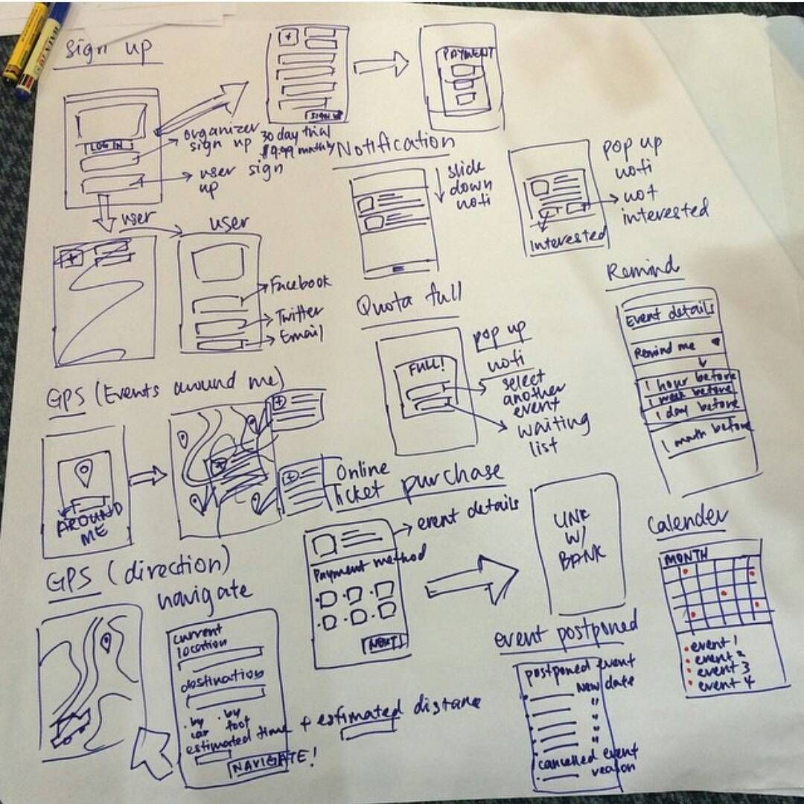

Slide 15
Ideas for Iteration 1
Create a Domain Model
Create a "Domain Class Diagram" showing...
  important classes in the domain
  what they know (attributes)
  major responsibilities
Another tool for this is CRC cards.

Slide 16
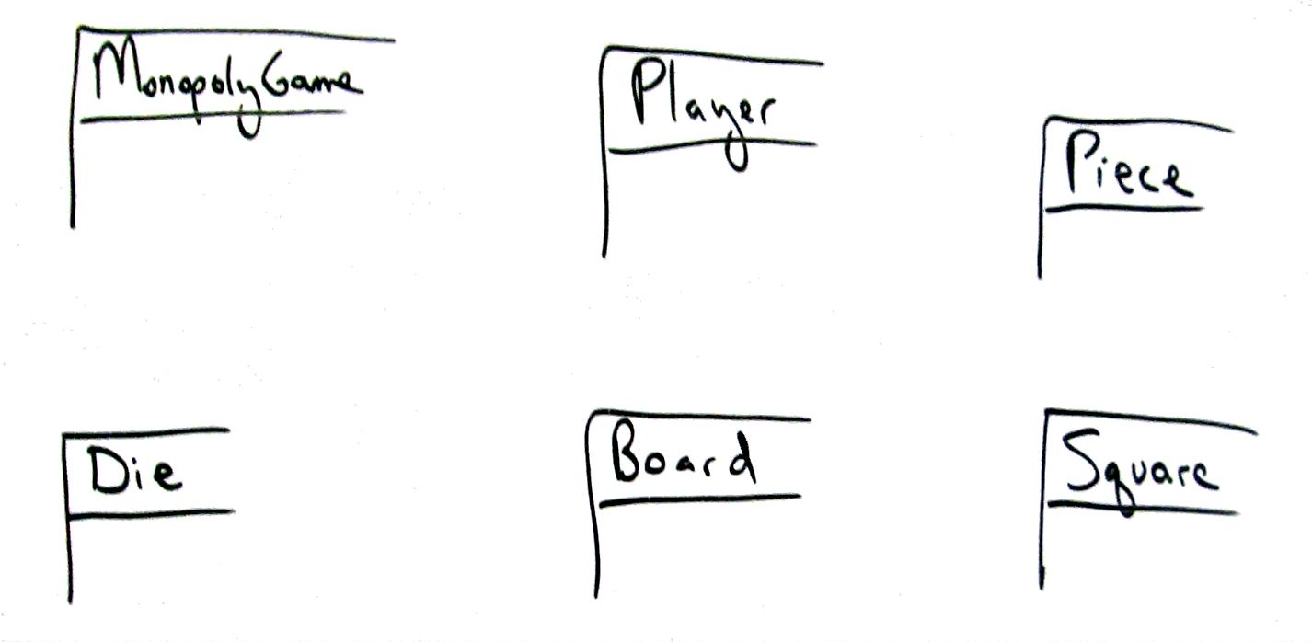
Model: Identify classes

Slide 17
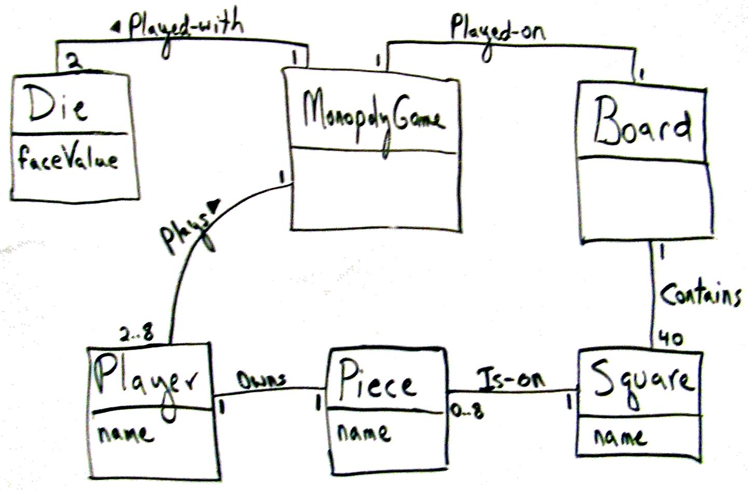
Identify relations and key attributes

Slide 18
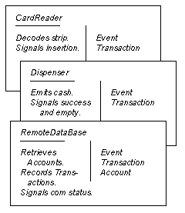
Class-Responsibility-Collaborator Cards
Back Side: notes, important things to validate

Slide 19
Concentrate on dynamic aspects
Beginners spend too much time on static structure,
not enough time on dynamic (behavior)
-- Craig Larman
You should draw sequence diagrams, too.

Slide 20
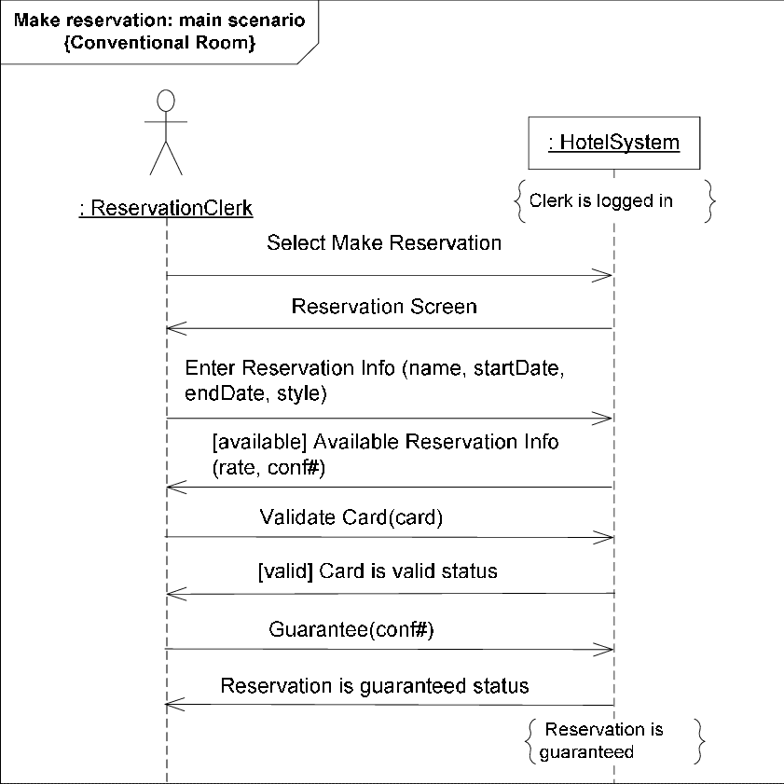
System Sequence Diagram
Shows interaction between "user" & system for one usage scenario.
Use SSD to discover what system must do.
May show external services.

Slide 21
Identify what you do Not know
Things you don't know could be risks.
Identify important things you don't know.
Domain or business related "don't knows":
what are the important terms and conditions of an apartment rental?
(so we can include them in the rental app UI)
learn more about app domain, what users want
ask people who do know

Slide 22
Technical Not Knowns
Examples:
- How to send and receive JSON requests in Django?
- How to integrate Google Calendar or existing Calendar framework into our app? (It's not useful to write your own calendar -- no one wants another calendar!)
Tasks:
Study possible solutions
Work through a tutorial or sample app
Create your own proof-of-concept app

Slide 23
Work should be VISIBLE
For any group project it is important
that progress is visible.
Lack of visibility => miscommunication, "surprises", defective or unusable work products.
Your work should produce work products.
Work products should be shared with team.
Make it visible and online.
Agile Practice: "Develop in plain sight".

Slide 24
Let's Not Do Waterfall Projects
Typical course project:
- Project presentation during last week.
- Project code & docs submitted during final.
- Instructor finds problems after semester ends.
Missed opportunity to learn.
Let's not do this.

Slide 25
Iteration Review & Demo
After each iteration:
  review progress & plan with TA.
  what did you do?
  any changes to the product or project plan?
Every iteration after the 1st one:
  Demo running software
  It should do more than the previous demo

Slide 26
Iteration Review & Demo
Who and where to demo?
  Each iteration a different team member must present
  Can be in-person or online

