Slide 1
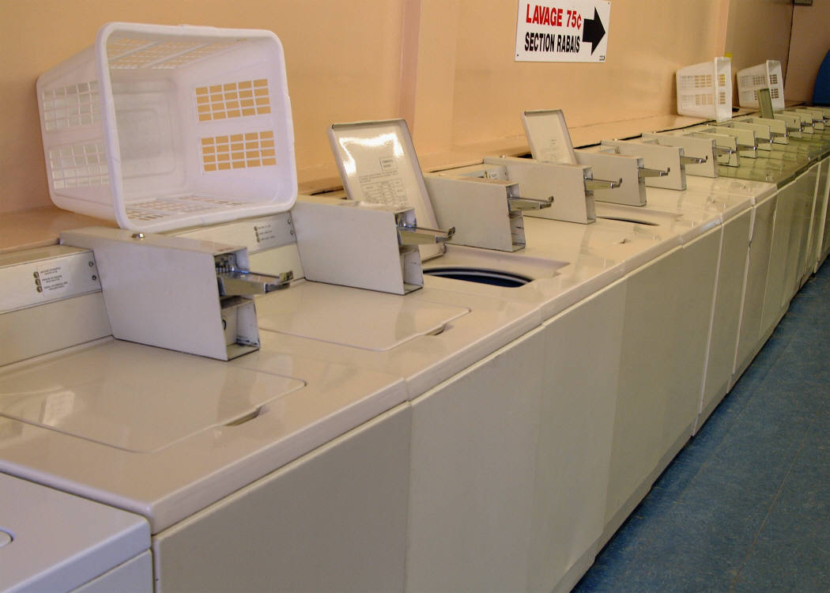
Service-Oriented Architecture (SOA)
David Patterson
Notes:
Very popular topics
Rent like using doing your laundry in a service

Slide 2
Building large SaaS?
Can you design software so that you can recombine independent modules to offer many different apps without a lot of programming?
  Solves “Agile only good for small teams”
“[Amazon CEO Jeff Bezos] realized long before the vast majority of Amazonians that Amazon needs to be a platform.”
Steve Yegge, Googler, former Amazonian, in a 2011 blog post
Notes:
Blog poster by Steve Yegge, used to be at Amazon, now at Google – I wish Google understood.
Circulated a
What does this require? TOTAL ISOLATION. SOA forces you to do that.

Slide 3
2002: Amazon shall use SOA!
“All teams will henceforth expose their data and functionality through service interfaces.”
“Teams must communicate with each other through these interfaces.”
“There will be no other form of interprocess communication allowed: no direct linking, no direct reads of another team's data store, no shared-memory model, no back-doors whatsoever. The only communication allowed is via service interface calls over the network.”
Notes:
Blogger at Google used to be at Amazon
Internal blog, for Google rant how screwed up company was
External blog for public
Mixed them up, and we put it into the book before he deleted entry
Amazon for all its weaknesses, does SOA
Google, for all its strengths, doesn’t get SOA
Started as silo’d sw in 1995, then 7 years later switched to SOA via directive from Bezos, CEO and founder of Amazon,
BS in CS Princeton
Blogger claims one of 7 points is false; we’ll figure out which at end
Millions of other things on the page

Slide 4
CEO: Amazon shall use SOA!
“It doesn't matter what [API protocol] technology you use.”
“Service interfaces, without exception, must be designed from the ground up to be externalizable. That is to say, the team must plan and design to be able to expose the interface to developers in the outside world. No exceptions.”
“Anyone who doesn't do this will be fired.”
“Thank you; have a nice day!”
Notes:
Why should Iisten to CEO? What does he know? Don’t you read Dilbert? I’m smarter than the CEO. What should I follow this email?
False was 7. Bezos doesn’t care about your day. He got them with “fired”
5 points is one of best descriptions of SOA; everything must use API
Facebook too; Facebook platform 3 years later, switched from monolithic silo’d to facebook (Facebook Platform)
(Google doesn’t get it – Google Groups could only watch what others could do)

Slide 5
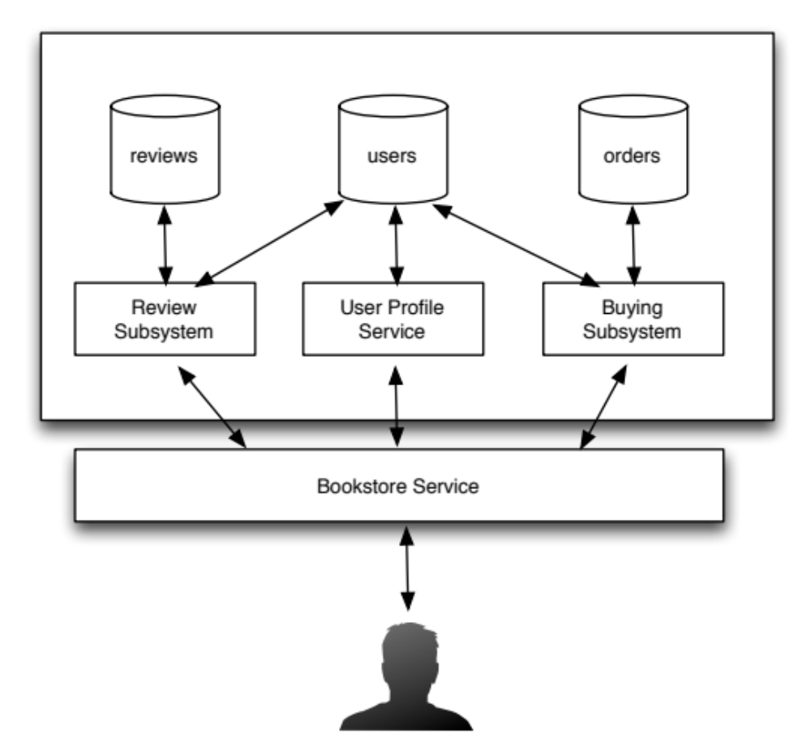

Bookstore: Silo
Internal subsystems can share data directly
  Review access user profile
All subsystems inside single API
(“Bookstore”)
(Figure 1.7, Engineering Software as a Service by Armando Fox and David Patterson, 2014.)
Notes:
Start with Silo’d version – natural to do
Shared memory, no extra overhead
the reviews subsystem can get user profile info out of the users subsystem
3 independent services inside the silo
There are services inisde, but one set of APIs for whole thinig

Slide 6
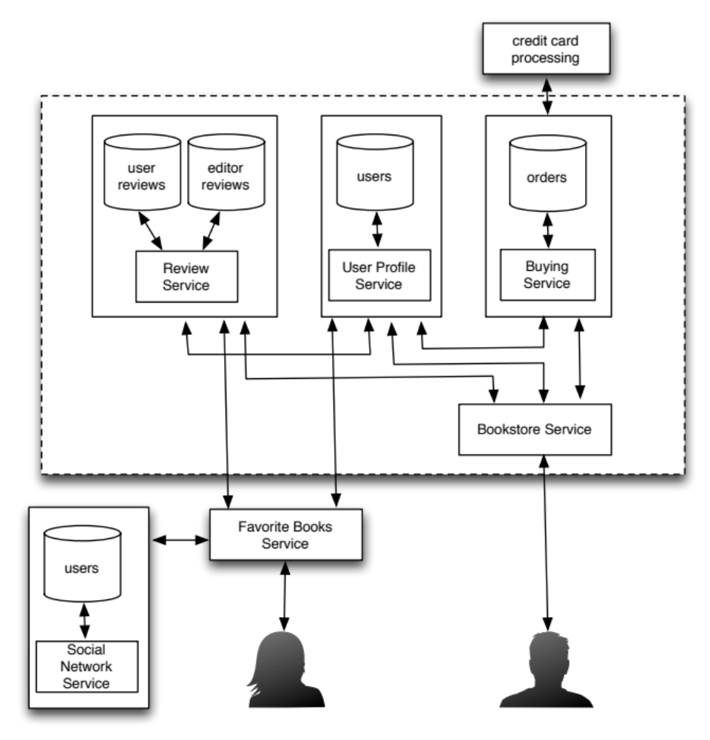
Bookstore: SOA
Subsystems independent,
as if in separate datacenters
  Review Service access User Service API
Can recombine to make new service (“Favorite Books”)
((Figure 1.7, Engineering Software as a Service by Armando Fox and David Patterson, 2014.)
Notes:
Creates another app – group’s favorite books app from standard bookstore just another combination
Even though all inside same datacenter, SW written as if in different ones
No service can access another services data – must go through API of service
Note not a layered model of software, but a network connection

Slide 7
Which of the following is a disadvantage of SOA compared to a silo design?
☐
SOA may be harder to debug & tune
☐
SOA results in lower developer productivity
☐
SOA’s complexity is a poor match for small teams
☐
SOA is more expensive to deploy than Silo, because more servers are needed to handle the same workload
Notes:
Harder to debug & tune, since may be hard to isolate/reproduce problem that touches many services (eg Amazon homepage touches hundreds of services to produce all content) – how to figure which of many is responsibility for performance problem
Lower Productivity? NO – reusability of SOA means higher productivity. E.g., use Google Maps as a library
Complexity bad for small teams? NO – each piece can be made small enough for small team to handle; multiple small teams >> 1 big team (re Twitter)
Need more servers: not necessarily; usually expensive part of app isn't communication with other services.
DON'T TAKE MY WORD FOR IT: Assignment includes watch interview with Twitter Dir of Eng – he'll talk about deliver productivity and SOA

