Slide 1


Jomzap
Entrepreneur, businessman, developer
CEO, Exzy (www.exzy.me)
SKE 2 Graduate
Reads a lot

Slide 2
His Advise to Developers

Slide 3
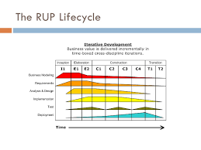
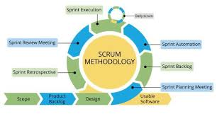
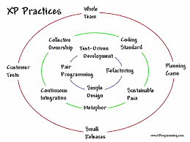
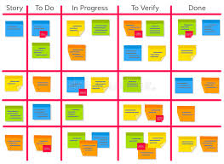
1. Know an Agile Process & Toolset

Slide 4
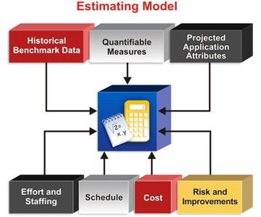
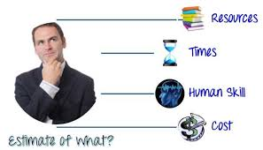
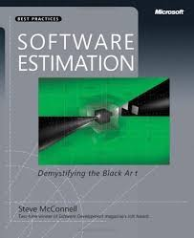
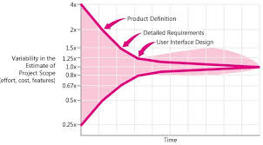
2. Know how to do effective estimation

Slide 5


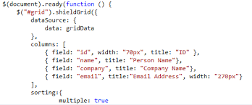
3. Know JavaScript

Slide 6




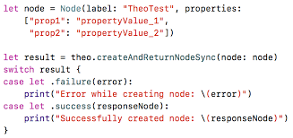
4. Know a Native Mobile Platform

Slide 7




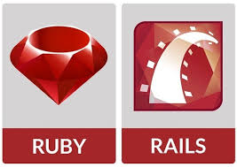
5. Know a Server-side Language

Slide 8
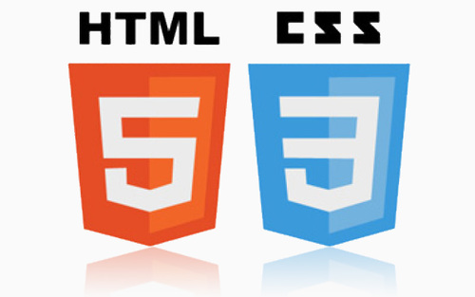
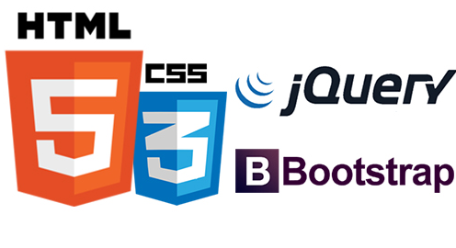



6. Know HTML and CSS
in actual use...

Slide 9
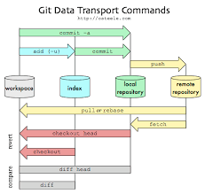
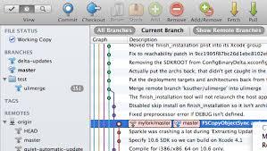

7. Know Git Really Well
"anyone who cannot use git... cannot code"

Slide 10
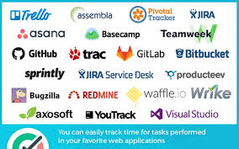
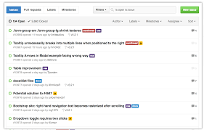
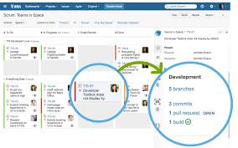
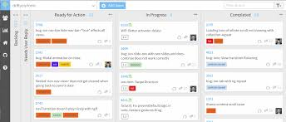
8. Know a good tool for tracking and issues
Does this look familiar?

Slide 11
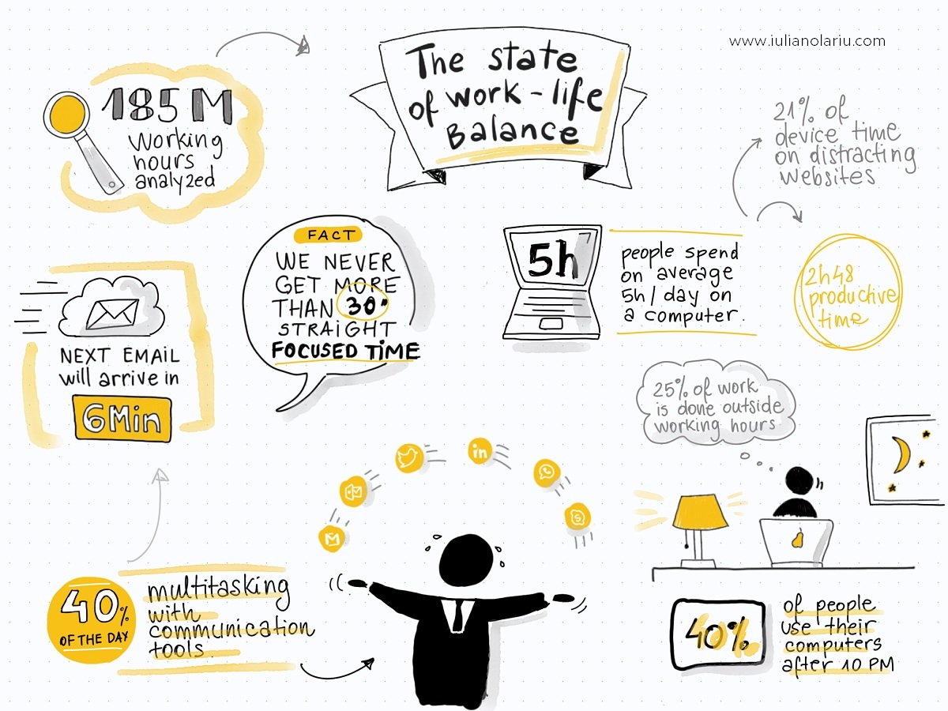
9. Manage your time & priorities

Slide 12
Which are Process Related?
1. Know an Agile Process & Toolset
2. Know how to do effective estimation
3. Know JavaScript
4. Know a Native Mobile Platform
5. Know a Server-side Language
6. Know HTML and CSS
7. Know Git Really Well
8. Know a good tool for tracking and issues
9. Manage your time & priorities

Slide 13
Which are Process Related?
1. Know an Agile Process & Toolset
2. Know how to do effective estimation
7. Know Git Really Well
8. Know a good tool for tracking and issues
9. Manage your time & priorities

