Slide 1
Exercise Using Selenium
"Scrape" URLs from a page of search results
Revised 6 Nov 2023 for Python Selenium 4.15.0

Slide 2
Selenium
Browser automation.
Not just testing.
https://selenium.dev/
We will use Selenium WebDriver
- programmatically control a web browser

Slide 3
Selenium Example
Goal:
Use duckduckgo.com to find links to Kasertsart U.
Print the top 10 links.

Slide 4
Software Needed
- Python 3.x
- Selenium WebDriver: pip install selenium
- Driver for the Web browser you use:
Firefox driver, called "geckodriver"
https://github.com/mozilla/geckodriver/releases
Chrome & Chromium driver (brittle):
https://sites.google.com/chromium.org/driver/
Safari driver: already in /usr/bin/safaridriver

Slide 5
Try it! Get a web page
from selenium import webdriver
# get the duckduckgo search page
url = "https://duckduckgo.com"
# browser: a WebDriver object
browser = webdriver.Firefox()
# or: browser = webdriver.Chrome()
browser.get( url )

Slide 6
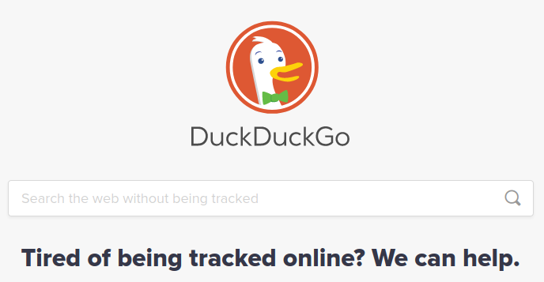
Get the id of the search input box
We will use this "id" to locate the input field
Firefox: right-click in search box -> "Inspect Element".
<input id='searchbox_input' name="q" type="text" ...>

Slide 7
Find the input field
Find the page element for the searchbox input field.
from selenium.webdriver.common.by import By
from selenium.webdriver.common.keys import Keys
# Find an "element" for the search box
element_id = 'searchbox_input'
element = browser.find_element(By.ID, element_id)

Slide 8
Enter some text and press ENTER
send_keys simulates typing into a field.
# Enter the search text & press ENTER
element.send_keys("Kasetsart Univer")
element.send_keys(Keys.ENTER)
# Run It! (if you are using a script)
# the browser should display results

Slide 9
Inspect the Page & Identify Links
We need a way for Selenium to "find" the hyperlinks on the results page.
browser.find_element( by=______, "value to find" )
By.CLASS_NAME By.NAME
By.ID By.TAG_NAME
By.LINK_TEXT By.PARTIAL_LINK_TEXT
By.CSS_SELECTOR
You can omit the parameter name "by="

Slide 10
Inspect one search result
Select a search result. Right Click -> Inspect.
The source looks like:
<div class="ikg2IXiCD14iVX7AdZo1">
<h2 class="LnpumSThxEWMIsDdAT17 CXMyPcQ6nDv47DKFeywM">
<a href="https://www.ku.ac.th/en/community-home" rel="noopener" target="_self" class="eVNpHGjtxRBq_gLOfGDr LQNqh2U1kzYxREs65IJu" data-testid="result-title-a" data-handled-by-react="true">
<span class="EKtkFWMYpwzMKOYr0GYm LQVY1Jpkk8nyJ6HBWKAk">News and Activities - Kasetsart University</span>
</a></h2>
</div>
The class names are random. Nothing we can reliably search.

Slide 11
Find all the "a" tags
# Find all "a" elements on page
links = browser.find_elements(
By.TAG_NAME, "a") len(links)
125
# Too many! Find links with text "Kaset.."
match = browser.find_elements(
By.PARTIAL_LINK_TEXT, "Kasetsart")
len(match)
13

Slide 12
Getting Data from a WebElement
browser.find_element and browser.find_elements returns WebElements that are parts of the page DOM.
You can:
- get "attributes" or text from each WebElement
- search its child WebElements - the DOM is a tree
Print value of the "href=" attribute of the first matches.
>>> match[0].get_attribute('href')
'https://duckduckgo.com/?q=Kasetsart%20University&t=h_' (not what we want)
>>> match[2].get_attribute('href')
'https://en.wikipedia.org/wiki/Kasetsart_University' (yes!)

Slide 13
"Click" on elements
When you locate a "clickable" web element like a button or hyperlink, you can click to activate it.
>>> match[2].click()
The browser should open the link you clicked.

Slide 14
Exercise: print first 10 URLs
Print the URLs of the first 10 hyperlinks on the DuckDuckGo search results page.
- omit hyperlinks that refer to duckduckgo.com
- some "a" tags may not have an "href" attribute.
Use try - except to catch this.

Slide 15
Composite Design Pattern
WebElement is the primary object for interacting with a web page using Selenium.
WebElement may contain other WebElements.
WebDriver contains many of the same methods as WebElement
WebElement
*
contains other WebElements

Slide 16
Headless Browsing
You can use a browser without opening the U.I. window.
This is called headless mode.
Headless mode is needed when running tests on a C.I. server, like Github Actions.
Headless mode is faster, too.
https://developer.mozilla.org/en-US/docs/Mozilla/Firefox/Headless_mode

Slide 17
References
Good Selenium Tutorial in Python
Uses the previous version of selenium, so some methods may no longer work.
https://blog.testproject.io/2019/07/16/web-ui-testing-python-pytest-selenium-webdriver
The same author has other good testing tutorials:
https://blog.testproject.io/2019/07/16/

Slide 18
Exercise
Write a unit test for this:
When I search DuckDuckGo for Kasetsart University,
then at least 1 of the top-10 search results contains a link to https://www.ku.ac.th/(anything)
1. Use setUp to create the browser instance.
2. Write a unit test method go perform the test above.
Wrong: testing for exact match of "https://www.ku.ac.th/", because KU's home page could change.
3. Once your test works, add headless mode to setUp and rerun. My intro to Selenium shows how to.

