Slide 1
Topics We Didn't Cover

Slide 2
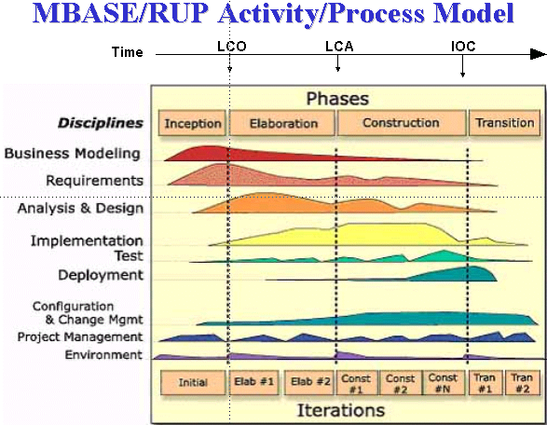
Unified Process
A flexible process model covering the whole project

Slide 3
UP is an Iterative Process
The previous diagram conveys a lot about the UP...
disciplines (kinds of work) done in parallel
"phases" for major evolutions of the project
iterations within each phase, as needed

Slide 4
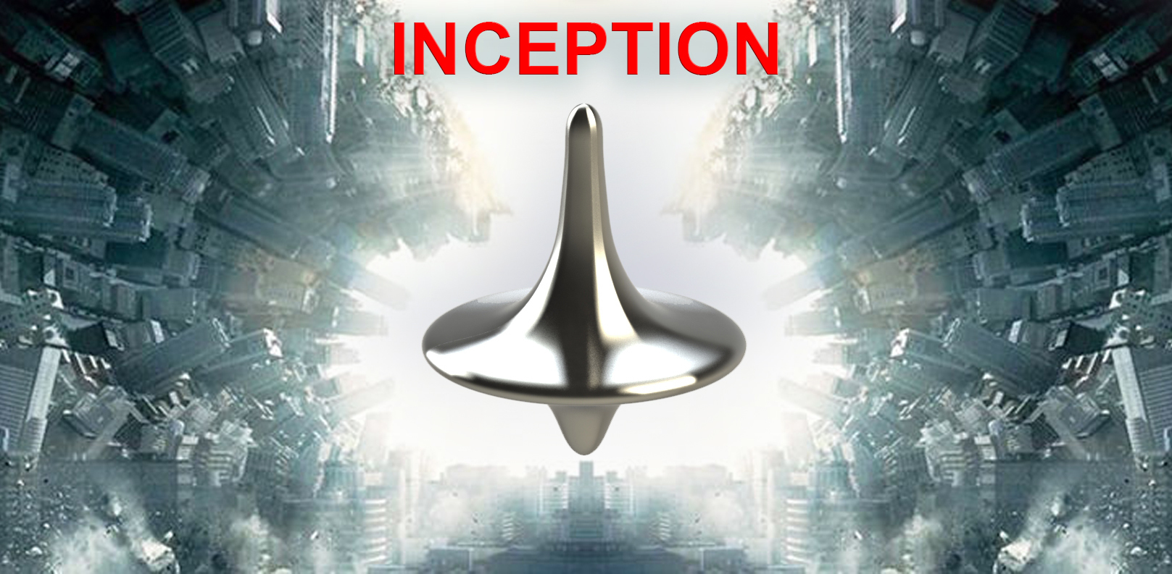
An Idea -- but is it a project?
Explore... Brainstorm... Clarify...
and decide if the idea is worth pursuing

Slide 5
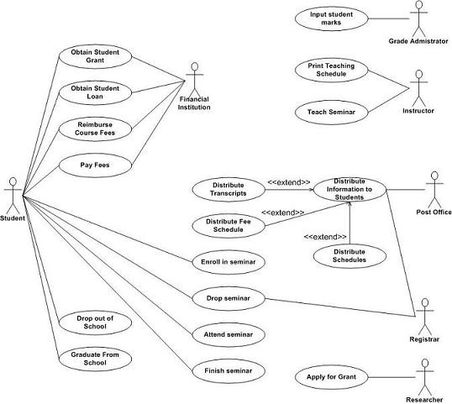
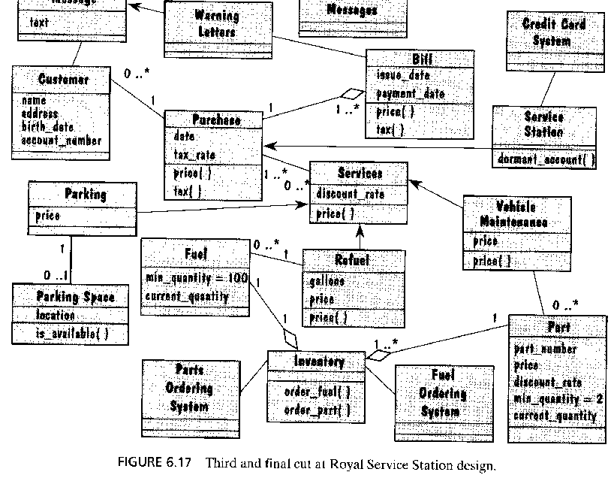
Elaboration
What is required?
Can it possibly work?
Can we build it?
How would we build it?
Do we want to do it?
Is it cheaper to buy it?
Accept as Project?
Do it.
Don't do it.

Slide 7
Construction - Build it!

Slide 8
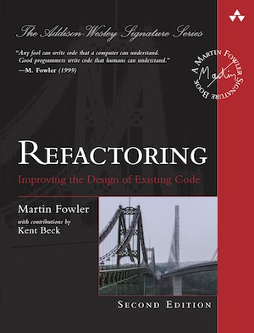
Refactoring
Improve existing code
- improve design
- improve implementation
- does not change external functionality

