Slide 1

Remotes

Slide 2
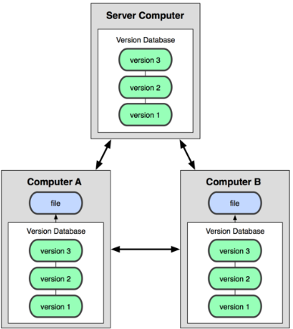
Working with a Remote Repo
Git is a distributed version control system.
git was invented to manage the Linux kernel source code, with thousands of developers in over a hundred countries.
You can have many repositories
on the net, called "remotes".
They may all be different!
No "master" repository
-- all repos are equal.

Slide 3
Git Hosting Sites
You can create free git repositories on these sites, for individual or team projects.
Github - https://github.com
Bitbucket - https://bitbucket.org
GitLab - https://gitlab.com

Slide 4
Commands for Remotes
Common commands for using a remote repo are:
git clone copy remote repo to your computer
git remote add define URL of a remote repository
git remote -v list remotes, with URLS
git push "push" local updates to a remote
git pull download and merge remote updates
git fetch download remote updates, but don't
merge into your working copy

Slide 5
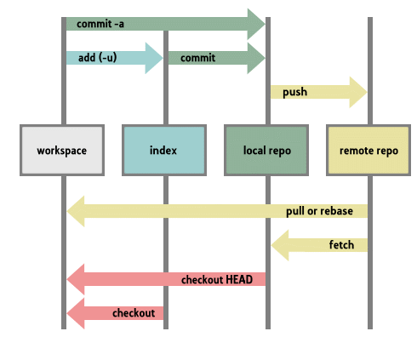

Slide 6
Cloning a Remote Repository
Create a local copy of a Github repo. Assign the name "origin" to the remote repo.
cmd> git clone
https://github.com/user/tictactoe
Cloning into "tictactoe" ...
(git creates a "tictactoe" directory for file)
Or, use the SSH protocol (requires SSH key)
cmd> git clone
git@github.com:user/tictactoe

Slide 7
Viewing Your Remotes
View the names and URLs of "remotes" for a repo:
cmd> cd tictactoe
cmd> git remote -v
origin https://github.com/user/tictactoe (fetch)
origin https://github.com/user/tictactoe (pull)

Slide 8
You Can Have Several Remotes
Each remote has a different name (origin, bbucket).
The username and repo name can be different, too.
cmd> cd tictactoe
cmd> git remote -v
origin https://github.com/barz/tictactoe (fetch)
origin https://github.com/barz/tictactoe (pull)
bbucket git@bitbucket.com:fooz/ttt (fetch)
bbucket git@bitbucket.com:fooz/ttt (pull)

Slide 9
Syntax for all "remote" commands
git remote
git help remote
git remote -v
git remote add remote_name URL
git remote show remote_name
git remote set-url remote_name new_url

Slide 10
Change remote URL
You make a copy of "git-commands" in your own Github account. Now change URL of the remote to "push" do:
cmd> git remote -v
origin https://github.com/ISP2020/git-commands-fatalai
cmd> git set-url origin
https://github.com/fatalai/git-commands
This does not move the repository on Github!
You must do that on Github (in Settings).

Slide 11
Detailed Info about a Remote
cmd> git remote show origin
* remote origin
Fetch URL: https://github.com/fatalai/git-commands
Push URL: https://github.com/fatalai/git-commands
HEAD branch: master
Remote branches:
master tracked
dev-branch tracked
Local branch configured for 'git pull':
master merges with remote master

Slide 12
Remote Branches
Branches are not automatically synced between remotes.
A local branch may not have any remote branch.
Host B
master
tracks
Host A
dev-bev
tracks
master
bug101
tracks
dev-foo
tracks
Host C
bug101
master
dev-bev
bug202

Slide 13
Remote Branch Naming
On your machine, refer to a remote branch as:
remote_name/branch_name
E.g. origin/master - master branch on "origin"

Slide 14
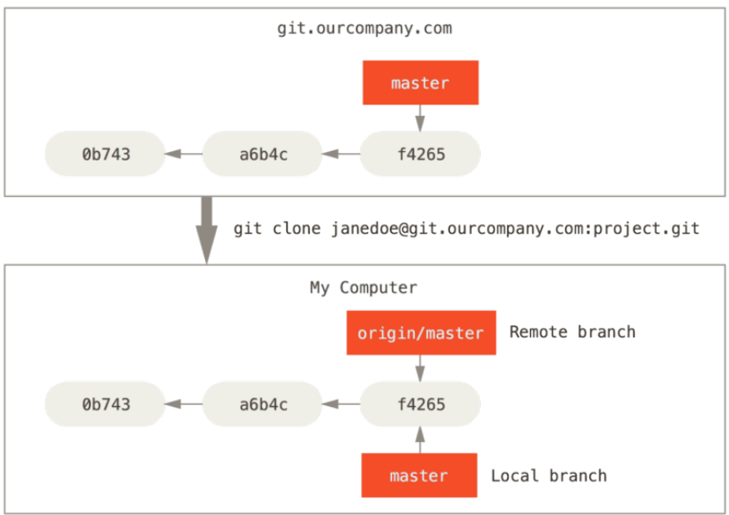
Example from Pro Git Book
You clone a repo from git.ourcompany.com.
Your repo now has 2 labels: master and origin/master

Slide 15
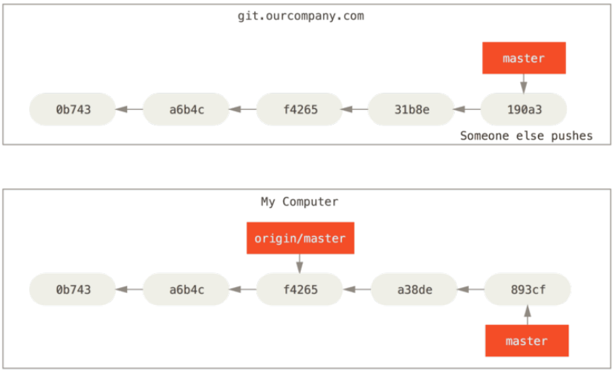
After some commits, branches diverge
You commit some work locally - your local master moves ahead. Someone else pushes work to ourcompany.com

Slide 16
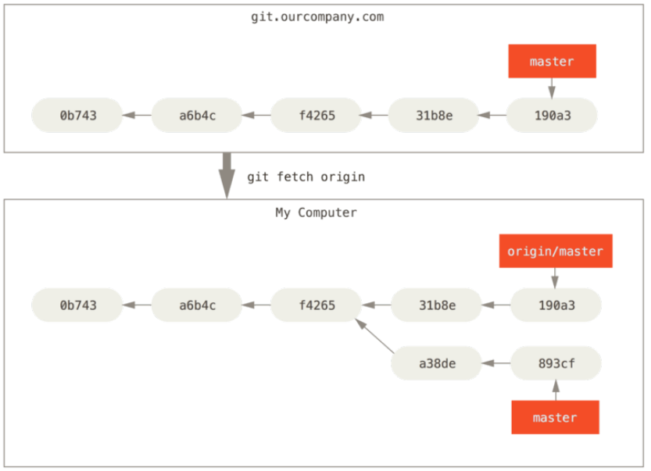
Fetch updates from remote
fetch copies the remote branch into your local repo.

Slide 17
What Has Changed?
View the differences. There may be many:
cmd> git diff master origin/master
diff --git a/README.md b/README.md
index ff3ac4b..1434aa0 100644
--- a/README.md
+++ b/README.md
@@ -1,6 +1,6 @@
## Unit Testing Procedure
diff --git a/ctl_test.py b/ctl_test.py
--- a/ctl_test.py
+++ b/ctl_test.py

Slide 18
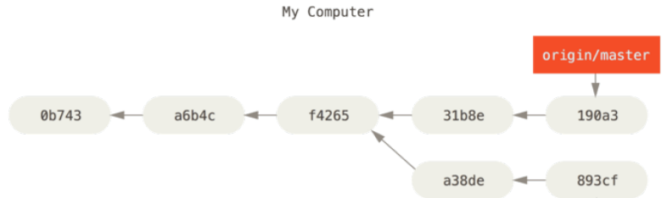



Merge and resolve conflicts
Merge the branches on your computer, resolve any conflicts, and commit.
Now your local master is ahead of the tracking branch.
git merge

Slide 19


Push your work to ourcompany
If nothing has changed on ourcompany master, it will advance to match your branch.
git.ourcompany.com
git push

Slide 20
Questions
1. If you "push" when master on ourcompany.com has a commit that is not in your tracking branch, what happens?
2. If you "fetch" and there is no new work on ourcompany.com, what will happen?

Slide 21
Tracking Branch
Remote-tracking branch is a local branch that holds a reference to the state of a remote branch.
tracking branches exist in your local repository
they update automatically when you contact the remote (push, fetch, pull, remote show) -- you can't modify them yourself.
name syntax: remote_name/branch_name

Slide 22
Tracking a Remote Branch
Two cases:
1. you checkout a remote branch and track it
2. you create a local branch, then push it to a remote (a tracking branch is created automatically)

Slide 23
Checkout a Remote & Track it
Many commands for this
# these two do the same thing
cmd> git checkout --track origin/dev-foo
cmd> git checkout -b dev-foo origin/dev-foo
# create branch with different name from remote branch
cmd> git branch -t foo origin/dev-foo
(-t is short form of --track)

Slide 24
Push a Local Branch
For a local branch that does not yet exist in the remote remote repository:
cmd> git checkout my-branch
cmd> git push -u origin my-branch
-u is short for --set-upstream
"my-branch" is name to assign to the new branch on origin.

Slide 25
Who is Ahead? Me or Origin?
Useful command:
cmd> git branch -vv

Slide 26
Working with a Remote on a Project

Slide 27
Workflow for an individual project
START
Push to
remote
Check status
git commit
Work on code
Stage files
(git add)
Test & review
Check status:
what changed?

Slide 28
Git Workflow for an Individual project
1) Check status of your working copy (*)
cmd> git status
It should be clean. If not, do "git diff" and then...
2) Commit changes or update your working copy.
(git diff, git add -u, git commit)
3) Do some work:
Code, test. Code, test. Review.
(*) if you work on more than one computer, you need to "fetch" or "pull" any work from Github that is not on this computer (i.e. this local repo).

Slide 29
Git Workflow (cont'd)
4) After code-test-reivew: check status again
cmd> git status
Changes not staged for commit:
modified: src/Problem2.java
Untracked files:
src/Problem3.java
5) Add and commit your work to the local repository
cmd> git add src/Problem2.java src/Problem3.java
cmd> git commit -m "Solved problems 2 and 3"
[master 29abae0] Solved problem 2 and 3
2 files changed, 44 insertions(+), 5 deletions

Slide 30
Git Workflow (update remote)
6) Push the changes to Github
cmd> git push
Compressing objects: 100% (12/12), done.
Writing objects: 100% (12/12), 3.60 KiB, done.
Total 12 (delta 9), reused 0 (delta 0)
remote: Resolving deltas: 100% (9/9), ...
To https://github.com/fatailaijon/demo.git
468abdf..29abae0 master -> master
7) Take a break.
That's it! Repeat the cycle as you work.

Slide 31
Github Workflow for Team Projects
On a team project, other people will commit files to the same Github repository!
You should update your local repository from Github before trying to "push" your work to Github.
Use "Github Flow" as workflow in team projects.
"Github Flow" is a separate topic. Its good for both team and solo projects.
Github Flow is the convention for team work in this course.

