Slide 1
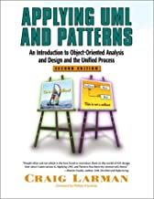
Domain Models
From Larman, Chapter 9
This is one of the most important chapters in the book.

Slide 2
What is a Domain Model?
Model of the problem domain, showing concepts, important attributes, and relationships.
Not a software model.

Slide 3
Concepts in "Make a Sale" for a Point of Sale (POS) Application
Register
Item
Store
Sale
Sales
Cashier
Customer
Ledger
LineItem
Cash
Product
Product
Payment
Catalog
Description

Slide 4
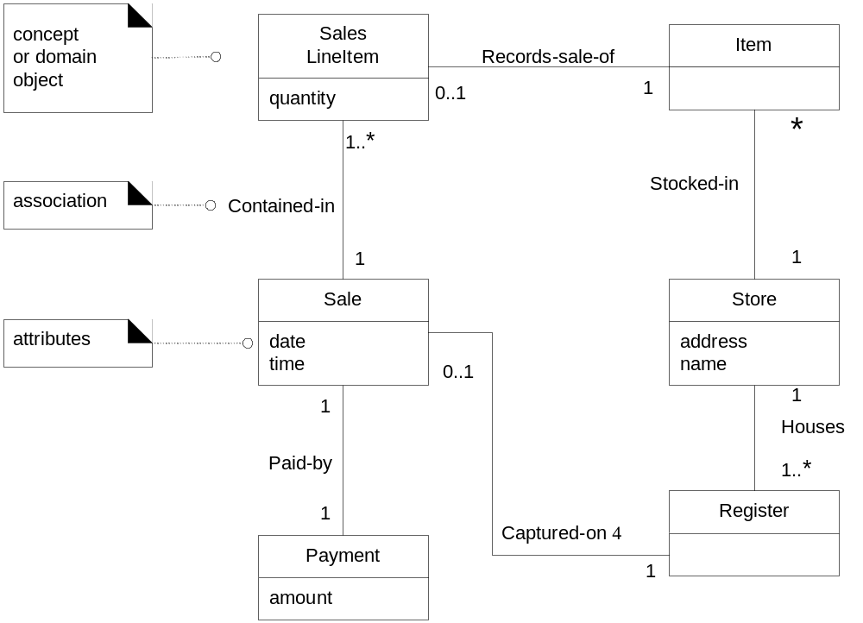
Domain Model for POS based on "Make a Sale"

Slide 5
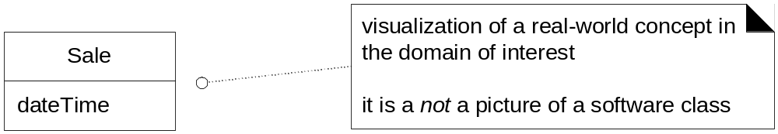
A Domain class
A Domain Class represents a "thing" or concept in a model of the application domain. It is not a software class.
In a Point-of-Sale application, a "Sale" is an important part of the model.

Slide 6
3 Techniques to Discover Domain Classes
1. Look for noun phrases in User Stories
2. Use a category list
3. Use a similar existing project

Slide 7
Look for Noun Phrases in Use Cases
This is a Use Case for how "make a sale" is performed..
1. Customer arrives at POS with items to purchase.
2. Cashier starts a new sale on register.
3. Cashier scans an item's barcode.
4. POS looks up Product using barcode and adds a line item to the sale.
5. Cashier repeats steps 2-4 until no more items.
6. Register displays sale total with tax.
7. Cashier asks Customer for payment.
8. Customer pays for items.
9. Cashier enters payment into POS.

Slide 8
Look for Noun Phrases
1. Customer arrives at POS with items to purchase.
2. Cashier starts a new sale on register.
3. Cashier scans an item's barcode.
4. POS looks up Product using barcode and adds a line item to the sale.
5. Cashier repeats steps 2-4 until no more items.
6. Register displays sale total with tax.
7. Cashier asks Customer for payment.
8. Customer pays for items.
9. Cashier enters payment into POS.

Slide 9
Noun Phrases
Noun phrases are candidates for domain classes, but not all are classes. Some noun phrases may be attributes, instance names, or not important to the model.
Customer
Cashier
POS
Sale
Register
Product
Line item
Payment
barcode
items
sale total
probably attributes rather than domain classes

Slide 10
Conceptual Category List
A list of common categories for domain classes, to help you think of things.
Table 9.1 in Larman's book
Business transactions
Product or service related to transaction
Where is transaction recorded?
Catalogs
Roles of people related to actors in UC
Link to the list posted on classroom.

Slide 11
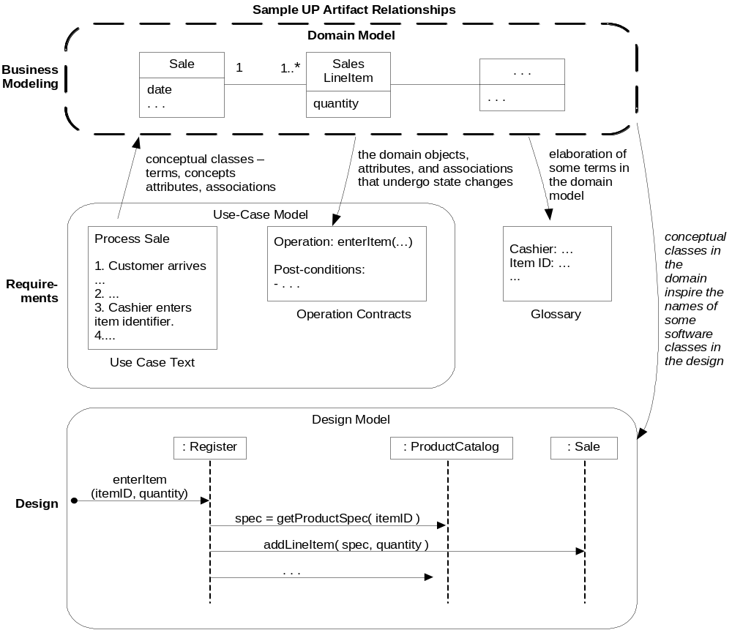
Design Documents for "Make a Sale"

Slide 12
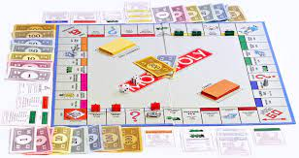
Domain Model for Monopoly Game

Slide 13
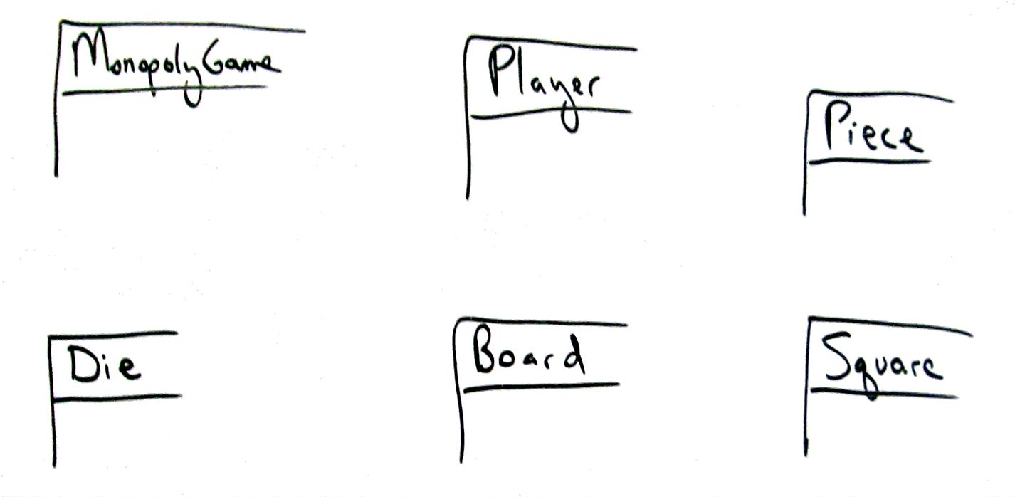

Don't try to be beautiful or complete
What is missing here?

Slide 14
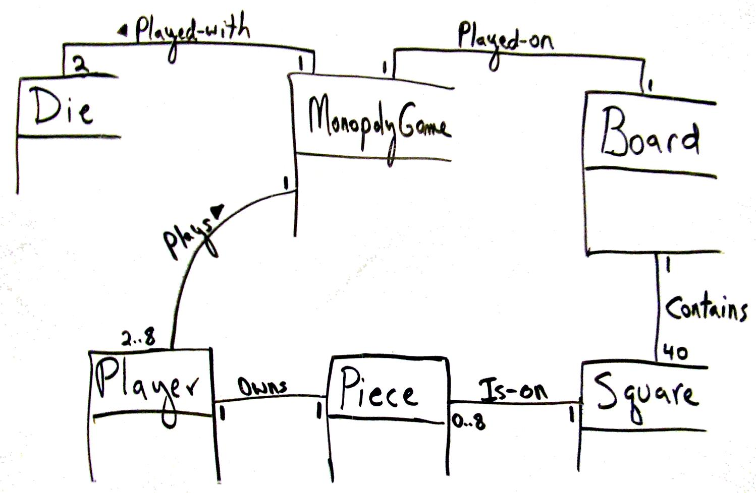
Express relationships

Slide 15
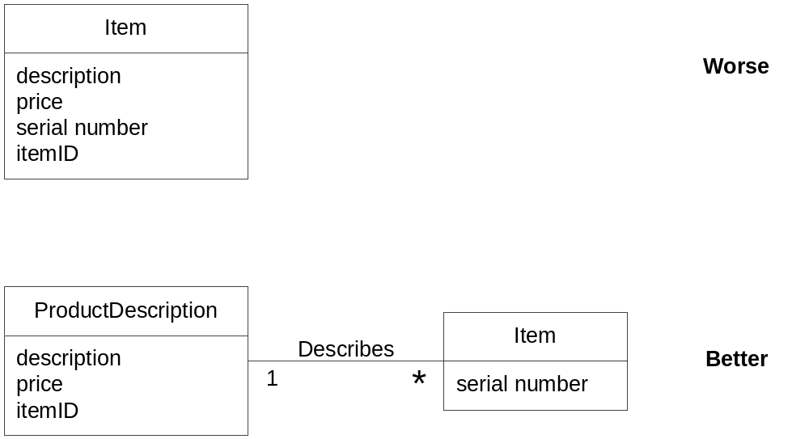
Prefer Associations over attributes

Slide 16
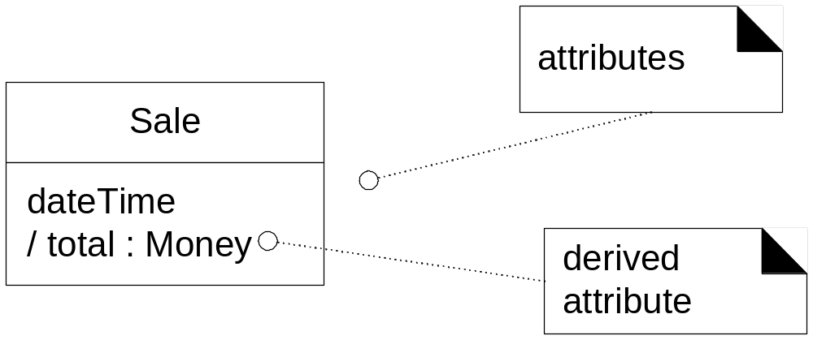
OK to show "derived" attributes

Slide 17
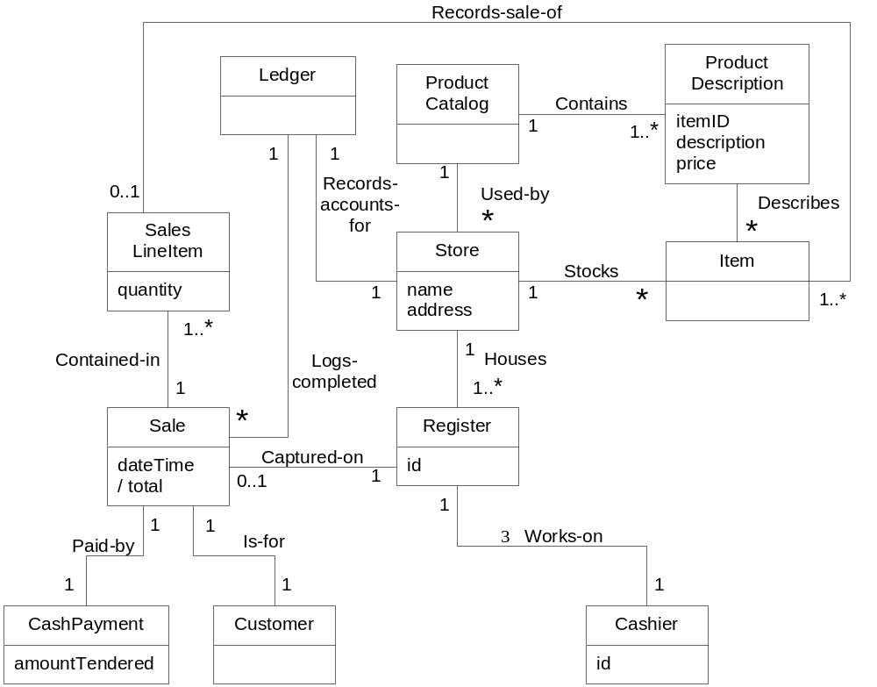
After first domain modeling session...

Slide 18
Your Turn
Construct a domain model for your project.
Analysis of your Use Cases (or User Stories)
Use a category list
Don't be influenced by what other teams are doing – design for yourself

