Slide 1
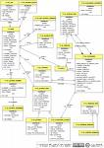
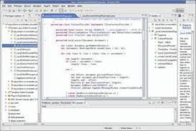
Performing a Task
People apply a process, use tools, standards, & guidance, to perform the various tasks.
Activity
Use Case
Main Scenaria
1.....
2.....
3.....
Extensions: ...
*
Work
Product
Task
Guidance
Standards
Templates
Role
Tools

