Slide 1
Feedback on Lab Exam

Slide 2
Test a Specification, not an Implementation
Don't test attributes (implementaton) -- the code may change.
def test_bids(self):
auction = Auction("Sailboat")
auction.start()
auction.bid("John", 10000)
self.assertEqual("Sailboat", auction.name)
self.assertEqual(10000, auction.bids["John"])
# trivial methods can be verified by code review
def test_active(self):
auction = Auction("Sailboat")
auction.start()
self.assertTrue( auction.active )

Slide 3
Don't test attributes
Test functionality instead of private attributes.
def test_init(self):
auction = Auction("iPad")
self.assertEqual(auction.name, "iPad")
self.assertEqual(auction.bids, {"no bids": 0})
self.assertEqual(auction.increment, 1)
self.assertEqual(auction.active, False)
auction.increment -- OK to test since it is important and no other way to verify in unit tests.
auction.name is not important and can test using str(auction)
auction.bids is implementation detail -- test behavior instead
auction.active is implementation detail -- test using is_active()

Slide 4
Respect Object Encapsulation
O-O programs encapsulate object information as attributes, and protect it -- but not in Python.
Objects expose information using methods.
A class should be free to change its implementation, as long as the interface (methods) behaves the same way.
So, avoid directly accessing an object's attributes!
Refactoring
def setUp(self):
self.auction = Auction("TDD in Python")
# BAD - directly setting an attribute
self.auction.increment = 2
self.auction.active = True

Slide 5
Use setUp to Create Test Fixture
Eliminate redundant code
def setUp(self):
self.auction = Auction("Sailboat")
self.auction.start( )
def test_bids(self):
#auction = Auction("Sailboat")
self.auction.bid("John", 10000)
self.assertEqual(10000,
self.auction.best_bid())
Must be setUp(self) - NOT setUP(self)
- NOT setUp(self, name, bid)
- unittest calls setUp itself!

Slide 6
Don't "guess" the specification
The Auction did not specify what happens if bid increment = 0 or < 0, so don't test that.
def test_negative_increment(self):
with self.assertRaises( AuctionError ):
auction = Auction("Sailboat", -1)
In a software project, tests help you find
ambiguity and incomplete specification.
Open an issue & discuss how to clarify spec.
Try not to guess what the spec "should" be.

Slide 7
Test Cases for Auction
I used 6 different Auction classes to test sensitivity and completeness of your tests, using realistic errors.
Case 1: Everything is correct. [All tests should pass.]
Case 2: Reject bid <= best_bid()+min_increment.
[Common programming error.]
Case 3: Accept any bid > best_bid()
Case 4: Accept bids when auction is stopped.
Case 5: If bid is too low (but bid > 0), silently ignore it instead of throwing AuctionError.
Case 6: a) Last bidder is winner even if his bid is rejected, b) Allow bidder name to be whitespace, " "

Slide 8
Correct Code Should Pass All Tests
1. If code is correct, all tests should PASS.
cmd> python -m unittest -v auction_test.py
--------------------------------------------------
Ran 8 tests in 0.001s
OK
2. If code contains bugs but no syntax or semantic errors, the appropriate test should fail. Or, sometimes "error".
test_bid_too_low (auction_test.TestAuction) ...FAIL
--------------------------------------------------
Ran 8 tests in 0.001s
FAILED (failures=1)

Slide 9
You should not make these mistakes
def test_bid(self):
# what is the error?
self.assertTrue(Auction("Sailboat"))
Auction("Pizza")
Auction.start( )
Auction.bid("Jim", 100)
def test_best_bid(self):
a = Auction("ISP Final Exam")
a.start()
a.bid("Hacker", 10000)
self.assertEqual( a, 1000)

Slide 10
Test Sensitivity
Sensitivity - ability to detect a flaw.
In scientific research: probability that a test will correctly detect a condition (when it is present).
What is wrong with this test?
def test_bid_invalid_parameters(self):
with self.assertRaises( ValueError ):
# both of these should raise error
self.auction.bid("", 100)
self.auction.bid("Joe", 0)

Slide 11
What is wrong with this test?
Suppose the code allows bidder name to be "" (a bug),
but auction.bid("Joe",0) raises ValueError (amount = 0).
The 2nd "bid" statement causes this test to always pass.
def test_bid_invalid_parameters(self):
with self.assertRaises( ValueError ):
# both of these should raise error
self.auction.bid("", 100)
self.auction.bid("Joe", 0)

Slide 12
Another Example
Suppose:
#1. auction allows bidding when stopped (incorrect)
#2. auction raises AuctionError if bid too low (correct!)
Will this test detect the bug?
def test_bid_when_auction_stopped(self):
self.auction.bid("Good", 600)
self.auction.stop()
with self.assertRaises( AuctionError ):
self.auction.bid("Bug", 1000) #1
self.auction.bid("Cheap", 500) #2

Slide 13
Can You Summarize?
A "with self.assertRaises" containing many statements
will pass when:
[ ] all statements throw the expected exception
[ ] any statement throws the expected exception (before some other exception is thrown)
def test_bid_when_auction_stopped(self):
with self.assertRaises( AuctionError ):
statement1( )
statement2( )
statement3( )

Slide 14
Tests Should Help Identify Problems
Tests should be specific -- not one big test.
def test_normal_bidding(self):
# auction created and started in setUp()
auction.bid("Ant", 100)
with self.assertRaises(AuctionError):
auction.bid("Bird", 100) #identical bid
# test bidding not allowed when stopped
with self.assertRaises(AuctionError):
auction.stop() # wrong location. Why?
auction.bid("Dog",1000)
These tests should be
in separate methods.

Slide 15
Focused tests help to identify problem
Use descriptive names, test a single kind of behavior
def test_normal_bidding(self):
self.auction.bid("Ant", 1) # minimum bid
self.auction.bid("Bat", 2) # minimum increase
self.auction.bid("Cat", 50.5) # decimals ok?
self.auction.bid("Ant", 51.5) # bid again ok?
self.assertEqual(51.1, auction.best_bid())
def test_low_bid_throws_exception(self):
self.auction.bid("Good guy", 10)
with self.assertRaises(AuctionError):
self.auction.bid("Cheap", 9.99) # too low
with self.assertRaises(AuctionError):
self.auction.bid("Cheap", 10) # same bid
with self.assertRaises(AuctionError):
auction.stop() # wrong location. Why?
auction.bid("Dog",1000)

Slide 16
Test What Could Reasonable Fail
We can't test everything, so don't test for stupid code.
def test_bid_must_be_positive(self):
with self.assertRaises(ValueError):
auction.bid("Ant", 0)
with self.assertRaises(ValueError):
auction.bid("Bird", -0.1)
with self.assertRaises(ValueError):
auction.bid("Cat", -20)
#OVERKILL if above tests pass, these will, too
with self.assertRaises(ValueError):
auction.bid("Dog", -100)
auction.bid("elephant", -500)
auction.bid("Frog", -10000000)

Slide 17
Use assertEqual instead of assertTrue
This is valid, but error report is less informative:
def test_best_bid(self):
# auction created and started in setUp
self.auction.bid('Cat', 500)
self.auction.bid('Dog', 550)
self.auction.bid('Cat', 560)
self.assertTrue(560 == self.auction.best_bid())
- if best_bid does not return 560 then assertTrue will report:
"expected True but was False"
- if you use assertEqual( 560, self.auction.best_bid() )
then it will tell you what value best_bid() returned.

Slide 18
Good Student Codes
Many short, specific tests with descriptive names:
Chayathon - 12 tests
Tharathorn - 12 tests
Mai - 31 tests, but some are "out of spec"
and several others.

Slide 19
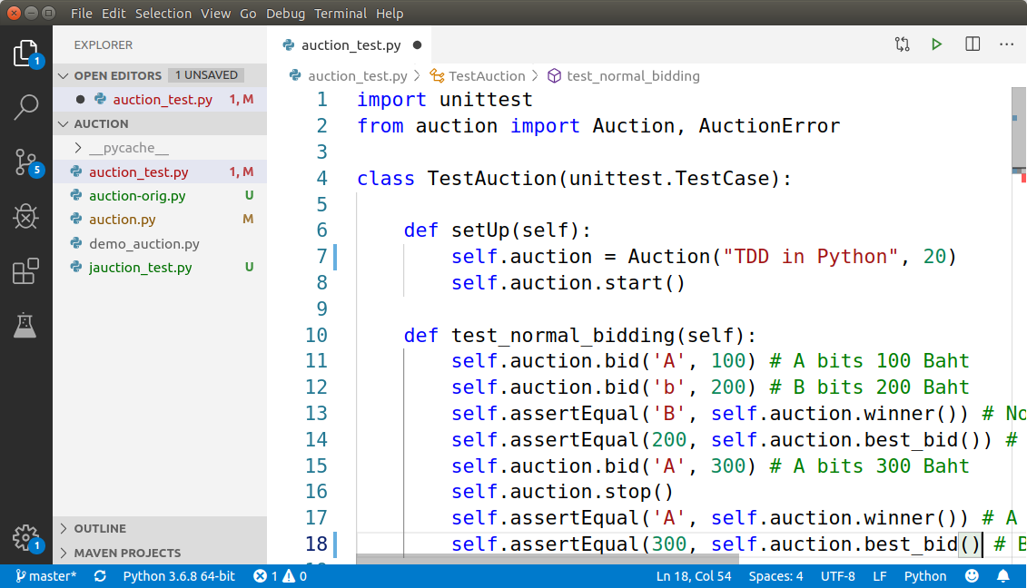
Know Your Tools
Know your IDE. Esp. how to select compiler & language level
What useful information is VSCode showing about project?
- describe everything you can!
- demo: create a "main" block

Slide 20
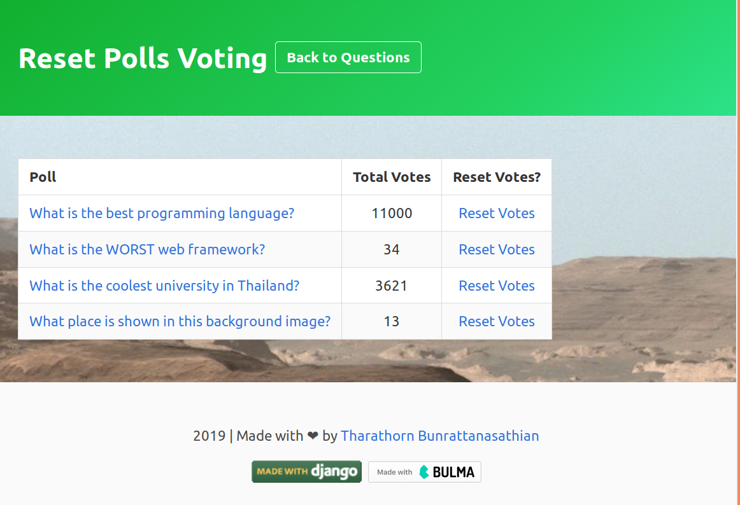
Best Django Applications
#1 Tharathorn
#2 Chananchida

Slide 21
total_votes() common mistakes
1. Using a query for Question instead of self.
2. Using a query for Choices instead of self.choice_set.
3. Using an attribute to sum votes instead of local var.
4. Poor variable names. Misuse of plurality.

Slide 22
Querying for Question instead of using self
What object is being retrieved by this query?
# In models.Question class
def total_votes(self):
question = Question.objects.get(id=self.id)
This query returns the same Question as self.

Slide 23
Data is same, but is it same object?
Which message will be logged?
# In models.Question class
def total_votes(self):
question = Question.objects.get(id=self.id)
if question is self:
log.info( "Its ME!" )
else:
log.info("Born again. A new object.")
This is an important feature of ORM:
If we retrieve the same thing using different queries,
does the ORM return a reference to the same object or distinct copies?

Slide 24
This could bring a server to its knees
Explain how this code could use a lot of memory & I/O.
Suppose Facebook is using your polls app for custom polls.
# In models.Question class
def total_votes(self):
# get ALL the choices in the database!
choices = Choice.objects.all( )
# sum only votes for this question
total = 0
for choice in choices:
if choice.question_id == self.id:
total += choice.votes
return total

Slide 25



Using attribute instead of local vars
A web application may have many simultaneous visitors. Some of them may invoke same code.
GET /polls/1/results/
GET /polls/1/results/
web server
GET /polls/1/results/
GET /polls/1/results/

Slide 26
Requests are handled using threads
Each request is usually handled in a separate thread of the same process (for efficiency).
That means they are sharing the same memory.
GET /polls/1/results/
GET /polls/1/results/
web server
total_votes()
GET /polls/1/results/
<<object>>
Question
id = 1
GET /polls/1/results/

Slide 27
Using attribute instead of local vars
If many simultaneous visitors (separate threads) invoke question1.total_votes( ),
how might this code produce the wrong results?
# In models.Question class
def total_votes(self):
self.count = 0
for self.choice in self.choice_set.all():
self.count += self.choice.votes
return self.count
There are 2 bugs.

Slide 28
Good web app coding
1. Use local vars for request handling
2. Be aware of "thread (un)safe" behavior
Most code provided by Django is thread safe.
# In models.Question class
def total_votes(self):
total = 0 # local var, descriptive name
for choice in self.choice_set.all():
total += choice.votes
return total
Each time a method is invoked, it gets its own memory for local vars.
So, multiple threads can safely call same method at the same time.

Slide 29
Misleading variables names
Are these variable names descriptive?
Use descriptive names
Correct plurality: list or set name should be plural
# In models.Question class
def total_votes(self):
q = Question.objects.get(id=self.pk).choice_set.all()
vote = 0
for i in q:
vote += i.votes
return vote

Slide 30
Code is too long
Can you reduce it to zero lines?
# In models.Question class
def total_votes(self):
return sum(choice.votes
for choice in self.choice_set.all())

Slide 31
Common Mistakes in urls.py
1. Mixing reset_index and reset (one poll) views.
2. Duplicate name for views.
path("reset/", views.reset_index, name="reset"),
path("reset/<int:id>/", views.reset, name="reset"),
3. Forget trailing "/" in URL.
4. Be careful! extra space at end of URL
path('reset/ ', views.reset_index,...)
Surprise! Django includes the space in required URL!
http://localhost:8000/polls/reset/%20

Slide 32
Django Template Filters
Django template filters let you add custom behavior or formatting in templates.
In a template, apply a filter with 2 commands:
{% load filterapp_name %} written only once
You are {{ 3 | ordinal }} in the queue.
You are 3rd in the queue.

Slide 33
Humanize intcomma filter
Humanize filters convert numbers and dates into text format. To use it:
1. In settings.py add:
2. in your poll reset_index template add:
INSTALLED_APPS = [
...,
django.contrib.humanize,
{% load humanize %}
<table>
{% for question in question_list %}
...
<td>{{question.total_votes | intcomma}}</td>

Slide 34
Demo Humanize
Add {{ question.total_votes | intcomma }}
to Tharatorn's project.

Slide 35
The BIG Question...

Slide 36


