Slide 1
Introduction to the Course
01219245/01219246
Individual Software Process
Spring Semester 2014

Slide 2
The original idea of the course
This course is the first one in the series of two software process course.
The second one is Team Software Process.
Both courses play the same role as PSP/TSP (PSP – Personal Software Process, TSP – Team Software Process) under the umbrella of CMMi.

Slide 3
Personal Software Process
PSP was developed in 1996 to apply the idea of CMMi to the level of single developer.
The idea is to use data to improve your development process.
"data" = something that you can measure.

Slide 4
A process?
A process is how you work on something.
Not following any process is, in itself, a process.

Slide 5
PSP
Input: a complete requirement
Output: a product (+ other artifacts)
There are 3 maturity levels:
  PSP0: start measurement
  PSP1: estimation and planning
  PSP2: quality and design
A lot of data is collected along the way, using various forms.

Slide 6
Why don’t we use PSP?
The main objective for using data to improve the process is timeless and remains valid.
However, software industry changed a lot from the day PSP was developed.

Slide 7
diff
We have "better" insights on how to develop software. (We seem to understand why it is hard.)
New development practices and tools were developed.
The business competition gets a lot stronger; this requires a cheaper, faster way to build products that satisfy the customer’s need.

Slide 8
OK, so what’s now?
We will try to cover various skills you need as a developer.
  There are tons of them, but we will focus on the ones you can use/practice even if you are a solo developer.
What are the skills/practices that you need to learn?

Slide 9
A biggest picture
Software is at the heart of business.
What are things that business concerns?
Let’s see another nice video on how to develop a business model:
Business Model Canvas Explained
http://www.youtube.com/watch?v=QoAOzMTLP5s
https://www.youtube.com/watch?v=IP0cUBWTgpY

Slide 10
A big picture
Customer segments and value propositions should match. This is VERY HARD.
Lean startup
  http://www.youtube.com/watch?v=i65PaoTlVKg

Slide 11
A smaller picture
Let’s see how a team fits in the modern software development process.
Agile Product Ownership in a Nutshell
http://www.youtube.com/watch?v=502ILHjX9EE
or here:
http://blog.crisp.se/2012/10/25/henrikkniberg/agile-product-ownership-in-a-nutshell

Slide 12
Ideal: a perfect balance
Building
the thing
right
Building
the right
thing
Building
it fast

Slide 13
This course
Building
the right
thing
Building
the thing
right
Building
it fast

Slide 14
The goal of this course
Short version:
To learn basic software development skills needed for an individual developer

Slide 15
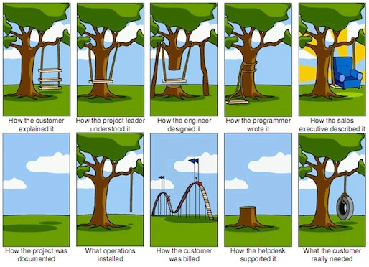
Why software development is hard
from: http://www.projectcartoon.com/

Slide 16
Communication
One of the biggest problems in software development is communication problems.
But that’s not all...

Slide 17
Compare these
I want to build a house
I want to build a website for house builders
Which one is harder to imagine how the product looks like, and how it should work?

Slide 18
Building a house
You can design and model a new house.
When the model is ready, you can start building the actual house.
DESIGN
BUILD

Slide 19
Building a software
You can design and model a new software.
When the model and design is ready, you can start building the actual software.
DESIGN
BUILD
What’s wrong with this approach?

Slide 20
Oh...
DESIGN
DESIGN
BUILD
BUILD
A house
A software

Slide 21
Perfect communication
Even with perfect communication, we still have to fix the design.
  See this by yourself, when you actually build a software project for yourself.

Slide 22
Change is inevitable

Slide 23
Challenges
LIMITED
RESOURCE
LIMITED
RESOURCES
COMPLEXITY
SIZE
CHANGES

Slide 24
Skills
Basic programming skills
  Coding
  Debugging
ONE
DAY
WORK

Slide 25
Basic skills: Progress over time
progress

Slide 26
Basic skills: codes/difficulties
complexity
code

Slide 27
Basic skills: code quality rating
code
quality

Slide 28
Skills
Basic programming skills
  Coding
  Debugging
ONE
DAY
WORK
How to keep making progress while
  the software gets larger
  the software gets more complex
  changes are arriving
SCALING
UP

Slide 29
Is it possible?
Engineering practices and cultures help facebook to keep building new features while the code base grows at an increasing rate.

Slide 30
Skills for not-so-small software
Project breakdown
  so that you can develop incrementally
Complexity reduction techniques
  so that you understand what you have done
Automation
  so that you do not have to do repetitive work
Work tracking
  so that you understand how well you work
Planning/Estimation
  so that you can make commitment

Slide 31
How to acquire these skills
?
?
?
?

Slide 32
Yes!
We will have to do quests

Slide 33
How to train your dragon self?
You work on your project.
Get some increment.
You tell your friend
about it
We plan on what to do next.

Slide 34
How to train your dragon self?
You work on your project.
Get some increment.
We plan on what to do next.
You tell your friend
about it
We will learn new techniques
that you can try to apply to your project

Slide 35
And do that again, and again...

