Slide 1
Merge Practice
Practice resolving conflicts in git.

Slide 2
Exercise
We will deliberately create a conflict by editing the README.md in two copies of same repo:
  1. Github using Github's online editor
  2. Your local repo using any editor
Then discover the differences and resolve them.

Slide 3

1. Make a change on Github
Use your git-commands repo on Github
1. On Github, edit README.md using Github's
online editor.
Add these three lines at the top:
  2. Write a descriptive commit message and Commit the change (green Commit button).
# The Ultimate Guide to Using Git
***For The Impatient.***

Slide 4
2. Make a different change in your local repo
1. In your local git-commands repo, edit README.md (in your working copy)
Add this title at the top of file:
2. Make some other change in README.md (anything).
3. Commit the changes to your local repo.
git add -u
git commit -m "Add a title to README"
# Quick Guide to Git
By Your Name

Slide 5
3. Check Status
git status
It should return:
On branch master
Your branch is ahead of 'origin/master' by
1 commit.
(use "git push" to publish your local commits)
nothing to commit, working tree clean
What is origin/master ???
Where is it ???
'origin/master' is a short form for 'remotes/origin/master'

Slide 6
4. What did I change?
You can compare all the changes between your local "master" branch and the tracking branch "origin/master".
Syntax: git diff commit1 commit2
where commit1 & commit2 refer to any commits.
> git diff master origin/master
It should show what you changed locally.
Does diff show the title line you added on Github?

Slide 7
5. push your work
Since your local copy is ahead of origin/master, push it.
> git push
What happens?
Remote repository contains work that you do not have! [rejected] master -> master (fetch first)
error: failed to push some refs to 'https://github.com/...'
hint: Updates were rejected because the remote
contains work that you do not have locally.

Slide 8
This is Good!
This is actually a good thing.
Git won't let you accidentally overwrite work that someone else has added to the repository.
Git forces you to merge the differences first.

Slide 9
6. What has changed on "origin"?
Let's see what has changed on "origin"...
Update your "tracking branch" for origin/master:
git fetch
This fetches the latest revisions from the remote origin into your tracking branch (origin/master) but does not merge them into your local branch (master).
It does not change your working copy either.

Slide 10
7. compare branches (again)
Show a graph of all branches, including tracking branches:
gitk --all
View the differences between all files in a terminal window:
git diff master origin/master
Does "git diff" show the differences in the title line now?

Slide 11
Where did "fetch" put the updates?
"git fetch" downloads changes from origin (Github).
Where did git save these updates?
[ ] In your working copy
[ ] In the `master` branch
[ ] In the `origin/master` tracking branch

Slide 12
"diff" format
diff is a standard command that shows differences in a standard format. It can be used to create patches, too!
diff --git a/README.md b/README.md
index 21b69e8..09b0702 100644
--- a/README.md ('a' = local version)
+++ b/README.md ('b' = remote version)
@@ -1,6 +1,6 @@
-# Quick Guide to Git
+# The Ultimate Guide to Using Git
-By Harry Hacker
+***For the impatient.***

Slide 13
8. merge the two versions
Use "git merge" to automatically merge branches.
cmd> git merge --no-commit
Auto-merging README.md
CONFLICT (content): Merge conflict in README.md
Automatic merge failed; fix conflicts and then commit the result.
--no-commit gives you a chance to review the results, even if automatic merge succeeds.

Slide 14
9. Edit and fix conflicts
Open an editor and examine the result of all files that contained merged lines.
Part(s) containing a conflict will look like this:
<<<<<<<<< HEAD
The text from your local repository
=========
Conflicting text from the remote version
>>>>>>>>> refs/remotes/origin/master
Note: Auto-merge may create bugs by successfully merging parts of code that are incompatible! Always test code after merge.

Slide 15
Fix conflicts yourself
You must decide which conflicting lines to keep and which to discard.
Keep lines you want, delete the others.
Delete the merge markers ("<<<<", ">>>>", "====").
<<<<<<<<< HEAD
The text from your local version
=========
Conflicting text from the remote version
>>>>>>>>> refs/remotes/origin/master

Slide 16
10. Mark Conflict as Resolved
Use "git status" to see that there is a conflict
cmd> git status
Unmerged paths:
(use "git add <file>..." to mark resolution)
both modified: README.md
When you are satisfied that file is fixed, then...
cmd> git add README.md
cmd> git commit
(You should write a good commit message explaining the merge.)
cmd> git push

Slide 17
I Give Up!
If the merge creates too many conflicts to fix, you can "undo" the merge and try something else.
cmd> git merge --abort

Slide 18
Graphical Merge Tools
Graphical tools show the differences side-by-side.
1. IDE visual merge feature
2. Graphical mergetool (enter: "git help mergetool").
3. Merge on Github
- ok if there are no conflicts (e.g. fast-forward merge)
- for conflicts, merge on your own computer so you can run tests before committing.

Slide 19
End Notes
Optional material you can ignore.

Slide 20
Understanding diffs
"diff" is a Unix command to show differences between text files. It shows:
lines changed (differences)
lines added in one file
lines deleted in one file
diff may show surrounding identical lines for context, to make it easier to identify the "diff" in code.
Example: make 2 copies of a text file. Change one copy (add lines, change lines, delete lines). Run diff:
cmd> diff a.txt b.txt

Slide 21
Diffs on Github
(Demo in class.)
Click on "commits" link on a repository.
Find an interesting commit and click the hash (6b57...)
Github shows changes from previous commit.

Slide 22
"git pull" = "git fetch" + "git merge"
"git pull" performs two commands:
git fetch - fetch updates from a remote repository. It saves the remote in a separate branch named:
origin/master or origin/branchname
git merge - merge two development histories.
If you don't specify which branches to merge,
the default is HEAD and origin/tracking_branch_name

Slide 23
git fetch and diff
It is safer to use "git fetch" instead of "git pull"
1. fetch the remote branch: git fetch
2. in your local repo, the branch you just fetched is named origin/master or origin/branch-name
3. view differences between working copy and remote:
git diff origin/master
== or ==
4. view differences between local HEAD and remote:
git diff HEAD origin/master

Slide 24
Visual Merge Tools
You can use a graphical diff viewer to both view and resolve differences. It is easier to comprehend.
meld and diffuse are good tools known by git.
cmd> git help mergetool
I use meld or diffuse. Example:
cmd> git mergetool --tool=meld

Slide 25
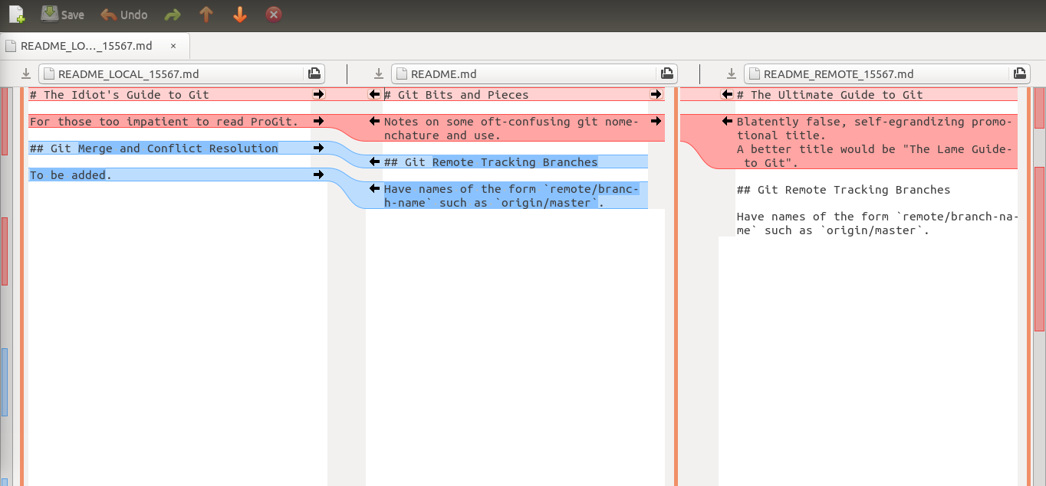
cmd> git mergetool --tool=meld
Merged version is here.

Slide 26
Common Cause of Conflicts
1. Developer A clones a repo from Github, or "pulls" latest rev from Github. Now he is up to date!
2. Developer A starts work on his local copy.
3. Developer B pushes a change to some files in the same repo to Github.
4. Developer A commits his work and does "git push".
What Happens?
Notes:
framework for management. You can use it to manage lots of things, not just software development.

Slide 27
What Happens?
dev-A> git commit -m "add tests for ..."
dev-A> git push
! [rejected] master -> master (fetch first)
error: failed to push some refs to https://github.com/...
hint: Updates were rejected because the remote contains
work that you do not have locally. This is usually caused
by another repository pushing to the same ref.
You may want to first integrate the remote changes
(e.g., 'git pull ...') before pushing again.

