Slide 1
Team Software Project
Getting started
Let's Not Do Waterfall Projects

Slide 2
How to Get Started?

Slide 3
You Already Have a [Partial] Plan
Your project proposal contains a partial project plan:
- development approach (iterative)
- initial time line with goals & deliverables
- technical approach
- some tools you're project will use

Slide 4
What Will You Do in Iteration 1?
Group exercise
  each team brainstorm and show result
  can use Google Doc or project wiki
  share screen with class
10 minutes to create a google doc or Markdown with everything you want to do in Iteration 1.

Slide 5
Your Results
Shared in class.

Slide 6
Milestone
For lack of a better definition, mine is:
Milestone:
an indicator that shows tangible progress toward completing a project, along with objectively verifiable criteria that show the milestone has been achieved (or not).
A milestone generally relates to achieving some goal or major work of the project. The criteria are how to evaluate that the work has been satisfactorily done.

Slide 7
Not Objectively Verifiable Criteria
These are obviously bad, but have been used before:
[ ] Study Django [when is it "done"? how does it show progress toward finishing the project?]
[ ] Write Use Cases [when are they done?]
[ ] Team meeting [so what? how did it help project?]
[ ] Task Board [this isn't a work product or activity]

Slide 8
Binary Milestones
A milestone is either 100% done or not done.
There are no "90% done" milestones.
-- Steve McConnell, Software Project Survival Guide

Slide 9
Milestones According to Agile
"Working software is the primary measure of progress."
They are not fans of documentation as milestones.

Slide 10
Create Your Own Milestones
Create milestones that are specific to your project plan & work.
Not a copy of examples.
Each milestone should have objectively verifiable ("done" or "not done") criteria.
In KU Polls Iteration 2, some students just copied my description as their iteration plan (it's not a plan).
That is C- level work.

Slide 11
Project Initiation Milestone
[ ] Vision statement reviewed, approved, and published
[ ] Business case for project reviewed, approved, and published
[ ] Initial timeline with iteration goals & features reviewed and published
[ ] Technical approach agreed on and published
[ ] Initial set of mock-ups of UI and screen-flow reviewed and published
[ ] Project home page on VCS and wiki created.
[ ] ... what is significant work your team needs to do?
published = published on wiki or Google Drive, with link on project home. approved = team and TA/instructor all agree

Slide 12
Ideas for Iteration 1
Detailed mock-up with screen flow.
For each usage scenario do this:
  one screen on one sheet of paper
  one person "clicks" or writes on paper screen
  another person decides what app should do next
  present user with the next paper screen
  repeat until user goal is achieved
record the screen flow + processing done in a file

Slide 13
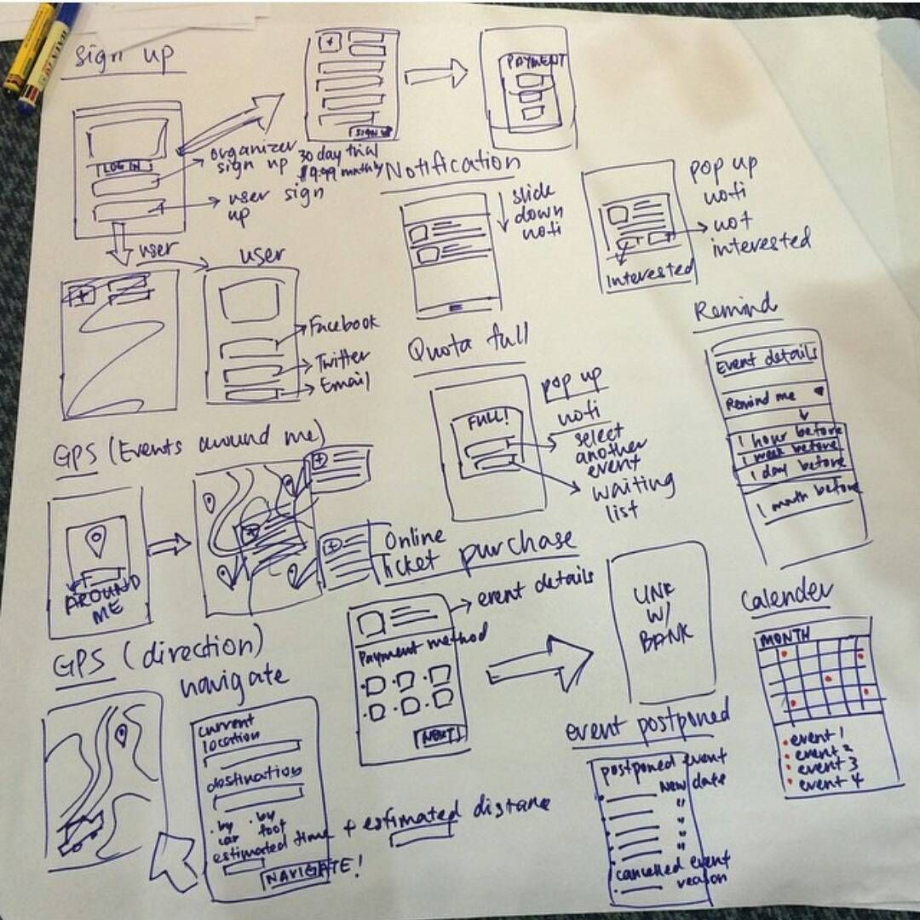

Slide 14
Ideas for Iteration 1
Domain Model
Create a "Domain Class Diagram" showing...
  important classes in the domain
  what they know (attributes)
  major responsibilities
Another tool for this is CRC cards.

Slide 15
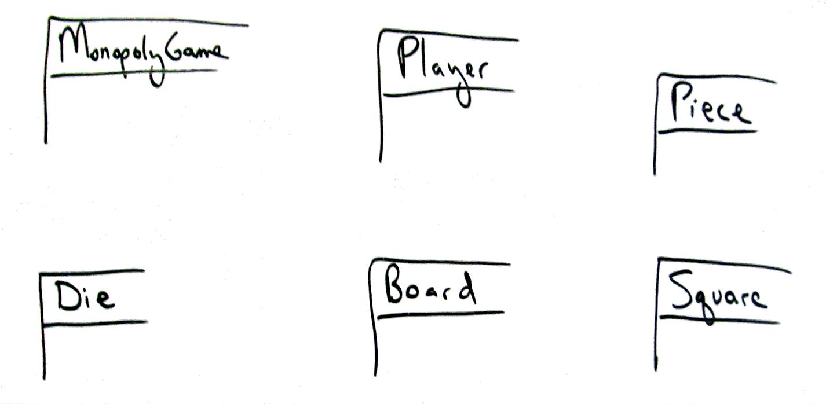
Model: Identify classes

Slide 16
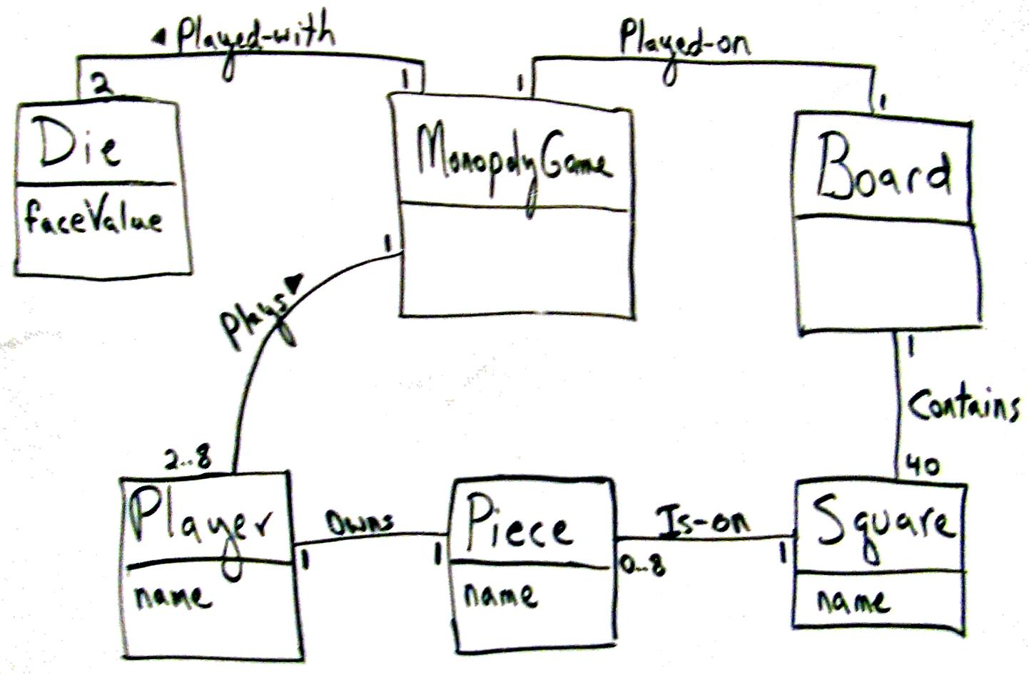
Identify relations and key attributes

Slide 17
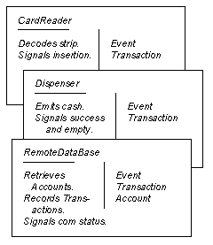
Class-Responsibility-Collaborator Cards
Back Side: notes, important things to validate

Slide 18
Concentrate on dynamic aspects
Beginners spend too much time on static structure,
not enough time on dynamic (behavior)
-- Craig Larman
You should draw sequence diagrams, too.

Slide 19
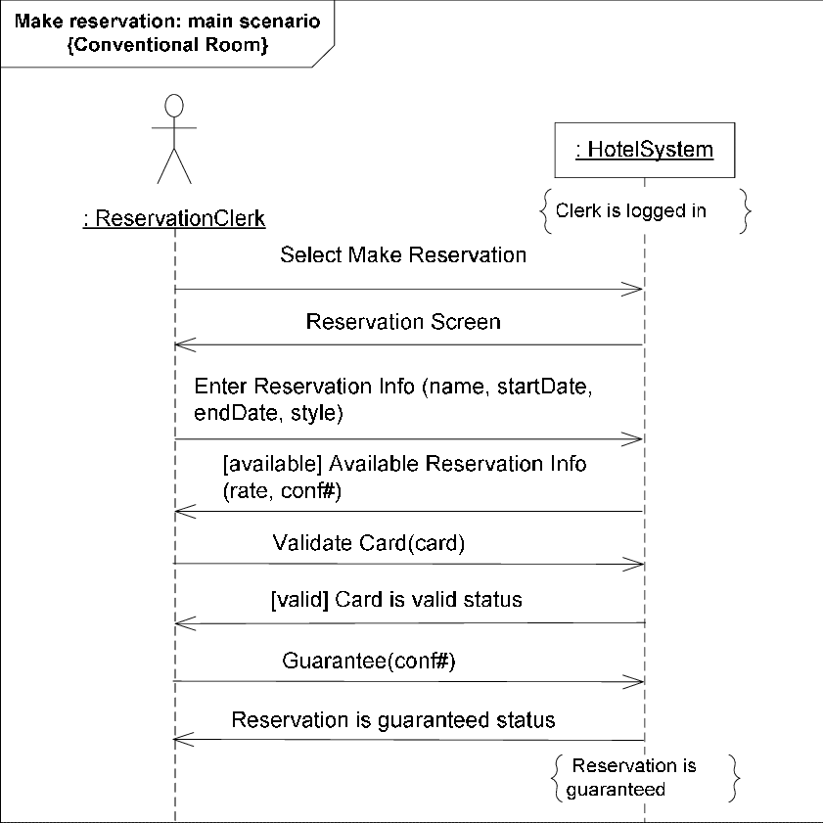
System Sequence Diagram
Shows interaction between "user" & system for one usage scenario.
Use SSD to discover what system must do.
May show external services.

Slide 20
Identify what do you Not know
Things you don't know could be risks.
Identify important things you don't know.
Domain or business related "don't knows":
what are the important terms and conditions of an apartment rental?
(so we can include them in the rental app UI)
learn more about app domain, what users want
ask people who do know

Slide 21
Technical Not Knowns
Examples:
- How to send and receive JSON requests in Django?
- How to integrate Google Calendar or existing Calendar framework into our app? (It's not useful to write your own calendar -- no one wants another calendar!)
Tasks:
Study possible solutions
Work through a tutorial or sample app
Create your own proof-of-concept app

Slide 22
Work should be VISIBLE
For any group project it is important
that progress is visible.
Lack of visibility => miscommunication, "surprises", defective or unusable work products.
Your work should produce work products.
Work products should be shared with team.
Make it visible and online.
Agile Practice: "Develop in plain sight".

Slide 23
Let's Not Do Waterfall Projects
Typical course project:
- Project presentation during last week.
- Project code & docs submitted during final.
- Instructor finds problems after semester ends.
Missed opportunity to learn.
Let's not do this.

Slide 24
Iteration Review & Demo
After each iteration:
  review progress & plan with TA or instructor.
  what did you do?
  any changes to the product or project plan?
Every iteration after the 1st one:
  Demo running software
  It should do more than the previous demo

Slide 25
Iteration Review & Demo
Who and where to demo?
  Each iteration a different team member must present
  Can be in-person or online

