Slide 1
Intro to Software Processes

Slide 2
Goal of Software Development
Need
(or Idea)
Product
Produce a software product that fulfills a need or realizes an idea.

Slide 3
What are the Steps?
Need
(or Idea)
_?_
_?_
_?_
Product
What are the major steps or activities you would need to do?
List as many as you can.

Slide 4
Software Development Steps
1. Elicit Requirements
2. Vision:
- Develop a business case
3. Analysis (of requirements)
4. Specification
5. Project Planning
6. Design
- architectural design
- detail design
7. Implementation.
8. Test and review.
9. Integration, integration testing.
repeat 6-9
10. Deployment.
11. Acceptance testing.
12. Migration.
13. Maintenance.
14. Enhancement, improve.
15. End-of-life

Slide 5
Activities in Software Development
elicit requirements
specification
high-level design
prototyping (maybe)
detailed (software) design
construction & testing
validation
documentation
transition
maintenance
Managing the project involves
planning
obtaining resources
measuring
tracking progress
review
analyze results, take action as needed

Slide 6
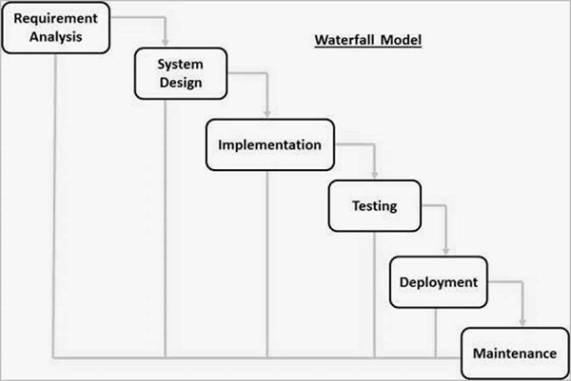
How about if we do them in order?
This is a logical way to proceed.
Similar to a civil engineering project.
(There are really more steps than this.)

Slide 7
What Could Go Wrong?

Slide 8
Consider these cases
What would be effect on project of each of these?
1. You fail to elicit some requirement(s).
2. You misunderstand some requirements, so the design is not what the customer wanted.
3. The framework you chose for the software can't handle requirements.
4. Lots of bugs during development, discovered late during test phase.

Slide 9
How to Avoid These Problems?
Frequently "check" your progress to see if you are on the right track.
Feedback
Testing
Review
Analyze results and take corrective action

Slide 10
Using Feedback
Updated goal
We are here.
original plan
We are here.

Slide 11
Overview of some Process Models
"Model" of how software development (SDLC) should go.
A "model" is an abstraction of something else.
So, some details are missing and it may be imprecise.

Slide 12
Code and Fix
The most common software development process
Ad hoc (chaos). Little or no planning and design.
Code and Fix
1. think about the problem, doodle ideas on paper
2. start coding
3. run it. Test what I just wrote and fix it.
4. as code grows, I realize that I need to change some parts.
  modify the code
  goto step 2.

Slide 13
Why "Code and Fix" is Inefficient
- No clear statement of what the result should be
- No design or "its in my head".
- Lots of rework.

Slide 14
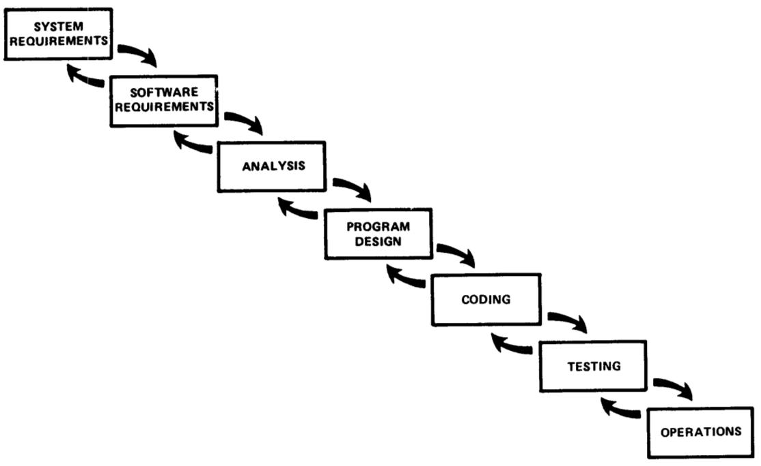
Waterfall Model
Winston Royce, Managing the Development of Large Software Systems (1970)
Still commonly used.
Not as simple as usually portrayed.

Slide 15
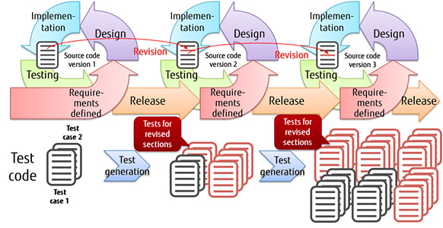
Iterative and Incremental
Incremental - project broken down into increments containing some useful features and/or other products.
Iterative - repeat it until satisfactory product is delivered.

Slide 16
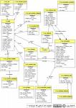
Unified Process Model
People
Technology
Roles:
Methods
Task
Task
Analysis
Design
Implement
Test
Activities:
Use Case
Description ...
Prerequisite...
Main Scenaria
1.....
2.....
3.....
Extensions: ...
Artifacts:
. . . . .
Desired Product
Communicate:
Measurements, Milestones, Documents

Slide 17
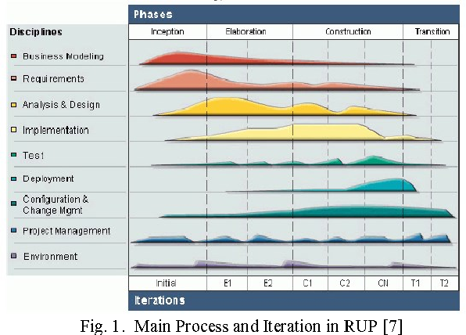
UP Disciplines and Workflow
Workflows related to different areas of concern.
Workflow contains activities and tasks.

Slide 18
Unified Process Characteristics
Characteristics
  time-boxed iterations
  plan based
  architecture centric
  address risks early
  implement requirements based on priority or business value
  accommodate change
Unified Software Development Process - a framework
  Rational UP
  Open-UP
  Agile UP (Scott Amber)

Slide 19
Agile Manifesto
We are uncovering better ways of developing
software by doing it and helping others do it.
Through this work we have come to value:
Individuals and interactions over processes and tools
Working software over comprehensive documentation
Customer collaboration over contract negotiation
Responding to change over following a plan
That is, while there is value in the items on
the right, we value the items on the left more.

Slide 20
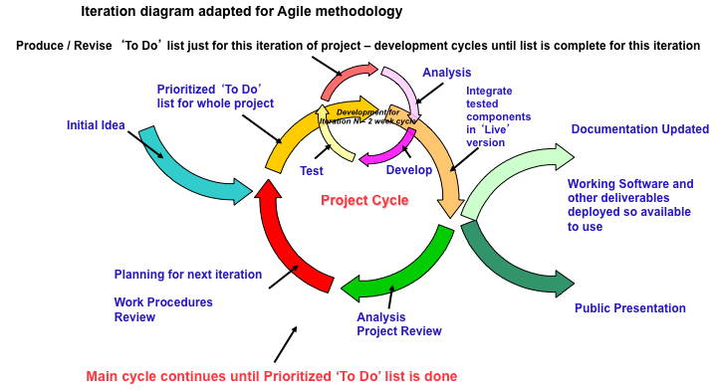
Agile Characteristics
See: 12 Agile Principles and Practices

Slide 21
Agile Process Characteristics
create customer "value" at each iteration
welcome evolving requirements
working software as primary measure of progress
lack of up-front architecture design (YAGNI)
simplicity of design (XP: "do the simplest thing that ...")
small, self-organizing teams at one site (preferred)
frequent customer feedback
shared understanding instead of comprehensive documents … but they do write documents
...

Slide 22
Some Agile Processes
eXtreme Programming
  Kent Beck: Chrysler
Scrum - called "more a management technique"
  iterative development in "Sprints"
  daily stand-up meeting
  small, democratic teams
Crystal
  a family of methods to address different types of projects
Synchronize and Stabilize (Microsoft process)

Slide 23
What About Individual Process?
Many software processes. So what?
... This is a course about individual process.
Can you define:
1. Goals for an I.S.P.?
2. Key practices and skills, based on the goals?

Slide 24
The End
(remain slides are unordered)

Slide 25
Why a Defined Process?
This is to try to convince you that a defined software process is a good thing.
Let's look at why software projects fail or succeed.
(separate slides)

Slide 26
Benefits of a Defined Process
Saves time
  less time spent on planning, estimates, decisions
Predictable - enables planning & scheduling
Repeatable
Trackable - observed progress compared to plan
Enables Quality Assurance
Provides a basis for improvement
  revise process based on experience
Ref: http://www.acm.org/crossroads/xrds6-4/software.html (2000)

Slide 27
The Role of Process
People
Technology
Methods
The Desired Product

Slide 28

The Role of Process
People
Technology
Methods
"the glue that binds [guides] people, methods, and technology to create a product."
Process
The Desired Product

Slide 29
Name some software process models?
"Software process" can be …
Software development process
Software life cycle process

Slide 30
Other "Disciplined" Processes
Team Software Process (TSP)
Personal Software Process (PSP)
  objective is to improve personal productivity through staged sequence of activities
  measure and analyze: time, defects
  improvement through reflection and planning

Slide 31
Personal Software Process (PSP)
Objective: provide a disciplined process for SEs to...
improve estimation and planning skills
reduce defects in their products
be able to manage their own schedule & work quality

Slide 32
PSP Approach
Engineers progress through 6 levels:
PSP0: [baseline] measure time you spend on planning, design, coding, test, and post mortem (retrospective)
PSP0.1: measure output LOC. Add coding standard and process improvement proposal (PIP).
PSP 1.0: Estimate program size using level 0 data. Make a test plan.
PSP 1.1: Add planning. Estimate time from program size.
PSP 2.0: Add design & code review. Emphasis on defect removal and prevention.
PSP 2.1: Add design specification.
PSP 3: Apply an iterative process to PSP2.1.

Slide 33
PSP Tools and Support
Humphrey emphasizes use of scripts, forms, and checklists to guide the user.
A useful tool is Process Dashboard (Sourceforge).
this tool includes the PSP scripts and forms, and generates reports for you.

Slide 34
Classic Mistakes: People
These practices are predictably likely to fail
Reliance on Heros (super-programmers)
Poor work environment: noisy, distractions
Adding people to a late project
"adding developers to a late project makes it later"

Slide 35
Classic Mistakes: Process
These practices are predictably likely to fail
Unrealistic schedule
Poor planning
Avoiding difficult decisions

Slide 36
Classic Mistakes: Product
Requirements often lead to failure...
Vague or unrealistic requirements
Feature creep, or requirements churn
Unnecessary features ("Gold plating")
Treating R&D project as development project

Slide 37
Typical Lifecycle Model
Inception of idea
  vision
  business case
Analysis
Design
Implementation
Acceptance
Deployment
  transition
  training & education
Maintenance and Support
End of Support
Retirement
  end of useful life
  transition or archiving
GREEN = part of the process, not life cycle

Slide 38
Classic Mistakes: Technology
Silver bullet thinking: expecting technology to provide improve productivity or make the problem easy
Using unfamiliar or unstable technology
"Let's use Lavarel because we want to learn it"
Lack of version control
Related:
Don't keep a "personal copy" outside of project VC.

Slide 39
Problem of Teaching Software Process
1. We learn on small, one-semester projects.
2. Projects often succeed based on heroic effort or super-programmers.
3. Programs aren't deployed or supported.
4. We are still learning, so process seems awkward.
Problem:
our process doesn't scale to larger projects.
benefits of many practices aren't visible.

Slide 40
Approach of this Course
Emphasis on understanding the elements of a process.
What is there purpose?
How can they help your projects?
How to do them practically?

Slide 41
Exercise 2
What process practices or activities did you use in your ExceedVote project?
Did you assign roles?

Slide 42
Some Terms
Software Life Cycle
Software Life Cycle Model
Software Development Life Cycle [Model]
Software Process
Software Process Model
  aka: Defined Software Process

Slide 43
What is a Life Cycle Model
A model of the phases that software goes through
Serves as a guide for management of software development
Models omit some real-life complexity and detail

Slide 44
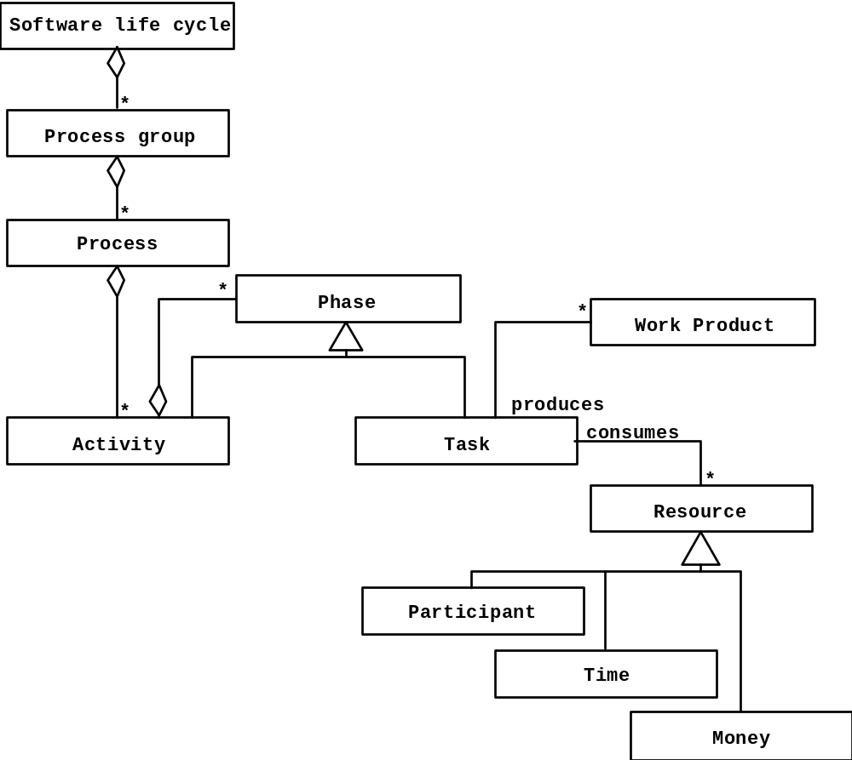
Model of Development Process
source: Bruegge, OOSE

