Slide 1
Web Application Testing in Python
With an Intro to Selenium WebDriver

Slide 2
Guidance
What to Test?
Application conforms to the requirements
Logic
Flow Control
Application Flow, e.g. Page Flow
Configuration
"Don't test Constants", e.g. HTML template text
Test your code, not the framework

Slide 3
Testing Parts of a Web App
How can we automate
testing of each of these?
View
(web page)
Controller
(django view)
url dispatcher
Model

Slide 4
Models: usual unit tests
import django.test
from polls.models import Question
class QuestionTest(django.test.TestCase):
def test_question_with_future_date(self):
tomorrow = timezone.now() +
datetime.timedelta(days=1)
question = Question( question_text=
"Is this the future?", pub_date=tomorrow)
# future date is not "recent"
self.assertFalse(
question.was_published_recently() )

Slide 5
Not necessary to test the framework
import django.test
from polls.models import Question
class QuestionTest(django.test.TestCase):
def setUp(self):
Question.objects.create(
question_text="Question One")
Question.objects.create(
question_text="Question Two")
def test_create_questions(self):
self.assertEqual(2, Questions.objects.count())

Slide 6
What is Being Tested? (cont'd)
def test_question_text(self):
self.assertTrue(
any("Question One" in q.question_text
for q in Questions.objects.all() )
This is testing Django's persistence framework.
OK to do it occasionally while learning Django.
But its not a useful test of your code.

Slide 7
Django Views and URLs
Use django.test.Client to experiment
$ python manage.py shell
>>> from django.test import Client
>>> c = Client()
# Get the /polls/ page. Should contain some polls
>>> response = c.get('/polls/')
# Did it succeed?
>>> response.status_code
200
# Print the html content
>>> response.content
'<html>\n<head>\n<style>...\n<h1>Active Polls</h1>...

Slide 8
Django Views and URLs
class TestViews(django.test.TestCase):
def setUp(self):
self.client = django.test.Client()
def test_polls_index(self):
poll = Question(question_text="ABCDEFGHIJ",...)
poll.save()
response = self.client.get('/polls/')
self.assertEqual(response.status_code, 200)
# Is test poll included in the page?
self.assertIn("ABCDEFGHIJ", response.content)

Slide 9
Test the / URL is Redirected
def test_redirect_root_url(self):
"""root url should redirect to polls index"""
response = self.client.get('/')
# Test using the basic (dumb) way
self.assertEqual(response.status_code, 302)
polls_url = reverse('polls:index')
self.assertEqual(response.url, polls_url)
# Using TestCase builtin asserts
self.assertRedirects(response, polls_url)

Slide 10
Explore Tests using Django Shell
If you are not sure how to test, use Django Shell to try it
>>> tc = django.test.TestCase()
>>> client = django.test.Client()
# The root url / should redirect to polls
>>> response = client.get('/')
>>> tc.assertRedirects(response, '/polls/')
# "Location" header field is the redirect url
>>> assert response.get('Location') == '/polls/'

Slide 11
How to Test a Template or HTML?
def test_polls_index(self):
poll = Question(question_text="ABCDEFGHIJ",...)
poll.save()
response = self.client.get('/polls/')
self.assertTemplateUsed(response,
template_name='polls/index.html')
# Is test poll included in the page?
self.assertIn("ABCDEFGHIJ", response.content)
Also: assertInHTML( )

Slide 12
Test POST, too
# Vote for a poll.
# Requires you discover the id of valid Choices,
# which is easy.
response =
self.client.post('/polls/1/', {'choice': '2'})
# What should POST return? (Should redirect)
# Test that the vote was recorded in choice.
# Test an invalid choice
response2 =
self.client.post('/polls/1/', {'choice': '9999'})

Slide 13
Are Unit Tests Enough?
No.
Unit tests don't test whether the application works.

Slide 14
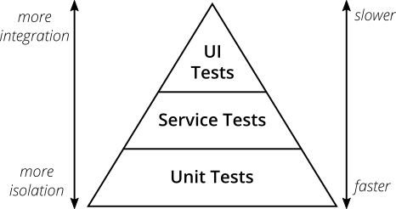
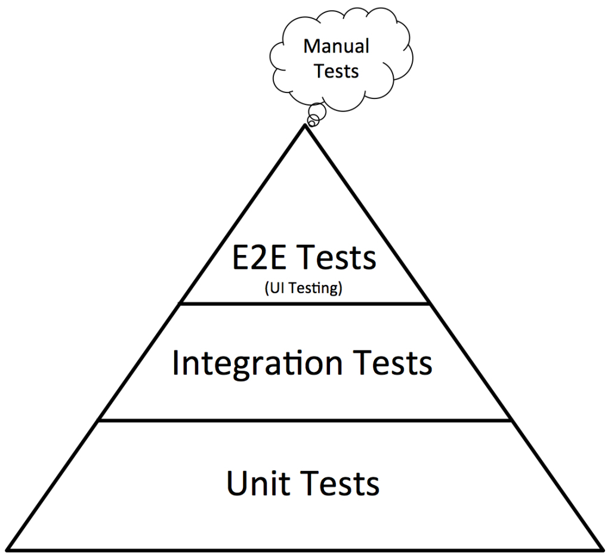
The Testing Pyramid
"Practical" pyramid
Mike Cohen's original Pyramid

Slide 15
Integration Testing
Test the interaction between components.
Components belonging to your app
Back-end services called by front-end
External components and web services
Examples:
database
filesystem used to save user uploaded files
a Google API used by your app
How to Test:
- often access a "service layer" or your standard URLs.

Slide 16
Functional or "End-to-End" Tests
Test the "development" or "production" app while its running! -- not a 'test' server.
Run tests through an actual web browser.
Test the application as a whole.

Slide 17
E2E Testing Tools
Selenium - control an actual web browser using code.
  Interface in many languages, incl. Python & Java
  Django has built-in support
  Selenium IDE for creating tests in a web browser
Cypress.io - Javascript testing tool. Natively interacts with pages in your application.
  uses Mocha and Chai for writing tests
  tests written in Javascript
Puppeteer - library for controlling a "headless" Chrome browser. Uses Javascript and node.js.
  uses: page scraping, web crawling, testing

Slide 18
Selenium
Browser automation. Not just testing.
https://selenium.dev/
We will use Selenium WebDriver
- programmatically control a web browser

Slide 19
Selenium Example
Goal:
Use duckduckgo.com to find links to Kasertsart U.
Print the top 10 links.
Requires:
- Selenium WebDriver (pip install selenium)
- driver for Firefox browser (called "geckodriver")
https://github.com/mozilla/geckodriver/releases
- you can use Chrome or Safari instead

Slide 20
Selenium: get a web page
from selenium import webdriver
from selenium.webdriver.common.keys import Keys
# browser: WebDriver object
browser = webdriver.Firefox()
browser.implicitly_wait(10) # seconds
# get the duckduckgo search page
url = "https://duckduckgo.com"
browser.get( url )

Slide 21
Selenium: find on page & send data
# Find the search box on page
# Selenium has many find_by_* commands
field_id = 'search_form_input_homepage'
input_field =
browser.find_element_by_id(field_id)
input_field.send_keys("Kasetsart Univer")
input_field.send_keys(Keys.RETURN)
# now the browser should display results

Slide 22
Page Scraping
# get the links from results page
# hacky way: use known CSS formatting
link_divs = browser.find_elements_by_css_selector(
'#links > div')
print(f"Found {len(link_divs)} matches.")
# Each result is a WebElement object
# we can search them. Look for <a href=...
element = link_divs[0]
.find_element_by_tag_name('a')

Slide 23
Page Scraping (2)
# element refers to another WebElement:
# <a href="..?..">some text</a>
# Get the 'href' value
url = element.get_attribute('href')
print("First link on page is", url)
# What the heck! Let's go visit...
element.click()
# OK, enough. Go back to search results.
browser.back()

Slide 24
Another Way to Find Links
# The Hyperlinks use class 'result__a'
links = browser.
find_elements_by_class_name('result__a')
for link in links:
if link.tag_name == 'a':
url = link.get_attribute('href')
print(url)

Slide 25
Composite Design Pattern
WebElement may contain other WebElements.
WebElement is the primary object for interacting with a web page using Selenium.
WebDriver contains many of the same methods as WebElement
WebElement
*
contains other WebElements

Slide 26
Headless Browsing
You can run a browser without opening a U.I. window.
This is called headless mode.
May be necessary when running E2E tests on a C.I. server.
It is faster, too.
https://developer.mozilla.org/en-US/docs/Mozilla/Firefox/Headless_mode

Slide 27
References
The Practical Test Pyramid
https://martinfowler.com/articles/practical-test-pyramid.html
Good Selenium Tutorial in Python (7 parts)
https://blog.testproject.io/2019/07/16/set-your-test-automation-goals/
The same author has other good testing tutorials:
https://blog.testproject.io/2019/07/16/

Slide 28
Django E2E Tests with Selenium
TDD in Python (online book)
Several chapters use Selenium for E2E testing of the Django project used in book.

Slide 29
Testing the Github Public API
developer.github.com/v3/users/

