Slide 1
"Code Smells" Review

Slide 2
Instructions
Name these symptoms of poor code.
Write the name of the "code smell" exactly as written
on refactoring.guru.
https://refactoring.guru/refactoring/catalog
The Code Smell Category
is shown at the bottom of each slide.

Slide 3
#1
class Choice(models.Model):
"""A Choice on a poll question."""
choice_text = CharField(length=80)
_votes = IntField()
@property
def votes(self):
self._votes = self.vote_set.count()
return self._votes
Category: O-O Abusers

Slide 4
#2
def roots(a, b, c):
"""Find the real roots of a quadratic
polynomial a*x^2 + b*x + c.
"""
if b*b - 4*a*c >= 0:
x1 = (-b + sqrt(b*b - 4*a*c))/(2*a))
x2 = (-b - sqrt(b*b - 4*a*c))/(2*a))
return (x1, x2)
# no real roots
return None
Category: Dispensables

Slide 5

#3
title = rental.get_movie().get_title()
Category: Couplers

Slide 6
#4
def print_rental(title, days_rented, price,
rental_pts):
print("{:40s} {:6d} {:8.2f} {:2d}"
.format(title, days_rented, price, rental_pts))
# Usage:
r = Rental("Oppenheimer", 3)
print_rental(r.get_title(), r.get_days_rented(),
r.get_price(), r.get_rental_points())
Bloaters, but not "Long Parameter List"

Slide 7
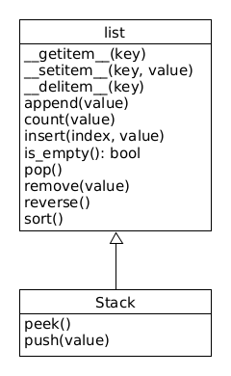
#5
A Stack data structure requires only these methods:
peek()
pop()
push()
is_empty()
Category: O-O Abusers

Slide 8
Why Not Stack extends List?
O-O Basics:
Fails the "is a" test. A Stack is not a List.
Liskov Substitution Principle -
can not substitute a Stack for a List in any usage
Design Principles:
Prefer Composition over Inheritance, also called
Prefer Delegation over Inheritance

