Slide 1
HTTP in Action
Experience HTTP

Slide 2
The Exercises
1. See what a web browser really sends.
Use ncat as HTTP server to receive requests
2. See what a web server really sends.
Use ncat as web client. Send a request to a web server.
3. Redirect a web browser
Send the browser to another web site.

Slide 3
ncat - tool to send & receive TCP
ncat is a tool that lets you:
manually send and receive TCP packets
be a server that accepts client connections
"netcat" (nc) - older tool, part of Linux and Mac OSx.
"ncat" is newer implementation that supports SSL/TLS. Available for Mac, Linux, and Windows.
Home: https://nmap.org/ncat
Download ncat as part of the nmap package: https://nmap.org/download.html

Slide 4


Exercise 1: ncat as a HTTP server
See what a request from a web browser really looks like.
Web Browser
ncat as server
> ncat -v -l -p 8080
http://localhost:8080/

Slide 5
Exercise 1: Use ncat as a server
1.1 In a terminal window. run ncat (or netcat) as a TCP server listening on port 8080
ncat -v -l -p 8080
-l means listen for connections, -v means verbose
You can use any free port number 1024 - 65535. (You must be root or admin to use ports 1-1023.)
To receive a request from a *different* host, make sure there is no firewall blocking tcp port 8080 (or whatever).

Slide 6
What is my browser sending?
1.2 Open a web browser and send a request to ncat:
http://localhost:8080/make-my-day
(8080 is the port number ncat is listening on)
Use http: not https (encrypted http).
If you use https, the request shown in ncat window will look like gibberish.

Slide 7
What did the ncat server receive?
1.3 The ncat console should print something like this:
GET /make-my-day HTTP/1.1
Host: localhost
Connection: keep-alive
User-Agent: Mozilla/5.0 (X11; Linux x86_64) AppleWebKit/537.36 (KHTML, like Gecko) Chrome/69.0.3497.81 Safari/537.36
Accept: text/html,application/xhtml+xml,application/xml;q=0.9,image/webp,image/apng,*/*;q=0.8
Accept-Encoding: gzip, deflate, br
Accept-Language: en-US,en;q=0.9,th;q=0.8

Slide 8
The Browser is Waiting for a Reply
You can see the browser is waiting for a reply.
We will use netcat to send a reply.
You are a human web server!

Slide 9
Send a Reply using HTTP protocol
1.4 In the ncat window, type a reply using HTTP.
First line must be "HTTP/1.1 200 OK"
HTTP/1.1 200 OK
Content-type: text/html
<-- blank line
<html><body>
<h1>Hello, Web Surfer</h1> <-- anything
you like

Slide 10
Let's Send a Form, too!
After the <h1>Hello Web Surfer</h1>, let's send a form:
<form method="POST">
<label>What's your name?</label>
<input type="text" name="username" />
<br/>
<button type="submit">Send</button>
</form>
<---- End the transmission by pressing
CTRL-D or CTRL-Z (Windows) or CTRL-C

Slide 11
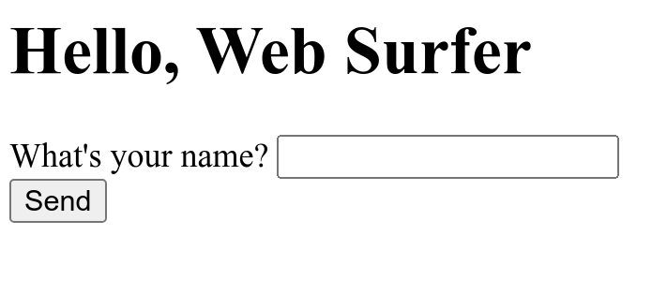
Do You See the Form?
Don't press "Send" yet!
You need to restart ncat to listen for the response:
ncat -v -l -p 8080
FYI: ncat has a -k (keep-open) option for this.

Slide 12
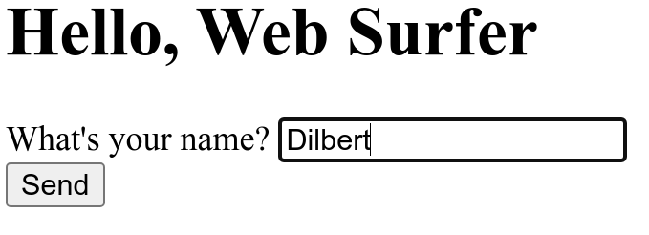
Restart ncat, then Send a Reply
When you press "Send", what does ncat show?

Slide 13
Form sends "POST" request with body
Unlike "GET", "POST" request can have a body with data.
POST /makemyday HTTP/1.1
Host: localhost:8080
Connection: keep-alive
Content-Length: 16
Content-Type: application/x-www-form-urlencoded
Referer: http://localhost:8080/makemyday
username=Dilbert <----- form data

Slide 14
Your Turn
Use ncat to send a personal greeting to the web browser.
1. Send an HTTP 200 or 201 response code.
2. In the "body", send a greeting with the user's name.
3. Press Ctrl-D or Ctrl-Z (windows) or Ctrl-C to end the transmission (otherwise, browser will wait for more data).

Slide 15
Exercise 2

Slide 16

What does a real web server send?
Now we know what a request from a web browser looks like.
What does a real reply from a real web server look like?
ncat as web client
www.cpe.ku.ac.th
> ncat -v hostname 80
GET / HTTP/1.1

Slide 17
Exercise 2: Use ncat to send http request
2.1 Send an HTTP request to http://www.cpe.ku.ac.th/
You must enter the HTTP request yourself !
cmd> ncat -v www.cpe.ku.ac.th 80
GET / HTTP/1.1
Host: www.cpe.ku.ac.th
(enter a blank line)
-v means verbose: ncat prints status messages.
Another way: curl -v http://www.cpe.ku.ac.th/ curl can also use https.

Slide 18
Exercise 2: Use ncat to send http request
2.1 Send an HTTP request to http://www.cpe.ku.ac.th/
You must enter the HTTP request yourself !
cmd> ncat -v www.cpe.ku.ac.th 80
Ncat: Connected to 158.108.215.144
GET / HTTP/1.1
Host: www.cpe.ku.ac.th
(enter a blank line)
-v means verbose. Ncat prints a message when you are connected ("Connected to 158.108.215.144")

Slide 19
What does server's reply mean?
What does the reply mean?
HTTP/1.1 301 Moved Permanently Server: nginx
Location: https://cpe.ku.ac.th/ Content-Length: 178
Content-Type: text/html
... (more header and body)
Status codes 301, 302, and 303 are redirects
A web browser will automatically go to the new URL.
Server "leaked" some info: what did you learn?

Slide 20
2.2 Follow the Redirect & Use https
2.2 Stop ncat (CTRL-C) and go to cpe.ku.ac.th
We must use TLS (--ssl flag) and port 443
cmd> ncat -v --ssl cpe.ku.ac.th 443
Ncat: SSL connection to 158.108.215.144
GET / HTTP/1.1
Host: cpe.ku.ac.th
(enter a blank line)
Do you get a web page in response?

Slide 21
Plain "http" sites are hard to find
Entire web is moving to https only.
Most http requests are redirected to an https URL.
Try: www.rd.go.th
cmd> ncat -v www.rd.go.th 80 (worked in 2021)
GET / HTTP/1.1
Host: www.rd.go.th
What does the response say?
Whose web site is this?

Slide 22
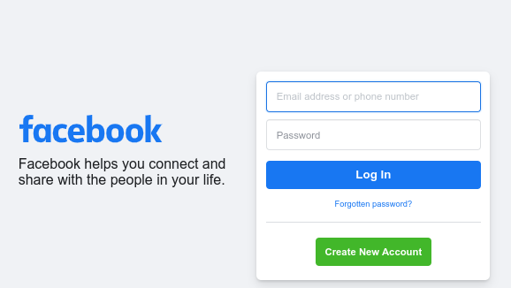
Can we redirect a web browser?
See what a request from a web browser really looks like.
Web Browser
ncat as server
http://localhost:8080/
> ncat -v -l -p 8080
302 Moved
Location: facebook.com
302 Moved Temporarily
redirect to

Slide 23
Can We Redirect a Browser?
Exercise: Use ncat to redirect web requests to Facebook.
1. Start ncat in listening (server) mode:
cmd> ncat -v -l -p 8080
2. Use a web browser, goto http://localhost:8080

Slide 24
Redirect the Browser
3. Redirect the browser to Facebook (or anyplace). Send status code 302 Moved Temporarily (not 301).
cmd> ncat -v -l -p 8080
Listening on 0.0.0.0 (family 0, port 80)
Connection from localhost 44240 received!
HTTP/1.1 302 Go away
Location: https://facebook.com
(blank line)
If you send status code 301 (Moved Permanently) the web browser will always go to Facebook instead of localhost.

Slide 25
Did the Browser obey your redirect?
Browser should follow 302 Redirect to new Location.
You can also send a message in the response body. In case the browser doesn't follow the redirect.
HTTP/1.1 302 Go away
Location: https://facebook.com
Content-type: text/plain
Only AIs allowed. <---- optional body
Try https://facebook.com instead. :-)

Slide 26
Optional Exercises
1. Redirect a friend's web browser.
2. Redirect from inside a web page.
3. How many requests on a page?
4. View page-load statistics using Chrome or Firefox Developer Tools.
see how much stuff is downloaded for a single page!

Slide 27
Can you Redirect your Friend's Browser?
Can you get a friend to connect to your ncat server,
and redirect his browser to facebook.com?
Some issues:
1. Friend needs to know your IP address. Type ifconfig or ipconfig to view it.
2. Your TCP port must not be blocked by firewall running on your computer. Windows: use Control Panel to create an exception.
3. KUWIN may block wifi-to-wifi connections (called Wifi isolation)

Slide 28
Redirect inside a Web Page?
In some situations you may want to use redirect a single web page.
You can also add a delay and display a text message:
<html>
<head>
<meta http-equiv="refresh"
content="5; URL='https://facebook.com'" />
</head>
<body>
<h2>You will be redirected in 5 seconds.</h2>
</body>
</html>

Slide 29
One page, many http requests
How many HTTP requests are needed to show this page?
<HTML>
<link rel="stylesheet" href="stylesheet.css">
<!-- Bootstrap makes my page look cool. -->
<link rel="stylesheet" href="https://maxcdn.bootstrapcdn.com/bootstrap/3.3.7/css/bootstrap.min.css">
<BODY>
<h1>My vacation</h1>
<p>
For vacation we went to <a href=”http://www.unseen.com/bangkok”>Bangkok</a>.
We visited <em>Wat Phra Kaeo</em>, and took this photo:
<br/>
<IMG src="images/watprakaew.jpeg" alt="Wat Phra Keao"/>

Slide 30
How Many Requests to Load a Page?
Use web developer tools to see requests, size, & time.
In Chrome:
1. From "dots" menu choose More Tools -> Developer Tools
2. In "Developer Tools" window, choose Network tab.
3. Check the box: [x] Disable cache
4. In Chrome, enter a URL (such as dailynews.co.th)
How many requests? How many MB?
For just one web page!

Slide 31
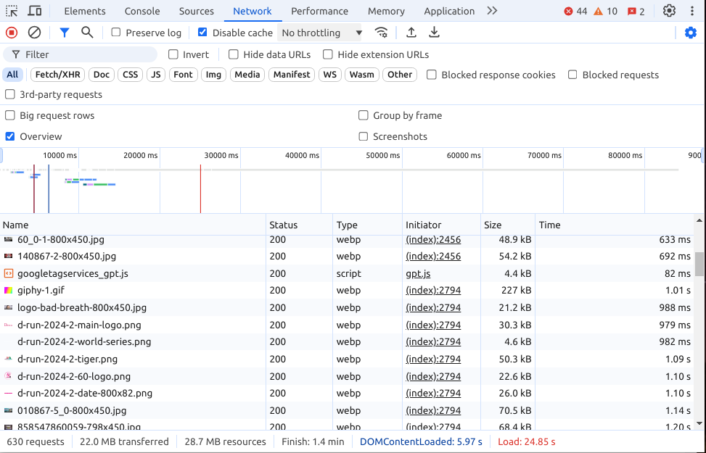
network stats for dailynews.co.th
630 requests, 22 MB transferred, 28.7 MB resources, Load: 24.5 sec

Slide 32
More Useful HTTP Tools
wget - Get one or more files via http/https.
- Used by Zuckerberg in The Social Network
curl - Transfer data to/from a server using many
different protocols, including HTTP & HTTPS
Browser Extensions - send custom HTTP requests and see the response. Good for web services. I use "RESTED" extension in Firefox and Brave.

