Slide 1
Logging
James Brucker

Slide 2
KBank admits data hack
The Nation
August 01, 2018 18:47
Pipit Aneaknithi, Kasikornbank president, revealed that on July 25, KBank found that 3,000 names of corporate customers using KBank’s website for the letter of guarantee service might have been leaked.
As soon as KBank detected the irregularity, it said it immediately closed the loophole... The data that may have been leaked was the names and telephone numbers of KBank’s corporate customers using the letter of guarantee service via the website only.
http://www.nationmultimedia.com/detail/business/30351237

Slide 3
KBank, KTB target in cyber-attacks
Bangkok Post
August 01, 2018 04:00
KBank ... found that the names of 3,000 corporate customers using KBank's website ... might have been hacked.
KTB president Payong Srivanich said in a statement that the bank had detected general information from 120,000 retail customers who applied for mortgages and personal loans online ... was hacked in the days leading up the July holidays.
https://www.bangkokpost.com/news/security/1513410/kbank-ktb-targeted-in-cyber-attacks

Slide 4
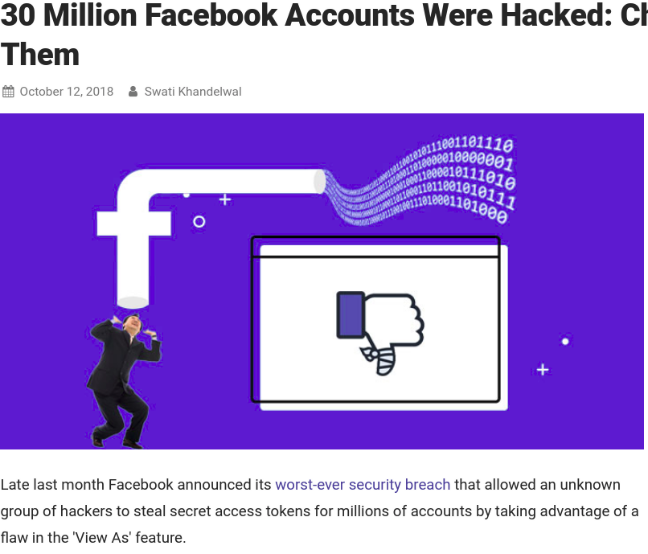

Slide 5
How Facebook was Hacked
The flaw in "View As" feature has been present since July 2017, but first detected on 14 Sep 2018 due to rise in suspicious activity.
Facebook knows exactly which accounts were hacked and you can check your account.
https://www.wired.com/story/how-facebook-hackers-compromised-30-million-accounts/
https://thehackernews.com/2018/10/hack-facebook-account.html

Slide 6
How Did They Know?
How did KBank know 3,000 customer's data stolen ... and what data was stolen?
How did KTB know 120,000 customers "who applied for a mortgage or loan" had data stolen?
How did Facebook know there was "suspicious activity"?
How does Facebook know whose data was stolen?

Slide 7
LOGGING
They keep "logs" of events and activity.

Slide 8
Chinese are Attacking My Server!
Unix/Linux keep logs for many services is /var/log.
A typical system has the following logs:
auth.log - authentication related (login, sudo)
boot.log - all system start-up (boot) messages
dpkg.log - package install and configuration messages
kern.log - messages from the kernel
lastlog - most recent login by each user
ufw.log - filewall messages

Slide 9
Chinese are Attacking My Server!
On se.cpe.ku.ac.th here is part of /var/log/auth.log:
Nov 18 06:29:48 se sshd[6720]: Failed password for root from 116.31.116.16 port 61430 ssh2
Nov 18 06:29:52 se sshd[6720]: message repeated 2 times: [ Failed password for root from 116.31.116.16 port 61430 ssh2]
Someone trying to login as root.
Where is 116.31.116.16?
Search Google...

Slide 10
116.31.116.16
116.31.116.16 | ChinaNet Guangdong Province Network | AbuseIPDB
https://www.abuseipdb.com/check/116.31.116.16
116.31.116.16 has been reported 409 times. ... 116.31.116.16 was first reported on December 3rd 2017 , and the most recent report was 4 hours ago .
IP List of Brute force attackers
https://report.cs.rutgers.edu/DROP/attackers
... 115.186.147.235 115.249.205.29 116.196.76.135 116.31.116.11 116.31.116.12 116.31.116.14 116.31.116.16 116.31.116.21 116.31.116.23 116.31.116.24 ...
The Anti Hacker Alliance™ fights against 116.31.116.20
https://anti-hacker-alliance.com/index.php?ip=116.31.116.20
116.31.116.x

Slide 11
Python Logging
logging - Python standard logging package
# get a named logger. Use any logical name
logger = logging.getLogger( __name__ )
# log some events
logger.info( "Successful login by " + user.username )
logger.warning( "Failed login by " + form.username )
logger.error( "Poll question has no choices: "+question )
logger.critical( "Connection to database failed" )
logger.log( logging,INFO, "another INFO level mesg" )

Slide 12
Logging Architecture
logging
manages collection of ...
Logger
filter messages and send them to...
1 .. *
Handler
one Logger may have many handlers. Each handler has its own log level and formatter.
StreamHandler
level = ERROR
formatter =
stream = ...
FileHandler
level = INFO
formatter =
file = ...
SysLogHandler
level = WARN
formatter =
syslog = ...

Slide 13
getLogger( "name" ) is a Singleton
log1 = logging.getLogger( "auth" )
log2 = logging.getLogger( "auth" )
# are they the same object?
log1 == log2
True
id(log1) == id(log2)
True

Slide 14
5 Log Levels
Level Names:
CRITICAL = 50
ERROR = 40
WARNING = 30
INFO = 20
DEBUG = 10
Aliases:
FATAL = 50
WARN = 30
Example:
logger.critical("Can't connect to db")
logger.error("Exception raised:", ex)
logger.warning("Failed login by wisa on ...")
logger.info("Successful login by nerd ...")
logger.debug( request )
logger.log( level, message )

Slide 15

Java Has More Log Levels
java.util.logging
SEVERE
WARNING
INFO
( CONFIG )
FINE
FINER
FINEST
OFF
ALL
(stupid names)
Log4J & SLF4J Levels
FATAL
ERROR
WARN
INFO
DEBUG
TRACE
OFF
ALL

Slide 16
How to Use the 5 Log Levels
What should you log to each of these levels?
CRITICAL
ERROR
WARNING
INFO
DEBUG
See: Python Logging Tutorial
https://docs.python.org/3/howto/logging.html

Slide 17
Log Handlers and Formatters
Python has many Log Handlers you can choose:
https://docs.python.org/3/library/logging.handlers.html
Important Handlers:
logging.StreamHandler(stream=sys.stdout)
logging.FileHandler( filename )
logging.RotatingFileHandler( filename, maxBytes=... )
logging.TimeRotatingFileHandler
logging.SysLogHandler(address=("localhost",port),...)

Slide 18
Loggers for a Hierarchy
rootlog = logging.getLogger( ) - the root logger
loga = logging.getLogger( 'a' ) - child of root
logb = logging.getLogger( 'a.b' ) - child of 'a',
grandchild of root
logb.warn("Warning!") - sent to logb, then loga, then root

Slide 19
Logging in a Web App
Web Apps have some special concerns:
1. want to log IP address for events and activity
2. Web app may be deployed on many hosts, and may not be persistent. How can you make separate logs from web app?
3. How to aggregate logs from different parts of app?

Slide 20
Web App Logging
What events or activity should a web app log?
1. Login - username, IP addr, date&time
2. Logout
3. Errors and exceptions
4. Deployment
5. User activity - at least all activity that changes something
6. Invalid requests

Slide 21
What Info Should You Log When...
1. A failed or successful login occurs.
> username
> IP address
> date/time
2. A user submits a "vote" to the polls application.
> question and choice he voted
> which session or IP address he voted from
>

Slide 22
Learn Python Logging
Python Logging Tutorial (Basic & Advanced)
https://docs.python.org/3/howto/logging.html
Logging Cookbook
https://docs.python.org/3/howto/logging-cookbook.html

Slide 23
Django Logging
Django uses Python Logging, adds some "conveniences".
See: Django User Guide, section 3.16 (only 10 pages)

Slide 24
Configure Django Logging
LOGGING = {
'disable_existing_loggers': False,
'handlers': {
'file': {
'level': 'DEBUG',
'class': 'logging.FileHandler',
'filename': '/path/to/myapp.log',
},
'console': {
'class': 'logging.StreamHandler'
}
}
'loggers': {
'myapp': {
'handlers': ['console'],
'level': 'INFO',
'propagate': False,
...

Slide 25
Logging Advice
1. Configure the root logger, but don't use it directly.
2. For deployed web apps, log to console (12FactorApp)
3. Configure logger via config variables, not settings.py.
  OK to partially configure in settings.py but get details from configuration file

