Slide 1
HTTP in Action
Some experiments using HTTP

Slide 2
Exercises
1. Use netcat as HTTP server. Send a request from web browser. Send HTTP response using netcat.
  So you can see what a web browser really sends.
2. Use netcat as web client. Send a request to a real web server.
  So you can see what a web server really sends.
3. Redirect a web browser using HTTP response codes and Location header.

Slide 3
Send & view HTTP using netcat
netcat (nc) or ncat are tools that let you:
  manually send and receive TCP packets
  act like a server that accepts client connections
"netcat" (nc) is a Linux command.
There is a version for Windows. MacOS?
"ncat" is newer implementation that supports IPv6.

Slide 4
Exercise 1: Use netcat as a server
In a terminal window. run netcat as a TCP server listening on port 8080
netcat -v -l 8080
TCP connections have a "port" (1 - 65,535).
Port 80 is the standard port for http,
but you must be root (admin) to use port 80.
If you want to send request from a *different* host,
then make sure there is no firewall blocking tcp port 8080 (or 80).

Slide 5
What is my browser sending?
Open a web browser and send a request to netcat:
http://localhost:8080/make-my-day
or, if netcat is using the standard http port (80):
http://localhost/make-my-day
you can request anything you like instead of "make-my-day".

Slide 6
What did the server receive?
The "netcat" console should print something like this:
GET /make-my-day HTTP/1.1
Host: localhost
Connection: keep-alive
User-Agent: Mozilla/5.0 (X11; Linux x86_64) AppleWebKit/537.36 (KHTML, like Gecko) Chrome/69.0.3497.81 Safari/537.36
Accept: text/html,application/xhtml+xml,application/xml;q=0.9,image/webp,image/apng,*/*;q=0.8
Accept-Encoding: gzip, deflate, br
Accept-Language: en-US,en;q=0.9,th;q=0.8

Slide 7
The Browser is Waiting for a Reply
You can see the browser is waiting for a reply.
We will use netcat to send a reply.
We are a human web server!

Slide 8
Send a Reply using HTTP protocol
In the netcat cmd window, type a reply using HTTP.
First line must be "HTTP/1.1 200 OK"
The body of the reply is HTML.
Type:
HTTP/1.1 200 OK
Content-type: text/html
<--blank line
<html><body>
<h1>Hello, Nerd</h1>
(you can send more stuff as html)
(more stuff and will be appended to the browser page as you send it). Press CTRL-C to stop the server.

Slide 9
What does a real web server send?
Now we know what a request from a web browser looks like.
What does a real reply from a real web server look like?

Slide 10
Exercise 2: Use netcat to send http request
Use netcat to send an HTTP request to http://www.ku.ac.th/
You have to enter the HTTP request yourself !
cmd> netcat -v www.ku.ac.th 80
GET / HTTP/1.1
Host: www.ku.ac.th
(enter a blank line)
"-v" means verbose. Netcat will print when you are connected.
Another way: curl -v http://se.cpe.ku.ac.th/
curl can also use https.

Slide 11
What does server's reply mean?
What does the reply mean?
HTTP/1.1 301 Moved Permanently
Server: Apache
Location: https://www.ku.ac.th/
Content-Length: 229
Content-Type: text/html
... (more header and body)
Status codes 301, 302, and 303 are redirects
A web browser will automatically go to new URL.

Slide 12
Plain "http" sites are hard to find
Entire web is moving to https only.
But there are a few... www.rd.go.th
cmd> netcat -v www.rd.go.th 80
GET / HTTP/1.1
Host: www.rd.go.th
What does the response say?
Whose web site is this?

Slide 13
Can We Redirect a Browser?
Exercise: Use netcat to redirect web requests to Facebook or wherever you want.
1. Start netcat in listening (server) mode:
cmd> netcat -v -l 8080
2. Use a web browser, goto http://localhost:8080

Slide 14
Redirect the Browser
3. Redirect the browser to Facebook (or anyplace).
cmd> netcat -v -l 8080
Listening on 0.0.0.0 (family 0, port 80)
Connection from localhost 44240 received!
HTTP/1.1 301 Don't Bother Me
Location: https://facebook.com
(blank line)

Slide 15
Did the Browser obey your redirect?
Browser should follow 301 Redirect to new Location.
You can also send a message in the response body. In case the browser doesn't follow the redirect.
HTTP/1.1 301 Sorry, humans not allowed
Location: https://facebook.com
Content-type: text/plain
Only robots allowed.
Try https://facebook.com instead. :-)

Slide 16
Optional
1. Redirect a friend's web browser.
2. Redirect from inside a single web page.
3. How many requests on a page?
4. View page-load statistics using Chrome or Firefox Developer Tools.
  see how much stuff is downloaded for a single page!

Slide 17
Can you Redirect your Friend's Browser?
Can you get a friend to connect to your netcat server,
and redirect his browser to facebook.com?
Some issues:
1. Friend needs to know your IP address.
Type ifconfig or ipconfig to view it.
2. Your TCP port must not be blocked by firewall on your computer. Windows: use Control Panel to create an exception.
3. KUWIN may be blocking wifi-to-wifi connections (called Wifi isolation)

Slide 18
Redirect inside a Web Page?
In some situations you may want to use redirect a single web page.
You can also add a delay and display a text message:
<html>
<head>
<meta http-equiv="refresh"
content="5; URL='https://facebook.com'" />
</head>
<body>
<h2>You will be redirected in 5 seconds.</h2>
</body>
</html>

Slide 19
Exercise
How many HTTP requests are sent to show this page?
<HTML>
<link rel="stylesheet" href="stylesheet.css">
<!-- Bootstrap makes my page look cool. -->
<link rel="stylesheet" href="https://maxcdn.bootstrapcdn.com/bootstrap/3.3.7/css/bootstrap.min.css">
<BODY>
<h1>My vacation</h1>
<p>
For vacation we went to <a href=”http://www.unseen.com/bangkok”>Bangkok</a>.
We visited <em>Wat Phra Kaeo</em>, and took this photo:
<br/>
<IMG src="images/watprakaew.jpeg" alt="Wat Phra Keao"/>

Slide 20
How Many Requests to Load a Site?
Use browser developer tools to see requests, size, & time.
In Chome:
1. Use Incognito or Private Browsing window to avoid caching.
2. From "dots" menu choose More Tools -> Developer Tools
3. In "Developer Tools" window, choose Network tab.
4. In Chrome, enter a URL (such as dailynews.co.th)
How many requests? How many MB?
For just one web page!

Slide 21
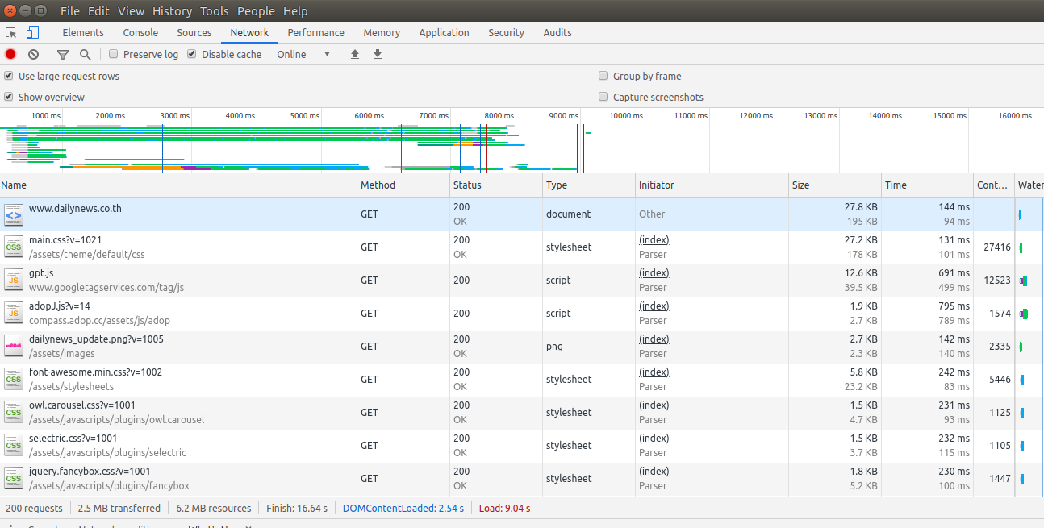
network stats for www.dailynews.co.th
201 requests, 2.5 MB transferred, 6.2 MB resources, Load: 9.04s

