Slide 1
Unit Testing with JUnit
James Brucker

Slide 2
What to Test?
In unit testing, we test functions or methods in classes.
Input
Function
Output

Slide 3
How to Test?
We can't test all possible input / output.
Divide input into categories, sets, or classes.
Or, discover "rules" that govern different sets of input.
Test a few samples from each set, category, or class.
  Test boundary values.
  Test "typical" values.
  Test "extreme" values.
  Test impossible values.
  Try to make things fail.

Slide 4
FIRST - guide for good tests
Fast
Independent - can run any subset of tests in any order
Repeatable
Self-checking - test knows if it passed or failed
Timely - written close in time to the code being tested

Slide 5
Example
Stack implements common stack data structure.
Has a fixed capacity and methods shown below.
Throws StackException if you do something stupid.
Stack<T>
+ Stack( capacity )
+ capacity( ): int
+ size( ): int
+ isEmpty( ): boolean
+ isFull( ): boolean
+ push( T ): void
+ pop( ): T
+ peek( ): T

Slide 6
What to Test?
Border Case: Stack with capacity 1 | 1. no elements in stack capacity() is 1 isEmpty() -> true isFull() -> false size() -> 0 peek() returns ??? 2. push one element on stack isEmpty() -> false isFull() -> true size() -> 1 3. can peek()? push one element peek() returns element stack does not change 4. push element, peek it, then pop pop -> returns same object test all methods idea: a helper method for all tests of an empty stack or full stack

Slide 7
Test for Methods
push( ) | Hard to test by itself! Need to use peek( ), pop( ), or size( ) to verify something was pushed. 1. Stack of capacity 2. push(x) verify size=1 peek()==x, not full, not empty push(y) verify again pop(y) push(x) - should have 2 items both == x

Slide 8
Test by writing Java code
Stack stack = new Stack(1);
// test empty stack behavior
if ( ! stack.isEmpty() )
out.println("error: should be empty");
if ( stack.isFull() )
out.println("error: should not be full");
if ( stack.capacity() != 1 )
out.println("error: capacity incorrect" );
if ( stack.size() != 0 )
out.println("error: size should be 0" );
if ( stack.peek() != null ) // what should it do?
out.println("error: peek() should be null");
... Many, many more tests

Slide 9
Too Slow, too boring
A lot of redundant code... even for simple tests.
Violates 2 Key Development Practices
1. don't repeat yourself
2. automate repetitive tasks

Slide 10
Insight
The test code is mostly redundant "boiler plate" code.
Automate the redundant code.
Create an automatic tool to perform tests and manage output.

Slide 11
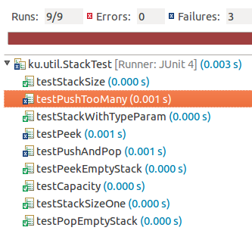
JUnit does it
public class StackTest {
@Test
public void testStackSize( ) {
...
}
@Test
public void testPeek() {
...
}
@Test
public void testPushAndPop() {
...
}

Slide 12
Using JUnit for Testing
makes it easy to write test cases
automatically runs your tests
reports failures with context information
JUnit can also...
test for Exceptions
limit the execution time
use parameters to vary the test data

Slide 13
Example: test the Math class
import org.junit.*;
public MathTest {
@Test // @Test identifies a test method
public void testMax( ) { // any public void method name
Assert.assertEquals( 7, Math.max(3, 7) );
Assert.assertEquals( 14, Math.max(14, -15) );
}
JUnit test methods are in the Assert class.
assertEquals(expected, actual )
assertTrue( expression )
assertSame( obja, objb )
actual
result
expected
result

Slide 14
Tests Using Floating Point Values
@Test
public void testMath( ) {
double TOL = 1.0E-8; // tolerance
Assert.assertEquals(
1.414213562, Math.sqrt(2), TOL );
Assert.assertEquals( "Should round up",
8.0, Math.round(7.50000001), TOL );
}
tolerance for floating point comparison
message to print if test fails (optional)
expected
result

Slide 15
Unit Testing Vocabulary
Test Suite - collection of unit tests. A test class.
Test Case - test method (@Test).
Test Fixture - attributes or local var that is being tested.
Test Runner - code that runs the tests, collects results.

Slide 16
Example: test the Stack constructor
import org.junit.*;
import static org.junit.Assert.* ; // import names of all static methods
public StackTest {
@Test
public void testStackConstructor( ) {
Stack stack = new Stack(5);
assertEquals("Stack should be empty", 0, stack.size() );
assertEquals("Capacity should be 5", 5, stack.capacity() );
assertFalse( stack.isFull() );
assertTrue( stack.isEmpty() );
}

Slide 17
What can you Assert ?
JUnit Assert class provides many assert methods
Assert.assertTrue( 2*2 == 4 );
Assert.assertFalse( "Stupid Slogan", 1+1 == 3 );
Assert.assertEquals( new Double(2), new Double(2));
Assert.assertNotEquals( 1, 2 );
Assert.assertSame( "Yes", "Yes" ); // same object
Assert.assertNotSame("Yes", new String("Yes") );
double[] a = { 1, 2, 3 };
double[] b = Arrays.copyOf( a, 3 );
Assert.assertArrayEquals( a, b );
Assert.assertThat( patternMatcher, actualValue );

Slide 18
Use import static Assert.*
Tests almost always use static Assert methods:
@Test
public void testInsert( ) {
Assert.assertTrue( 1+1 == 2 );
Use "import static" to reduce typing:
import static org.junit.Assert.*;
public class ArithmeticTest {
@Test
public void testInsert( ) {
assertTrue( 1+1 == 2 );

Slide 19
Test Methods are Overloaded
Assert.assertEquals is overloaded (many param. types)
assertEquals( expected, actual );
assertEquals( "Error message", expected, actual );
can be any primitive data type or String or Object
// assertSame(a,b) tests a == b
assertSame( expected, actual );

Slide 20
AssertEquals for Floating Point
assertEquals for float and double require a tolerance as allowance for limit on floating point accuracy.
final static double TOL = 1.0E-8; // be careful
@Test
public void testPythagorus() {
assertEquals( 5.0, Math.hypot(3.0,4.0), TOL );
}
@Test
public void testSquareRoot( ) {
assertEquals( 1.41421356, Math.sqrt(2), TOL );
Expected
Result
Actual
Result
Tolerance for comparison

Slide 21
Running JUnit 4
1. Use Eclipse, Netbeans, or BlueJ (easiest)
Eclipse, Netbeans, and BlueJ include JUnit.
2. Run JUnit from command line.
CLASSPATH=c:/lib/junit4.1/junit-4.1.jar;.
java org.junit.runner.JUnitCore PurseTest
3. Use Ant (automatic build and test tool)

Slide 22
JUnit 4 uses Annotations
JUnit 4 uses annotations to identify methods
@Test a test method
@Before a method to run before each test
@After a method to run after each test
@BeforeClass method to run one time before testing starts

Slide 23
Before and After methods
@Before indicates a method to run before each test
@After indicates a method to run after each test
public PurseTest {
private Purse purse;
@Before
public void runBeforeTest( ) { purse = new Purse( 10 ); }
@After
public void runAfterTest( ) { purse = null; }
@Test public void testPurse( ) {
Assert.assertEquals( 0, purse.count() );
Assert.assertEquals( 10, purse.capacity() );
}

Slide 24
@Before (setUp) and @After (tearDown)
@Before - method that is run before every test case.
  setUp( ) is the traditional name.
@After - method that is run after every test case.
  tearDown( ) is the traditional name.
setUp( )
setUp( )
testFun1( )
one test case
testFun2( )
another test
tearDown( )
tearDown( )

Slide 25
Using @Before and @After
You want a clean test environment for each test.
This is called a "test fixture". Use @Before to initialize a test fixture. Use @After to clean up.
private File file; // fixture for tests writing a local file
@Before
public void setUp( ) {
file = new File( "/tmp/tempfile" );
}
@After
public void tearDown( ) {
if ( file.exists() ) file.delete();
}

Slide 26
Testing for an Exception
you can indicate that a test should throw an exception.
List should throw IndexOutOfBoundsException if you go beyond the end of the list.
// this test should throw an Exception
@Test( expected=IndexOutOfBoundsException.class )
public void testIndexTooLarge() {
List list = new ArrayList();
list.add( "foo" );
list.get( 1 ); // no such element!
}

Slide 27
Stack Example
If you pop an empty stack it throws StackException
@Test( expected=StackException.class )
public void testPopEmptyStack() {
Stack stack = new Stack(3);
Object x = stack.pop( );
}

Slide 28
Limit the Execution Time
specify a time limit (milliseconds) for a test
if time limit is exceeded, the test fails
// this test must finish in less than 500 millisec
@Test( timeout=500 )
public void testWithdraw() {
// test fixture already created using @Before
// method, and inserted coins, too
double balance = purse.getBalance();
assertNotNull( purse.withdraw( balance ) );
}

Slide 29
fail!
Signal that a test has failed
@Test
public void testWithdrawStrategy() {
//TODO write this test
fail( "Test not implemented yet" );
}

Slide 30
What to Test?
Test BEHAVIOR not just methods.
One test may involve several methods.
May have several tests for the same method,
each testing different behavior or test cases.

Slide 31
Designing Tests
"borderline" cases:
  a Purse with capacity 0 or 1
  if capacity is 2, can you insert 1, 2, or 3 coins?
  can you withdraw 0? can you withdraw 1?
  can you withdraw exactly amount in the purse?
impossible cases:
  can you withdraw negative amount? -1?
  can you withdraw balance+1 ?
  can you withdraw Double.INFINITY ?

Slide 32
Designing Tests
typical cases
  Purse capacity 10. Insert many different coins.
  When you withdraw, do coins match what you inserted?
extreme cases
Purse with capacity 9.999,999.
Insert 9,999,999 of 1 Trillion Zimbabwe dollars.
Is balance correct? Can you withdraw everything?

Slide 33
Test Behavior, not methods
Test behavior ... not just methods
Stack:
  can I push until stack is full, then pop each one?
  do peek() and pop() return same object as push-ed?

Slide 34
Questions about JUnit 4
Why use:
import static org.junit.Assert.*;
How do you test if Math.sin(Math.PI/2) is 1 ???
assertEquals( 1.0, Math.sin(Math.PI/2), 1.0E-8 )
How do you test if a String named str is null ???
assertNull( str )
assertTrue( str == null )
assertSame( str, null )

Slide 35
Fluent JUnit
Assume.that( actual, matcher )
Assume.assumeTrue( stack.isEmpty() )
- skip a test unless some conditions are true
Theories - define more complex test conditions.
See:
https://dzone.com/articles/parameterized-tests-and-theories

Slide 36
Parameterized Tests
We want to test the isPrime(long) method.
public class MathUtil {
/**
* Test if a number is prime.
* @param n the numbe to test
*/
public static boolean isPrime(long n) {
//TODO complete the code
return false;
}
}

Slide 37
Redundant Tests
import static org.junit.Assert.*;
public class MathUtilTest {
@Test
public void testPrimeNumbers( ) {
long[] primes = [2,3,5,29,163,839,...];
for(long p: primes)
assertTrue( MathUtil.isPrime(p) );
}
@Test
public void testNonprimeNumbers() {
long[] nonprime = [4,99,437,979,3827,...];
for(long n: nonprime)
assertFalse( MathUtil.isPrime(n) );
}
}

Slide 38
Parameters for Unit Tests
JUnit Parameterized Tests
- set parameters as attributes or method arguments
- you inject (set) values directly to attributes.
- See JUnit docs for "Parameterized Tests"
Maybe Better (and simpler):
JUnitParams: add-on with easier syntax for parameters:
https://github.com/Pragmatists/JUnitParams
Tutorial: https://www.baeldung.com/junit-params

Slide 39
Using Parameter class
@RunWith(Parameterized.class)
public class TestMathUtil {
private long input;
private boolean expected; // expected result
public MathUtilTest(long n, boolean result) {
this.input = n;
this.expected = result;
}
@Test
public void testPrimeNumber( ) {
assertEquals(expected,MathUtil.isPrime(input));
}
}
// ...continued

Slide 40
Method defines parameter values
@Parameterized.Parameters
public static Collection makeTestValues() {
// collection of (input,result) pairs
return Arrays.asList( new Object[][] {
{2, true},
{3, true},
{4, false},
{19, true},
{21, false},
...
});
}
Use @Parameterized.Parameters annotation.
Each item in the Collection is injected into the test constructor (MathUtilTest(long,boolean)) before running one test.

Slide 41
More Parameterized Tests
Previous example is too simple to show usefulness.
You can inject values directly into attributes (fields) or as method parameters.

Slide 42
JUnitParams
JUnitParams is an open-source add-on Test Runner for JUnit.
Less coding to define parameters
Many ways to inject values
Easier to read - data is closer to test method
https://github.com/Pragmatists/JUnitParams
Tutorial: https://www.baeldung.com/junit-params

Slide 43
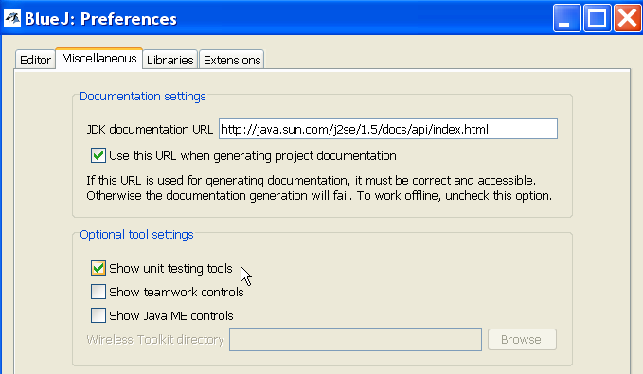
Using JUnit in BlueJ
1. From "Tools" menu select "Preferences..."
2. Select "Miscellaneous" tab.
3. Select "Show unit testing tools".

Slide 44
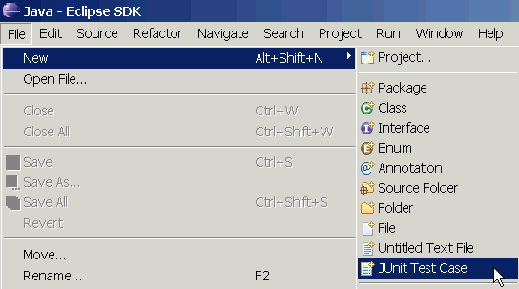
Using JUnit in Eclipse
Eclipse includes JUnit 3.8 and 4.x libraries
  you should use Junit 4 on your projects
eclipse will manage running of tests.
  but, you can write your own test running in the main method
Select a source file to test and then...

Slide 45
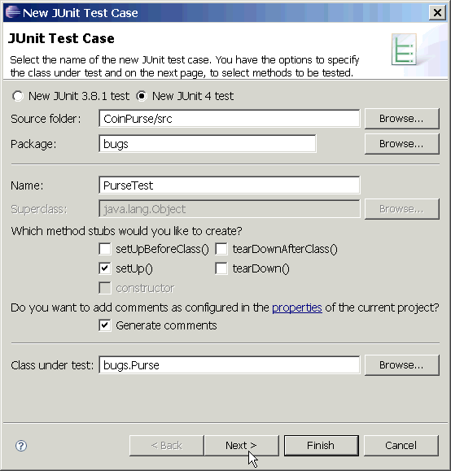
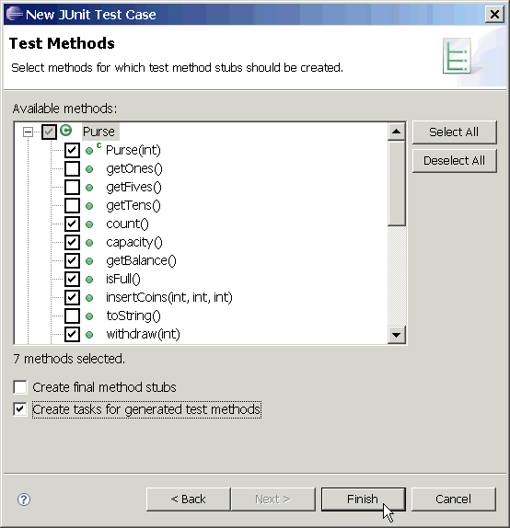
Using JUnit in Eclipse (2)
Select test options and methods to test.

Slide 46
Using JUnit in Eclipse (3)
/** Test of the Purse class
* @author James Brucker
*/
public class PurseTest {
private Purse purse;
private static final int CAPACITY = 10;
/** create a new purse before each test */
@Before
public void setUp() throws Exception {
purse = new Purse( CAPACITY );
}
@Test
public void testCapacity() {
assertEquals("capacity wrong",
CAPACITY, purse.capacity());
}
Write your test cases.
Eclipse can't help much with this.

Slide 47
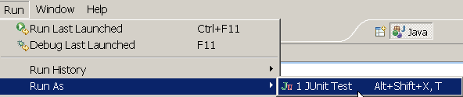
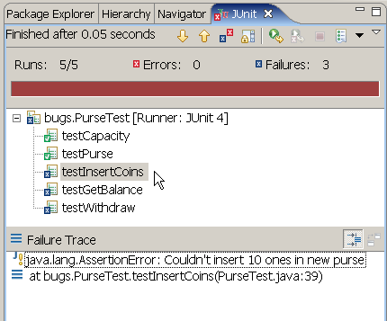
Run JUnit in Eclipse (4)
Select the JUnit test case file and choose
Run => Run As => JUnit Test
Results appear in a new JUnit tab.
Click on any result for details and to go to the source code.

Slide 48
References
JUnit Home
http://www.junit.org
JUnit Software & documentation
http://www.sf.net/projects/junit
  Eclipse & Netbeans include Junit, but you still need to install JUnit to get documentation

Slide 49
Quick Starts
JUnit 4 in 60 Seconds
  http://www.cavdar.net/2008/07/21/junit-4-in-60-seconds/
JUnit Tutorial by Lars Vogel
  includes how to use JUnit in Eclipse.
  http://www.vogella.de/articles/JUnit/article.html
JUnit 4 in 10 Minutes
  on JUnit web site

Slide 50
Other Software for Testing
JUnit 5 - The new version of JUnit
TestNG - a "better" JUnit, but not widely used
http://www.testng.org
NUnit - Unit testing for .Net Applications
http://www.nunit.org

