Slide 1
Some Git Basics

Slide 2
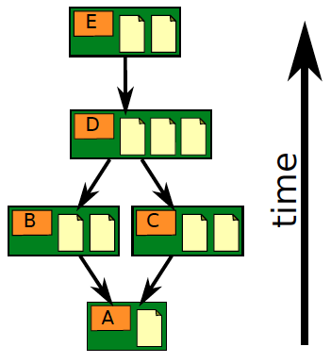
Git is a Version Control System
A VCS stores files in a repository.
Its keeps a history of all additions & changes, and prevents "old" versions from overwriting newer versions.
Adding new files or updating files is called a "commit".

Slide 3
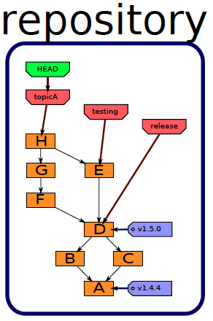
Git repository
Git repository is usually stored in a subdirectory named .git

Slide 4
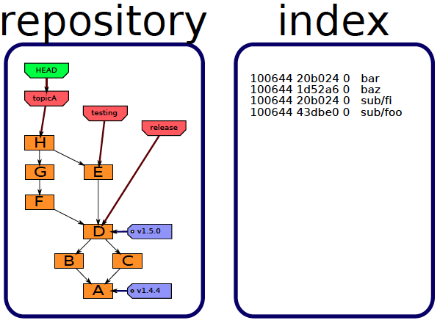
Staging area
"Staging area" or "index" is for files and other transactions waiting to be added/deleted/updated in the repository.

Slide 5
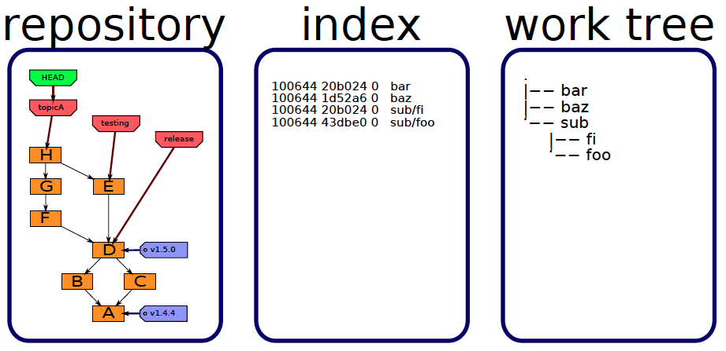
Working Copy
Your working copy contains both "tracked" files (files in repo) and "untracked" files (not included in repository).

Slide 6


Slide 7
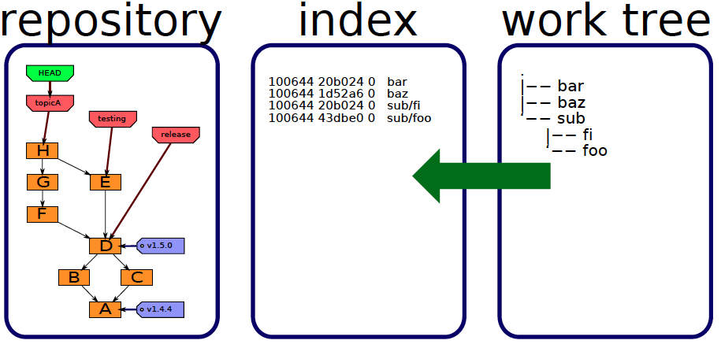
Staging: adding & updating files
add
There are 2 steps to storing files in the repository:
1) mark the files you want to add/update/move/delete
2) "commit" the changes

Slide 8
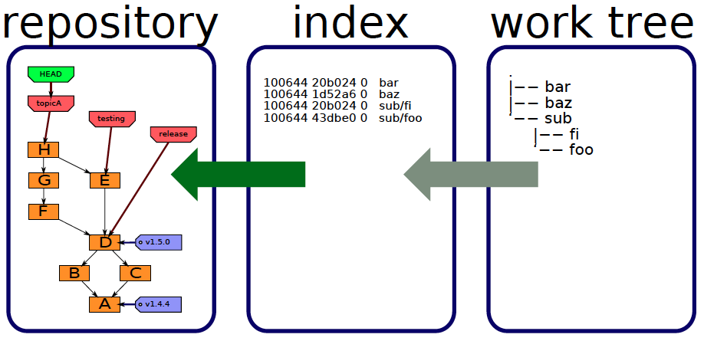
Commit: update work in the repo
commit
"commit" updates the repository using the index (staging area).
Each "commit" stores a snapshot of some work as a new node in the repository.

Slide 9
Checking out a version
git checkout [commit-id]
repository
working copy
Update your working copy to match current version, or specified commit.
Untracked files are not affected.
Tracked files are only "checked out" if working copy has been commited or stashed (it's "clean").

Slide 10
Checking out a file
git checkout -- filename
filename
repository
working copy
You can checkout an individual file or files.
Useful if you accidentally delete or screw-up a file.

Slide 11
What to Include in a Repo?
Files you should include are:
1. source code
2. configuration and data files (but not sensitive data)
3. documentation
4. (optional) project plans and project documents
  a wiki may be better for these
Notes:
framework for management. You can use it to manage lots of things, not just software development.

Slide 12
What NOT to save in repo
1. compiler output
2. anything you can recreate with a build tool.
- For executable "releases" use Github "releases"
3. virtual environments, such as Python virtualenv.
  can be recreated using a requirements.txt file
4. IDE or editor project files, such as .vscode/ or .idea/
5. temporary files and log files

Slide 13
Essential Git
Essential commands to know are:
git init create a new repository
git status check status of your working copy
git add add files to staging area
git commit commit staged work to repo
get checkout update working copy
git log view history of commits
git help cmd show help on any git command

Slide 14
Create a repo for existing code
Verify that git is installed and on your search PATH:
cmd> git --version
Change to your project directory
cmd> cd workspace/myproject
Create a new (empty) repository
cmd> git init

Slide 15
Adding Files
You need some files to add.
Create a file README.md containing description of your project. You can use Markdown mark-up.
cmd> edit README.md (any editor you like)
Add the file to "staging area"
cmd> git add README.md

Slide 16
Check Status & Commit
Always check status before commiting, to avoid mistakes.
cmd> git status
On branch master
Changes to be committed:
(use "git rm --cached <file>..." to unstage)
new file: README.md
Commit the files, -m "message" is a commit msg.
cmd> git commit -m "Initial code checkin"
[master (root-commit) 51a8d5a] initial code checkin
1 file changed, 5 insertions(+)
create mode 100644 README.md

Slide 17
View History
There are several command for this, depending on system:
cmd> git log --oneline
cmd> git log1
cmd> gitk (a graphical tool)
51a8d5a (HEAD -> master) initial code checkin

Slide 18
Normal Workflow
1. Do some work and save files
2. a) Add files to staging area
git add file1 file2 ...
b) or rename existing files
git mv oldname newname
c) or delete files previously added to repo
git rm unwanted_file
3. Check status: git status
4. Commit changes: git commit -m "helpful msg"

Slide 19
Commit a Unit of Work
Commit a group of files that represent a unit of work.
Avoid committing individual files.
OK to frequently commit files as protection against loss of work, then squash the commits later.
  squash is a git command to combine multiple commits

Slide 20
Write Descriptive Commit Msgs!
Good:
"add interface for money and update implementing classes"
"fix issue #3 in recursive withdraw"
Bad:
"finish"
"add interface"
"commit"

Slide 21
.gitignore
To avoid accidentally adding unwanted files a repository, add a file named .gitignore to the top directory of your repo. This is common practice.
.gitignore contains names or patterns for files and directories that git should ignore -- that is, never add to a repository (unless you force it to).
See next slide for example.
Github can create a .gitignore for you when you create a repository! This is a good way to see an example of what you might put in .gitignore.

Slide 22
Examples what not to save
# Example .gitignore for a Python project
__pycache__
*.py[cod] this means *.pyo or *.pyc or *.pyd
.coverage output of code coverage app
*.log
# Intellij files
.idea/
*.iml
# Eclipse, Pydev, and VSCode files
.settings
.project/
.vscode/
# Virtual env files (common directory names)
venv/
env/

Slide 23
References
Tutorial from the Git home
  https://git-scm.com/docs/gittutorial
Pro Git Book - free on git-scm.com
https://git-scm.com/book/en/v2
Git Intro (PDF) from U. of Washington
https://courses.cs.washington.edu/courses/cse391/18su/lectures/9/391Lecture09-Git-18su.pdf
Git Tutorial on freecodecamp
https://www.freecodecamp.org/news/what-is-git-and-how-to-use-it-c341b049ae61/

Slide 24
Command Line Essentials
Developers need to know how to use a terminal or "shell" window. Essential commands are:
move from one directory to another
list files in a directory
find your home directory
find files in the file system
rename, move, and delete files
edit a text file
how to use and modify the PATH

