Slide 1

Remotes & Github

Slide 2
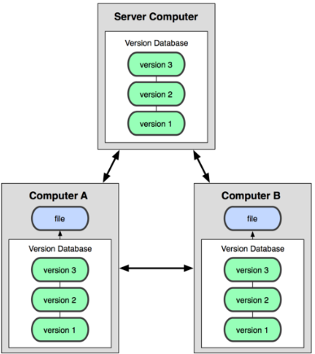
Working with a Remote Repo
Git is a distributed version control system.
git was invented to manage the Linux kernel source code, with thousands of developers in over a hundred countries.
You can have many repositories
on the net, called "remotes".
They may all be different!
No "master" repository
-- all repos are equal.

Slide 3
Git Hosting Sites
You can create free git repositories on these sites, for individual or team projects.
Github - https://github.com
Bitbucket - https://bitbucket.org
GitLab - https://gitlab.com

Slide 4
Commands for Remotes
Common commands for using a remote repo are:
git clone copy remote repo to your computer
git remote add define URL of a remote repository
git remote -v list remotes, with URLS
git push "push" local updates to a remote
git pull download and merge remote updates
git fetch download remote updates, but don't
merge into your working copy

Slide 5
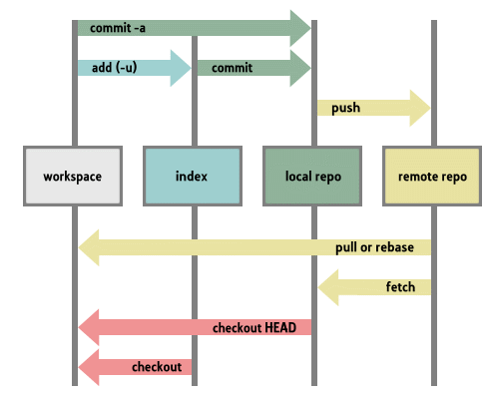

Slide 6
What Github Does
Online project hosting site.
"Remote" git repository with access control
Issue Tracking
Project Boards
Documentation and web pages (github.io)
Integrates with other services
  Travis CI for automatic testing

Slide 7


Github Profile
Example of SKE student profiles.
1. Real name
2. Photo
3. (Optional) Email
4. Description of you

Slide 8
How to Use Github

Slide 9
Creating and using a Repository
Case 1: Project code is on your local computer. You want to copy it to Github.
Case 2: Project already exists on Github.
You want to copy it to your computer.
Special Case:
Case 3: A new project (no files yet).

Slide 10
Case 1: Starting from Local Project
You already have a project on your computer
1. Create a local "git" repository.
cmd> git init
# These two files are typical
cmd> git add .gitignore README.md
# Add some source code
cmd> git add src/*.java (for example)
# Commit code to github
cmd> git commit -m "initial code checkin"

Slide 11
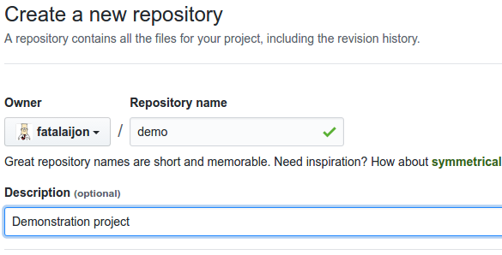
Case 1: Remote must be empty
2. Create an empty repository on Github.

Slide 12
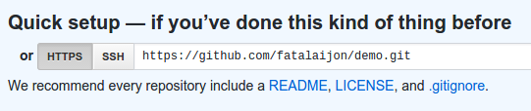

Case 1: add Github as remote
3. Copy the URL of new Github repository (https or ssh).
4. In your local project, add Github as a remote repository named "origin":
cmd> git remote add origin
https://github.com/fatalaijon/demo.git
5. Push (copy) the local repository to Github
cmd> git push -u origin master
You only need "-u origin master" the first time you push to Github. Next time, just type "git push".

Slide 13

Case 2: Starting from Github
A project already exists on Github.
You want to "clone" it your local computer.
1. Get the Github project URL
https://github.com/user/demo.git
or: go to project on Github and click on
and copy the URL.
2. In your workspace directory, type:
cmd> git clone https://github.com/user/demo
NOTE: "git clone" creates a new directory named "demo" inside your current directory. If this directory already exists, clone won't work.

Slide 14
Case 2: ready to use
That's it!
Github is automatically the remote named "origin".
Just "git push" your commited work to github.

Slide 15
You can use a different project name
The name of your local directory (cloned from Github) can be different from the Github repository name.
1) Specify local directory name when you "clone":
# Clone "demo" into local directory "mydemo"
cmd> git clone https://github.com/fatalai jon/demo.git mydemo
Syntax: git clone remote_url local_repo_name
-- or --
2) or rename the directory yourself!
use the command line or any file manager

Slide 16
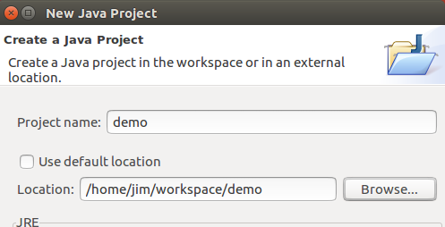
Eclipse create project with existing source
After cloning code from a remote, create an IDE project from "existing source code".
1. uncheck "use default location"
2. locate the project folder & select it
Simpler: Most IDE have a menu function to create a project from a remote git repository. They clone it and create project all in one.

Slide 17
Comparison of 2 Cases
(done in class)

Slide 18

Workflow for an individual project
START
Push to
remote
Check status
git commit
Work on code
Stage files
(git add)
Test & review
Check status:
what changed?

Slide 19
Git Workflow for an Individual project
1) Check status of your working copy (*)
cmd> git status
It should be clean. If not, do "git diff" and then...
2) Commit changes or update your working copy.
(git diff, git add -u, git commit)
3) Do some work:
Code, test. Code, test. Review.
(*) if you work on more than one computer, you need to "fetch" or "pull" any work from Github that is not on this computer (i.e. this local repo).

Slide 20
Git Workflow (cont'd)
4) After code-test-reivew: check status again
cmd> git status
Changes not staged for commit:
modified: src/Problem2.java
Untracked files:
src/Problem3.java
5) Add and commit your work to the local repository
cmd> git add src/Problem2.java src/Problem3.java
cmd> git commit -m "Solved problems 2 and 3"
[master 29abae0] Solved problem 2 and 3
2 files changed, 44 insertions(+), 5 deletions

Slide 21
Git Workflow (update remote)
6) Push the changes to Github
cmd> git push
Compressing objects: 100% (12/12), done.
Writing objects: 100% (12/12), 3.60 KiB, done.
Total 12 (delta 9), reused 0 (delta 0)
remote: Resolving deltas: 100% (9/9), ...
To https://github.com/fatailaijon/demo.git
468abdf..29abae0 master -> master
7) Take a break.
That's it! Repeat the cycle as you work.

Slide 22
Github Workflow for Team Projects
On a team project, other people will commit files to the same Github repository!
You should update your local repository from Github before trying to "push" your work to Github.
Use "Github Flow" as workflow in team projects.
"Github Flow" is a separate topic. Its good for both team and solo projects.
Github Flow is the convention for team work in this course.

