Slide 1
Authentication and Authorization
Basic Introduction for Web Apps
Authorization in Django

Slide 2
Authenticate & Authorize
Authentication - validate the identity of a "user", agent, or process
Authorization - specifying rights to access a resource
Authentication is responsible for identifying who the user is.
Authorization is responsible for deciding what the user has permission to do.

Slide 3
Other Aspects of Security
Access Control - controls access to resources
Data Integrity - prevent data from being modified or corrupted, and prove that data hasn't been modified
Confidentiality & Privacy - privacy is about people, confidentiality is about data
Non-repudiation - prove that user has made a request
  "repudiate" means to deny having done something
Auditing - make a tamper-resistant record of security related events

Slide 4
Authentication Methods
Authentication methods for humans:
1. Username & password
2. Username & one-time password (TOTP, codes, SMS)
3. Biometrics - fingerprint, facial recognition, iris scan
4. Trusted 3rd party - OAuth and OpenId
"Login with Google" or "Login with Facebook"
5. Public-private keys
6. SQRL - a new method by Steve Gibson

Slide 5
Certifcate-based Authentication
Public-private key pairs: RSA (uses large prime numbers), Elliptic Curves (Ecliptic Curve Cryptography)
Private key:
p(m)
Public key:
P(m)
p(m) and P(m) are inverse:
P( p(m) ) --> m
p( P(m) ) --> m
PKI = public key infrastructure

Slide 6
Public-Private Auth Example
1. You connect to a server and give your username.
2. Server looks up your public key (P) and chooses a random message: m1 (also called a "challenge")
3. Server encrypts m1 with your public key:
challenge = P(m1)
4. Senver sends challenge to you and says:
"if this is really who you claim to be, then decrypt this challenge and send it back.":
5. You decrypt the challenge: m2 = p(challenge)
5. You encrypt and return a response: p(m2 + 1)
6. Server checks response: P(response) == m1 + 1 ??

Slide 7
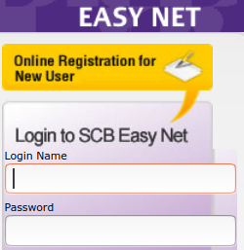
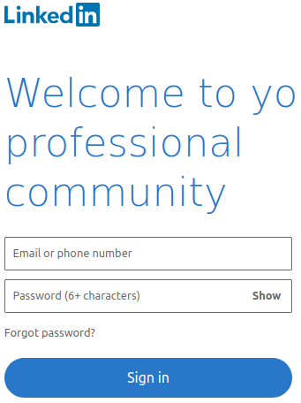
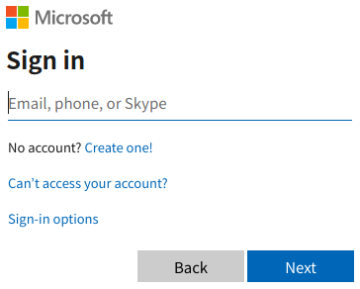
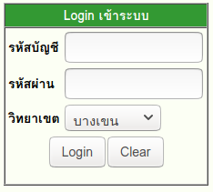
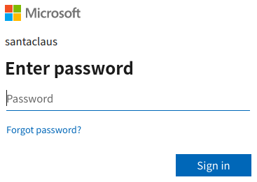
Username & Password
The oldest and one of the worst authentication methods.
Two page design
KU

Slide 8
Username & Password
Why passwords are not very secure:
passwords can be stolen
passwords can be guessed or "brute forced"
vulnerable to man-in-the-middle & replay attack
people reuse passwords or use weak passwords

Slide 9
Key Observation about Passwords
password is not using the computational ability of the user's device. It's just a fixed string.
with just a little computation ability we can devise much more secure authentication protocols
  Time-based OTP (Authenticator apps)
  Challenge-response
  FIDO
  Web Auth aka Passkeys - a new standard from Google, Apple, and others
  SQRL - a better Passkeys, but not widely used

Slide 10
Exercise: Have You Been Pwned?
Has your email address (and data) been stolen?
https://haveibeenpwned.com/
Has your password been seen in a data breach?
https://haveibeenpwned.com/Passwords

Slide 11

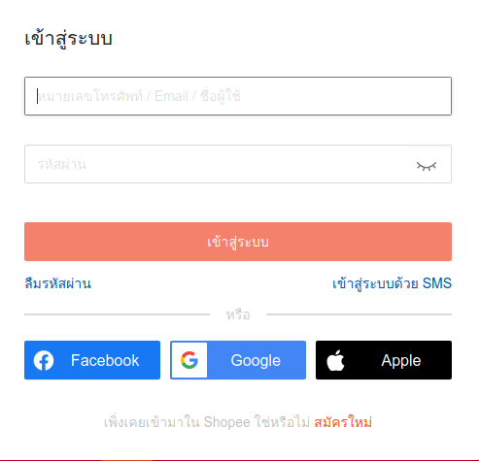
OAuth & OpenID
Use a 3rd party to validate the user's identity
OAuth providers

Slide 12
OAuth 2.0
OAuth is really about granting access to resources.
But, as a side effect, you confirm your identity.
- tells Shopee who you are (grant access to your name & email),
and proves that you have authenticated yourself to Google.
Google.com
"shopee.co.th wants access to your name and email"
Agree
Cancel

Slide 13
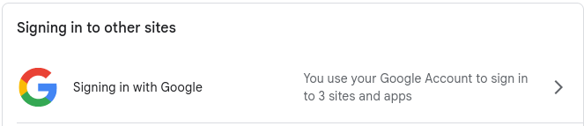
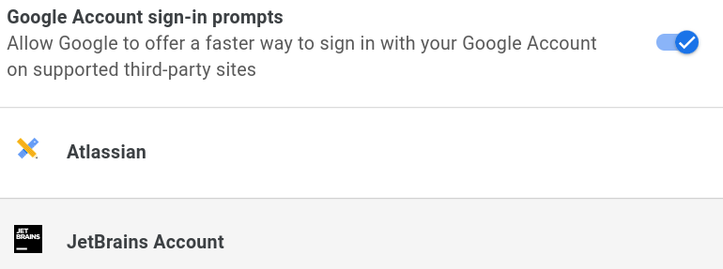
Who has Access to your Google Account?
1. Login to Google.
2. Visit https://accounts.google.com
Chrome: Click your Photo -->
"Manage Your Google Account"
3. Choose Security. Scroll down to...
List of sites with access.

Slide 14
Who has Access to your Google Account?
Does anyone have more than 10 sites with access to your Google account info?
Any sites that you don't use anymore?
Delete them!

Slide 15
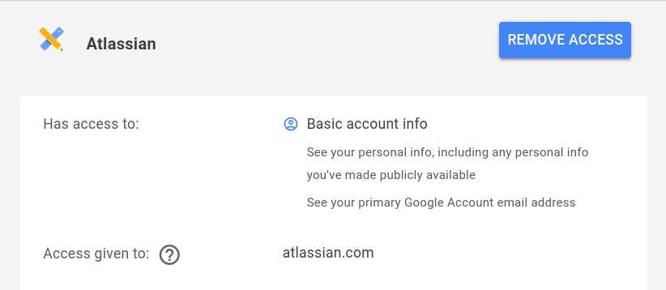
What Privileges (access) do they have?
This is called the "scope".
When a site requests OAuth access to your account, it specifies what privileges (scope) it wants.
Click on a site name to view details:

Slide 16
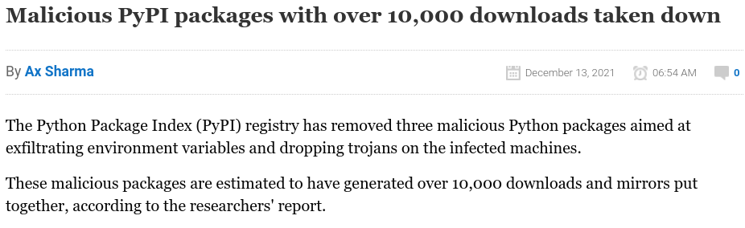
Be Security Conscious
Supply Chain Attack: hackers target developer accounts.
If successful, they plant back doors or malicious code in the developer's source code.
https://www.bleepingcomputer.com/news/security/malicious-pypi-packages-with-over-10-000-downloads-taken-down/

Slide 17
What You Should Do
Google Account
1. Review everything in the "Security" page on Google.
2. Use 2-Factor Authentication.
Github Account
1. Review everything in "Settings".
2. OAuth grants: Applications -> Authorized OAuth Apps
3. Consider using SSH and GPG keys
4. Use 2-Factor Authentication.

Slide 18
OAuth Use Cases or "Flows"
Server-side web app: The web app gets a "secret" that it uses when requesting access to a user's resources.
Browser-based app: Javascript code running in web browser. Cannot keep a secret, so the flow is different.
Mobile app: uses the mobile browser or native app as intermediary to grant OAuth access. Cannot keep a secret.
When you apply for your app to use OAuth on Google, etc, it is important to choose the correct "flow" or "grant type".

Slide 20
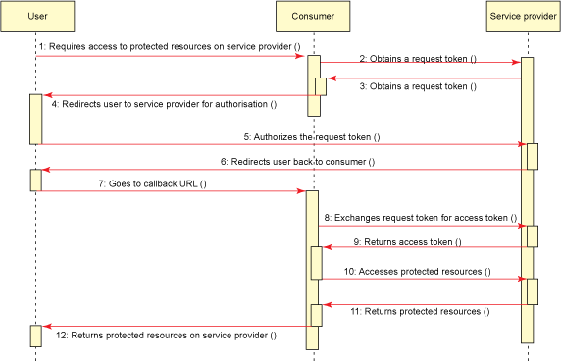
OAuth Flow for Server-Side Web Apps
Web App
This is the OAuth 1.0 flow, some names and parameters are different in OAuth 2.0

Slide 21
Step 0: Register your app
Go to the OAuth provider and request OAuth access.
"Register an application" using "Authorization Code" flow
give the server:
app. name and URL,
a callback URL,
requested scopes
server gives you:
- client_id
- client_secret
- authorization URL - where you send the user's browser

Slide 22
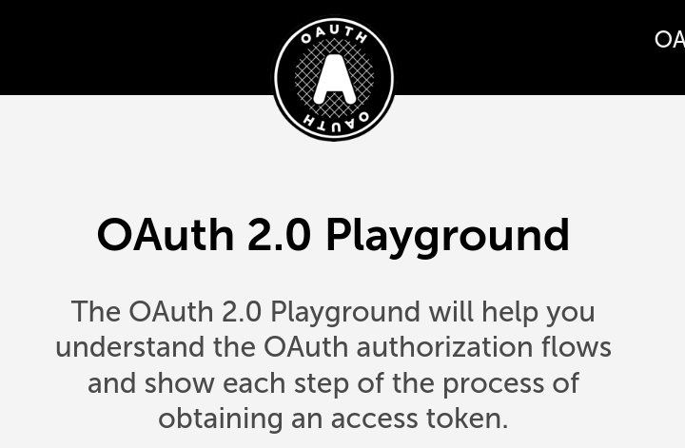
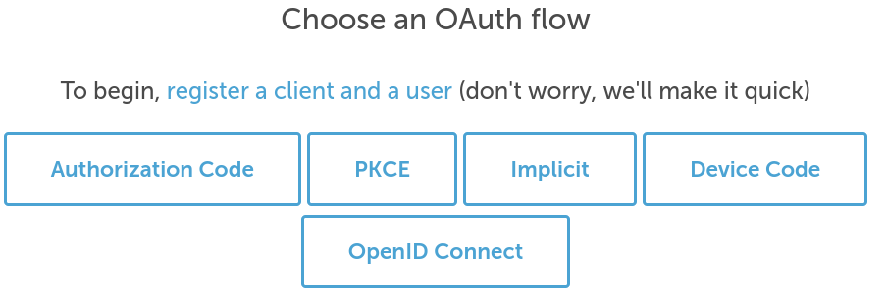
Exercise: OAuth 2.0 Playground
https://www.oauth.com/playground/
Choose "Authorization Code" Flow

Slide 23
Exercise: OAuth 2.0 Playground
Choose "Authorization Code" flow.
Work through the exercise.
Note: you need to remember (or write down) the username and password the site gives you during "Client Registration".

Slide 24
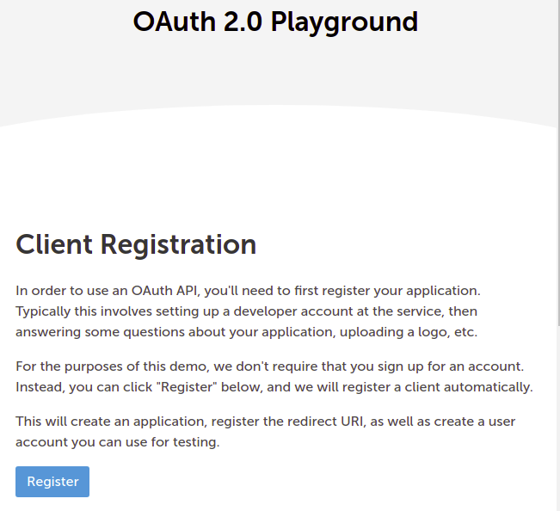

Slide 25
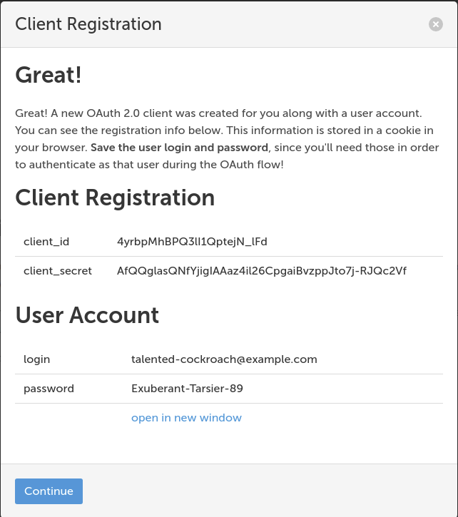

Slide 26
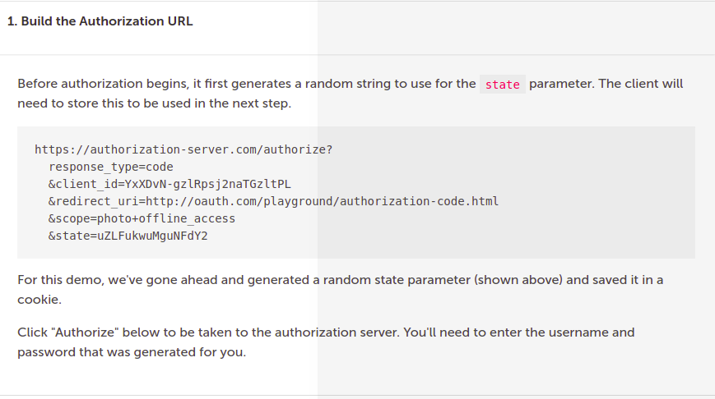

Slide 27
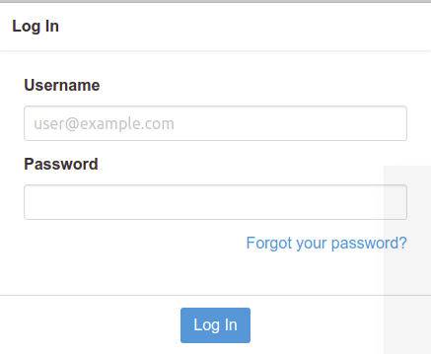
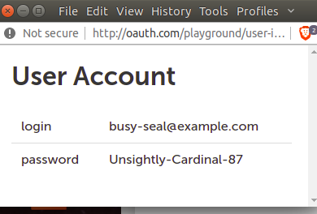

Slide 28
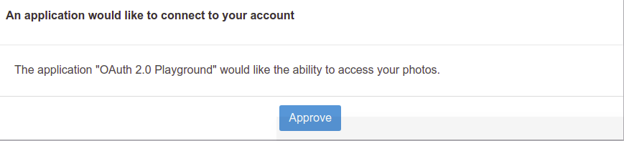

Slide 29
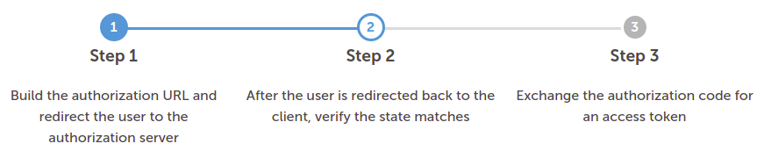
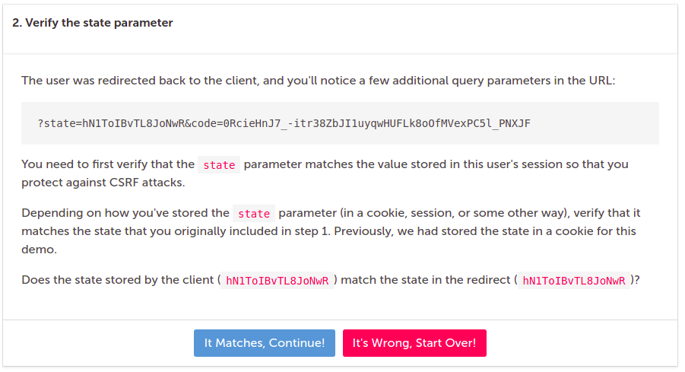

Slide 30
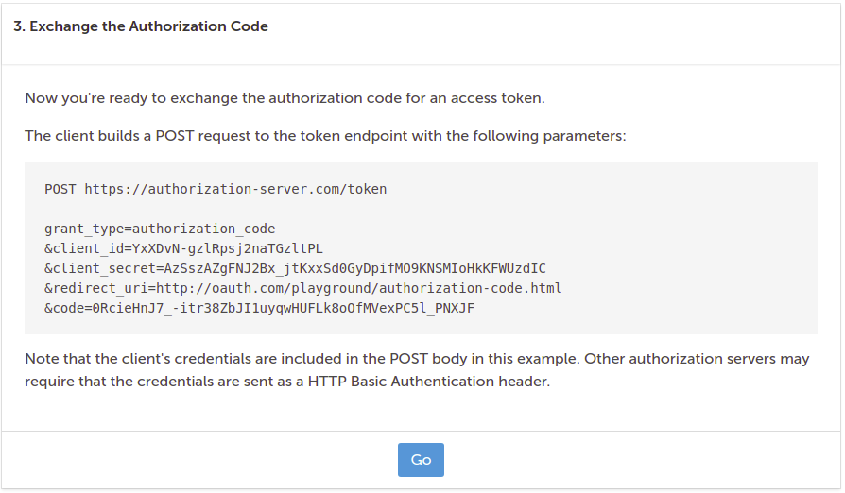

Slide 31
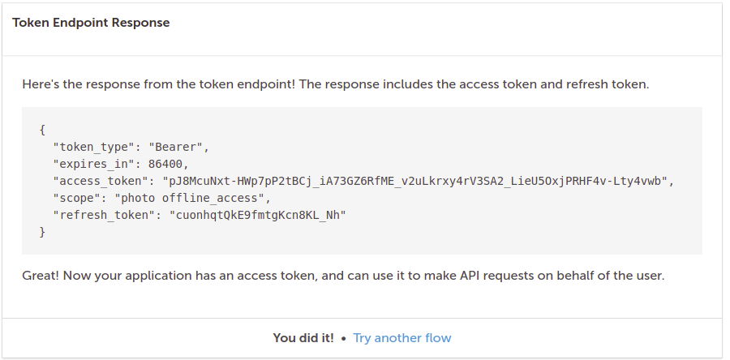

Slide 32
What's Next?
OK, you can an authorization code or authorization token.
How do you use it?

Slide 33
Authorization
Specify what rights or access a user has.
Access rules apply to:
resources - read a file? modify a file?
functionality - create a new poll question?

Slide 34
Role Based Authorization
Permissions are based on the roles a user possesses.
A user may have many roles.
Example: “joe” has roles “voter” and “administrator”
Subject
(user)
Principal
Role
identifies
has
1..*
*
Permissions

Slide 35
How Django Does It
User - identifies a user, authenticate using one of many backends.
Group - User is assigned one or more groups. Each group has some Permissions.
Permission - key-value pair (anything you like) used in code to enforce authorization
User
username
password
email
first_name
last_name
Group
name
Permission
name
description
member of
has
1..*
*

Slide 36
Checking Authorization in Code
from django.contrib.auth
import authenticate, login
def dumb_login_view(request):
# authenticate first
user = authenticate(request, "hacker", "Hack!")
login(request, user)
if user.is_authenticated:
# allow any logged in user to do something
if user.has_perm('blog.can_create'):
# allow user to create a blog entry

Slide 37
Checking Auth in Views
The request object has reference to current user.
def blog_index(request):
if not request.user.is_authenticated:
return redirect('login')
if request.user.has_perm(
'blog.can_post_comment')
# include form for posting comments

Slide 38
Use Decorators on Views
Decorators reduce risk of errors, create cleaner code
from django.contrib.auth.decorators
import login_required, permission_required
@login_required
def blog_index(request):
"""show index of todos for this user"""
@permission_required('blog.can_create')
def add(request):
"""post a new blog entry"""

Slide 39
Decorators in urls.py
You can add decorators in urls.py. I think using
decorators in views is more readable & avoids errors.
urlpatterns = [
path('blog/', login_required(views.index)),
...

Slide 40
Define Your Own Decorators
If none of Django's decorators do what you want...
https://docs.djangoproject.com/en/3.0/topics/auth/default/
def kasetsart_email(user) -> bool:
return user.email.endswith('@ku.ac.th')
@user_passes_test( kasetsart_email )
def vote(request, question_id):
# only users at KU can vote

Slide 41
Mixins for Class-based Views
"Mixin" means to combine or "mix in" behavior from several different classes.
from django.contrib.auth.mixins
import LoginRequiredMixin
class PollsIndex(LoginRequiredMixin, ListView):
template_name = 'polls/index.html'
...

Slide 42
Authorization Checks in Templates
Templates can use the user and perms objects.
{% if user.is_authenticated %}
Hello, {{ user.username }}
{% else %}
Please <a href="{% url 'login'%}">Login</a>
{% endif %}
{# same as user.has_perm('blog.post_entry') #}
{% if perms.blog.post_entry %}
You can post a blog entry
{% endif %}

Slide 43
Where to Apply Authorization?
1. In templates. Gives web page the desired appearance and page flow, but can be by-passed. Don't rely on it.
2. In views. Requests are always passed to a view, so this is fairly secure. Prefer decorators or Mixins instead of checks in code.
3. In models? In some frameworks, you can configure required permissions directly into model classes. Apparently not in Django.
4. In url mapping (urls.py).

Slide 44
Learn OAuth
https://www.oauth.com
Google OAuth Playground
https://developers.google.com/oauthplayground/

Slide 45
Resources
Mozilla Django Tutorial on MDN
https://developer.mozilla.org/en-US/docs/Learn/Server-side/Django/Authentication
"Authentication System" in Django Docs
https://docs.djangoproject.com/en/3.0/topics/auth/
https://docs.djangoproject.com/en/3.0/topics/auth/default/

