Slide 1
Team Software Project
Getting started
Let's Not Do Waterfall Projects

Slide 2
How to Get Started?

Slide 3
You Already Created a Plan
Your project proposal isn't a complete plan, but it contains:
- development approach (iterative)
- initial time line with goals & deliverables
- technical approach

Slide 4
Milestone
For lack of a better definition, mine is:
Milestone:
an indicator that shows tangible progress toward completing a project, along with objectively verifiable criteria that show the milestone has been achieved (or not).
A milestone generally relates to achieving some goal or major work on the project. The criteria are how to evaluate that the goal or work has been satisfactorily done.

Slide 5
Not Objectively Verifiable Criteria
These are obviously bad, but I have see them repeatedly:
[ ] Study Django [done or not? what's the result?]
[ ] Write Use Cases [when are they done?]
[ ] Team meeting [so what? how did it help project?]
[ ] Task Board [this isn't a work product or activity]

Slide 6
Binary Milestones
A milestone is either 100% done or not done.
There are no "90% done" milestones.
-- Steve McConnell, Software Project Survival Guide

Slide 7
Milestones According to Agile
"Working software is the primary measure of progress."
They are not fans of documentation as milestones.

Slide 8
Create Your Own Milestones
Create milestones that are specific to the way your project is actually performed.
Not a copy of examples.
Each milestone should have objectively verifiable ("done" or "not done") criteria.
In KU Polls Iteration 2, some students just copied my description as their iteration plan (it's not).
That is C- level work.

Slide 9
Project Initiation Milestone
[ ] Vision statement reviewed, approved, and published
[ ] Business case for project reviewed, approved, and published
[ ] Initial timeline with iteration goals & features reviewed and published
[ ] Technical approach agreed on and published
[ ] Initial set of mock-ups of UI and screen-flow reviewed and published
[ ] Project home page on VCS and wiki created.
[ ] ... what is significant work your team needs to do?
published = published on wiki or Google Drive, with link on project home. approved = team and TA/instructor all agree

Slide 10
What Will You Do in Iteration 1?
Group exercise
  each team brainstorm and show result
  can use Google Doc or project wiki
  share screen with class
10 minutes to create a google doc or Markdown with everything you want to do in Iteration 1.

Slide 11
Your Results

Slide 12
Ideas for Iteration 1
Detailed mock-up with screen flow.
For each usage scenario do this:
  one screen on one sheet of paper
  one person "clicks" or enters on paper screen
  another person decides what to do next
  third person draws next screen
  repeat until user goal is achieved
  record the screen flow + processing in a file

Slide 13
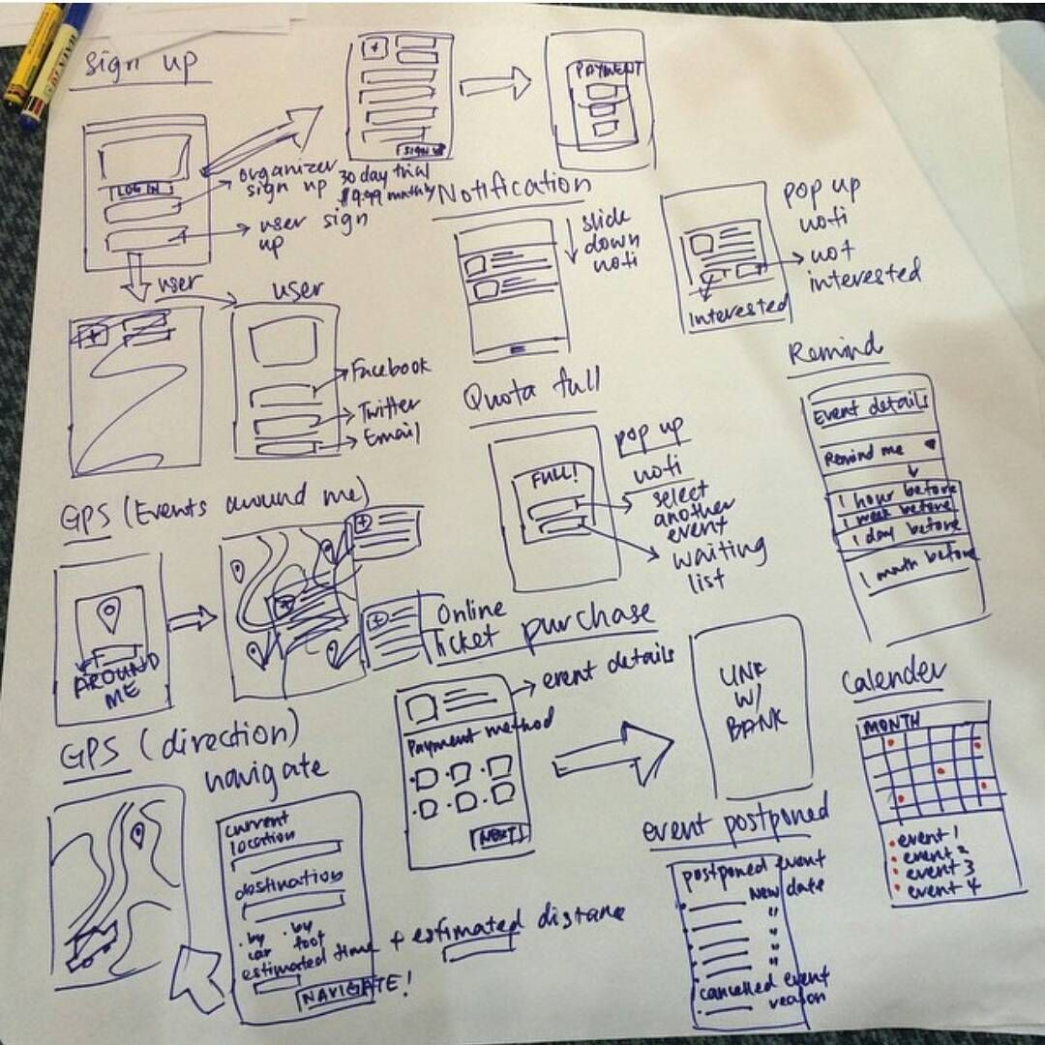

Slide 14
Some Ideas for Iteration 1
Domain Model
Create a "Domain Class Diagram" showing...
  important classes in the domain
  what they know (attributes)
  major responsibilities
Another tool for this is "CRC cards".

Slide 15
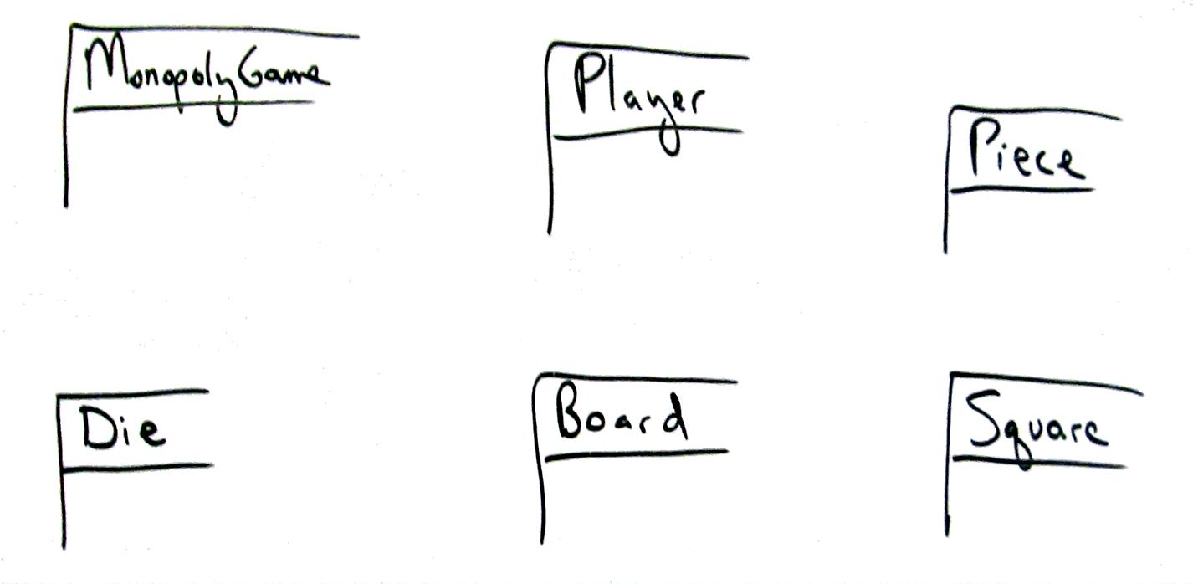
Model: Identify classes

Slide 16
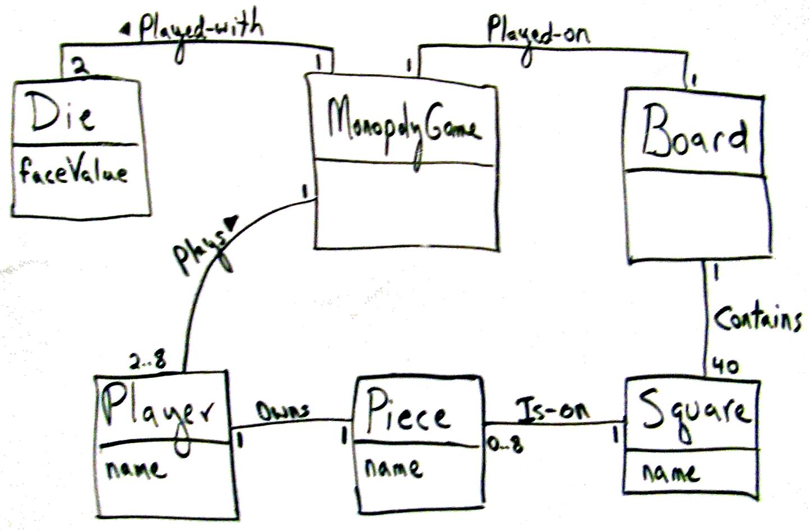
Identify relations and key attributes

Slide 17
Concentrate on dynamic aspects
Beginners spend too much time on static structure,
not enough time on dynamic (behavior)
-- Craig Larman
You should draw sequence diagrams, too.

Slide 18
Let's Not Do Waterfall Projects
- Project presentation during last week.
- Project code & docs submitted during final.
- Instructor finds problems after semester ends.
Missed opportunity to learn.
Let's not do this.

Slide 19
Iteration Review & Demo
After each iteration:
  review progress and plan with TA or instructor.
  what did you do?
  any changes to the product or project plan?
Every iteration after the 1st one:
  Demo running software
  Software should do more than previous demo

Slide 20
Iteration Review & Demo
Who and where?
  Each iteration a different person must present
  Can be in-person on online

Slide 21
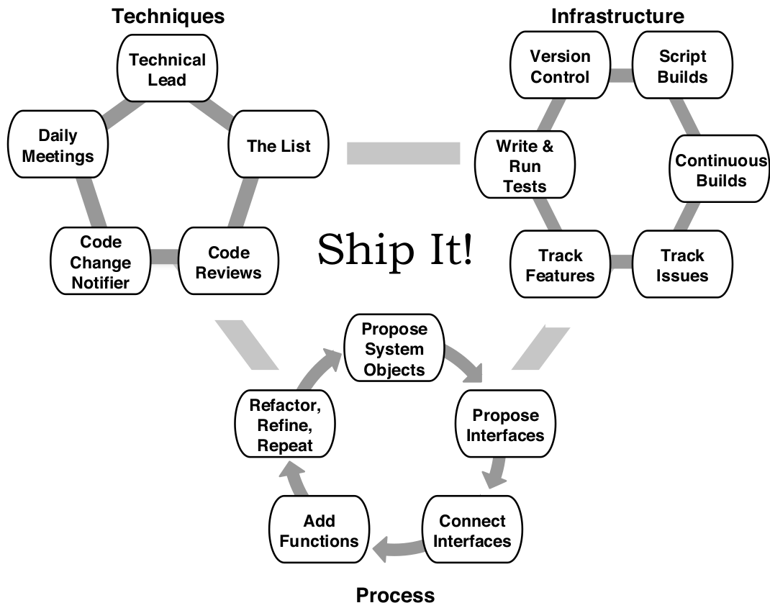
Key Project Elements from Ship It!

