Slide 1
Web Servers and Web Apps

Slide 2
What a Web Server Does
Receives web requests & sends replies
Can serve static content (web page in a file, images, etc),
Can create dynamic content using applications written in PHP, Python, Java, other; typically using a back-end processor for a specific language
Handles security certificates and secure sessions
May perform authentication, but many web apps and web frameworks do this themselves.

Slide 3
Static vs Dynamic Content
https://yoursite/index.html static file
https://yoursite/media/logo.png static file
https://yoursite/media/xmas.mp3 static file
https://yoursite/media/intro.webm static file
https://yoursite/index.php dynamic page from PHP
https://amazon.com/books/ dynamic page of
best selling books
https://yoursite/polls/ list of polls generated
by Django (Python)

Slide 4
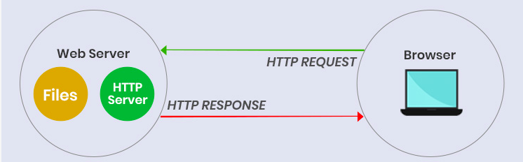
Web Server for Static Content
Return content from files, based on the request URL.
Very little processing needed.
May perform authentication & authorization.
May process aliases, perform redirects, URL rewriting.
May perform cookie handling & session management.
Most Popular Servers: Apache Httpd & Nginx

Slide 5
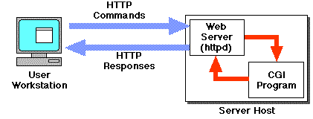
Common Gateway Interface
The original standard for invoking scripts or apps from a web server was CGI.
Each CGI request was run as a separate process, and it was the CGI app's responsibility to manage sessions, parse requests, etc. Very low performance.
CGI scripts (apps) often written in Perl, C, or Bash script.

Slide 6
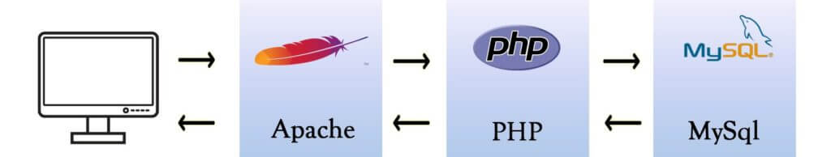
Web Server for Application
To create dynamic content, a web application uses "scripts" or applications in a programming language.
The web server forwards the HTTP request to the application running in a separate thread or process.
The app returns a response (or an i/o stream) that the server returns to the web client.
Web Client: GET /store/products.php
PHP code run in mod_php module

Slide 7
Django App in Development Mode
Django includes a built-in HTTP server, written in Python.
The server parses requests and passes them to the Django application.
This is low performance and not for production use.
Django Framework
Web
Client
HTTP Server
Your Django App
Running in Python (of course)

Slide 8
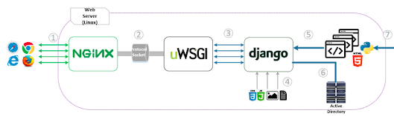
Django App in Production
(1) Web server receives http requests. It handles requests for static content itself.
(2) Web server forwards http request to a WSGI container.
WSGI is a standard interface to Python web apps,
uWSGI is a web app container that supports WSGI.
(3) Django receives the request via wsgi, processes it, and returns an HTTP response

Slide 9
Web App Containers
A Web App Container executes or "serves" web applications and provides services to the app.
Python web app containers use the WSGI interface:
  Gunicorn
  uWSGI
Java is a popular language for web apps because there are so many excellent Web App Servers & Containers for the Java web app standard (JEE), and the spec defines useful services for web apps.

Slide 10
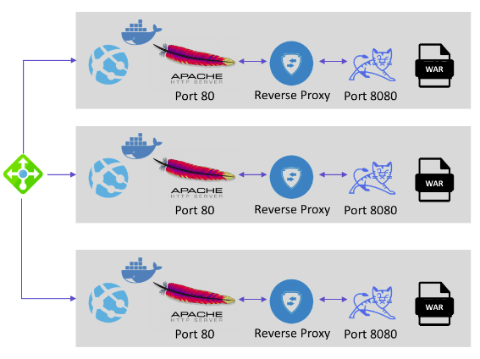
Containers and VMs
For reliability and scalability, many web apps are run in Docker "containers" or on virtual machines (VMs).
Web app in a Docker container.
The app and its dependencies are bundled in an "image" run in a Dockor container.
New instances can be started quickly to handle high loads.
Deploy in a Virtual Machine.
Even stronger isolation.
isolated web apps
Http request

Slide 11
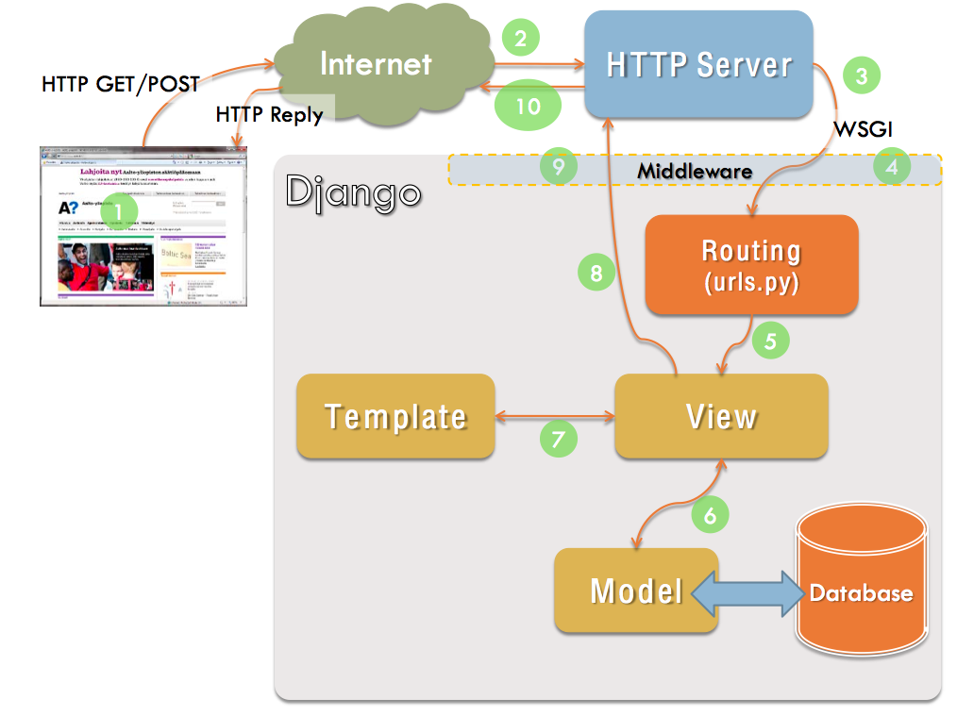
Django Request Processing
Source: https://devopedia.org/django

Slide 12
The Most Popular Web Servers?
nginx
Apache httpd
OpenResty
Cloudflare
Monthly surveys:
Netcraft Server Survey https://news.netcraft.com
https://www.datanyze.com/market-share/web-and-application-servers/

Slide 13

What Software Does SCB Use?
1. Go to SCB EasyNet at: www.scbeasy.com
2. Choose English or Thai.
3. Look at the URL on the logon page.
https://www.scbeasy.com/v1.4/site/presignon/index.asp
What web framework does SCB use?
Experts say that you should not expose implementation in URLs. A better URL would be:
https://www.scbeasy.com/login

Slide 14
Extra Material
You can skip the following slides.
Content Delivery Networks and Caching are services to improve performance on the world wide web.

Slide 15
Content Delivery Networks
Akamai, Digital Island, etc.
A network of servers that replicates content (such as images and video) at many different sites around the world.
When a web browser requests content (image, video), the CDN delivers it from the closest site!
It does this by cleverly directing your web browser to a CDN host that is closest to your location.

Slide 16
CDN Example
You visit www.cnn.com & the web page contains images. Each image has a URL like this:
<img src="https://cdn.cnn.com/assets/images/sports.gif">
"cdn.cnn.com" refers to a CDN provider like Akamai.
Your web browser sends a DNS request to get the IP address of "cdn.cnn.com".
(It does this the first time only, then remembers the IP address for a while.)
"cdn.cnn.com" has many IP addresses -- their DNS server returns the IP address of the server closest to your location.
Your browser gets the images from the CDN server closest to you. All the CDN servers have identical copies of all the content.

Slide 17
Web Caching
Caching is critical to performance of the web
Multiple levels of caching:
  client (web browser caches content)
  server (manually configured cache)
  gateway (uses a transparent Cache Engine)
  network (CDN, cooperating caches)
Cache Engines
Harvest (free)
Squid (free)
Cisco Cache Engine (based on Harvest)

Slide 18
Why Web Caching?
Decrease use of network bandwidth
Faster response time
Decrease server load
Security and web access controls (auth, blocking)

