Slide 1
OAuth Practice
OAuth Playgrounds

Slide 2
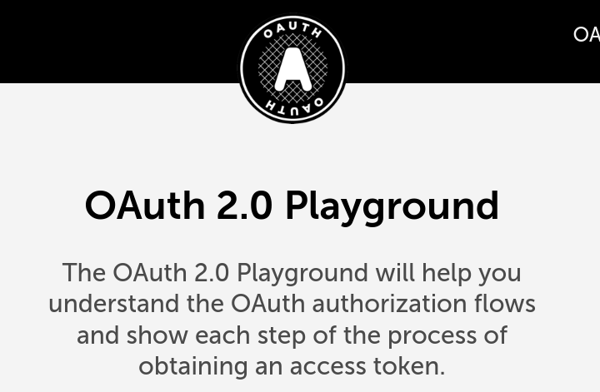
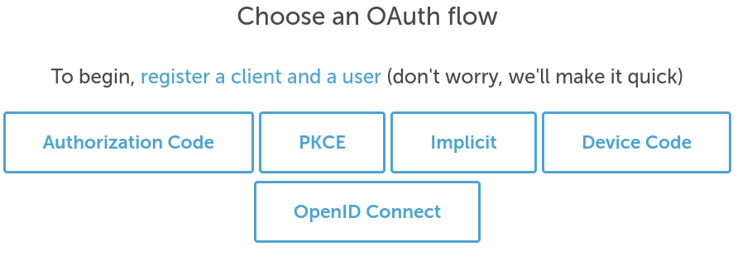
Exercise: OAuth 2.0 Playground
https://www.oauth.com/playground/
Choose "Authorization Code" Flow

Slide 3
Exercise: OAuth 2.0 Playground
Choose "Authorization Code" flow.
Work through the exercise.
Note:
you need to save the User login and password the site gives. Click "open in new window" to preserve it.
Next Slide for Important Terms

Slide 4
OAuth Terms
Client - application that wants access to a "user's" resource(s).
Authorization Server - host or app on Resource Server that handle authentication. This is where you register a Client application.
User - any end user of the Client application.
Redirect URL - when you register a client, you must tell the Authorization Server where to "redirect" users after they grant (or deny) access to their resources.
Authorization code - a random value assigned by the Authorization Server. The Client can use this code only once to get an "Access Token"

Slide 5
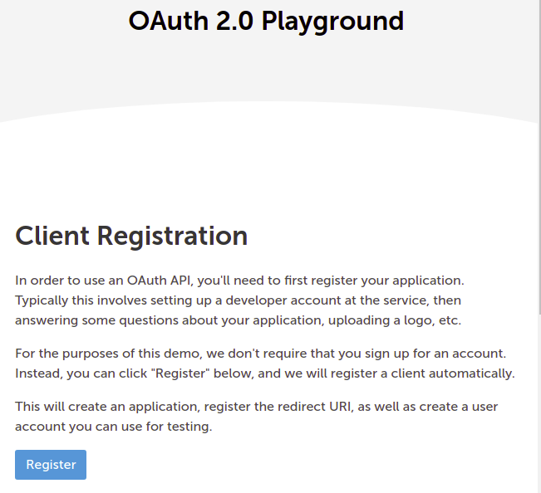

Slide 6
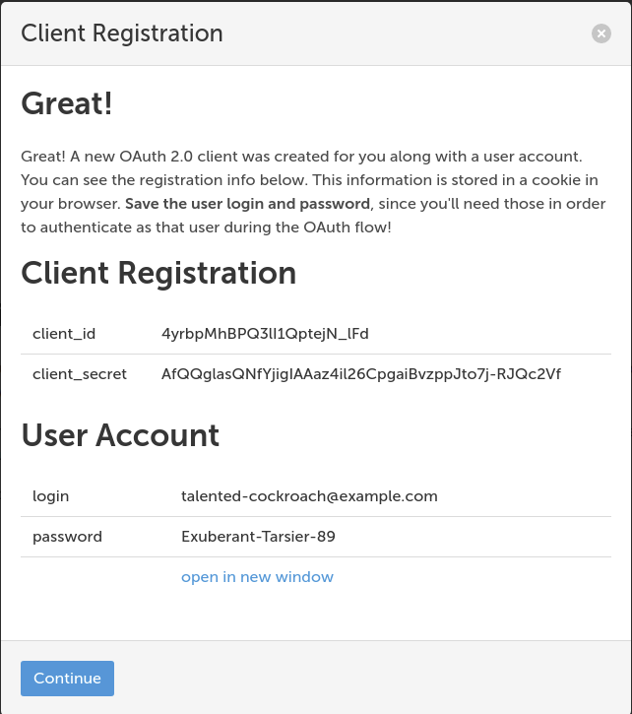

Slide 7
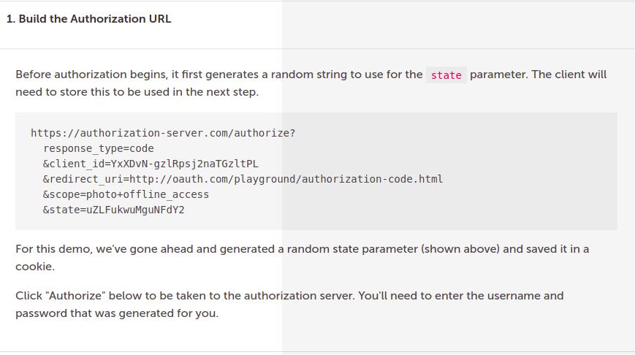

Slide 8
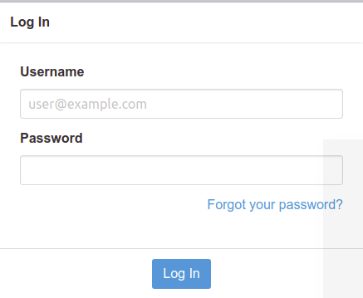
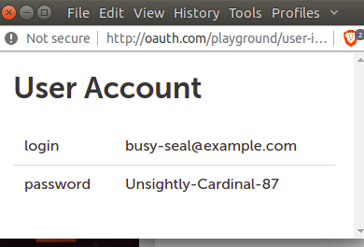

Slide 9
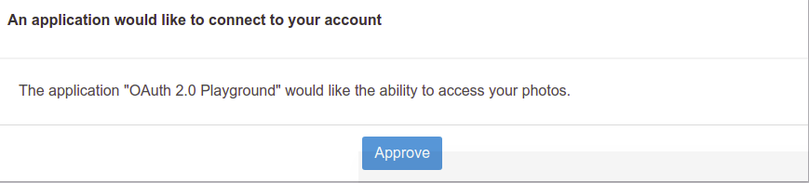

Slide 10
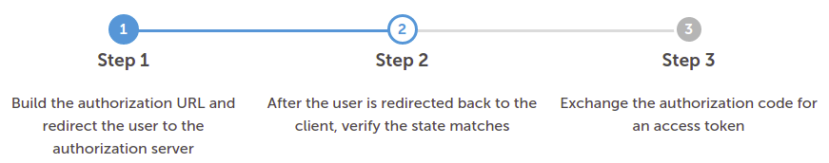
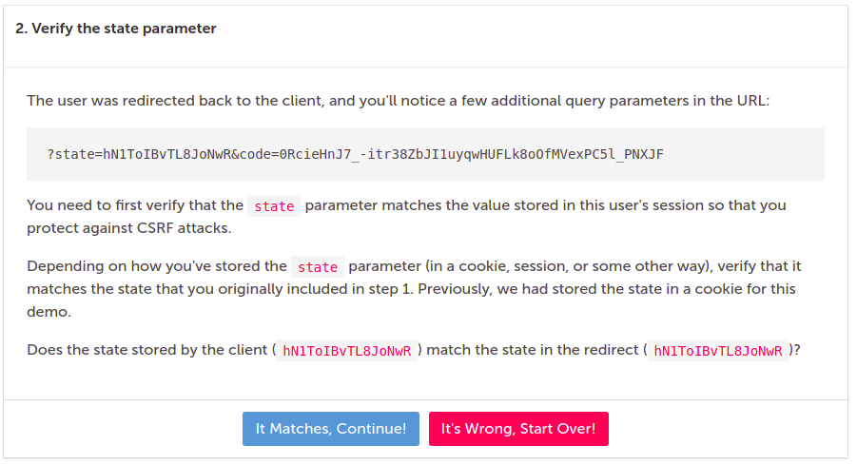

Slide 11
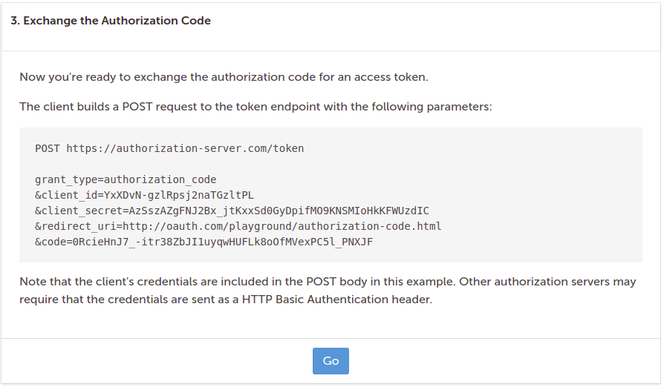

Slide 12
