Slide 1
Intro to Software Processes
and the Software Development Life Cycle

Slide 2
Goal of Software Development
Need (or Idea)
Product
Produce a software product that fulfills a need or realizes an idea.

Slide 3
What are the Steps?
Need (or Idea)
_?_
_?_
_?_
Product
What are the major steps or activities you would need to do?
List major activities that would apply to almost any software project.

Slide 4
Activities in Software Development
Not necessarily in the order they are performed.
1.
2.
3.
4.

Slide 5
Activities
Creating software involves
elicit requirements
analysis & specification
design
construction & testing
validation
documentation
maintenance
enhancement
Managing the project involves
planning
obtaining resources
tracking progress
resolving problems
analyzing results
closing the project

Slide 6
Process
Process -
a [systematic] series of actions to achieve a particular result
Software process - a method for producing software

Slide 7
Software Process according to experts
A software process is a sequence of activities that leads to production of a software product.
-- Ian Summerville, Software Engineering, 9 Ed.
...a collection of activities, actions, and tasks that are performed to create [software].
-- Roger Pressman, Software Engineering: A Practitioner's Approach, 7 Ed.

Slide 8
Do You Have a Software Process?
What is your software process?
(discussion)
What did you do to create:
Programming 2 project?
Exceed Camp project?

Slide 9
Do You Have a Software Process?
Yes!
Everyone who creates software uses a process.

Slide 10
Do You Have a Software Process?
"I never thought about it"
,,, the process is implicit or informal
"It's different for each project"
... ad hoc process

Slide 11
Why Define a Software Process?
Why not just do it? (like Nike)

Slide 12
Realities of Software
Software projects are plagued by defects, over-budget, schedule overrun, and complete failure.
Why?
1. Change can occur almost any time in a project.
2. Software is complex.
3. Software must evolve over time (more change)
4. Communication problems
- between developers and customer
- within development team
- implicit assumptions are often not true

Slide 13
Common Project Outcomes (failures)
1. Project is late and over-budget.
2. Software does not do what customer wants.
3. Excessive defects.
4. Project is canceled.

Slide 14
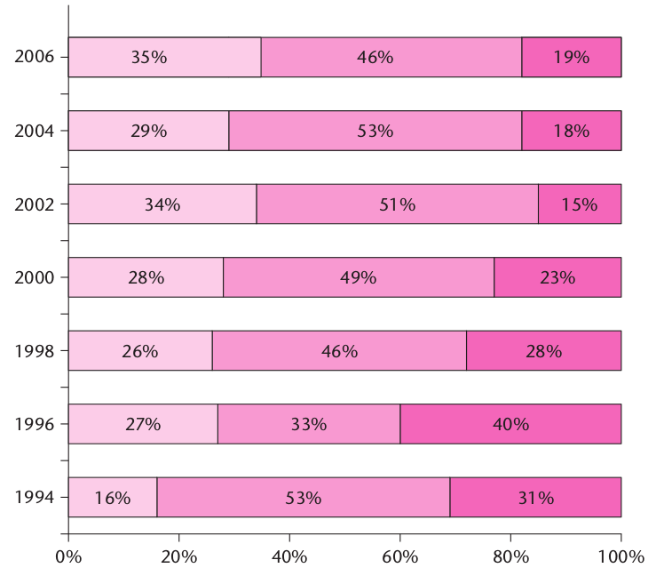
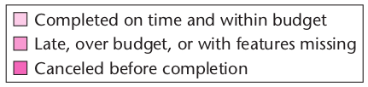
Software Project Failure over Time
Stanish Group annual CHAOS report

Slide 15
Britain Abandons NHS IT Project
After 10 years and 11 Billion pounds (450,000,000,000 Baht), the British government abandoned a huge IT project for the National Health System (NHS) in 2011.
Some components continue to be developed, but they are all late and over-budget.
Why? What Happened?
https://www.henricodolfing.com/2019/01/case-study-10-billion-it-disaster.html
https://www.computerweekly.com/opinion/Six-reasons-why-the-NHS-National-Programme-for-IT-failed

Slide 16
Microsoft Windows Critical Flaws
In 2020, Microsoft set new records for the number of critical vulnerabilities disclosed & patched each month.
Microsoft programmers have been working on Windows code for almost 20 years.
...but Windows still contains thousands of (unknown) critical vulnerabilities.
Why?
* Assuming Windows 7 as the start for current code base

Slide 17
Causes of Project Failure
1. Poor communication.
2. Unclear requirements.
3. Excessive change in requirements.
4. Unwillingness to accept change.
5. Not monitoring actual progress regularly.
6. Unrealistic schedule or budget.
7. Forced deadlines.
8. Insufficient developer skills.
process related

Slide 18
Benefits of a Defined Process
Save Time - don't rediscover how to perform each project
Enable Planning and Tracking
Basis for Estimation - you collect data for each activity and task from previous projects and learn
Repeatable results
Process Improvement - it must be defined before you can examine and improve it

Slide 19
4 Factors in Development Speed
1. People
ability, knowledge, skills, motivation
2. Process
promotes effective work or hinders it
helps team stay on track? quality focus?
3. Product
Size and characteristics, nature of requirements
4. Technology
Language and software frameworks
Tools

Slide 20
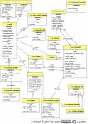
Software Process Model
Process consists of activities
Analysis
Design
Implement
Verify
Activities
Tasks
Tasks
Tasks
Role
Guidance
Standards
Templates
Use Case
Main Scenaria
1.....
2.....
3.....
Extensions: ...
. . . . .
Desired Product
Artifacts (work products)
Communication
Measurements, Milestones, Documents

Slide 21
Activities
Activities are large(r) scopes of work. They may be general things that occur repeatedly.
Major activities:
requirements specification
modeling & design
construction
validation
deployment
[Major activities listed by Summerville & Pressman.]

Slide 22
Tasks
Activities are large and general.
Activity is broken down into concrete tasks.
Some tasks during Construction:
iteration planning
backlog selection & estimation
detail design
coding
unit testing
integration testing

Slide 23
Activity May Subdivide into 2 Levels
In Pressman, an activity consists of actions divided into tasks.
Activity: Construction
Action: iteration (or sprint) planning meeting
Tasks:
review & prioritize items in product backlog
select items for this iteration (sprint)
estimate time for each item
define a "done" criterion (acceptance test) for each
software design to implement the items

Slide 24
How to do it? What to produce?
"Activities", "actions", and "tasks" should make progress toward finishing the project.
What to do?
A task has a description & guidance
What is the result?
Every task should have an output -- a work product
Is the work correct?
Define how to evaluate the work product

Slide 25
Example Task
Title: Add Item to Cart Priority: High Est: 8 hr
Description:
When a visitor navigates to item detail page, there is an "Add to Cart" button on the page. When visitor clicks "Add to Cart", a unit of the item is added to his shopping cart.
Acceptance Criteria
Given that user is viewing an in-stock item
When he clicks "Add to Cart"
Then the item is added to his shopping cart.
When navigate to "My Cart" page, the item, with quantity and price, are shown.

Slide 26
Common Process Models

Slide 27
Code and Fix
The most common software development process
Little or no planning and design.
1. think about the problem, write ideas on paper
2. start coding
3. run it. fix the code.
4. add another feature. As code grows I need to rewrite some parts to support each new feature.
modify the code for new feature
goto step 2.
My software process since high school

Slide 28
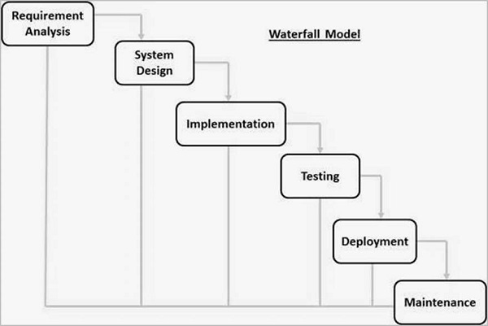
Do the activities in order
Similar to a civil engineering project.
(This is a typical diagram of the waterfall model.)

Slide 29
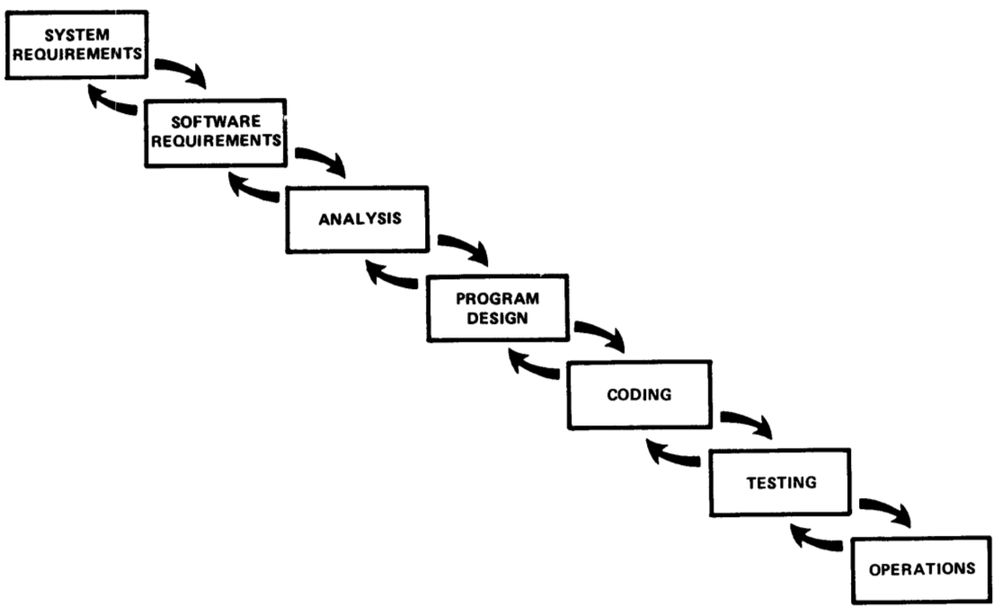
The Original Waterfall Model
Winston Royce, Managing the Development of Large Software Systems (1970)
Waterfall is still widely used.

Slide 30
What Could Go Wrong?

Slide 31
Problems with Waterfall
What would be the effect on project if ...
1. You miss some requirement(s).
2. You misunderstand a requirement, so the design is not what the customer wants.
3. The solution you design can't meet the requirements.
4. Coding takes a lot longer than expected.
5. Testing discovers a lot of defects in the code.

Slide 32
How to Avoid These Problems?
Early Feedback
Early Testing
Continuously review actual versus planned progress
Involve customer at key points during project
Incremental delivery of functionality -- get feedback.
Analyze results and take corrective action

Slide 33
Royce Waterfall Model with Prototype
- Explicit feedback - Prototype: “Do it twice”

Slide 34
Project Phase = Process Activity
In Waterfall, major activities are phases of the project...
Requirements phase
Analysis phase
Design phase
Construction phase
...

Slide 35
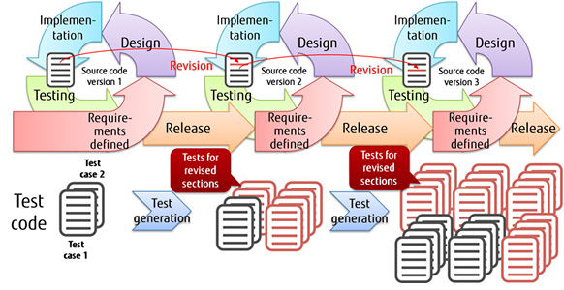
Iterative and Incremental
Let's not build the whole product at once. Build a useful part (subset), evaluate it, and repeat.
Activities ≠ Phases
Phase 1
Phase 2
Phase 3

Slide 36
Iterative and Incremental
Incremental - product divided into increments. Each increment adds new features and produces a usable product.
Iterative - iterate over the (almost) same activities for each product increment.
You may have many iterations to produce one increment.

Slide 37
Benefits
1. Rapid delivery of value to customer - he can try the features you have implemented.
What are other benefits of iterative & incremental?
Consider:
feedback
detecting problems in design or implementation
monitoring progress & deviation from schedule
effect of change

Slide 38
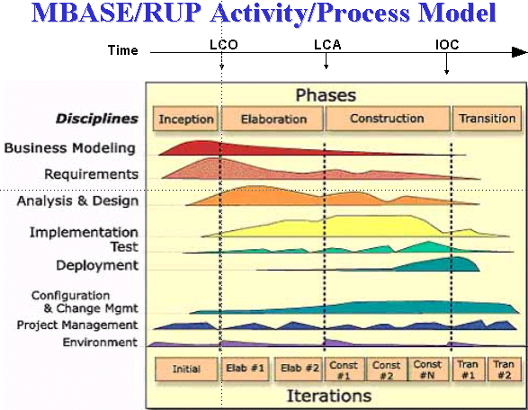
Unified Software Dev't Process (U.P.)
Workflows (disciplines) for different kinds of activities.
Phases: major divisions of project. Each has iterations.

Slide 39
UP is an Iterative Process Model
The diagram conveys a lot about UP...
workflows (activities) are done in parallel
"phases" for major evolutions of the project
iterations within each phase, as needed

Slide 40
Characteristics of UP
Time-boxed iterations
Plan based, but adapts to change
"Architecture centric"
Identify risks & address them early
Order requirements based on business value, architecture, & risk
handle risky requirements early
implement requirements that have big impact on the architecture
UP is a "framework" for a process -- tailor it to your project
UP is covered in SKE Software Spec and Design course.

Slide 41
Agile
Agile is not a software process
Agile is a mindset, collection of values, and practices that reflect those values.
Agile & Scrum are covered later

Slide 42
What About Individual Process?
This is a course about individual process.
What is that?

Slide 43
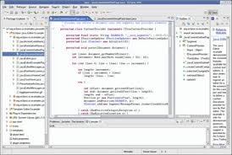
The Individual
People apply a process, use tools, technology, & guidance, to create the work products.
Activity
Use Case
Main Scenaria
1.....
2.....
3.....
Extensions: ...
*
Work
Product
Task
UML
Guidance
Standards
Templates
Role
Tools

Slide 44
Problem of Teaching Software Process
1. We learn on small, one-semester projects.
2. Projects often succeed based on heroic effort or super-programmers.
3. Programs aren't deployed or supported.
4. We are still learning, so process seems awkward.
5. We have many courses -- different environment from full-time developers
6. Outcome is a grade, not a paycheck or bonus

Slide 45


Reading
These are highly regarded books about Software Engineering. Each has a chapter or two on software process.
Ian Summerville, Software Engineering, 10th Ed.
Stephen Schach, Object-oriented & Classical Software Engineering, 8th Ed.
Roger Pressman, Software Engineering: A Practitioner's Approach.

Slide 47
Historical Material
...for the curious

Slide 48
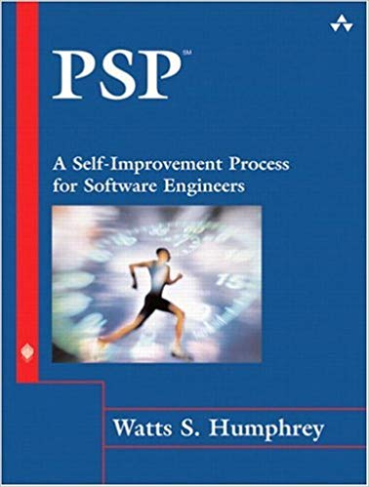
Original Syllabus: Personal Software Process
Step-by-step course to build a personal process for:
planning
defect tracking
estimation
measuring quality & efficiency
evaluation
process improvement

Slide 49
Goals of PSP
Objective: provide a disciplined process for SEs to manage their own work
improve estimation and planning skills
reduce defects in their products
manage their own schedule & work quality
improve their own software process

Slide 50
PSP progress through levels
PSP0: [baseline] measure time you spend on planning, design, coding, test, and post mortem (retrospective)
PSP0.1: measure output LOC. Add a coding standard and process improvement proposal (PIP).
PSP 1.0: Estimate program size using level 0 data. Make a test plan.
PSP 1.1: Add planning. Estimate time from program size.
PSP 2.0: Add design & code review. Emphasis on defect removal and prevention.
PSP 2.1: Add design specification.
PSP 3: Apply an iterative process to PSP2.1.

Slide 51
PSP Tools and Support
PSP emphasizes use of scripts, forms, and checklists to guide the user. These are included in course.
A useful tool is Process Dashboard (Sourceforge).
performs time tracking. Automates some reporting.
includes the PSP scripts and forms, and generates reports
can be used for other processes!

