Slide 1
Requirements

Slide 2
Discovering Requirements
Outside the scope of this course.
Some approaches:
1. interview with customers and stakeholders
2. brainstorming
3. existing system
4. observe how people do work

Slide 3
User Stories
Requirements from the users' point of view.
Should express the value the user gets from the system.
As a <who wants to accomplish something>
I want <goal or what to accomplish>
So that <why or value that results>

Slide 4
User Story Example
Title: Borrow a Tablet Priority: Must Estimate:
As a Student at KU
I want to borrow a tablet to takes online quiz in course
So that I have a device to take quiz on
How to Test (Acceptance Test): [may have > 1]
Given I am authenticate to KU Lend
When I select an available Tablet device
And I complete and submit the borrowing form
And I select dates to borrow and return tablet
Then I receive a reservation to borrow a tablet

Slide 5
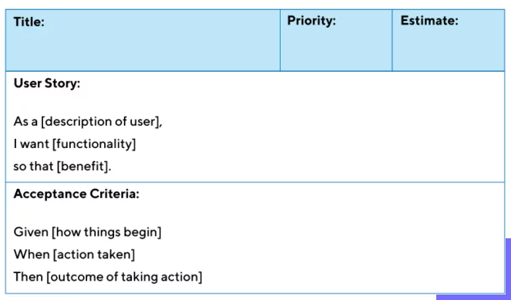
User Story Template
There is more than one template for the Story.

Slide 6
INVEST in Good User Stories
Independent - changes to one story have no or minimal effect on other stories
Negotiable - up to team to decide how to implement
Valuable - has clear value to the end users/stakeholders
Estimable - can make a good estimate of time to impl.
Small - can be implemented & tested in one increment
Testable - has clear acceptance criteria

Slide 7
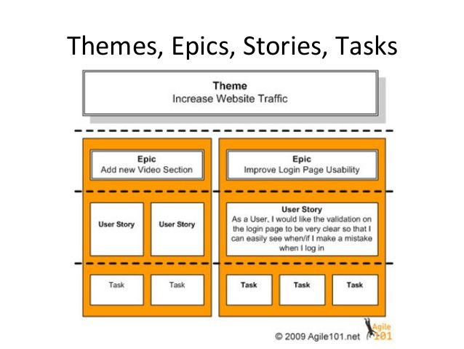
Grouping Stories into "Epics"

Slide 8
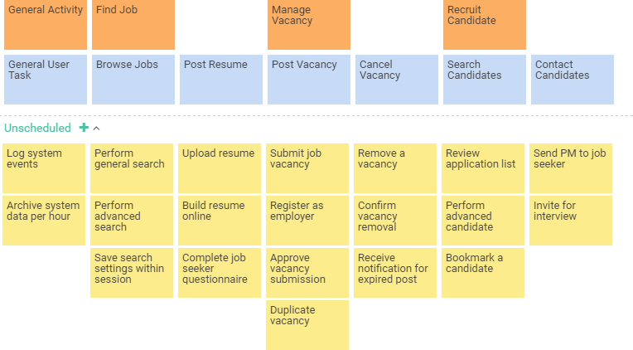
Job Search Application

Slide 9
Grouping Stories into "Epics"
User Story - smallest unit of work that has clear value to stakeholders
Can be implemented in one product increment or sprint
Epic - related User Stories that can be implemented and tested in a few increments or sprints

