Slide 1
Intro to Software Processes
and the Software Development Life Cycle

Slide 2
Goal of Software Development
Need
(or Idea)
Product
Produce a software product that fulfills a need or realizes an idea.

Slide 3
What are the Steps?
Need
(or Idea)
_?_
_?_
_?_
Product
What are the major steps or activities you would need to do?
List major activities that would apply to almost any software project.

Slide 4
Activities
Creating software involves
elicit requirements
analysis & specification
design
construction & testing
validation
documentation
maintenance
improvement
Managing the project involves
planning
obtaining resources
tracking progress
resolving problems
analyzing results
closing the project

Slide 5
Process
Process -
  a [systematic] series of actions to achieve a particular result
Software process - a method for producing software

Slide 6
Software Process according to experts
A software process is a sequence of activities that leads to production of a software product.
-- Ian Summerville, Software Engineering, 9 Ed.
...a collection of activities, actions, and tasks that are performed to create [software].
-- Roger Pressman,
Software Engineering: A Practitioner's Approach, 7 Ed.

Slide 7
Do You Have a Software Process?
What is your software process?
(discussion)
What did you do to create:
  Programming 2 project?
  Exceed Camp project?

Slide 8
Do You Have a Software Process?
Yes!
Everyone who develops software uses a process.
"Never thought about it" ...
process is implicit or informal
"It's different for each project" ...
ad hoc process

Slide 9
Why Define a Software Process?
Why not just do it?

Slide 10
Realities of Software
Software is plagued by defects, over-budget, schedule overrun, and complete failure of projects to deliver.
1. Change can be required almost anytime during a project.
2. Useful software is complex.
3. Useful software must evolve (more change)
4. Communication problems plague software
  - between devs and customer
  - within development team
  - implicit assumptions are often not true

Slide 11
Common Project Outcomes (failures)
1. Project is late and over-budget.
2. Software does not do what the customer wants.
3. Excessive defects.
4. Project is canceled.

Slide 12
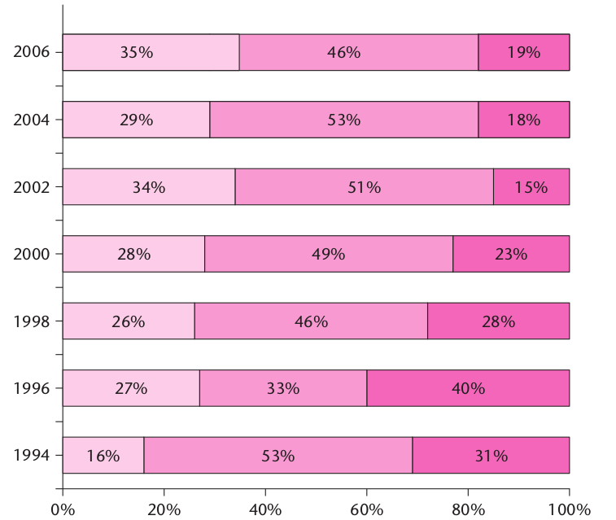
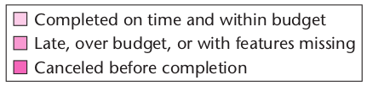
Software Project Failure over Time
Stanish Group annual CHAOS report

Slide 13
Britain Abandons NHS IT Project
After 10 years and 11 Billion pounds (450,000,000,000 Bt), the British government abandoned a huge IT project for the National Health System (NHS) in 2011.
Some components continue to be developed, but they are all late and over-budget.
Why? What Happened?
https://www.henricodolfing.com/2019/01/case-study-10-billion-it-disaster.html
https://www.computerweekly.com/opinion/Six-reasons-why-the-NHS-National-Programme-for-IT-failed

Slide 14
Microsoft Windows Critical Flaws
Each month in 2020, Microsoft set a new record for the number of critical vulnerabilities disclosed & patched.
Microsoft programmers have been working on Windows code for almost 20 years -- if we take Windows 7 as the starting point.
Yet Windows still contains hundreds or thousands of critical vulnerabilities.
Why?

Slide 15
Causes of Project Failure
1. Poor communication.
2. Unrealistic schedule or budget. Forced deadlines.
3. Unclear requirements.
4. Excessive change in requirements.
5. Unwillingness to accept change.
6. Not monitoring actual project progress regularly.
7. Insufficient developer skills.

Slide 16
Benefits of a Defined Process
Saves Time - don't rediscover how to execute each project
Enable Planning and Tracking
Basis for Estimation - you collect data for each activity and task from previous projects and learn
Repeatable results
Improve the Process - it must be defined before you can examine and improve it

Slide 17
4 Factors in Development Speed
1. People
ability, knowledge, skills, motivation
2. Process
promotes effective work or hinders it
helps team stay on track? quality focus?
3. Product
Size and characteristics, nature of requirements
4. Technology
Language and software frameworks
Tools

Slide 18
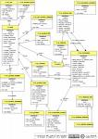
Software Process Model
Process consists of activities
... and a lot of other stuff
Analysis
Design
Implement
Verify
Activities
Tasks
Tasks
Tasks
Guidance
Standards
Templates
Role
Use Case
Main Scenaria
1.....
2.....
3.....
Extensions: ...
. . . . .
Desired Product
Artifacts
(work products)
Communication
Measurements, Milestones, Documents

Slide 19
Activities
Process consists of several activities.
Activities may be performed differently on different projects, and sometimes not at all.
Major activities:
requirements specification
modeling & design
construction
validation
deployment
[Major activities listed by Summerville & Pressman.]

Slide 20
Tasks
Activities are large and general.
An activity is broken down into (concrete) tasks.
Some tasks during Construction:
iteration planning
backlog selection & estimation
detail design
coding
unit testing
integration testing

Slide 21
Activity May Subdivide into 2 Levels
In Pressman, an activity consists of actions divided into tasks.
Construction Activity
Action: iteration planning meeting
Tasks:
  review & prioritize items in product backlog
  select items for this iteration (sprint)
  estimate items
  assign "done" (test) criteria to each item
  design software for this iteration

Slide 22
How to do it? What to produce?
"Activities", "actions", and "tasks" should make progress toward finishing the project.
What to do? How to do it?
Need a task description and guidance
What to produce?
  Every task should have an output -- a work product
Is the work correct?
  Need a way to evaluate the work product

Slide 23
Common Process Models

Slide 24
Code and Fix
The most common software development process
Little or no planning and design.
1. think about the problem, write ideas on paper
2. start coding
3. run it. fix the code.
4. add another feature. As code grows I need to rewrite some parts to support each new feature.
  modify the code for new feature
  goto step 2.
My software process since high school (Fortran)

Slide 25
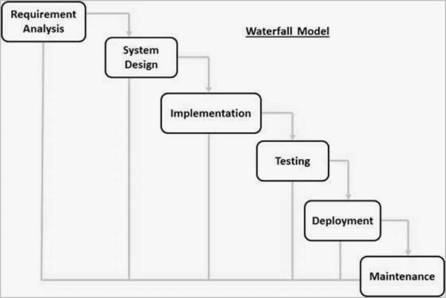
What if we do the activities in order?
Similar to a civil engineering project.
(This is a common diagram of the waterfall model.)

Slide 26
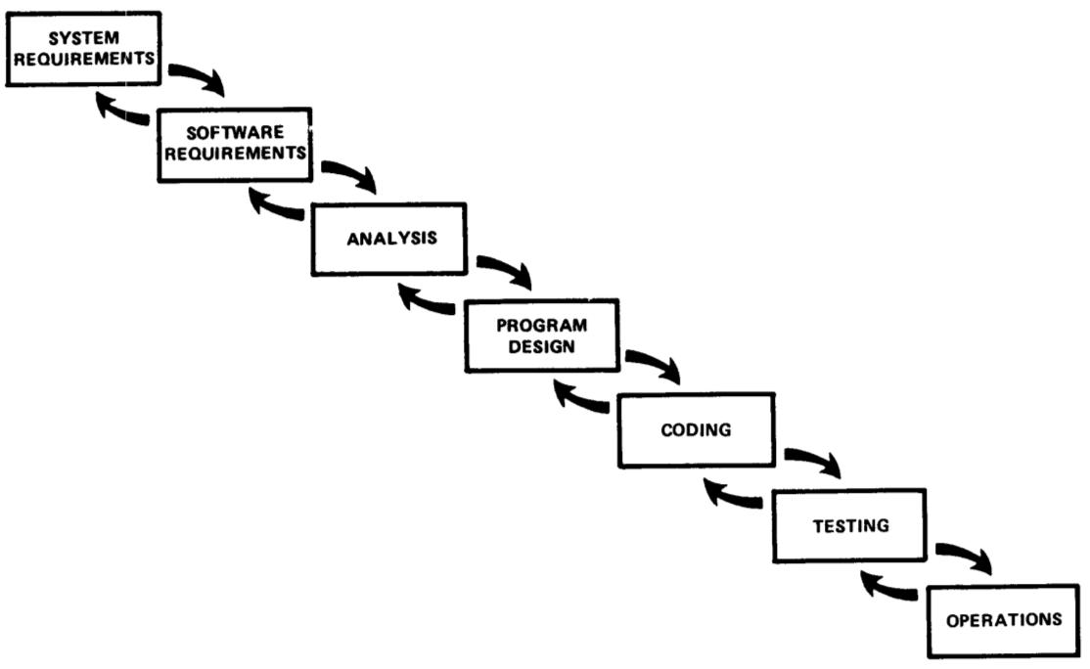
The Original Waterfall Model
Winston Royce, Managing the Development of Large Software Systems (1970)
Waterfall is still widely used.

Slide 27
What Could Go Wrong?

Slide 28
Common Problems with Waterfall
What would be effect on project if ...
1. You miss some requirement(s).
2. You misunderstand requirements, so the design is not what the customer wants.
3. The solution you chose can't handle the requirements.
4. Lots of defects during development, discovered only late during testing.

Slide 29
How to Avoid These Problems?
Early Feedback
Early Testing
Continuously review actual versus planned progress
Involve customer at key points during project
Incremental delivery of functionality.
Analyze results and take corrective action

Slide 30
- Explicit feedback
- Prototype: “Do it twice”
Royce Waterfall Model with Prototype

Slide 31
Project Phase = Process Activity
In Waterfall, major activities are phases of project...
  Requirements phase
  Analysis phase
  Design phase
  Construction phase
...

Slide 32
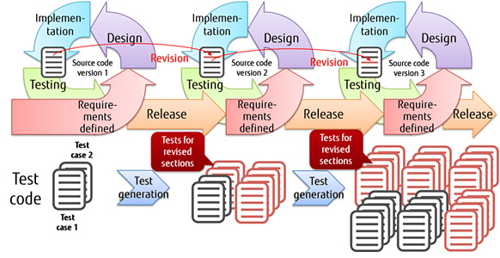
Iterative and Incremental
Let's not try to build the whole product at once.
Build a useful part and evaluate it, then repeat.
Activities ≠ Phases
Phase 1
Phase 2
Phase 3

Slide 33
Iterative and Incremental
Incremental - product divided into increments.
Each increment adds new features and produces a usable product.
Iterative - iterate over the (almost) same activities for each phase or increment.

Slide 34
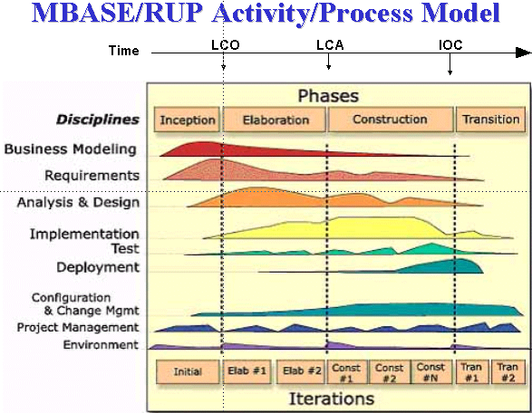
Unified Software Dev't Process (U.P.)
Workflows (disciplines) for different kinds of activities.
Phases: major divisions of project. Each has iterations.

Slide 35
UP is an Iterative Process
The diagram conveys a lot about the UP...
workflows (disciplines) are done in parallel
"phases" for major evolutions of the project
iterations within each phase, as needed

Slide 36
In U.P. what are "activities"?
The definition of software process refers to "activities".
What word does U.P. use for these?

Slide 37
Characteristics of UP
Time-boxed iterations
Plan based, but adapts to change
"Architecture centric"
Identify & address risks early
Implement requirements based on business value, architecture, or risk
  handle risky requirements early
  choose requirements that have big impact on the architecture
UP is a "framework" for a process -- tailor to your project
UP is covered in Software Spec and Design course.

Slide 38
Agile
Agile is not a software process
Agile & Scrum is a separate topic

Slide 39
What About Individual Process?
Many software processes.
So what?
... This is a course about individual process.

Slide 40
The Role of Individual Process
See "Task-model" slide (1 slide).

Slide 41
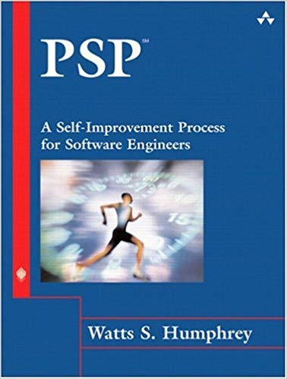
Original Syllabus: Personal Software Process
Step-by-step course to build a personal process for:
planning
defect tracking
estimation
measuring quality & efficiency
evaluation
process improvement

Slide 42
Personal Software Process (PSP)
Objective: provide a disciplined process for SEs to manage their own work
improve estimation and planning skills
reduce defects in their products
manage their own schedule & work quality
improve their own software process

Slide 43
PSP progress through levels
PSP0: [baseline] measure time you spend on planning, design, coding, test, and post mortem (retrospective)
PSP0.1: measure output LOC. Add a coding standard and process improvement proposal (PIP).
PSP 1.0: Estimate program size using level 0 data. Make a test plan.
PSP 1.1: Add planning. Estimate time from program size.
PSP 2.0: Add design & code review. Emphasis on defect removal and prevention.
PSP 2.1: Add design specification.
PSP 3: Apply an iterative process to PSP2.1.

Slide 44
PSP Tools and Support
PSP emphasizes use of scripts, forms, and checklists to guide the user. These are included in course.
A useful tool is Process Dashboard (Sourceforge).
performs time tracking. Automates some reporting.
includes the PSP scripts and forms, and generates reports
can be used for other processes!

Slide 45
Problem of Teaching Software Process
1. We learn on small, one-semester projects.
2. Projects often succeed based on heroic effort or super-programmers.
3. Programs aren't deployed or supported.
4. We are still learning, so process seems awkward.
5. We have many courses -- different environment from full-time developers
6. Outcome is a grade, not a paycheck or bonus

Slide 46
21934x
Software Process & ...
A preview of some boring stuff from a later course.

Slide 47
IEEE Std 1074: Standard for Software Lifecycle
Process Group
IEEE Std 1074
Project
Management
Pre-
Development
Develop-
ment
Post-
Development
Cross-
Development
(Integral Processes)
> Project Initiation
>Project Monitoring
&Control
> Software Quality
Management
> Concept
Exploration
> System
Allocation
> Requirements
Analysis
> Design
> Implemen-
tation
> Installation
> Operation &
Support
> Maintenance
> Retirement
> V & V
> Configuration
Management
> Documen-
tation
> Training
source: Bruegge, OOSE
Processes

Slide 48
IEEE 1074
IEEE Standard for Developing a Software Project Life Cycle Process
Software Project Life Cycle Model
Software Process Architect
Select SPLCM
Select activities
OPAs
uses
incorporates
Software Project Life Cycle

Slide 49
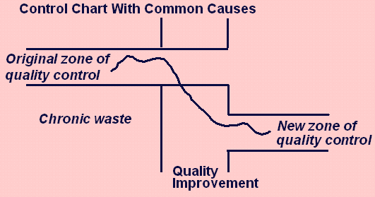
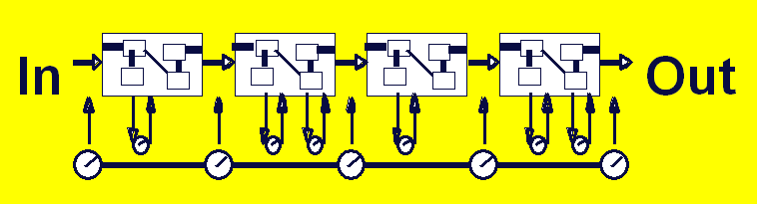
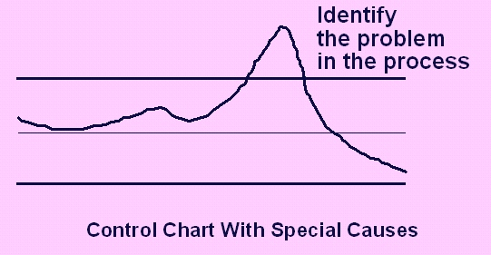

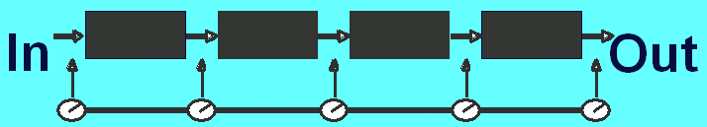

Overview of CMMI - Maturity Levels
5
"Optimizing"
Focus on process improvement;
4
Process measurements; adapt to problems to reduce variance; predictable performance
“Quantitatively
Managed"
3
“Defined"
Process and procedures are standard, managed, improved over time
2
has process model but varies project to project; repeatable
"Managed"
1
ad hoc
not repeatable
"Performed"
0
Outcome
depends
on “heroes”
“Incomplete"

