Slide 1
Use Case: Delegating Access
Scenario:
we want to access some Facebook data on behalf of a user.
Solution:
ask the user to enter his Facebook login and password. Send them to Facebook.
Forces:
what not do this?

Slide 2
Auth vs Auth
Authentication - verifying that a user is who he/she/it claims to be.
Authorization - verifying that an entity can access a resource, or
the process of controlling or granting access to resources

Slide 3
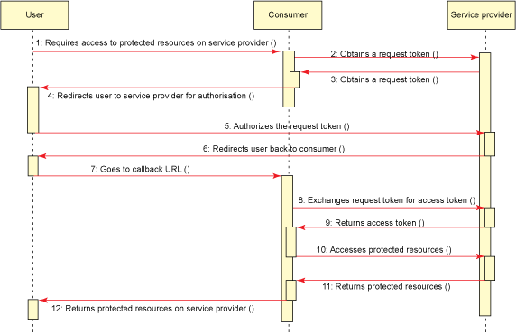
OAuth 1.0 Work flow

Slide 4
Step 0: Register your app
1. Go to the OAuth provider (Authentication server) and request OAuth access.
2. Choose "Register an application"
3. Give the OAuth provider:
- your application name
- your application URL,
- a callback URL, where to redirect clients after they grant access to your app
- requested scopes: what "resources" of the user does you app want to access?

Slide 5
Step 0: Register
The OAuth Provider gives you:
- client ID
- client secret

Slide 6

