Slide 1
Pull Requests
Why Use Them?

Slide 2
What is a Pull Request?

Slide 3
When and Why to Use PR
Propose a small change - bug fix, improvement
Merge a new feature
Merge feature improvements
Request review and discussion of your work
  not merge into master branch
Unit & Integration Tests?
Cases 2 - 3 must have new unit tests!
Case 1 may have new tests, must pass existing tests.

Slide 4
What Happens after a Pull Request?
"Interested parties" (the core dev team):
1. Review the set of changes
2. Test the changes
3. Discuss the potential impact
4. Suggest modifications

Slide 5
References
About Pull Requests - Github
https://help.github.com/articles/about-pull-requests/
Pull Request Tutorial - what buttons to press. Discusses squashing commits before a pull request.
https://yangsu.github.io/pull-request-tutorial/

Slide 6
Pyup
Radii has 82 closed pull requests.
40 are by pyup-bot See https://pyup.io
What does pyup-bot do?

Slide 7
pyup.io - Security Updates
Please look at Pyup's nicely formatted docs page.
(https://pyup.io/docs/)
Try to write documentation like this!
1. Add to repo as an online service.
* Must grant pyup.io OAuth access to the repository
* Can automatically update project dependencies
== or ==
2. Run the Safety Service on CI server.
pip install safety (installs several packages. use venv)
safety check [ -r requirements.txt ]

Slide 8
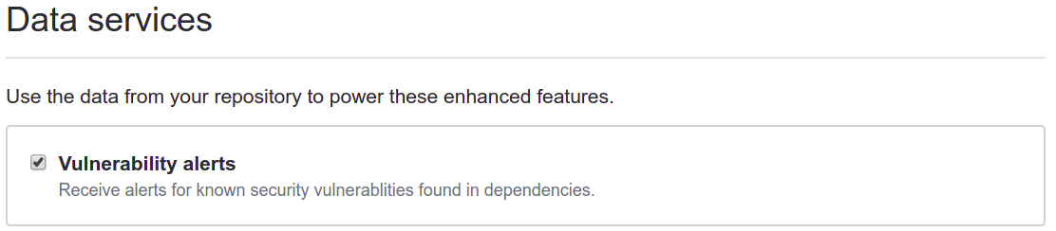
Security Alerts from Github
On Github repository settings page:
Github "vulnerabilities" based on CVE database.
Where are Alerts?
Repository "Insights" tab -> "Alerts"
or "Dependency Graph"

Slide 9
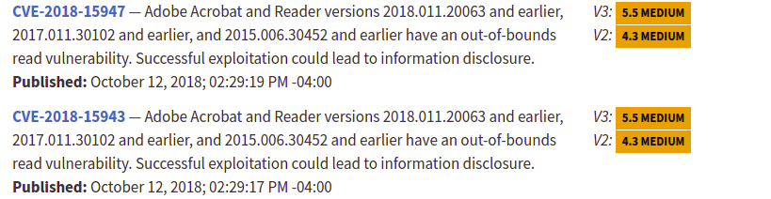
National Vulnerability Database
https://nvd.nist.gov
A global database of security problems.
Managed by U.S. NIST, but everyone can use.
Assigns CVE-# for reported & verified security problems.

Slide 10
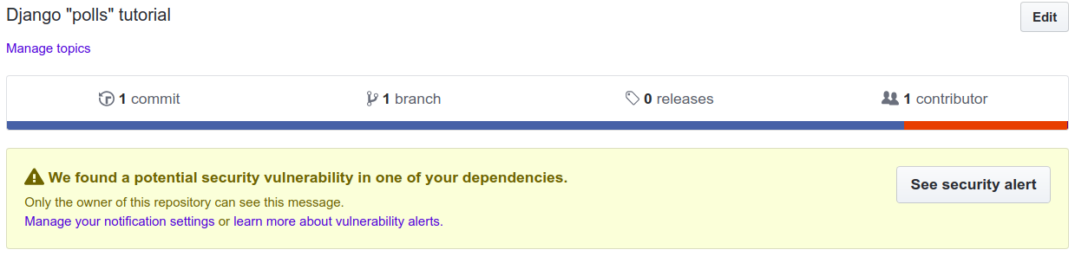
Is Django Secure?
Search the CVE database for "Django".
In your project requirements.txt put:
Django==2.1.0 # has a known vulnerability
Github will show:

