Slide 1
Authentication and Authorization
Basic Concepts

Slide 2
Authenticate & Authorize
Authentication - validate the identity of a "user", agent, or process
Authorization - specifying rights to access a resource
Authentication is responsible for identifying who the user is.
Authorization is responsible for deciding what the user has permission to do.

Slide 3
Other Aspects of Security
Access Control - controls access to resources
Data Integrity - prevent data from being modified or corrupted, and prove that data hasn't been modified
Confidentiality & Privacy - privacy is about people, confidentiality is about data
Non-repudiation - prove that user has made a request
"repudiate" means to deny having done something
Auditing - make a tamper-resistant record of security related events

Slide 4
Authentication Methods
Authentication methods for humans:
1. Username & password
2. Username & one-time password (TOTP, codes, SMS)
3. Biometrics - fingerprint, facial recognition, iris scan
4. Trusted 3rd Party - OAuth and OpenID "Login with Google" or "Login with Facebook"
5. Public-Private Keys
6. Passkeys
7. SQRL - similar to Passkeys (maybe better), by Steve Gibson

Slide 5
Mantra of Authentication
Use at least 2 of these...
Something you
- a username and password
Something you
- key card, registered mobile phone
Something you
- finger print, face, iris pattern

Slide 6
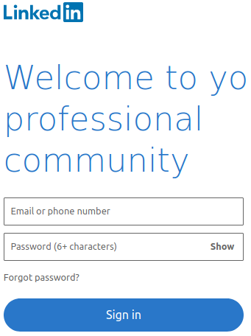
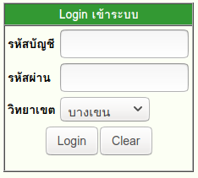
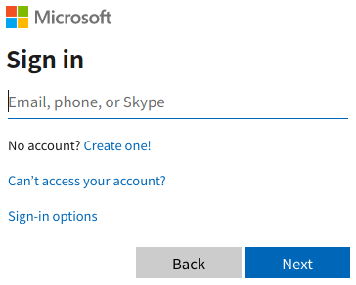
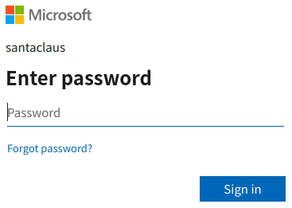
Username & Password
The oldest and one of the worst authentication methods.
KU
Two page design

Slide 7
Username & Password
Passwords are not secure (obviously)
can be stolen
can be guessed or "brute forced"
vulnerable to man-in-the-middle & replay attack
people reuse passwords or use weak passwords

Slide 8
Exercise: Have You Been Pwned?
Has your email address (and data) been stolen?
https://haveibeenpwned.com/
Has your password been seen in a data breach?
https://haveibeenpwned.com/Passwords

Slide 9
Key Observation about Passwords
password is not using the computational ability of the user's device. It's just a fixed string.
with just a little computation ability we can create a much more secure protocols (like challenge - response)

Slide 10
Public-Private Key Algorithms
Public-private key pairs: Uses RSA (large prime numbers) or Elliptic Curves (Ecliptic Curve Cryptography)
Private key:
p(m)
Public key:
P(m)
m = a message to send
p(m) and P(m) are inverse:
P( p(m) ) --> m
p( P(m) ) --> m
PKI = public key infrastructure

Slide 11
Public-Private Auth Example
1. You connect to a server and give your username.
2. Server looks up your public key (P) and chooses a random message: m1
3. Server encrypts m1 with your public key: challenge = P(m1)
4. Server sends challenge to you and says: "if this is really who you claim to be, then decrypt this challenge and send it back."
5. You decrypt the challenge: m2 = p(challenge)
5. You encrypt and return a response = p(m2 + 1)
6. Server checks response: P(response) == m1 + 1 ??

Slide 12

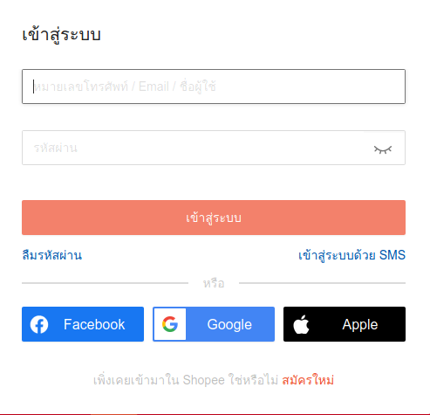
OAuth & OpenID
Use a 3rd party to validate the user's identity
OAuth providers

Slide 13
OAuth 2.0
You choose "Google".
Shopee redirects you to Google (may open a pop-up):
- tells Shopee who you are (grant access to your name & email), and proves that you have authenticated yourself to Google.
Google.com
"shopee.co.th wants access to your name and email"
Agree
Cancel

Slide 14
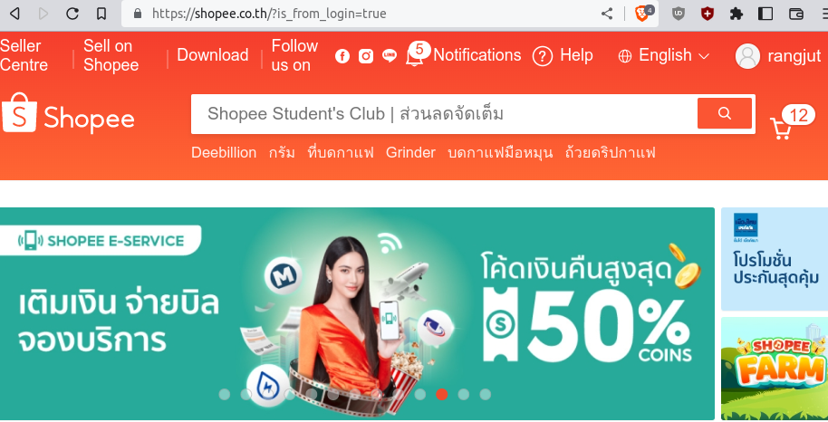
After You Approve...
You are redirected back to Shopee (the client).
What happened?
- Google gave your browser an "authorization code", & redirected the browser to Shopee "callback address"
- Shopee used the "authorization code" to get an "access token" to access your resources
- Shopee uses Google API and the "access token" to get your name and email address.

Slide 15
OAuth is for Authorization
OAuth is really about granting access to resources.
But, as a side effect, you confirm your identity.
Google.com
"shopee.co.th wants access to your name and email"
Agree
Cancel

Slide 16
What Happened?
When you click "Login with Google", what happens behind the scene?
details in OAuth presentation

Slide 17
Authorization
Specify what rights or access a user has.
Access rules apply to:
resources - can read a file? modify a file?
functionality - create a new poll question?

Slide 18
Role Based Authorization
Permissions are based on the roles a user possesses.
A user may have many roles.
Example: “joe” has roles “voter” and “administrator”
Subject
(user)
Principal
Role
identifies
has
1..*
*
Permissions

