Slide 1
OAuth Concepts

Slide 2
What is OAuth for?
An authorization protocol to allow an application to access a user's resources on a different system.
Analogy:
ATS authorization at bank to allow AIS or True to debit your mobile phone bill.
หนังสือมอบอำนาจ (power of attorney) to authorize someone else to view your tax records.

Slide 3
Counter-example
Email client apps require you to input your username & password for the mail server.
The client app can do anything you can do.
Your password is stored in the app.
Difficult to revoke.

Slide 4
OAuth Roles (the Players)
Resource Owner | User who owns the resource
Client | Application that wants to access the resource
Authorization Server | Server that authenticates Resource Owner and grants access to Client. Does this using an Authorization Code and Access Token.
Resource Server | Hosts the resource(s) and manages access to it.
User Agent | software used by the user to interact with client, such as a web browser.

Slide 5
Example
Resource Owner
Client
Authorization Server
Resource Server

Slide 6
The Steps in Using OAuth
Prerequisite: Client registers the application on the Authorization Server.
Example: https://github.com/settings/applications/new
Client provides: KU Polls Example
App Name KU Polls
Homepage URL http://localhost:8000/polls
App Description Polls for KU
Scopes what you want to access
Callback URL http://127.0.0.1:8000/accounts/github/login/callback/

Slide 7
Client Registration
Client application receives KU Polls Example
client_id Ov23liFqvTsWsOScBptr
client_secret
bab2ca077c6daa534bc437b66b52767e7eaea951
key (not used on Github)
authorization Url (where to send User Agent)
https://github.com/login/oauth/authorize

Slide 8
Using OAuth
When user of Client wants to authenticate or access his resources...
1. Client requests authorization by redirecting the User Agent (browser) to Auth Server with an "Authorization Request" for resource it wants to access.
2. User (Resource Owner) authenticates himself and agrees to grant access to Client app
3. Auth Server gives User Agent a temporary authorization code & redirects him back to Client.

Slide 9
Using OAuth (cont.)
4. User Agent gives Auth Server the authorization code along with Client's credentials
5. Auth Server gives Client an Access Token. This grants access to specified resources.
6. Client includes the Access Token in each request it sends to Resource Server. The Resource Server checks validity before granting access (in case the token has been revoked or Client's credential were revoked)

Slide 10
OAuth Use Cases
Server-side web app: The server-side can securely store secrets.
Single Page Web App: Javascript code running in web browser. Cannot keep a secret.
Mobile App: storing a client secret is difficult or impossible.
Server-to-server apps with no user interaction

Slide 11
OAuth Use Cases & Grant Flows
Grant Flow | Use Case | Security
Authorization Code | Web app where back-end securely stores secrets. | High
Authorization Code + PKCE | SPA web apps & mobile apps | Medium
Client Credentials | Server-to-server apps | High
Resource Owner Password | First-party & trusted apps | Moderate (not recommended)
PKCE = Proof Key for Code Exchange
"Implicit Grant" flow is deprecated. Use Auth Code + PKCE

Slide 12
Resources
My Intro to OAuth has links to resources
To avoid duplication, I don't repeat them here.
https://cpske.github.io/ISP/authentication/oauth

Slide 13
Exercise 1
What sites use Google to authenticate you?
1. Go to https://accounts.google.com
2. Choose Security
3. Look under "Your connections to third-party apps & services"
How many are there?
Any that you do not use (or want)?

Slide 14
Exercise 2
What data do you share with other apps?
This may also be in same place.

Slide 15
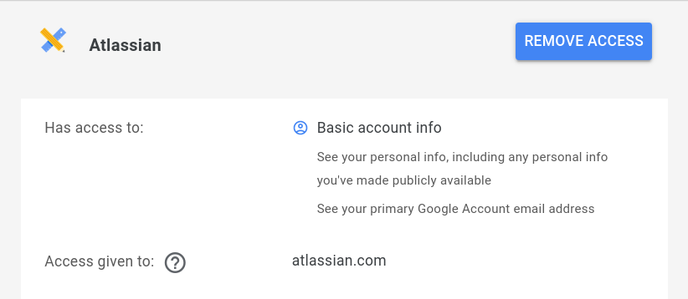
What Privileges (access) do sites have?
When a site requests OAuth access to your account, it specifies the privileges (scope) it wants.
Click on a site name to view details:

Slide 16
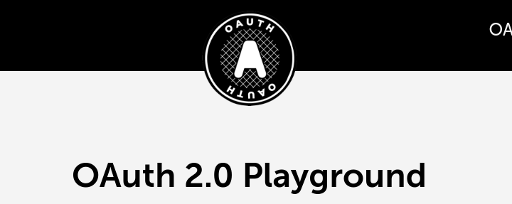
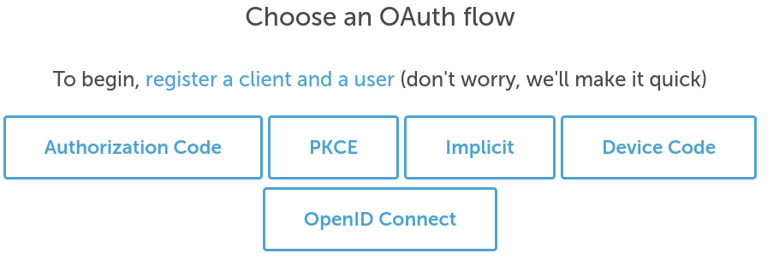
Hands on: OAuth Playground
https://www.oauth.com/playground/
Choose "Authorization Code" Flow and work through the exercise

