Slide 1
Intro to Software Processes

Slide 2
Goal of Software Development
Need
(or Idea)
Product
Produce a software product that fulfills a need or realizes an idea.

Slide 3
What are the Steps?
Need
(or Idea)
_?_
_?_
_?_
Product
What are the major steps or activities you would need to do?
List major activities that would apply to almost any software project.

Slide 4
Activities
Creating software involves
elicit requirements
specification
design
construction & testing
validation
documentation
maintenance
improvement
Managing the project involves
planning
obtaining resources
tracking progress
resolving problems
analyzing results
closing the project

Slide 5
Process
Process -
  a [systematic] series of actions to achieve a particular result
Software process - a method for producing software

Slide 6
Software Process according to experts
A software process is a sequence of activities that leads to production of a software product.
-- Ian Summerville, Software Engineering, 9 Ed.
...a collection of activities, actions, and tasks that are performed to create [software].
-- Roger Pressman,
Software Engineering: A Practitioner's Approach, 7 Ed.

Slide 7
Do You Have a Software Process?
What is your software process?
(discussion)
What did you do to create:
  Programming 2 project?
  Exceed Camp project?

Slide 8
Do You Have a Software Process?
Yes!
Everyone who develops software uses a process.
"Never thought about it" ...
process is implicit or informal
"It's different for each project" ...
ad hoc process

Slide 9
Why Define Your Software Process?
Why not just do it?

Slide 10
Realities of Software

Slide 11
4 Factors in Development Speed
1. People
ability, knowledge, skills, motivation
2. Process
Customer focus
QA, risk management, iteration planning, version control, ...
3. Product
Size and characteristics, phasing
4. Technology
Language and software frameworks
Tools

Slide 12
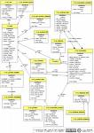
Software Process Model
Process consists of activities
... and a lot of other stuff
Analysis
Design
Implement
Verify
Activities
Tasks
Tasks
Tasks
Guidance
Standards
Templates
Role
Use Case
Main Scenaria
1.....
2.....
3.....
Extensions: ...
. . . . .
Desired Product
Artifacts
(work products)
Communication
Measurements, Milestones, Documents

Slide 13
Activities
Process consists of several activities.
Activities may be performed differently on different projects, and some may be absent.
Major activities:
specification
modeling & design
construction
validation
deployment
[Major activities listed by Summerville & Pressman.]

Slide 14
Tasks
Activities are large and general.
An activity is broken down into tasks.
Some tasks during Construction:
iteration planning
backlog selection & estimation
detail design
coding
unit testing
integration testing

Slide 15
Activity May Subdivide into 2 Levels
In Pressman, an activity consists of actions divided into tasks.
Construction activity
Action: iteration or sprint planning meeting
Tasks:
  review & prioritize items in product backlog
  select items for this iteration (sprint)
  estimate items
  assign "done" (test) criteria to each item
  design software for this iteration

Slide 16
Common Process Models

Slide 17
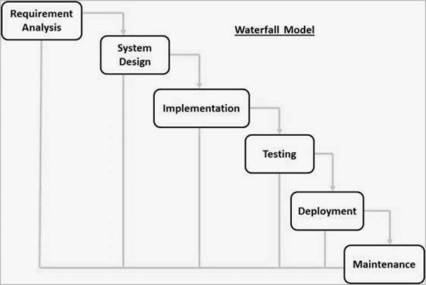
What if we do them in order?
Similar to a civil engineering project.
(There are really more steps than this.)

Slide 18
What Could Go Wrong?

Slide 19
Common Problems
What would be effect on project of each of these?
1. You miss some requirement(s).
2. You misunderstand some requirements, so the design is not what the customer wants.
3. The framework or design you chose can't handle the requirements.
4. Lots of defects during development, discovered late during testing.

Slide 20
Common Project Outcomes (failures)
1. Project is late and over-budget.
2. Software does not do what the customer requires.
3. Excessive defects.

Slide 21
Causes of Project Failure
1. Poor communication.
2. Unrealistic schedule or budget. Forced deadlines.
3. Unclear requirements.
4. Excessive change in requirements.
5. Unwillingness to accept change.
6. Not monitoring actual project progress regularly.
7. Insufficient developer skills.

Slide 22
How to Avoid These Problems?
Frequently "check" progress to see if you are on the right track.
Feedback
Testing
Compare actual versus planned progress
Analyze results and take corrective action

Slide 23
Software Development Steps
1. Elicit Requirements
2. Vision of a solution
3. Analyze requirements
4. Specification
5. Design
- architectural design
- detail design
6. Implementation
7. Test and Review
8. Integration & testing
repeat 5 - 8
9. Acceptance testing
10. Deployment
11. Migration
12. Maintenance
13. Improvement
14. End-of-life

Slide 24
Overview of some Process Models
"Model" of how software development should go.
A "model" is an abstraction of something else.
So, some details are missing and it may be imprecise.

Slide 25
Code and Fix
The most common software development process
Ad hoc (chaos). Little or no planning and design.
Code and Fix
1. think about the problem, write some ideas on paper
2. start coding
3. run it. Test what I just wrote and fix it.
4. add more features to implement.
  modify the code
  goto step 2.

Slide 26
Why "Code and Fix" is Inefficient
- No clear statement of what the result should be
- No design or "its in my head".
- Lots of rework.

Slide 27
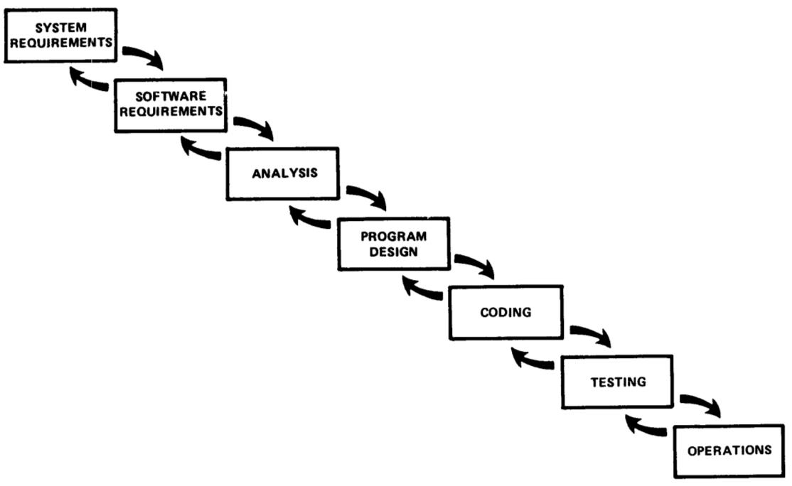
Waterfall Model
Winston Royce, Managing the Development of Large Software Systems (1970)
Still commonly used.
Not as simple as usually portrayed.

Slide 28
Project Phases = Software Activities
In Waterfall, major activities are phases of project...
  Requirements phase
  Analysis phase
  Design phase
  Construction phase
...

Slide 29
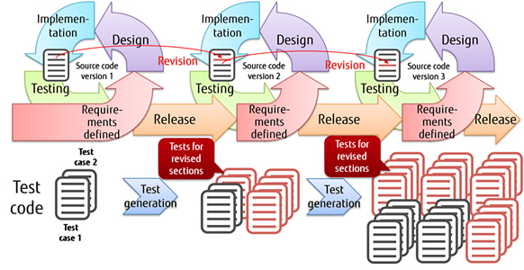
Iterative and Incremental
Let's not try to totally finish one activity (requirements, design) before starting others.
Iterate over each one.
Activities ≠ Phases

Slide 30
Iterative and Incremental
Incremental - project broken down into increments.
Each increment adds some useful features and produces a usable result.
Iterative - add increments until satisfactory product is delivered.

Slide 31
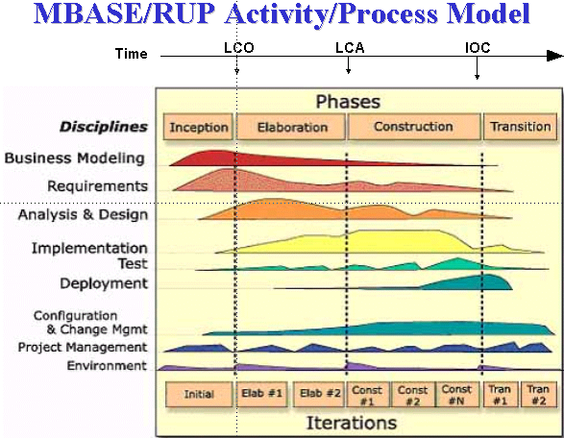
UP Model
Workflows (disciplines) for different kinds of activities.
Phases: major divisions of project. May have many iterations.

Slide 32
UP is an Iterative Process
The previous diagram conveys a lot about the UP...
disciplines (kinds of work) done in parallel
"phases" for major evolutions of the project
iterations within each phase, as needed

Slide 33
Characteristics of UP
Time-boxed iterations
Plan based, but adapts to change
"Architecture centric"
Identify & address risks early
Implement requirements based on priority, business value, or risk
  handle risky requirements early
  choose requirements that have big impact on the architecture (design)
Accommodate change
UP is a "framework" for a process -- you can tailor it as you like.
UP is covered in Software Spec and Design course.

Slide 34
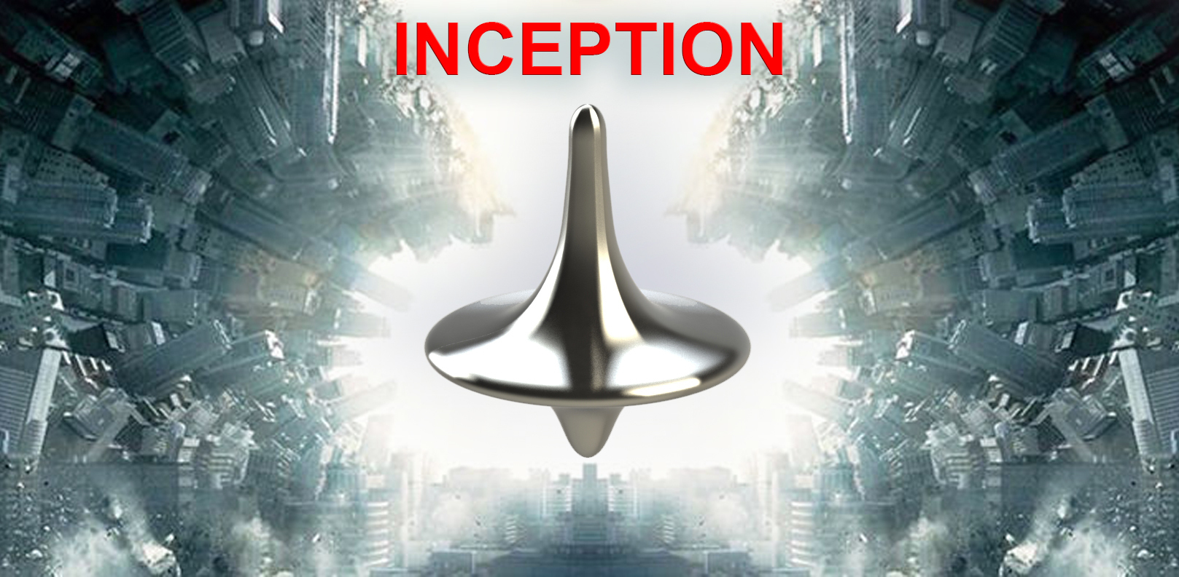
An Idea -- but is it a project?
Explore... Brainstorm... Clarify...
and decide if the idea is worth pursuing

Slide 35
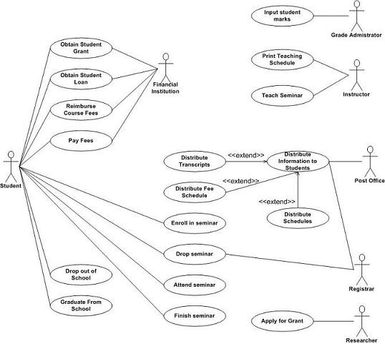
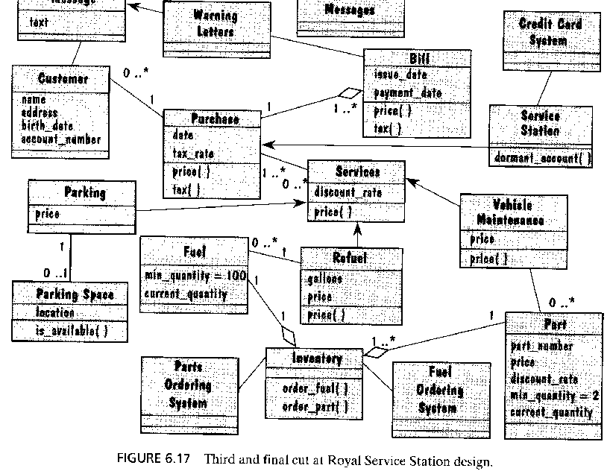
Elaboration
What is required?
Can it possibly work?
Can we build it?
How would we build it?
Do we want to do it?
Is it cheaper to buy it?
Accept as Project?
Do it.
Don't do it.

Slide 36
Construction - Build it!

Slide 37
Agile Manifesto
We are uncovering better ways of developing
software by doing it and helping others do it.
Through this work we have come to value:
Individuals and interactions over processes and tools
Working software over comprehensive documentation
Customer collaboration over contract negotiation
Responding to change over following a plan
That is, while there is value in the items on
the right, we value the items on the left more.

Slide 38
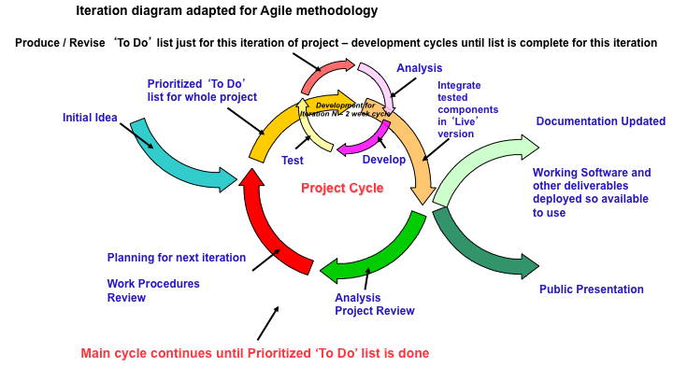
Agile Characteristics
See: 12 Agile Principles and Practices

Slide 39
Agile Process Characteristics
create customer "value" at each iteration
welcome evolving requirements
working software as primary measure of progress
lack of up-front architecture design (YAGNI)
simple design (XP: "do the simplest thing that ...")
small, self-organizing teams at one site (preferred)
frequent customer feedback
shared understanding instead of comprehensive documents … but do write documentation
...

Slide 40
Some Agile Processes
eXtreme Programming
  Kent Beck: Chrysler
Scrum - called "more a management technique"
  iterative development in "Sprints"
  daily stand-up meeting
  no advise about requirements
Crystal
  a family of methods to address different types of projects
Synchronize and Stabilize (Microsoft process)

Slide 41
What About Individual Process?
Many software processes.
So what?
... This is a course about individual process.

Slide 42
The End
(remain slides are unnecessary supplement)

Slide 43
Why a Defined Process?
This is to try to convince you that a defined software process is a good thing.
Let's look at why software projects fail or succeed.
(separate slides)

Slide 44
Benefits of a Defined Process
Saves time
  less time spent on planning, estimates, decisions
Predictable - enables planning & scheduling
Repeatable
Trackable - observed progress compared to plan
Enables Quality Assurance
Provides a basis for improvement
  revise process based on experience
Ref: http://www.acm.org/crossroads/xrds6-4/software.html (2000)

Slide 45
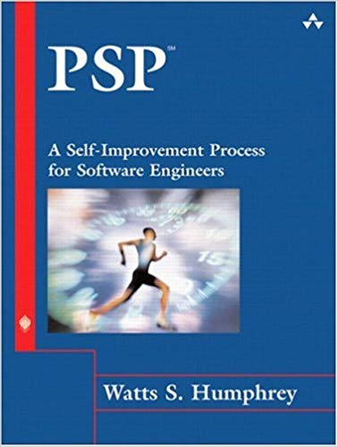
Original Syllabus of the Course
Step-by-step practices to build a personal process for:
planning
defect tracking
estimation
measuring quality & efficiency
evaluation
process improvement

Slide 46
Personal Software Process (PSP)
Objective: provide a disciplined process for SEs to manage their own work
improve estimation and planning skills
reduce defects in their products
manage their own schedule & work quality
improve their own software process

Slide 47
PSP in an 8-part course
Clear instructions of what to do at each part.
At each step you follow a process and write some code.
You add to your "process" during the course.

Slide 48
PSP progress through levels
PSP0: [baseline] measure time you spend on planning, design, coding, test, and post mortem (retrospective)
PSP0.1: measure output LOC. Add a coding standard and process improvement proposal (PIP).
PSP 1.0: Estimate program size using level 0 data. Make a test plan.
PSP 1.1: Add planning. Estimate time from program size.
PSP 2.0: Add design & code review. Emphasis on defect removal and prevention.
PSP 2.1: Add design specification.
PSP 3: Apply an iterative process to PSP2.1.

Slide 49
PSP Tools and Support
PSP emphasizes use of scripts, forms, and checklists to guide the user. These are included in course.
A useful tool is Process Dashboard (Sourceforge).
tool includes the PSP scripts and forms, and generates reports for you.
performs time tracking. Automates some reporting.

Slide 50
Classic Mistakes: People
These practices are likely to fail
Reliance on Heros (super-programmers)
Poor work environment: noisy, distractions
Adding people to a late project
"adding developers to a late project makes it later"

Slide 51
Classic Mistakes: Process
These practices are likely to fail
Unrealistic schedule
Poor planning
Avoiding difficult decisions

Slide 52
Classic Mistakes: Product
Requirements often lead to failure...
Vague or unrealistic requirements
Feature creep, or requirements churn
Unnecessary features ("Gold plating")
Treating R&D project as a development project

Slide 53
Classic Mistakes: Technology
Silver bullet thinking: expecting technology to provide improve productivity or make the problem easy
Using unfamiliar or unstable technology
"Let's use Lavarel because we want to learn it"
Lack of version control
Related:
Don't keep a "personal copy" outside of project VC.

Slide 54
Problem of Teaching Software Process
1. We learn on small, one-semester projects.
2. Projects often succeed based on heroic effort or super-programmers.
3. Programs aren't deployed or supported.
4. We are still learning, so process seems awkward.
Problem:
our process doesn't scale to larger projects.
benefits of many practices aren't visible.

Slide 55
What is a Life Cycle Model
A model of the phases that software goes through
Serves as a guide for management of software development
Models omit some real-life complexity and detail

Slide 56
Typical Lifecycle Model
Inception of idea
  vision
  business case
Analysis
Design
Implementation
Acceptance
Deployment
  transition
  training & education
Maintenance and Support
End of Support
Retirement
  end of useful life
  transition or archiving
GREEN = part of the process, not life cycle

Slide 57
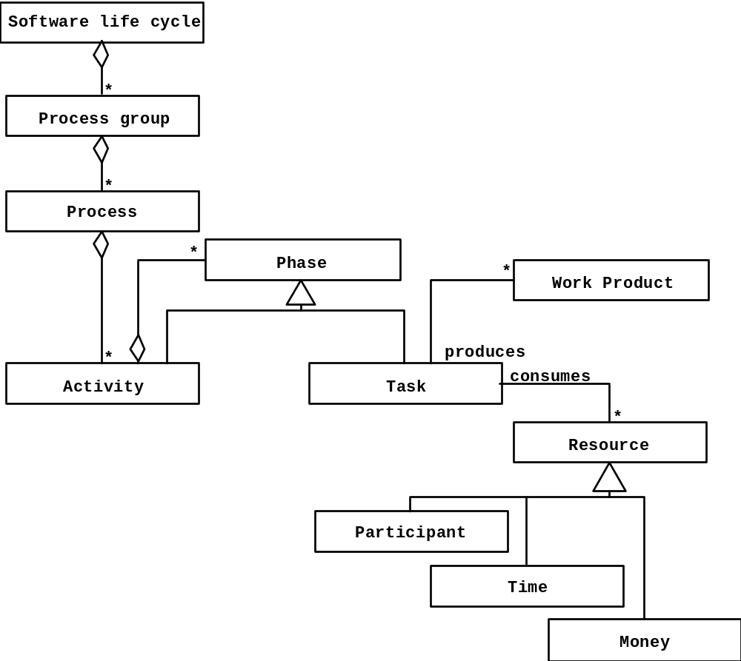
Model of Development Process
source: Bruegge, OOSE

