Slide 1
Intro to Django
An overview to help make learning easier.

Slide 2
Topics
1. Model-View-Controller (MVC) Design Pattern - most web apps use this pattern.
2. Structure of a Django Project
...and tip so your configuration directory always has the same name
3. How Django Processes a Web Request.

Slide 3
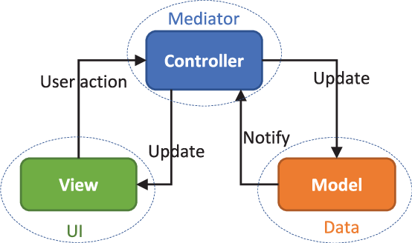
Model-View-Controller Pattern
There are many ways to implement MVC, with different interactions between M-V-C. This is just one of them:
Handles requests or events from UI; converts them into commands for model or views.
May receive notifications from models.
Displays info to user and accepts interactions.
Application logic, data, and rules.
Model usually doesn't know about the UI (View).

Slide 4
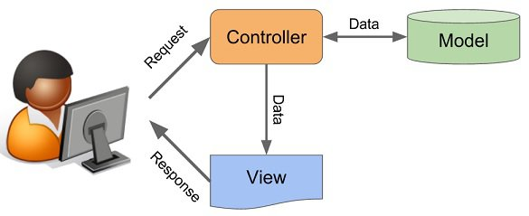
Simple MVC for Web Apps
Shows flow of request-response; the label "Data" is misleading. Controller makes requests of Application Layer (including Model) to handle user requests.
Source: https://www.tech101.in/streamline-your-system-with-the-mvc-model/

Slide 5
MVC in Web Apps
Views - web pages or code that generates the web pages. View may be passive (HTML) or interact with user via code such as Javascript in web pages.
Controllers - code that receives user's request. Usually the first thing after the "router" (part of framework that assigns URLs to methods)
Model(s) - responsible for application data and logic. Often involves handling persistent data.

Slide 6
Structure of a Django Project
Create a project named "mysite".
cmd> django-admin startproject mysite
Creates:
mysite/
manage.py
mysite/
__init__.py
settings.py
urls.py
wsgi.py
script to start, stop, test, or update the project
subdirectory for project settings and configuration

Slide 7
"mysite" configuration directory
Every Django project has a project configuration dir.
settings.py - names of apps and "middleware" you use.
- database location and credentials
- variables used by your apps and Django
- a project "secret" key
urls.py - defines which URLs should be sent to which
methods.
Used to "route" requests to your code, e.g.
GET /polls/1 -> polls.views.detail(1)

Slide 8
Demo: real settings.py and urls.py
View some actual settings.py and urls.py files.

Slide 9
Demo: start the built-in server
cmd> python manage.py runserver
Django is a web application framework.
Its not a "web server", but includes a web server for development. Its not a production-level server.

Slide 10
Demo: add static content
While the development server is still running!
1. Edit mysite/settings.py. At the end of file add:
STATIC_URL = '/static/'
STATICFILES_DIRS = [
os.path.join(BASE_DIR, 'static'),
]
2. In the project base directory, create a subdir "static/". Then create static/greeting.html
3. You can view the file without restarting server!
http://localhost:8000/static/greeting.html

Slide 11
Create an "app" for your code
Inside your django project, create an "app" for actual code:
cmd> cd mysite
cmd> python manage.py startapp polls
Creates:
mysite/
manage.py
polls/
admin.py
apps.py
migrations/
models.py
tests.py
urls.py urls is optional
views.py
subdirectory for your application code.

Slide 12
admin.py
Used to "register" your models with Django middleware.
Can also be used to customize the "admin" panel for your app.
# admin.py
from django.contrib import admin
from .models import Question, Choice
# Register your models here.
admin.site.register(Question)
admin.site.register(Choice)
Our Model classes

Slide 13
apps.py
Define a Class for app configuration and a name for your app. It inherits everything from AppConfig, so you don't need to write any code.
This is used in settings.py (in project config dir).
# apps.py
class Polls(AppConfig):
name = 'polls'

Slide 14
models.py
Define Model classes containing data and application logic. Model objects are saved to a database.
This is one of the most important parts of your app!
# models.py
from django.db import models
class Question(models.Model):
question_text = models.CharField(
'question', max_length=100)
pub_date = models.DateTimeField(
'date published')
def isPublished(self):
return datetime.now() > self.pub_date

Slide 15
migrations/
A directory containing "SQL migrations".
When you change the structure of models, the structure of the database table (schema) must be updated to match.
Django creates an "SQL migration" in this directory whenever you run:
python manage.py makemigrations
migrations/
0001_initial.py
0002_add_closing_date.py

Slide 16
tests.py
A file for unit tests of your app.
Putting all your tests in one file is not a good idea.
We will later replace this file with a tests/ directory.
# tests.py
from django.test import TestCase
class QuestionModelTest(TestCase):
def test_create_question(self):
q = Question(question_text="...")
q.save()
self.assertTrue(q.id > 0)
...

Slide 17
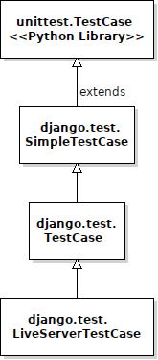
Use django.test.TestCase
Use django.test.TestCase instead of Python's TestCase.
Django's TestCase adds important features.
- automatically creates a "test" database in-memory before each test.
- extra assert methods, like assertInHTML, assertRedirects
- provides a Client class for testing views.

Slide 18
views.py
A file for your "view" methods that handle requests from the user. views may also be classes.
Views often provide data for an HTML "template" and tell Django to render it, as in example below.
# views.py
def index(request):
"""show index of recent poll questions"""
questions = Question.objects.order_by('id'[:10]
template =
loader.get_template('polls/index.html')
return render(request, 'polls/index.html',
{'question_list':questions})
...

Slide 19
views, requests, and responses
Django creates an HttpRequest object from the data in the HTTP request received from the web.
It gives this request object to the view.
A view returns an HttpResponse that Django returns.
# views.py
def index(request):
"""show index of recent poll questions"""
questions = Question.objects.order_by('id'[:10]
template =
loader.get_template('polls/index.html')
return render(request, 'polls/index.html',
{'question_list':questions})
...
HttpRequest object
render() creates HttpResponse object

Slide 20
Templates
Web apps return customized HTML pages.
Apps inject data values into a "template" for the HTML page. A "rendering engine" processes the template.
Templates may include other templates.
render(
template,
list)
HTML Page
including data from list
list_view.py
list = ...
template =
'List_template'
Rendering Engine
process
List template
.html
includes
Base template

Slide 21
templates/
You create this directory for your HTML templates.
Django recommends an extra subdirectory so that references to files are unambiguous.
mysite/
manage.py
polls/
admin.py
apps.py
...
templates/polls/
index.html
poll_detail.html
poll_results.html
views.py

Slide 22
Template to show a List
{%...%} are commands, {{ name }} are for data values.
{% extends 'base.html' %}
{% block content %}
<h1>List of Polls</h1>
<table>
{% for question in question_list %}
<tr>
<td><a href="{% url 'polls:detail'
question.id %}">
{{question.question_text}}
</a>
</td>
</tr>
{% endfor %}
</table>
template can access attributes of an object

Slide 23
Django Project Creation
By default, the project config directory has the same name as the project main directory.
cmd> django-admin startproject amazon
Creates:
amazon/
manage.py
amazon/
__init__.py
settings.py
urls.py
wsgi.py
This is CONFUSING

Slide 24
I want "mysite" !!
I want the project config directory to always be named "mysite" ... or "web" or ... (whatever you prefer).
We should have a standard name for the config dir
for all our projects!
amazon/
manage.py
mysite/
__init__.py
settings.py
urls.py
wsgi.py
I want my settings here!

Slide 25
Method 1: Rename project
Always create a project with name "mysite",
then rename the project directory.
cmd> django-admin startproject mysite
cmd> rename mysite amazon
amazon/
manage.py
mysite/
__init__.py
settings.py
urls.py
wsgi.py

Slide 26
Method 2: Create project in "."
Create project directory yourself, "cd" to that directory, and then run "startproject" with an extra parameter:
cmd> mkdir amazon
cmd> chdir amazon
cmd> django-admin startproject mysite .
"." means: create the project in the current directory.

Slide 27
Resources for MVC
Too many! Everyone has their own interpretation of the MVC Pattern. A useful place to start is:
Wikipedia page for "MVC Design Pattern"
Implementing MVC is different for GUI apps running on a single host and web apps.

