Slide 1
Merge Practice
Some simple examples of merging and conflict resolution.

Slide 2
A Common Problem
1. Developer A clones a repo from Github, or "pulls" latest rev from github. Now his local copy is up to date!
2. Developer A starts work on his local copy.
3. Developer B (same person or other) directly edits a file on Github -- quite often its README.md, and saves it. That is a new commit.
4. Developer A finishes his work, commits it, and does "git push" to Github.
What Happens?
Notes:
framework for management. You can use it to manage lots of things, not just software development.

Slide 3
Understanding diffs
"diff" is a Unix command to show differences between text files. It show:
lines changed (differences)
lines added in one file
lines deleted in one file
may show surrounding identical lines for context.
Example: make 2 copies of a text file. Change one copy (add lines, change lines, delete lines). Run diff:
cmd> diff a.txt b.txt

Slide 4
Git diffs
Git displays differences between files using "diff" notation.
Example: Go to a repository you already have.
1. Verify your working copy is "clean": git status
2. Edit README.md (on any text file, including *.py).
2. What has changed?
cmd> git diff

Slide 5
Output of git diff
diff --git a/README.md b/README.md
index ff3ac4b..1434aa0 100644
--- a/README.md
+++ b/README.md
@@ -1,6 +1,6 @@
## Unit Testing Assignment
-by Bill Gates.
+by Bill Gates. ARE YOU REALLY BILL GATES???

Slide 6
Try It!
Use your unittesting repo on Github.
Dev A: On your own computer...
1. Make sure your local repo and Github are in sync.
cmd> cd workspace/unittesting (wherever you cloned)
cmd> git status
On branch master
Your branch is up to date with 'origin/master'.
cmd> git push
Everything up-to-date (no changes to push)
Alternative: Create a fresh clone from Github
cmd> cd workspace
cmd> git clone [github-unittesting-url] unittesting-merge

Slide 7
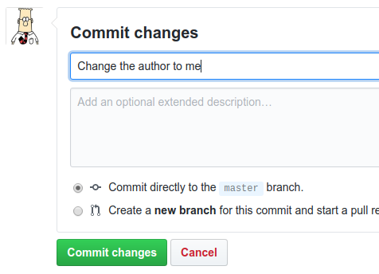
Dev B: Make a change on Github
1. Browse to
https://github.com/ISP19/unittesting-your_github_id
2. The README.md file is shown at bottom. Click edit icon to edit it.
3. Change the author -- any
change is OK.
4. Write a commit message
and click
[Commit changes]

Slide 8
Dev A: Commit work your local repo
1. Edit README.md and change some lines:
## Unit Testing Assignment
Copyright by Bill Gates and Fatalai Jon
2. Commit the changes to your repo git commit -a -m "..."
3. Push your changes to Github
cmd> git push
To https://github.com/ISP19/unittesting-fatalaijon.git
! [rejected] master -> master (fetch first)
error: failed to push some refs to 'https://github.com/ISP19/unittesting-fatalaijon.git'
hint: Updates were rejected because the remote contains
hint: work that you do not have locally. This is usually
hint: caused by another repository pushing to the same ref.

Slide 9
What Happened? What to Do?
Your local "master" is "behind" the master on Github.
Your work is based on a previous commit to master.
Need to update your local repo before you can push.
cmd> git pull
remote: Total 3 (delta 2), reused 0 (delta 0), pack-reused 0
Unpacking objects: 100% (3/3), done.
From https://github.com/ISP19/unittesting-fatalaijon
81fcef6..855692a master -> origin/master
Auto-merging README.md
CONFLICT (content): Merge conflict in README.md
Automatic merge failed; fix conflicts and then commit the result.

Slide 10
Understand the conflict
"git status" might help...
cmd> git status
On branch master
Your branch and 'origin/master' have diverged,
and have 1 and 1 different commits each, respectively.
(use "git pull" to merge the remote branch into yours)
You have unmerged paths.
(fix conflicts and run "git commit")
(use "git merge --abort" to abort the merge)
Unmerged paths:
(use "git add <file>..." to mark resolution)
both modified: README.md

Slide 11
Fixing conflicts
1. For text files, conflicts are written into your working copy. Example in next slide.
2. You have to edit the files and fix the conflicts.
  or use a GUI merge tool and "git mergetool"
3. After fixing conflicts use "git commit" to resolve the conflict and save changes.
--- or ---
3b. If you can not fix conflicts, abort the merge operation:
git merge --abort
this resets your working copy to before the merge.

Slide 12
View the conflicts
Edit the file to see what has changed.
cmd> edit README.md
++<<<<<<< HEAD
+by Bill Gates and Fatalai Jon
++=======
+by Fatalai Jon.
++>>>>>>> 855692a4b30b46645e51999bb27e72adbfbaca9d

Slide 13
"git pull" = "git fetch" + "git merge"
"git pull" performs two commands:
git fetch - fetch updates from a remote repository. This changes your local repo.
git merge - merge two development histories.

