Slide 1
OAuth Practice
OAuth Playgrounds

Slide 2
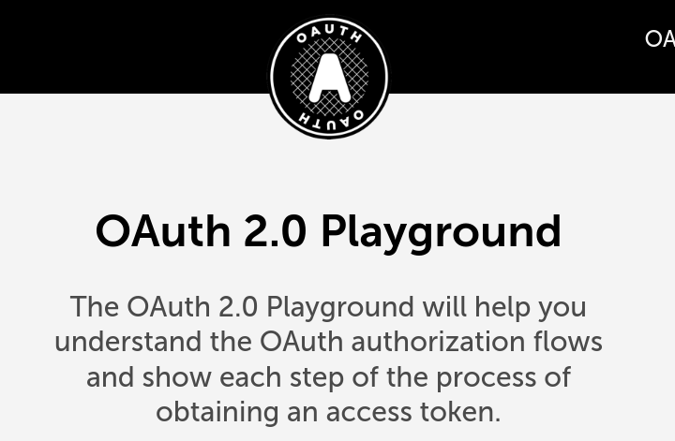
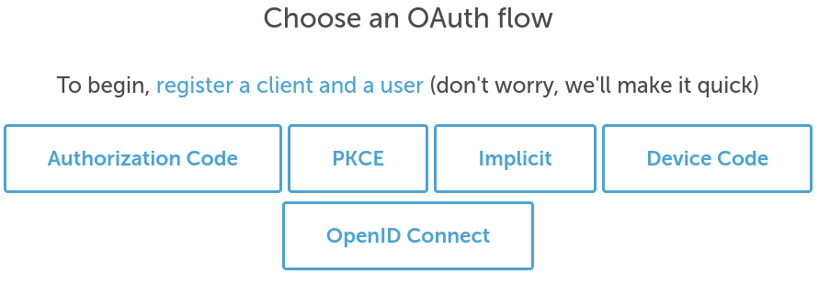
Exercise: OAuth 2.0 Playground
https://www.oauth.com/playground/
Choose "Authorization Code" Flow

Slide 3
Exercise: OAuth 2.0 Playground
Choose "Authorization Code" flow.
Work through the exercise.
Note:
you need to remember (or write down) the username and password the site gives.

Slide 4
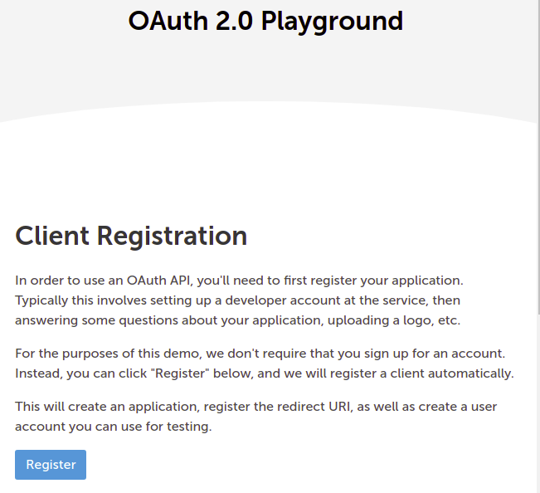

Slide 5
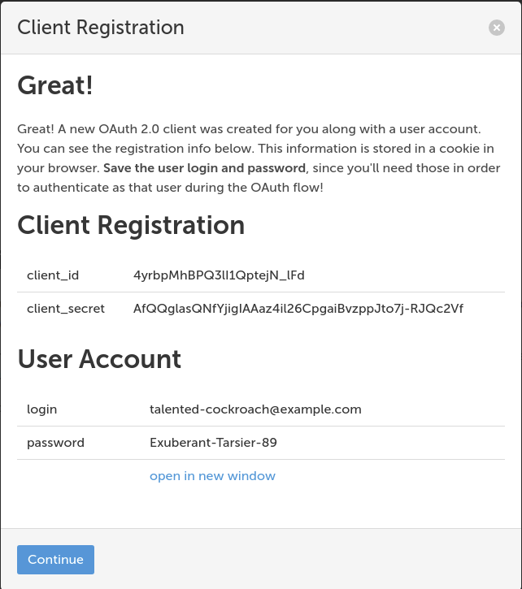

Slide 6
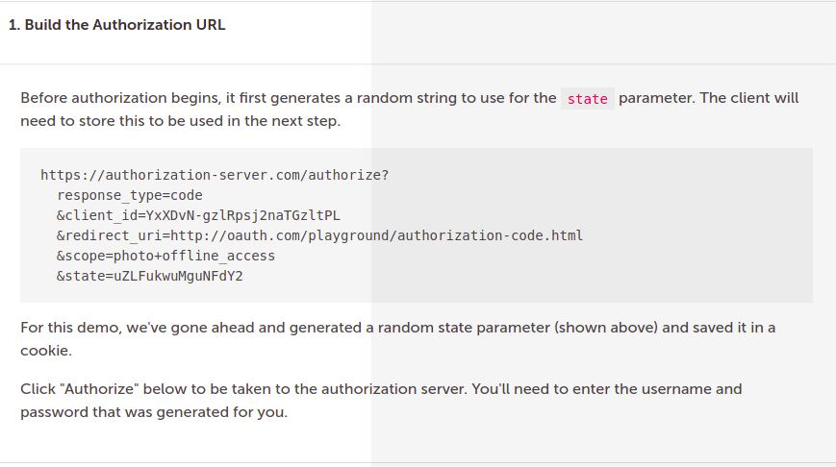

Slide 7
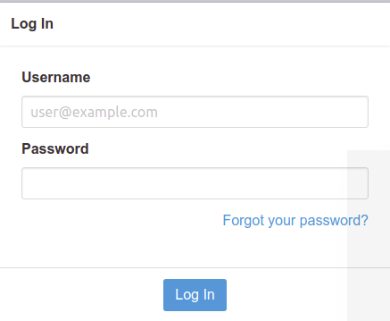
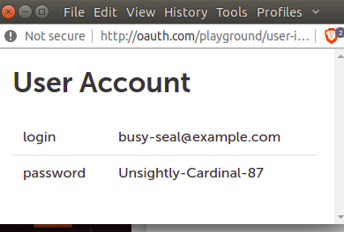

Slide 8
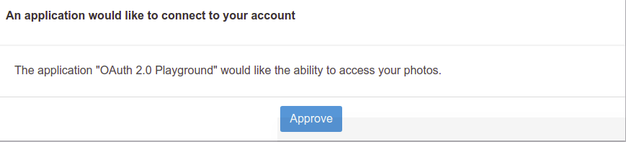

Slide 9
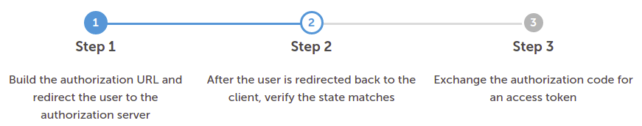
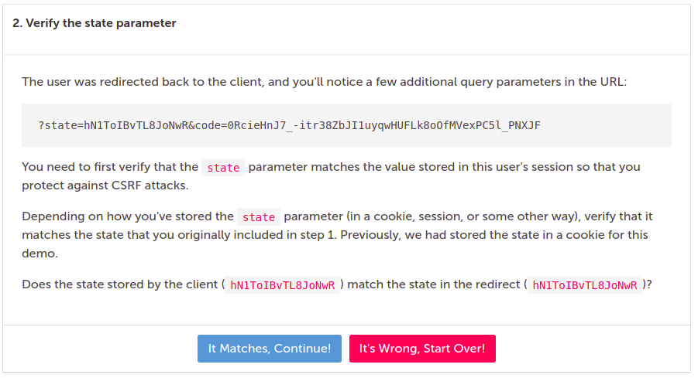

Slide 10
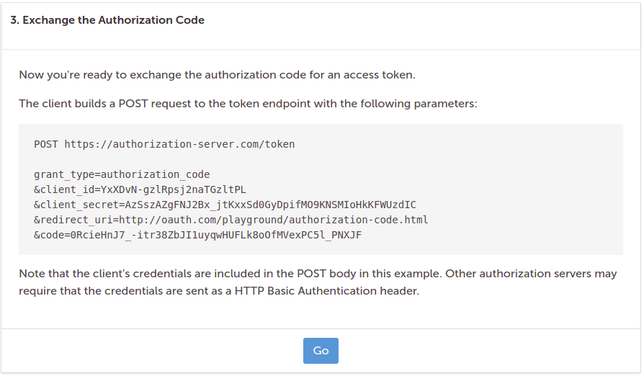

Slide 11
