Slide 1
Intro to Unit Testing
James Brucker

Slide 2
Many Kinds of Software Testing
Test requirements - consistent? unambiguous?
Test application design - does it satisfy requirements? Consistent with Vision? Anything not in requirements?
Unit Testing - test individual methods and functions
Integration Testing
End-to-End or Functional Testing
Acceptance Testing
Usability Testing

Slide 3
Why Test?
1. Saves time!
Testing is faster than fixing "bugs".
2. Testing finds more errors than debugging.
3. Prevent re-introduction of old errors (regression errors).
Programmers often recreate an error that was already fixed when they modify code.
4. Validate software: does it match the specification?

Slide 4
Psychological Advantages
Keeps you focused on current task.
Increase satisfaction.
Confidence to make changes.

Slide 5
Test Often
Design
Test
Code
Test
Code
Test
Refactor
Test
Code
Agile Development
Test early.
Test continually!

Slide 6
Testing Done Wrong
Design
More Code
Fix Bugs
More Code
Code
More Code
Code
Test

Slide 7
When to Test?
While you are coding.
Whenever you fix or modify existing code.
Before & after refactoring.
When the environment changes - upgrade a package, "pull" new code, change Python version, change OS, change computer.

Slide 8
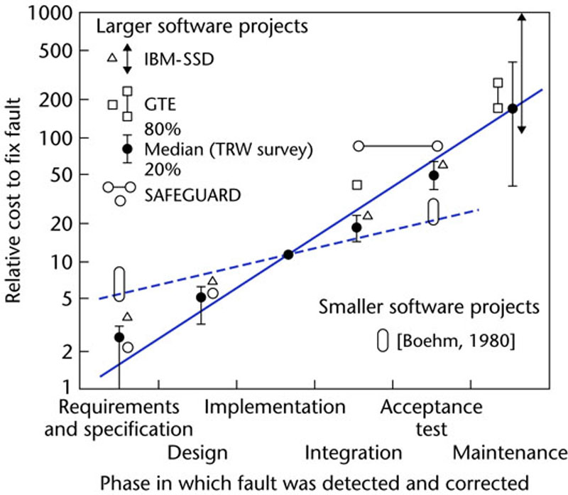
The Cost of Fixing "faults"
Discover & fix a defect early is much cheaper (100X) than to fix it after code is integrated.
Figure 1.5

Slide 9
What to Test?
In unit testing, we test functions or methods.
Test that inputs produce the expected results.
Input
Function
Output

Slide 10
Test State, Too
Many operations change the state of an object or component.
You should test the expected state, too.
start()
Stopwatch
is running ?
is elapsed increasing?

Slide 11
How to Test?
We can not test all possible inputs & outputs.
Divide input into categories or sets.
Discover "rules" that apply to different sets of input.
Test a few samples from each set, category, or class.
Test boundary values.
Test "typical" values.
Test "extreme" values.
Test impossible values.
Try to make the code fail.

Slide 12
Example: gcd(a,b)
gcd(a:int, b:int) = greatest common divisor
gcd(24,30) -> 6
gcd(3, 7) -> 1 (no common factors)
Rule: gcd is always positive
gcd(80,-15) -> 5
gcd(-7,-3) -> 1
Rule: gcd involving zero is positive
gcd(8,0) -> 8
gcd(0,-8) -> 8
Edge Case: something the may go wrong
gcd(0,0) -> 1

Slide 13
Defining Test Cases
Test Case | Example Arguments
Two positive ints with common factor | (30, 35), (48, 20), (36, 999)
Two int with no common factor | (1, 50), (50, 3), (370, 999), (1,1)
One or both args are negative | (-30,45), (72,-27), (-1,-2)
One or both args are zero | (99, 0), (0, 7), (0, -7), (0, 0)
Extreme case to test algorithm efficiently terminates | (123*123457890123, 123*789012345890)

Slide 14
Don't Rely on Manual Tests
Automate
Automate
Automate
Why?

Slide 15
Python Unit Test Libraries
Doctest - tests in code provide documentation
Unittest - the standard, based on JUnit
Pytest - simple yet powerful package for concise tests. Can execute doctests & unittests, too.
Tools to Enhance Testing:
Mock objects - "fake" objects for external components
Hamcrest - declarative rules of "intent" to help write readable, powerful matching rules for tests.

Slide 16
Python unittest
import unittest
class TestGcd(unittest.TestCase):
def test_gcd_positive_values(self):
"""Should return positive gcd."""
self.assertEqual(5, gcd(30, 35))
self.assertEqual(4, gcd(48, 20))
def test_gcd_no_common_factors(self):
"""gcd of relatively primes values is 1."""
self.assertEqual(1, gcd(30, 49))
self.assertEqual(1, gcd(27, 29))
self.assertEqual(1, gcd(44, 1))

Slide 17
Doctest
def gcd(a: int, b: int):
"""Return the greatest common divisor two ints.
Examples:
>>> gcd(24, 30)
6
>>> gcd(24, -36)
12
>>> gcd(24, 49)
1
>>> gcd(0, 15)
15
"""
Provides documentation. Each test is a different category of input.

Slide 18
Pytest
import pytest
def test_gcd_positive_values():
"""Should return positive gcd."""
assert 5 == gcd(30, 35)
assert 4 == gcd(48, 20)
def test_gcd_no_common_factors():
"""gcd of relatively primes values is 1."""
assert 1 == gcd(30, 49)
assert 1 == gcd(27, 29)
assert 1 == gcd(44, 1)
Run: pytest -v
pytest -v test_file_name.py

Slide 19
Parameterize: reuse test code
import pytest
@pytest.mark.parametrize( #"parametrize" is not typo
"a, b, expected",
[ (30, 35, 5),
(48, 20, 4),
(27, 29, 1),
])
def test_gcd_positive_values(a, b, expected):
assert expected == gcd(a, b)
Run a test with multiple sets of values.
unittest has parameterized tests, too.

Slide 20
FIRST guide for good tests
Fast
Independent - can run any subset of tests in any order
Repeatable - always get same result
Self-checking - test knows if it passed or failed
Timely - written at same time as the code to test

Slide 21
Prepare for Quiz
On a quiz, you will not have time to stumble around searching for how to perform some test.
You should learn and memorize in advance
what "asserts" are available and how to quickly find them in the unittest docs (points deducted for nonspecific assert)
how & when to use setUp, setUpClass, and tearDown
how to test for exceptions
parameterized tests
how to test Django views, models, & templates. How to use django.test.TestCase and Client classes.

Slide 22
References
unittest in Python Library (search for "unittest")
Learn the many "assert" methods
Learn to use setUp, tearDown, setUpClass
Parameterized testing
Getting Started with Testing in Python
Article on using unittest. Includes testing of web API and web applications.
https://realpython.com/python-testing/

