Slide 1
Feedback on Lab Exam

Slide 2
Test a Specification, not an Implementation
Don't test attributes (implementaton) -- the code may change.
def test_bids(self):
auction = Auction("Sailboat")
auction.start()
auction.bid("John", 10000)
self.assertEqual("Sailboat", auction.name)
self.assertEqual(10000, auction.bids["John"])
# trivial methods can be verified by code review
def test_active(self):
auction = Auction("Sailboat")
auction.start()
self.assertTrue( auction.active )

Slide 3
Don't test attributes
Test functionality instead of private attributes.
def test_init(self):
auction = Auction("iPad")
self.assertEqual(auction.name, "iPad")
self.assertEqual(auction.bids, {"no bids": 0})
self.assertEqual(auction.increment, 1)
self.assertEqual(auction.active, False)
auction.increment -- OK to test since it is important and no other way to verify in unit tests.
auction.name is not important and can test using str(auction)
auction.bids is implementation detail -- test behavior instead
auction.active is implementation detail -- test using is_active()

Slide 4
Use setUp to Create Test Fixture
Eliminate redundant code
def setUp(self):
self.auction = Auction("Sailboat")
self.auction.start( )
def test_bids(self):
#auction = Auction("Sailboat")
self.auction.bid("John", 10000)
self.assertEqual(10000,
self.auction.best_bid())
Must be setUp(self) - NOT setUP(self)
- NOT setUp(self, name, bid)
- unittest calls setUp itself!

Slide 5
Don't "guess" the specification
The Auction class did not specify what happens if bid increment = 0 or < 0, so don't test that.
def test_negative_increment(self):
with self.assertRaises( AuctionError ):
auction = Auction("Sailboat", -1)
In a software project, tests help you find
ambiguity and incomplete specification.
Open an issue & discuss how to clarify spec.
Try not to guess what the spec "should" be.

Slide 6
Correct Code Should Pass All Tests
1. If code is correct, all tests should PASS.
cmd> python -m unittest -v auction_test.py
--------------------------------------------------
Ran 8 tests in 0.001s
OK
2. If code contains bugs but no syntax or semantic errors, the appropriate test should fail. Or, sometimes "error".
test_bid_too_low (auction_test.TestAuction) ...FAIL
--------------------------------------------------
Ran 8 tests in 0.001s
FAILED (failures=1)

Slide 7
Should not make these mistakes...
def test_bid(self):
# these statements are wrong
self.assertTrue(Auction("Sailboat"))
Auction("Pizza")
Auction.start( )
Auction.bid("Jim", 100)
def test_best_bid(self):
a = Auction("ISP Final Exam")
a.start()
a.bid("Hacker", 1000)
self.assertEqual( a, 1000)

Slide 8
Test Sensitivity
Sensitivity - ability to detect a flaw.
In scientific research: probability that a test will correctly detect a condition (when it is present).
What is wrong with this test?
def test_bid_invalid_parameters(self):
with self.assertRaises( ValueError ):
# both of these should raise error
self.auction.bid("", 100)
self.auction.bid("Joe", 0)

Slide 9
What is wrong with this test?
Suppose the code permits bidder name to be "" (bug),
but auction.bid("Joe",0) raises ValueError (amount = 0).
The 2nd statement causes the test to always pass.
def test_bid_invalid_parameters(self):
with self.assertRaises( ValueError ):
# both of these should raise error
self.auction.bid("", 100)
self.auction.bid("Joe", 0)

Slide 10
Another Example
Suppose:
1. auction allows bidding when stopped (incorrect)
2. auction raises AuctionError if bid too low (correct!)
Will this test detect the bug?
def test_bid_when_auction_stopped(self):
self.auction.bid("Good", 600)
self.auction.stop()
with self.assertRaises( AuctionError ):
self.auction.bid("Bad", 1000) #1
self.auction.bid("Worse", 500) #2

Slide 11
Can You Summarize?
If a "with self.assertRaises" contains many statements, the test will pass under what conditions?
[ ] all statements throw expected exception
[ ] any statement throws expected exception
def test_bid_when_auction_stopped(self):
with self.assertRaises( AuctionError ):
statement1( )
statement2( )
statement3( )

Slide 12
Tests Should Help Diagnose Problem
Tests should be specific -- not one big test.
def test_normal_bidding(self):
# auction created and started in setUp()
auction.bid("Ant", 100)
with self.assertRaises(AuctionError):
auction.bid("Bird", 100) #identical bid
# bid + minimum should be OK
auction.bid("Cat", 100+auction.increment)
with self.assertRaises(AuctionError):
auction.stop() # wrong location. Why?
auction.bid("Dog",1000)
These tests should be
in separate methods.

Slide 13
Focused tests help to identify problem
Use descriptive names, test single kind of behavior
def test_normal_bidding(self):
self.auction.bid("Ant", 1) # minimum bid
self.auction.bid("Bat", 2) # minimum increase
self.auction.bid("Cat", 50.5) # decimals ok?
self.auction.bid("Ant", 51.5) # bid again ok?
self.assertEqual(51.1, auction.best_bid())
def test_low_bid_throws_exception(self):
self.auction.bid("Good guy", 10)
with self.assertRaises(AuctionError):
self.auction.bid("Cheap", 9.99) # too low
with self.assertRaises(AuctionError):
self.auction.bid("Cheap", 10) # same bid
with self.assertRaises(AuctionError):
auction.stop() # wrong location. Why?
auction.bid("Dog",1000)

Slide 14
Test What Could Reasonable Fail
We can't test everything, so don't test for stupid code.
def test_bid_must_be_positive(self):
with self.assertRaises(ValueError):
auction.bid("Ant", 0)
with self.assertRaises(ValueError):
auction.bid("Bird", -0.1)
with self.assertRaises(ValueError):
auction.bid("Cat", -20)
#OVERKILL - if above tests pass, this will, too
with self.assertRaises(ValueError):
auction.bid("Dog", -100)
auction.bid("elephant", -500)
auction.bid("Frog", -10000000)

Slide 15
Student Codes
Many short, specific tests with descriptive names:
Tharathorn - 12 tests, mostly short (some could be shorter)
Mega-test non-specific "all in one" tests:
Apipark - one test, 26 lines

Slide 16
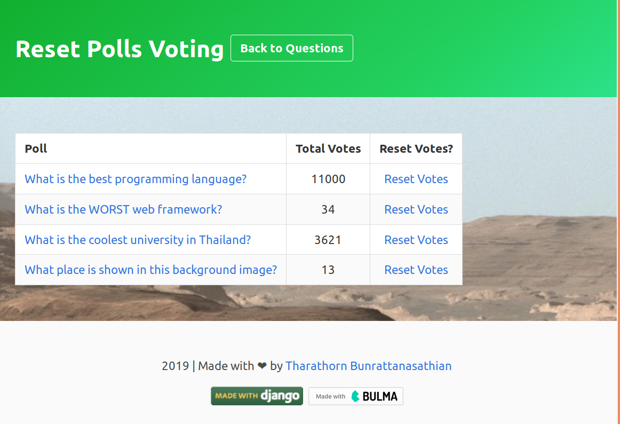
Best Django Applications
#1 Tharathorn
#2 Chananchida

