Slide 1
What's a Name?
During a Sale, input requests are handled by the Register.
Why call it Register?
Why not Controller?

Slide 2
What's a Name?
During a Sale, input requests are handled by the Register.
Why call it Register? Why not Controller?
Lower Representational Gap (LRG)

Slide 3
What Diagram?
What info do you get from this sequence diagram?
What is this type of diagram called?
Process Sale Scenario
:
System
:
Cashier
makeNewSale
loop
[
more items
]
enterItem
(
itemID
,
quantity
)
description
,
total
endSale
total with taxes
makePayment
(
amount
)
change due
,
receipt

Slide 4
Assigning Responsibilities
Larman recommends what 3 steps for assigning responsibilities?
1.
2.
3.

Slide 5
Assigning Responsibilities
Larman recommends what 3 steps for assigning responsibilities?
1. clearly state the responsibility
2. identify the information needed to perform it
3. apply design principles (GRASP, SOLID)

Slide 6
GRASP Principles
Information Expert
Creator
Controller
Low Coupling
High Cohesion

Slide 7
GRASP Review
__________________ all input should be sent to the Register first.
__________________ behavior related to a sale should be in the Sale class, ...and nothing else.
__________________ Sale should create LineItems because it closely uses them
__________________ Sale shouldn't depend on too many other classes
__________________ Sale should compute the total because it has all the info needed to compute it

Slide 8
Information Expert
Question:
Who should compute the total value of a Sale?
Answer:
Sale. Because Sale has all the information needed to do this.

Slide 9
Creator
Question:
Which object should create LineItems ("A")?
Solution: choose the class that...
1. contains or is composed of A
2. records A
3. closely uses A
4. has the data needed to initialize A

Slide 10
Controller
Question:
How should the User Interface connect to the domain layer of our application?
Solution:
design a controller class to receive all requests from the U.I.
Alternative:
create one controller per Use Case or bundle of related Use Cases

Slide 11
Low Coupling
Question:
How to reduce the impact of change?
The contents of a Sale or Payment may change in later iterations.
Solution:
1. use an interface, "program to a specification (interface, abstract base class), not to an implementation"

Slide 12
High Cohesion
Question:
How to keep objects focused, understandable, managable, and, as a side effect, support Low Coupling?
Answer:
have them meditate :-)
if that doesn't work, read Larman, Ch. 17

Slide 13
More GRASP Principles

Slide 14
More GRASP Principles
Polymorphism
Pure Fabrication
Indirection
Protected Variations

Slide 15
Polymorphism
"Don't ask what type"
Problem:
How to handle alternative types of objects?
That is, a set of responsibilities can be performed by different types of objects (decided at runtime)?
How to create pluggable components?
Example:
How can the Medical Record system find and display new types of tests without modifying existing code?

Slide 16
Polymorphism
Example:
how to support changing rules for computing tax of a Sale?
Solution:
Define an interface for TaxCalculator.
In Sale, create a setTaxCalculator( ) to inject the calculator.

Slide 17
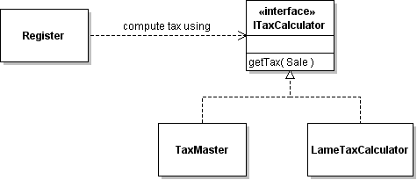
TaxCalculator

Slide 18
Polymorphism
Search for Product in ProductCatalog:
ProductCatalog.search( searchspec ) matches products using description, category, and price.
How can we enable searching for new kinds of products with other attributes (e.g. search for book by author)?
List<Product> search(Product spec) {
String desc = spec.getDescription().toLowerCase();
if (! desc.isEmpty()
&& this.getDescription().toLowerCase().contains(desc)) return false;
... // check other attributes
return true;
}

Slide 19
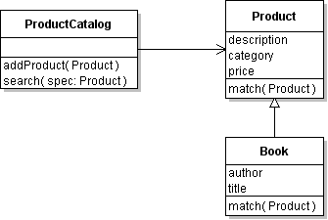
Use Polymorphism
(1) ProductCatalog.search( ) invokes Product.match( )
Product matches itself to search spec.
(2) Create subclass of Product for new types and override match( ).
There is a better design than this, right?
Dog
match(Product)

Slide 21
Pure Fabrication
"What do you do when nothing else works?"
Problem:
What object should be given a responsibility when the choices suggested by Info Expert violate the goals of high cohesion and low coupling?
Example:
What class should save a Sale to the database?
The method needs to use JPA or (worse) JDBC.

Slide 22
Pure Fabrication
Solution:
Create an artificial or convenience class.
Example Solution:
Create a Dao (data access object).

Slide 23
Pure Fabrication
Example:
give your own example

Slide 24
Behavioral Decomposition
We can decompose a problem in two ways:
Representational Decomposition
classes in model represent things in the problem domain.
Behavioral Decomposition
problem is broken done by behavior. Related functions are placed in the same class.
(a pure fabrication)

Slide 25
Behavioral Decomposition
Example:
In Course Scheduler problem, a behavior is to find a feasible solution to the course requirements and constraints.
Solution:
Create a ScheduleOptimizer class that provides this behavior.

Slide 26
Indirection
Question:
How to assign responsibilities to avoid direct coupling between classes, even though one class needs the services of another one?
Solution:
Assign the responsibility to an intermediate object.

Slide 27
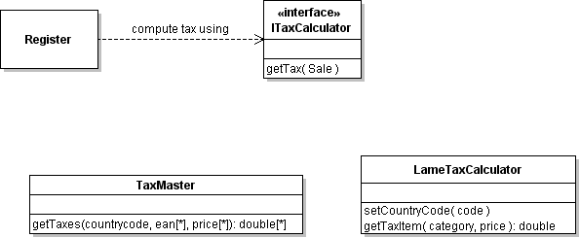
Indirection & Tax Calc
Example:
Each TaxCalculator (3rd party software) has its own API.
How can our software "talk to" any tax calc?
?

Slide 28
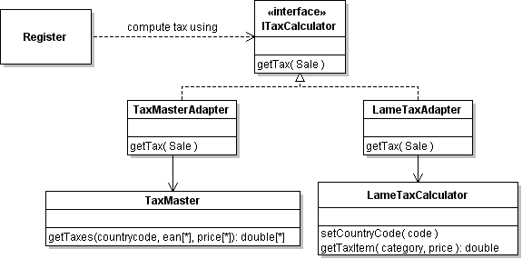
Indirection & Tax Calc
Solution:
Create an Adapter for each type of TaxCalculator, that adapts to our TaxCalculator interface.

Slide 29
Protected Variations
"How to protect against change?"
Question:
How to design objects so that variations or change does not impact other objects?
How to avoid changing the source code to accommodate changes in other systems?
Example:
The medical tests may change.
The language displayed in UI may need to change.
The way of accessing persistent storage may change.

Slide 30
Protected Variations
Solution:
Identify points of variation.
Create a stable interface around them.

Slide 31
Mechanisms for P.V.
Service Lookup
Externalizing data, such as a properties file
Indirection
Reflection
Uniform Access
Standard Language, e.g. SQL

Slide 32
Service Lookup
Use a Service Locator so that the provider of a service can be changed dynamically.
String URL = properties.getProperty( "jdbc.url" );
String user = properties.getProperty( "jdbc.user" );
String pass = properties.getProperty("jdbc.password");
// DriverManager is the service locator.
// It finds a connection provider based on URL
Connection connection = DriverManager.getConnection(URL, user, pass);
MySQL URL = "jdbc:mysql://hostname/world"
DerbyDB URL = "jdbc:derby:/path/database"

Slide 33
Externalize Data
log4j.properties file to configure Log4J
messages.properties resource bundle for messages
# English messages (default)
greet.hello = Hello, {0}
greet.goodbye = Goodbye
messages_de.properties
# German messages
greet.hello = Hallo {0}
greet.goodbye = auf Wiedersehen
// Java: get string from bundle
ResourceBundle bundle =
ResourceBundle.getBundle("messages");
String hello = bundle.getString("greet.hello");

Slide 34
Use Your Own Properties
Create a java.util.Properties object.
Load data from a file located on the classpath.
Properties properties = new Properties();
// locate file "pos.config" on the classpath
ClassLoader loader =
Properties.class.getClassLoader();
try {
InputStream instream =
loader.getResourceAsStream( "pos.config" );
properties.load( instream );
instream.close( );
} catch ( IOException e ) { ... }

Slide 35
Uniform Access
method and field exposed in the same way
Is amount a field (attribute) or a property (method)?
# a Money object in Python
Money m = Money( 0.0, "Baht")
m.amount = 1000.0
m.amount = m.amount + 50

Slide 36
Properties in C#
struct Money {
private String currency;
private double amount;
public Money( double amt, String currency ) {
this.amount = amt; this.currency = currency;
}
public String Currency {
get { return currency; }
}
public double Amount {
get { return amount; }
set { amount = value; }
}
define properties

Slide 37
Uniform Access
Operator Overloading for uniform access:
user data type behaves like built-in types
// Money arithmetic in C#
Money m1 = new Money(100.0, "Baht");
Money m2 = new Money(200.0, "Baht");
Money total = m1 + m2; // is this legal???

Slide 38
Operator Overloading
struct Money {
private String currency;
private double amount;
public Money( double amt, String currency ) {
this.amount = amt;
this.currency = currency;
}
public static Money operator+(Money a, Money b){
if ( a.currency != b.currency ) throw ...;
Money result = new Money(a.currency);
result.Amount = a.amount + b.amount;
return result;
}

Slide 39
EL Expressions in JSP
In JSP, use EL expression to access object properties:
<p>Hello, ${user.name}. </p>
Can mean:
user.getName() or user.get("name") if user is a Map.
What is user? It can an attribute from page, request, session, or application (context) scope.
In Servlet:
this never causes a null pointer exception
request.setAttribute("user", myuser);
or... session.setAttribute("user", myuser);
// now forward to JSP

Slide 40
More Uniform Access with EL
<p>Hello, ${user.name}. </p>
Can mean:
user.getName() or user.get("name") if user is a Map.
What is user? It can an attribute from page, request, session, or application (context) scope.
In Servlet:
request.setAttribute("user", user);
or... session.setAttribute("user", user);
// now forward to JSP

Slide 41
Reflection
Used by Hibernate and other ORM to determine structure of your classes at run-time.
Used by Property Editors to access Java Bean properties.
JSP: ${a.cost} can mean
a.getCost( ) or a.get("cost") if a is a Map.

Slide 42
When and Where to use P.V.
Variation points
places where variation is required by the current, existing design.
POS must accommodate varying TaxCalculators, varying pricing rules.
Evolution points
places where changes in requirements could force a change in design.
POS might require UI in a different language.

Slide 43
Avoid Too Much P.V.
Avoid "future proofing" without good reason
P.V. can add complexity to design.
Adds to development cost.
Makes code harder to understand.

Slide 44
Open-Closed Principle
Mechanisms of Protected Variations are also

Slide 45
Name the GRASP principle
create an intermediate object to avoid direct coupling between two classes
design objects so that changes in one component do not affect others
it is described as "don't ask what type"
we "invent" a class for a particular responsibility when no domain class is suitable

Slide 46
Model-View-Controller
In the MVC pattern what are the responsibilities of the model, view, and controller?
Which components are coupled to which other component?

Slide 47
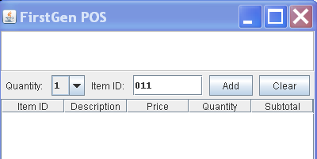
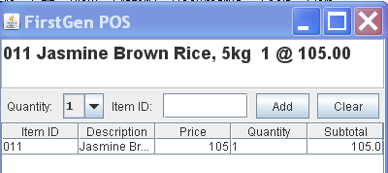
MVC in POS
1. Cashier inputs item ID.
2. POS displays description and price.
How did the view get the description and price?

Slide 48
Forms and Controls Pattern
1. The form notifies controller when there is input.
2. Controller reads data from form.
3. Controller processes data:
pd = catalog.getProductDescription( id );
sale.add( pd, quantity );
4. Controller updates fields on view.

Slide 49
Model View Controller
View layer has its own event handlers for UI-level events (e.g. ActionListener).
1. View's event handler reads cashier input.
2. View notifies controller and gives it the data.
3. Controller updates the model.
4. Model notifies observers of value change.
5. View (as Observer) gets data from model, updates the display.

Slide 50
View
Controller
addItem(id,qnty)
get model data
pd = catalog.getProduct(id)
sale.addItem( pd, qnty )
<<interface>>
Observer
notify observers
Model

Slide 51
MVC in Web Applications

Slide 52
Reference
GUI Architectures by Martin Fowler, http://martinfowler.com/eaaDev/uiArchs.html

