Slide 1
Web Application Testing in Python
With an Intro to the Testing Pyramid
and E2E Testing Tools

Slide 2
Guidance
What to Test?
Application conforms to the requirements
Logic
Flow Control
Application Flow, e.g. Page Flow
Configuration
"Don't test Constants", e.g. HTML template text
Test your code, not the framework

Slide 3
Testing Parts of a Web App
How can we automate
testing of each of these?
UI (web page)
Controller (django view)
url dispatcher
Model

Slide 4
Models: test using standard unit tests
import django.test
from polls.models import Question
class QuestionTest(django.test.TestCase):
def test_question_with_future_date(self):
tomorrow = timezone.now() +
datetime.timedelta(days=1)
question = Question( question_text=
"Is this the future?", pub_date=tomorrow)
# future date is not "recent"
self.assertFalse(
question.was_published_recently() )

Slide 5
Not necessary to test the framework
import django.test
from polls.models import Question
class QuestionTest(django.test.TestCase):
def setUp(self):
Question.objects.create(
question_text="Question One")
Question.objects.create(
question_text="Question Two")
def test_create_questions(self):
self.assertEqual(2, Questions.objects.count())

Slide 6
What is Being Tested? (cont'd)
def test_question_text(self):
self.assertTrue(
any("Question One" in q.question_text
for q in Questions.objects.all() )
This is testing Django's persistence framework.
OK to do it occasionally while learning Django.
But its not a useful test of your code.

Slide 7
Test Views and URLs
Use django.test.Client to experiment
$ python manage.py shell
>>> from django.test import Client
>>> c = Client()
# Get the /polls/ page. Should contain some polls
>>> response = c.get('/polls/')
# Did it succeed?
>>> response.status_code
200
# Print the html content
>>> response.content
'<html>\n<head>\n<style>...\n<h1>Active Polls</h1>...

Slide 8
Testing Django Views and URLs
class TestViews(django.test.TestCase):
def setUp(self):
super().setUp()
self.client = django.test.Client()
def test_polls_index(self):
poll = Question(question_text="ABCDEFGHIJ",...)
poll.save()
response = self.client.get('/polls/')
self.assertEqual(response.status_code, 200)
# Is test poll included in the page?
self.assertContains(response, "ABCDEFGHIJ")

Slide 9
Rewrite the Test using reverse()
Instead of writing "/polls/" URL as a String, use reverse() to get the URL by name from urls.py.
from django.urls import reverse
def test_polls_index(self):
poll = Question(question_text="ABCDEFGHIJ",...)
poll.save()
url = reverse('polls:index')
response = self.client.get( url )
self.assertEqual(response.status_code, 200)
# Is test poll included in the page?
self.assertContains(response, "ABCDEFGHIJ")

Slide 10
Test the / URL is Redirected
Test that 'GET /' redirects the browser to polls index.
def test_redirect_root_url(self):
"""root url should redirect to polls index"""
response = self.client.get('/')
# Test using the basic way
self.assertEqual(response.status_code, 302)
polls_url = reverse('polls:index')
self.assertEqual(response.url, polls_url)
# Better way: use TestCase assertRedirects
self.assertRedirects(response, polls_url)

Slide 11
Explore Tests using Django Shell
If you are not sure how to test, use Django Shell to try it
>>> tc = django.test.TestCase()
>>> client = django.test.Client()
# The root url / should redirect to polls
>>> response = client.get('/')
>>> tc.assertRedirects(response, '/polls/')
# "Location" header field is the redirect url
>>> assert response.get('Location') == '/polls/'

Slide 12
Useful django.test.TestCase asserts
# the response contains some text
assertContains( response, "some text")
assertNotContains( response, "bad text")
# response is a redirect to some url
assertRedirects( response, url )
# response uses a template we expect
assertUsesTemplate( response, 'polls/detail.html')

Slide 13
Useful Info in HttpResponse
client.get() or client.post() return an HttpResponse obj.
response = client.get( '/polls/' )
response attributes:
status_code - the HTTP status code (200 = OK, etc.)
request - the HttpRequest that caused this response
templates - a list of templates used in the response
content - body of the response, as a byte-string
context - the context that was used to render the template; context contains a key-value map.

Slide 14
Where is the info for TestCase?
How do you know what TestCase and Client can do?
See the "Django Testing Tools" page.
https://docs.djangoproject.com/en/3.1/topics/testing/tools/
The asserts are buried near the bottom of the page, in section "Assertions".

Slide 15
How to Test a Template?
def test_polls_index(self):
poll = Question(question_text="ABCDEFGHIJ",...)
poll.save()
response = self.client.get('/polls/')
self.assertTemplateUsed(response,
template_name='polls/index.html')

Slide 16
You can test POST, too
# Vote for a poll.
# This example assumes you somehow know the poll
# id is 1. Send POST data as a Python dictionary.
response =
self.client.post('/polls/1/', {'choice': '2'})
# What should POST return? (Should redirect)
# Test that the vote was recorded in choice.
# Test an invalid choice
response2 =
self.client.post('/polls/1/', {'choice': '9999'})

Slide 17
Are Unit Tests Enough?
No.
Unit tests don't verify that the application works.

Slide 18
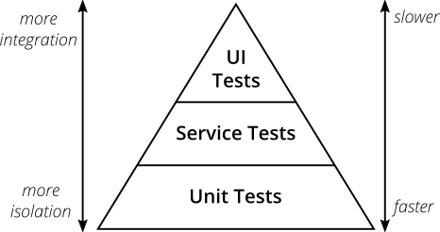
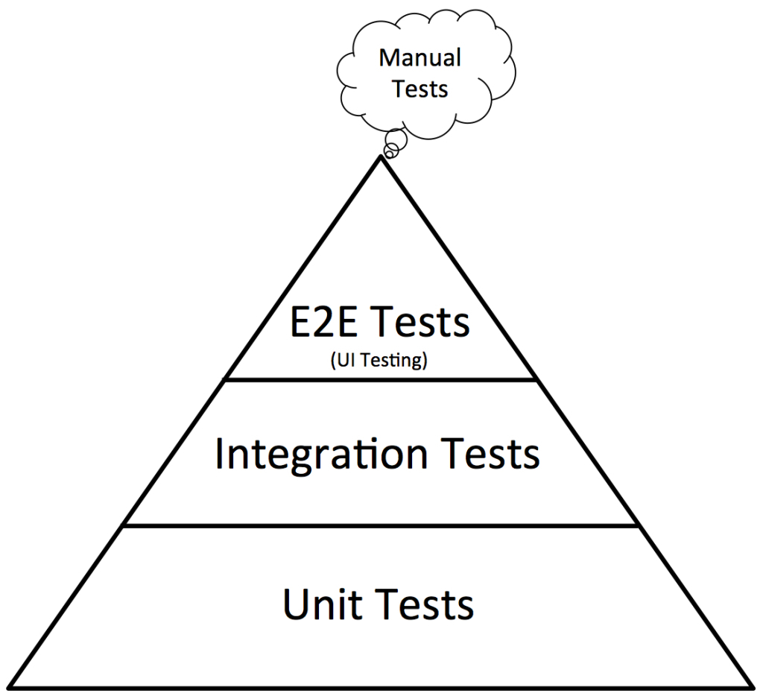
The Testing Pyramid
"Practical" pyramid
Mike Cohen's original Pyramid

Slide 19
Integration Testing
Test the interaction between components.
Components belonging to your app
Back-end services called by front-end
External components and web services
Examples:
database
file system used to save user uploaded files
a Google API used by your app
How to Test:
- often access a "service layer" or your standard URLs.

Slide 20
Functional or "End-to-End" Tests
Test the "development" or "production" app while its running! -- not a 'test' server.
Run tests through an actual web browser.
Test the application as a whole.

Slide 21
Goals of E2E Testing
1. Verify the application works "from start to finish".
2. Can perform the major use cases (user stories) via the browser interface.
- called "happy path" (nothing goes wrong)
3. Test that required services work, too.
Goal is not comprehensive testing of every feature.

Slide 22
Secondary Use of E2E Tests
Useful to verify all links, buttons, and menu items work.
No "404" or "5xx" errors.

Slide 23
E2E Testing Tools
Selenium - control an actual web browser using code.
Interface in many languages, incl. Python & Java
Django has built-in support
Selenium IDE for creating tests in a web browser
Cypress.io - Javascript testing tool. Natively interacts with pages in your application.
uses Mocha and Chai for writing tests
tests written in Javascript
Puppeteer - library for controlling a "headless" Chrome browser. Uses Javascript and node.js.
uses: page scraping, web crawling, testing

Slide 24
Human Readable Test Automation
robotframework.org - write tests in plain English
Web testing, GUI testing, process automation,
and other applications.

Slide 25
robot framework example
Test that a login succeeds.
See: https://robotframework.org/#examples
*** Settings ***
Documentation A single test for valid login.
... workflow that is created using keywords in:
Resource resource.txt
*** Test Cases ***
Valid Login
Open Browser To Login Page
Input Username demo
Input Password fatchance
Submit Credentials
Welcome Page Should Be Open
[Teardown] Close Browser

Slide 26
References
The Practical Test Pyramid
https://martinfowler.com/articles/ practical-test-pyramid.html
8 Best Testing Frameworks for Python
Article by a developer at TestProject.io
https://blog.testproject.io/2020/10/27/ top-python-testing-frameworks/
including RobotFramework, Behave, PyTest, and unittest

Slide 27
Django E2E Tests with Selenium
Test-Driven Development in Python (online book)
Several chapters use Selenium for E2E testing of the Django project in the book.

Slide 28
Testing the Github Public API
https://developer.github.com/v3/users/

