Slide 1
Refactoring Review

Slide 2
Instructions
Write the name of refactoring examples.
Write the name exactly as shown on refactoring.guru.
https://refactoring.guru/refactoring/techniques
If there are two possible answers, then
write the name of either one refactoring.
The Refactoring Category is shown
at the bottom of each slide.

Slide 3
#1
BEFORE
def normalize(text):
"""Reformat some text"""
text = text.trim()
text =
text.replace('_', ' ')
return text
AFTER
def normalize(text):
"""Reformat some text"""
result = text.trim()
result =
result.replace('_',' ')
return result
Refactoring Category: Composing Methods

Slide 4
#2 (two possible answers)
BEFORE
def roots(a, b, c):
"""Roots of Quadratic"""
if b*b - 4*a*c >= 0:
x1 = (-b +
sqrt(b*b-4*a*c))/(2*a))
x2 = (-b -
sqrt(b*b-4*a*c))/(2*a))
return (x1, x2)
return None
AFTER
def roots(a, b, c):
"""Roots of Quadratic"""
descrim = b*b - 4*a*c
if descrim >= 0:
descrim = sqrt(descrim)
x1 = (-b + descrim)/(2*a)
x2 = (-b - descrim)/(2*a)
return (x1, x2)
return None
Composing Methods

Slide 5
#3
BEFORE
def find(text: str):
"""Find text in file"""
found = False
line = None
file = open("somefile")
while not found:
line = file.readline()
if text in line:
found = True
file.close()
return line
AFTER
def find(text: str):
"""Find text in file"""
with open("somefile")
as file:
for line in file:
if text in line:
return line
return None
Simplifying Conditional Expressions
(many students write code like on the left)

Slide 6

#4
BEFORE
# chain calls to get title
title = rental.get_movie()\
.get_title()
AFTER
# Rental gets title from
# movie and returns it.
# Movie still has get_title
title = rental.get_title()
Moving Features Between Objects

Slide 7
#5
BEFORE
first = 'Bill'
last = 'Gates'
email = 'bill@msft.com'
print_person(
first, last, email)
def print_person(*args):
print(f"{args[0]}
{args[1]} email <{args[2]}>")
AFTER
@dataclass
class Person:
first: str
last: str
email: str
p = Person("Bill","Gates",...)
print_person(p)
def print_person(person):
print(f"{person.first}
{person.last}
email <{person.email}>")
Simplifying Method Calls

Slide 8
#6
BEFORE
def print_rental(title,
days_rented, price): print("{:20s} {:6d} {:f}"
.format(title,
days_rented,
price))
# Usage:
r = Rental("Frozen", 3)
print_rental(r.get_title(),
r.get_days_rented(),
r.get_price())
AFTER
def print_rental(r: Rental):
print("{:20s} {:6d} {:f}"
.format(
r.get_title(),
r.get_days_rented(),
r.get_price()))
# Usage:
r = Rental("Frozen", 3)
print_rental(r)
Simplifying Method Calls

Slide 9
#7
BEFORE
def vote(question, choice):
if not question.can_vote():
messages.error(
"voting not allowed")
elif choice not in
question.choice_set():
messages.error("invalid ...")
else:
Vote.objects.create(
user=user, question=...)
return redirect('polls:result')
# if any error, redirect to detail
return redirect('polls:detail',...
AFTER
def vote(question, choice):
if not question.can_vote():
messages.error(
"voting not allowed")
return redirect('polls:detail',..
if choice not in \
question.choice_set():
messages.error("invalid ...")
return redirect('polls:detail',..
Vote.objects.create(
user=user, question=...)
return redirect('polls:result',...)
Simplifying Conditional Expressions

Slide 10
#8 (two possible answers)
BEFORE
def greet(name):
if datetime.now().hour<12:
print("Good morning",
name)
else:
print("G'd afternoon",
name)
AFTER
def greet(firstname):
if is_morning():
print("Good morning",
name)
else:
print("G'd afternoon",
name)
def is_morning() -> bool:
return \
datetime.now().hour < 12
1. Simplifying Conditional Expressions
2. Composing Methods

Slide 11
#9
BEFORE
game = Game(800, 600)
AFTER
CANVAS_WIDTH = 800
CANVAS_HEIGHT = 600
game = Game(CANVAS_WIDTH,
CANVAS_HEIGHT)
Organizing Data

Slide 12
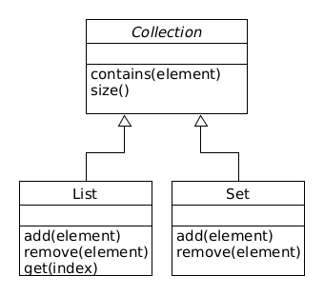
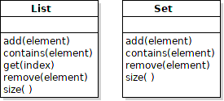
#10
BEFORE
AFTER
Dealing with Generalization

Slide 13
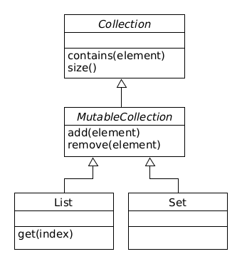
#11
BEFORE
Same code in many collections.
AFTER
Dealing with Generalization

Slide 14
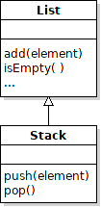
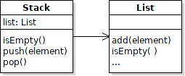
#12
BEFORE
class Stack(List):
def push(self, e):
super().append(e)
AFTER
class Stack:
def push(self, e):
self.list.append(e)
Dealing with Generalization

Slide 15

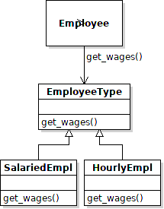
#13 (two possible answers)
BEFORE
def get_wages(self, type):
if type == SALARIED:
# return self.salary
elif type == HOURLY:
# return wage*hours
AFTER
1. Organizing Data
2. Simplifying Conditional Expressions

Slide 16
#14 Name Two Refactorings
BEFORE
class Rental:
def get_price(self):
if type == NEW_RELEASE:
price = 3*self.days
elif type == CHILDREN:
price = 1.5 + \
1.5*max(0, self.days-3)
else:
price = ...
return price
AFTER
class Rental:
days: int
price_code: PriceCode
def get_price(self):
return self.price_code.\
get_price(self.days)
class PriceCode(ABC):
pass
class NewRelease(PriceCode):
def get_price(self, days):
return 3*days
1. Organizing Data, 2. Simplifying Conditional Expressions

Slide 17
#14 Hint
Answer is not Replace Type Code with Subclass
There are also classes (not shown to save space)
class ChildrensMovie(PriceCode):
def get_price(self, days): ...
class RegularMovie(PriceCode):
def get_price(self, days): ...

Slide 18
#15
BEFORE
SPADES = 1
HEARTS = 2
CLUBS = 3
DIAMONDS = 4
class Card:
def __init__(self, value,
suite: int):
...
c = Card(4, HEARTS)
AFTER
class Suite(Enum):
SPADES = 1
HEARTS = 2
CLUBS = 3
DIAMONDS = 4
class Card:
def __init__(self, value,
suite: Suite):
...
c = Card(4, Suite.HEARTS)
Organizing Data, but different refactoring from #12 - 14.

Slide 19
Can You Justify Your Refactorings?
Imagine refactoring during a code review.
Can you explain to the team why you refactor?
You should be able to:
Explain the Benefit of each refactoring
Be specific in your reason - no vague claim like "easier to ..."
Instead, state why and how something is "easier".

Slide 20
Example: Extract Method
Why? What's the Benefit?
method logic becomes clearer, which reduces errors and improves maintainability
the code you extract can be tested separately.
When it is embedded in another method, it might not be testable.
by reducing the amount of work a method is doing, it gets closer to the goal of "1 method does 1 thing".
And the method name can be more descriptive.
increase opportunity to reuse code and eliminate duplicate code - focused methods are more reusable

Slide 21
Refactoring is Not Always this Simple
These examples are simple
in order to fit on one slide.
Actual code is much more complex.
...and the more complex the code is,
the more it may need refactoring.
It helps to know
1) refactoring signs and symptoms,
2) design principles.

