Slide 1
Personality Assessment
Take the personality ASSESSMENT:
https://www.16personalities.com

Slide 2
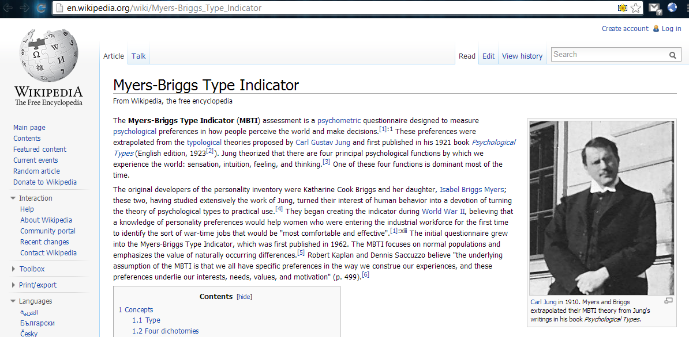

Slide 3
16 Personality "types"

