Slide 1
Introduction to Graphical Interfaces

Slide 2
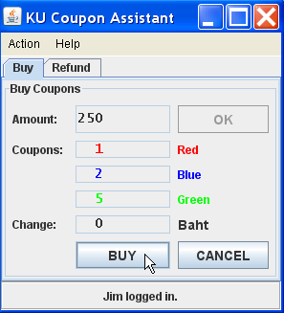
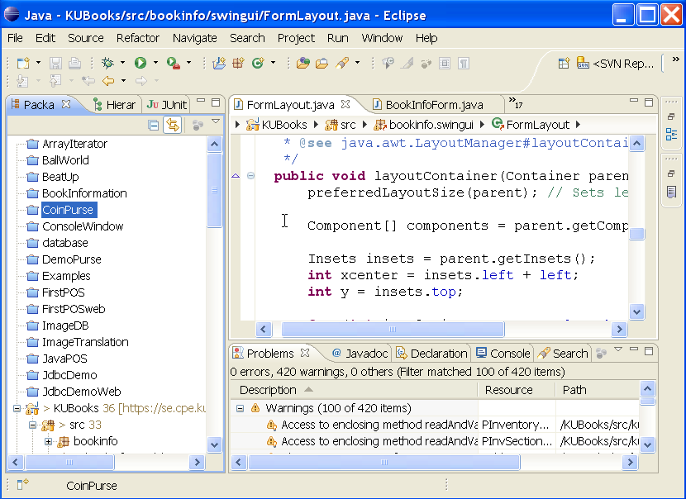
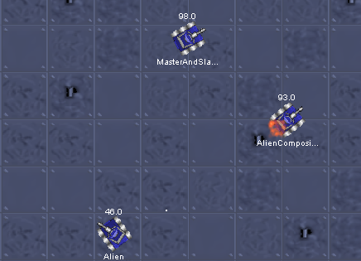
Different Kinds of Apps
Graphical User Interface
Display info and accept user input
Built using components
"Forms" applications
IDE, File Manager, etc.
Graphics Programming
Manipulate graphical elements on a display
points, lines, curves, shapes
images, textures,
animation, 3D effect

Slide 3
Frameworks
Python has frameworks for building graphical apps.
Tkinter - included with Python distribution, easy to use.
PyQt5 - built on QT cross-platform framework. Powerful, requires Qt be installed on host.
wxPython - wrapper for wsWidgets API for creating cross-platform GUI interfaces.
Kivy - based on OpenGL, suitable for GUI and games.

Slide 4

Parts of a GUI
Window shown on screen
Components
("widgets")
Label (r/o)
Entry (input)
Button
Container contains Components
Layout Manager
Arrange & align components, resize things when window size changes.
Event Handlers
(code)
def button_handler():
name = entry.get()
print(f"Hello, {name}")
entry.delete(0, len(name))

Slide 5
Define our GUI
Layout - using a grid:
column 0 column 1 column 2
tkinter.Tk Window
row 0
label:
Label
namefield: Entry
greet_button: Button

Slide 6
Create a Simple GUI
1. create a window (includes a container)
import tkinter as tk
root = tk.Tk()
root.title("Greeter")
2. create components & add them to the window
label = tk.Label(root, text="Your name?")
namefield = tk.Entry(root, width=20)
greet_button = tk.Button(root, text="Greet Me")
3. position components using grid layout grid(row,col)
label.grid(row=0, column=0)
namefield.grid(row=0, column=1)
greet_button.grid(row=0, column=2)

Slide 7
Run it
4. instruct window (root) to wait for events
root.mainloop()
Save file & Run it:
> python3 greeter.py
Resize the window.
What happens to the component sizes?

Slide 8
Event Driven Programming
Graphics apps are event-driven.
An event dispatcher receives events and notifies event handlers (code).
Events come from user actions, operating system, timers, or other code.
Event
Event
Dispatcher
Event Handler for a button
button press
key press
mouse movement
window resize
...
def handle_button_click(*args):
"""do something when the
button is clicked."""
. . .
notify

Slide 9
Kinds of Events
  mouse button click on a component
  key press
  mouse movement
  text changed in a text component
  a timer triggers an event
  operating system triggers an event

Slide 10
Add an Event Handler (code)
Event: users presses button.
5. define an event handler to greet the user
def greet_handler(*args):
name = namefield.get()
message = f"Hello, {name}"
print(message)
# clear text from the input field
namefield.delete(0, tk.END)
6. add the event handler to Button component
greet_button = tk.Button(root, text="Greet Me",
command=greet_handler)
Run it.
Write this function before the greet_button code.

Slide 11
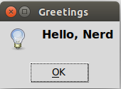
Improve the Behavior
Show a dialog box instead of printing on console
from tkinter import messagebox
def greet_handler(*args):
name = namefield.get()
message = f"Hello, {name}"
messagebox.showinfo("Greetings", message)
# clear text from the input field
namefield.delete(0, tk.END)
Run it.

Slide 12
Event Handler for other Events
If user enters a name and presses ENTER, then greet him (no button press).
Bind the greet_handler code to keyboard "<Return>" event on the Entry field.
namefield.bind('<Return>', greet_handler)
List of common event names:
https://python-course.eu/tkinter/events-and-binds-in-tkinter.php
(I really hate using strings for event names.)

Slide 13
Improve the Appearance
Components have a common set of attributes you can set.
1. Set namefield text color & font using dict syntax:
namefield['foreground'] = "blue"
namefield['font'] = ('Monospace', 16)
2. Customize other components using .configure
options = {'font': ('Arial', 14)}
label.configure(**options)
greet_button.configure(**options)

Slide 14
Grid Spacing
The Grid Layout ("Geometry") has properties you can set.
Add some space between components
label.grid(row=0, column=0, padx=5, pady=5)
namefield.grid(row=0, column=1, padx=5, pady=5)
greet_button.grid(row=0, column=2, padx=5, pady=5)
Make the namefield expand to fill available space:
root.columnconfigure(1, weight=1)
namefield.grid(sticky=tk.EW) # EW = east-west sides
Run It and resize the window. What happens?

Slide 15
Variables for Component Data
Many tkinter components require a variable to set/get component data.
Examples: Radiobutton, Listbox
Define a variable for the namefield text value
name = tk.StringVar()
namefield = tk.Entry(root, width=20,
textvariable=name)

Slide 16
Use StringVar in Event Handler
tk.StringVar has 'get' and 'set' methods.
def greet_handler(*args):
message = f"Hello, {name.get()}"
messagebox.infomessage("Greetings", message)
# clear the input field
name.set("")
#TODO if no name is entered, just ignore the event

Slide 17
Low Coupling is Good
The greet_handler does not depend on the Entry component.
It depends only on the name StringVar.
def greet_handler(*args):
message = f"Hello, {name.get()}"
messagebox.infomessage("Greetings", message)
# clear text from input field
name.set("")

Slide 18
Summary: What do you need to know?
Window - how to create a window
Components - what components are available
  how to set attributes of the components?
Layouts - how to arrange components
Containers - how to group components in containers to simplify layout
Events - what events are there?
  How to I connect an event to my code?
Dialogs - special purpose dialogs for message and input (e.g. file chooser)
Event looping - how to create event for later callback?

Slide 19
Know your components
You need to know the available components
... and what they can do.
https://anzeljg.github.io/rin2/book2/2405/docs/tkinter/index.html - John Shipman's popular Tkinter guide
https://python-course.eu/tkinter
https://runestone.academy/ns/books/published/thinkcspy/GUIandEventDrivenProgramming/03_widgets.html
Aj. Chaiporn's slides from Programming 2 in 2021.

Slide 20
Containers and Components
A GUI has many components in containers.
Use add to put component in a container.
A container is also a component; so a container may contain other containers.
add(component)
container
component
component
add(...)
add(component)
container
container
component
component
component
component

Slide 21
Object-Oriented Tk Application
Your class can extend tkinter.Tk or a container such as tkinter.ttk.Frame
Your class's __init__ should call superclass __init__ first.
tkinter.Tk
mainloop()
GreeterApp
__init__()
init_components()
greet_handler(*args)
run()

Slide 22
GreeterApp Class
class GreeterApp(tk.Tk):
def __init__(self):
# call the superclass constructor FIRST
super().__init__()
self.title("Greeter")
# Create components in a separate method
self.init_components()
Use a separate method (init_components) to create & layout components.
In this course, points deducted if lots of tkinter code in __init__.

Slide 23
Add components & event handler
The components are assigned to local variables.
But self.name is an attribute.
Why?
def init_components(self):
"""Define components and layout"""
self.name = tk.StringVar()
label = tk.Label(self, text="Your name?")
namefield = tk.Entry(self, width=12,
textvariable=self.name)
greet_button = tk.Button(self, text="Greet Me",
command=self.greet_handler)
namefield.bind('<Return>', self.greet_handler)
# position the components
label.grid(row=0, column=0, padx=5, pady=5)
... (same as before)
# style the components
options = {'font': ('Arial',16)}
... (same as before)

Slide 24
Define the event handler
def greet_handler(self, *args):
"""Greet the user."""
who = self.name.get().strip()
# clear input field for next use
self.name.set("")
message = f"Hello, {who}"
messagebox.showinfo("Greetings", message)
The event handler needs access to name (StringVar) so name must be an attribute.
No event handler needs access to the components, so we don't need a reference to them (no attributes).

Slide 25
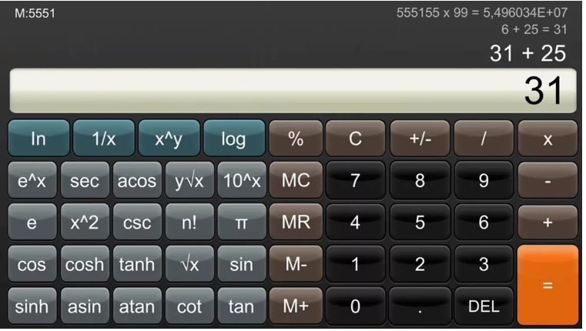
Containers for Complex Layouts
Display
functions = Frame()
add a key for each function
using grid layout

