Slide 1
What's a Name?
During a Sale, System requests are handled by the Register.
Why name it Register?
Why not name it Controller?

Slide 2
What's a Name?
During a Sale, System requests are handled by the Register.
Why name it Register?
Why not Controller?
Lower Representational Gap (LRG)

Slide 3
What Diagram?
What info do you learn from this sequence diagram?
What is this type of sequence diagram called?
Process Sale Scenario
:
System
:
Cashier
makeNewSale
loop
[
more items
]
enterItem
(
itemID
,
quantity
)
description
,
total
endSale
total with taxes
makePayment
(
amount
)
change due
,
receipt

Slide 4
Assigning Responsibilities
Larman recommends what 3 steps for assigning responsibilities?
1.
2.
3.

Slide 5
Assigning Responsibilities
Larman recommends what 3 steps for assigning responsibilities?
1. clearly state the responsibility
2. identify the information needed to perform it
3. apply design principles (GRASP, SOLID)

Slide 6
GRASP Principles
Information Expert
Creator
Controller
Low Coupling
High Cohesion

Slide 7
Information Expert
Question:
Who should compute the total value of a Sale?
Answer:
Sale. Because Sale has all the information needed to do this.

Slide 8
Creator
Question:
Which object should create LineItems ("A")?
Solution: choose the class that...
1. contains or is composed of A
2. records A
3. closely uses A
4. has the data needed to initialize A

Slide 9
Controller
Question:
How should the User Interface connect to the domain layer of our application?
Solution:
design a controller class to receive all requests from the U.I.
Alternative:
create one controller per Use Case or bundle of related Use Cases

Slide 10
Low Coupling
Question:
How to reduce the impact of change?
The contents of a Sale or Payment may change in later iterations.
Solution:
1. use an interface, "program to a specification (interface, abstract base class), not to an implementation"
2. assign responsibilities in a way the does not introduce extra coupling, or minimizes coupling

Slide 11
High Cohesion
Question:
How to keep objects focused, understandable, manageable, and, as a side effect, support Low Coupling?
Answer:
have them meditate :-)
if that doesn't work, read Larman, Ch. 17

Slide 12
More GRASP Principles

Slide 13
GRASP Review
__________________ all input should be sent to the Register first.
__________________ behavior related to a sale should be in the Sale class, ...and Sale should do nothing else!
__________________ Sale should create LineItems because it closely uses them
__________________ Sale shouldn't depend on Store or Product catalog if we can avoid it
__________________ Sale should compute the total price because it has all the info needed to compute the total

Slide 14
More GRASP Principles
Polymorphism
Pure Fabrication
Indirection
Protected Variations

Slide 15
Polymorphism
"Don't ask what type"
Problem:
How to handle alternative types of objects?
That is, a set of responsibilities can be performed by different types of objects (decided at runtime)?
How to create pluggable components?
Example:
How can the Medical Record system find and display new types of tests without modifying existing code?

Slide 16
Polymorphism
Example:
how to support changing rules for computing tax of a Sale?
Solution:
Define an interface for TaxCalculator.
In Sale, create a setTaxCalculator( ) to inject the calculator.

Slide 17
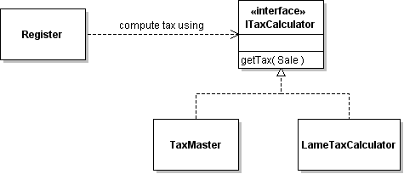
TaxCalculator

Slide 18
Polymorphism
Search for Product:
ProductCatalog.search( searchspec ) matches products using description, category, and price.
How can we enable searching for new kinds of products with other attributes (e.g. search for book by author)?
List<Product> search(Product spec) {
String desc = spec.getDescription().toLowerCase();
if (! desc.isEmpty()
&& this.getDescription().toLowerCase().contains(desc)) return false;
... // check other attributes
return true;
}

Slide 19
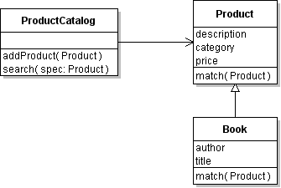
Use Polymorphism
(1) ProductCatalog.search( ) invokes Product.match( )
Product matches itself to search spec.
(2) To accommodate products with different attributes, create a subclass of Product for new types and override match( ).
There is a better design than this, right?
Dog
match(Product)

Slide 21
Pure Fabrication
"What do you do when nothing else works?"
Problem:
What object should be given a responsibility when the choices suggested by Info Expert and Creator violate the goals of high cohesion and low coupling?
Example:
1. What class should save a Sale to the database?
2. Each credit card service has a different API.
How can we make them use the same interface?

Slide 22
Pure Fabrication
Solution:
Create an artificial or convenience class.
Example Solution:
Database: Create a class for Data Access Object (DAO).
Credit Card Validator: what design pattern to apply?

Slide 23
Pure Fabrication
Example:
give your own example

Slide 24
Behavioral Decomposition
We can decompose a problem in two ways:
Representational Decomposition
classes in model represent things in the problem domain.
Behavioral Decomposition
problem is broken done by behavior. Related functions are placed in the same class.
(a pure fabrication)

Slide 25
Behavioral Decomposition
Example:
In Course Scheduler problem, a behavior is to find a feasible solution to the course requirements and constraints.
Solution:
Create a ScheduleOptimizer class that provides this behavior.

Slide 26
Indirection
Question:
How to assign responsibilities to avoid direct coupling between classes, even though one class needs the services of another one?
Solution:
Assign the responsibility to an intermediate object.

Slide 27
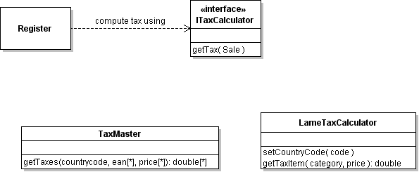
Indirection & Tax Calculator
Example:
Each TaxCalculator (3rd party software) has its own API.
How can our software "talk to" any tax calculator?
?

Slide 28
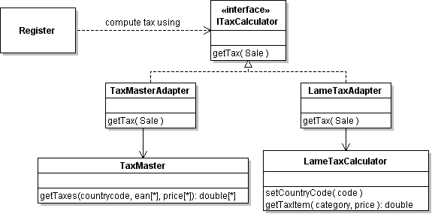
Indirection & Tax Calculator
Solution:
Create an Adapter for each type of TaxCalculator, that adapts to our TaxCalculator interface.

Slide 29
Protected Variations
"How to protect against change?"
Question:
How to design objects so that variations or change does not impact other objects?
How to avoid changing the source code to accommodate changes in other systems?
Example:
The kinds of musical instruments may change.
The language displayed in UI may need to change.
The way of accessing persistent storage may change.

Slide 30
Protected Variations
Solution:
Identify points of variation.
Create a stable interface around them.

Slide 31
Polymorphism & Protect Variations
What was the slogan used in the Head First book?
This is well-known in OO design.
___________ that varies from that which ____________
___________ the part that varies (and define an interface for it)

Slide 32
Mechanisms for P.V.
Service Lookup
Externalizing data, e.g. properties files
Indirection
Reflection
Uniform Access
Standard Language, such as SQL

Slide 33
Service Lookup
Use a Service Locator so that the provider of a service can be changed dynamically.
String URL = properties.getProperty( "jdbc.url" );
String user = properties.getProperty( "jdbc.user" );
String pass = properties.getProperty("jdbc.password");
// DriverManager is the service locator.
// It finds a connection provider based on URL
Connection connection =
DriverManager.getConnection(URL, user, pass);
MySQL URL = "jdbc:mysql://hostname/world"
DerbyDB URL = "jdbc:derby:/path/database"

Slide 34
Externalize Data
log4j.properties file to configure Log4J
messages.properties resource bundle for messages
# English messages (default)
greet.hello = Hello, {0}
greet.goodbye = Goodbye
messages_de.properties
# German messages
greet.hello = Hallo {0}
greet.goodbye = auf Wiedersehen
// Java: get string from bundle
ResourceBundle bundle =
ResourceBundle.getBundle("messages");
String hello = bundle.getString("greet.hello");

Slide 35
Use Your Own Properties
Create a java.util.Properties object.
Load data from a file located on the classpath.
Properties properties = new Properties();
// locate file "pos.config" on the classpath
ClassLoader loader =
Properties.class.getClassLoader();
try {
InputStream instream =
loader.getResourceAsStream( "pos.config" );
properties.load( instream );
instream.close( );
} catch ( IOException e ) { ... }

Slide 36
Uniform Access
method and field exposed in the same way
Is amount a field or a property?
// a Money object in C#
Money m = new Money( 0.0, "Baht");
m.amount = 1000.0;
m.amount = m.amount + 50;

Slide 37
Properties
struct Money {
private String _currency;
private double _amount;
public Money( double amt, String currency ) {
this._amount = amt;
this._currency = currency;
}
public String currency {
get { return _currency; }
}
public double amount {
get { return _amount; }
set { _amount = value; }
}
properties in C#

Slide 38
Uniform Access
Operator Overloading for uniform access:
user data type behaves like built-in types
// Money arithmetic in C#
Money m1 = new Money(100.0, "Baht");
Money m2 = new Money(200.0, "Baht");
Money total = m1 + m2;

Slide 39
Operator Overloading
struct Money {
private String currency;
private double amount;
public Money( double amt, String currency ) {
this.amount = amt;
this.currency = currency;
}
public static Money operator+(Money a, Money b){
if ( a.currency != b.currency ) throw ...;
Money result = new Money(a.currency);
result.Amount = a.amount + b.amount;
return result;
}

Slide 40
When and Where to use P.V.?
Variation points
places where variation is required by the current, existing design.
POS must accommodate varying TaxCalculators, varying pricing rules.
Evolution points
places where changes in requirements could force a change in design.
POS might require UI in a different language.

Slide 41
Avoid Too Much P.V.
Avoid "future proofing" without good reason
P.V. can add complexity to design.
Adds to development cost.
Makes code harder to understand.

Slide 42
Open-Closed Principle

Slide 43
Name the GRASP principle
create an intermediate object to avoid direct coupling between two classes
design objects so that changes in one component do not affect others
it is described as "don't ask what type"
we "invent" a class for a particular responsibility when no domain class is suitable

Slide 44
Model-View-Controller
In the MVC pattern what are the responsibilities of the model, view, and controller?
Which components are coupled to which other component?

Slide 45
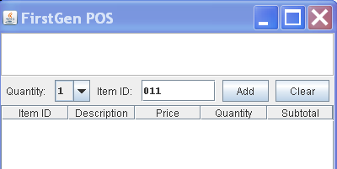
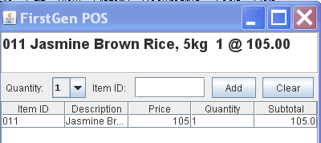
MVC in POS
1. Cashier inputs item ID.
2. POS displays description and price.
How did the view get the description and price?

Slide 46
Forms and Controls Pattern
1. The form notifies controller when there is input.
2. Controller reads data from form.
3. Controller processes data:
pd = catalog.getProductDescription( id );
sale.add( pd, quantity );
4. Controller updates fields on view.

Slide 47
Model View Controller
View layer has its own event handlers for UI-level events (e.g. ActionListener).
1. View's event handler reads cashier input.
2. View notifies controller and gives it the data.
3. Controller updates the model.
4. Model notifies observers of value change.
5. View (as Observer) gets data from model, updates the display.

Slide 48
View
Controller
addItem(id,qnty)
get model data
pd = catalog.getProduct(id)
sale.addItem( pd, qnty )
<<interface>>
Observer
notify observers
Model

Slide 49
MVC in Web Applications

Slide 50
Reference
GUI Architectures by Martin Fowler, http://martinfowler.com/eaaDev/uiArchs.html

