Slide 1
Overview of Web Services

Slide 2
Network Services
A conversation between software applications over a network
listen *:80/TCP

Slide 3
Example: Domain Name Service (DNS)
named port 53
Command line utility
> nslookup ku.ac.th
158.108.216.5
Code
#!python
import socket
socket.gethostbyname("ku.ac.th")
'158.108.216.5'

Slide 4
SMTP server-to-server Email transport
smtp.mail.yahoo.com
smtp.gmail.com smtpd tcp/25 & 465
HELO smtp.mail.yahoo.com 250 Hello
MAIL FROM <santa@yahoo.com> 250 OK
RCPT TO <joe@gmail.com> 250 OK
DATA
(sends email message)
Server-to-client services: POP3, IMAP4
SMTP Ref: https://www.ionos.com/digitalguide/e-mail/technical-matters/smtp/

Slide 5
Web Services Use Web Protocols
DNS, SMTP, IMAP ... use service-specific protocols.
HTTP is everywhere, so let's use HTTP as the protocol for software-to-software communication!
Advantages of using HTTP(S) Protocol
Standard protocol -- no need to invent a new one
Many existing servers, code libraries, resources
Existing infrastructure, such as web caches
Firewalls already allow HTTP(S) packets to pass

Slide 6
Some History
Companies and government agencies have used machine-to-machine communication since 1960s.
Stores: Upload sales data, orders, shipping.
"Nightly upload"
Customs (import/export) data: communicated between machines
Aviation: communicate routes and schedule between airports

Slide 7
Hardware
1960s - telex machines
1970s - modems. "Nightly upload".
1980s - value-added networks
1990s - public computer networks become available

Slide 8
Protocols
1975: Electronic Data Interchange (EDI) - standard protocol and format for business transactions.
1991: Common Object Request Broker Architecture (CORBA) - distributed objects with a standard Interface Definition Language (IDL) and mappings to C/C++, Java, COBOL, etc. Object-references (URLs) for remote objects.
1993: DCOM - Microsoft's answer to CORBA, for communication between software components (IPC) on different machines.
Remote Procedure Call (RPC) - concept of invoking process on remote computer as if it was a local function. RPC appears in many protocols like CORBA, DCOM, RMI (Java), and XML-RPC (SOAP web services).

Slide 9
SOAP
XML based, simple standard for data services and messaging. Services on known end-points handle multiple messages, similar to RPC.
Microsoft developed SOAP 1.0 around 1998-1999 as message-passing protocol using XML, but reluctant to release it.
So, they started dialog with IBM and other companies.
Backed by IBM, SOAP became a standard in 2000.
Soon added UDDI as a way to discover SOAP services.

Slide 10
SOAP Example
Calculator service at service-repository.com
http://service-repository.com/service/overview/877027757
Click "Interface" tab to see operations.
Add 2 and 3 (you can do this interactively)

Slide 11
SOAP Request (2+3)
POST /glue/calculator HTTP/1.1
Host: ws1.parasoft.com
Content-Type: text/xml; charset=utf-8
Content-Length: length
SOAPAction: "add"
<?xml version="1.0" encoding="utf-8"?>
<soap:Envelope xmlns:soap="http://schemas.xmlsoap...">
<soap:Body>
<ns1:add xmlns:ns1="http://www.parasoft.com/wsdl/calculator/">
<ns1:x>2</ns1:x>
<ns1:y>3</ns1:y>
</ns1:add>
</soap:Body>
</soap:Envelope>

Slide 12
SOAP Response
HTTP/1.1 200 OK
Content-Type: text/xml; charset=utf-8
Content-Length: length
<?xml version="1.0" encoding="utf-8"?>
<soap:Envelope
xmlns:xsi="http://www.w3.org/2001/XMLSchema-instance"
xmlns:xsd="http://www.w3.org/2001/XMLSchema"
xmlns:soap="http://schemas.xmlsoap.org/soap/envelope/">
<soap:Body>
<n:addResponse
xmlns:n="http://www.parasoft.com/wsdl/calculator/">
<n:Result xsi:type="xsd:float">5.0</n:Result>
</n:addResponse>
</soap:Body>
</soap:Envelope>

Slide 13
WS-* : Beyond SOAP
SOAP alone didn't solve needs for electronic enterprise.
Needed standards for …
WS-Addressing - routing, forwarding, transport via headers
WS-Discovery - beyond UDDI
WS-Security
WS-Trust (managing trust relationships like security tokens)
many, many more

Slide 14
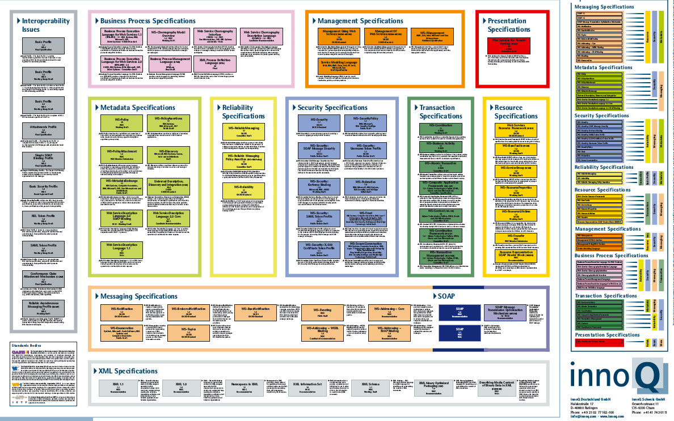
Web Service Standards
https://www.innoq.com/soa/ws-standards/poster/innoQ WS-Standards Poster 2007-02.pdf

Slide 15
REST
Represental State Transfer
Motivation: SOAP messages are too large and complex. SOAP services don't scale well.
Most of SOAP's capabilities aren't used in typical apps (feature bloat).
Roy Fielding: design stateless services that use the web's semantics fluently.
design web services as resources that support requests (methods).
separate the representation from the operations

Slide 16
REST example
Example: calculator
API:
GET /host/calculator/add?a=2&b=3

Slide 17
HTTP Request (2+3)
GET /calculator/add?a=2&b=3 HTTP/1.1
Host: se.cpe.ku.ac.th
Accept: text/plain
HTTP/1.1 200 OK
Content-type: text/plain
Content-length: 4
5.0

Slide 18
HTTP Request for XML
GET /calculator/add?a=2&b=3 HTTP/1.1
Host: se.cpe.ku.ac.th
Accept: text/xml
HTTP/1.1 200 OK
Content-type: text/xml
Content-length: 21
<result>5.0</result>

Slide 19
Google Geolocation Service
http://maps.googleapis.com/maps/api/geocode/xml? address=Kasetsart University&sensor=false
Try this in your browser.
1) browser automatically converts space to %20
2) sensor parameter is optional. It indicates whether your client has GPS. "sensor=false" for laptop computer.
3) change "/xml" to "/json" in path.
Try it in REST Console or DHC

Slide 20
Another Example: Google Calendar
Google calendar v. 3 (v.2 to be deprecated in Nov 2014)
Requires a Google API key

Slide 21
Where to Find Services
www.programmableweb.com - services and mashups
service-repository.com (for SOAP services)
xmethods.com - not very active anymore
apihub.com
Google, Yahoo, Facebook publish their WS APIs

Slide 22
Software as Services
Motivation:
You have an application that needs data from a remote source, like a remote database.
Or, your application needs to store data remotely.
Forces:
The service you need is not available locally
You want to support many platforms with same back-end
You want to let other developers write apps that use your service

Slide 23
Software as Services
Solution:
Separate the service from the applications that use it.
Provide a network interface so apps can submit requests to your service.
Define an API for your service interface.
Use standard data formats (platform independent).

Slide 24
Why Web Services?
A web service is a network service using World Wide Web protocols, principly, HTTP.
Why Not Some Other Protocol?
There are many standards for remote services:
Corba
Remote Procedure Call (RPC)
Microsoft DCOM
Issues: language or platform dependent need to configure firewalls to allow access (port)

Slide 25
Web Service Advantage
Web protocol is already accessible through firewalls
Many web server apps already exist (reuse)
Web protocol is language & platform independent
The resources we'd like to access are already web resources

Slide 26
Software as a Service
Principles for services:
Loosely coupled
Independent of programming language and platform
Standard format(s) for requests and responses
Self-describing: there is a way to discover what service is offered

Slide 27
World Wide Web for computers
The web is intended for humans.
Web services are intended for computers.
Example:
http://finance.yahoo.com provides stock information for people to access.
http://ichart.finance.yahoo.com provides web services for computer software to access.
A Yahoo service call: http://ichart.finance.yahoo.com/table.csv?s=MSFT&... get daily price data for Microsoft, in CSV format. (many optional parameters not shown)

Slide 28
Bots Rule the Web
61% of all web traffic is bots, not people.
bots communicate using web services.
Most bots are benign (harmless) but about 30% have unknown purpose.

Slide 29
Page Scraping
Before web services, an application that wants a stock price would invoke a URL at finance.yahoo.com,
then parse the HTML to get the stock price.
This is called page scraping.

Slide 30
Exercise
1. Name some other standard network service and its protocol.
2. What is the standard TCP or UDP port for each of these services?
Service Protocol Name Port(s) tcp/udp
web HTTP and HTTPS tcp 80 and 443

Slide 31
Answers
1. Name some other standard network service and its protocol.
2. What is the standard TCP or UDP port for each of these services?
Service Protocol Name Port(s) tcp/udp
web HTTP and HTTPS tcp 80 and 443
mail smtp tcp 25
file transfer ftp tcp 21 (also 20)
secure shell ssh tcp 22

