Slide 1
Logical Architecture

Slide 2

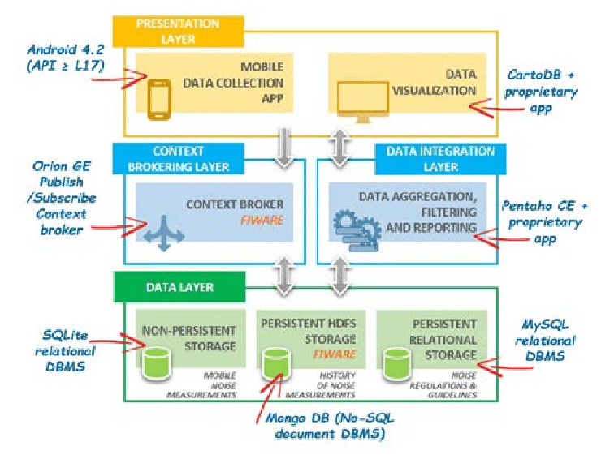
Software Architecture
The overall design and implementation of the system.
It has multiple descriptions, called views, that address interests of different groups.
Viewpoint
Stakeholders,
their concerns,
templates & conventions
View
description of the application

Slide 3
Logical Architecture
Conceptual view of the design of the application.
May include layers, packages, subsystems, components.
Development Viewpoint
Software designer & developer
View
Layers, Components, Packages, Dependencies

Slide 4
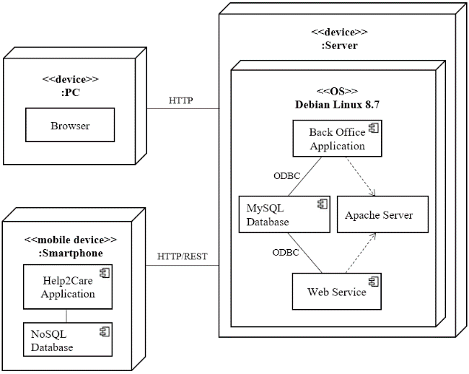
Deployment (Physical)
Where the application runs & dependencies.
Computer hardware, OS, storage, supporting software, communication links.
Deployment Viewpoint
CIO, Installer,
Sys admin
View
Deployment diagram, hardware requirements,
software requirements

Slide 5
What Views?
4 Standard Views
Logical
Process
Physical (Deployment)
Development
Many others exist.
IEEE 1471 & TOGAF attempt to standardize the viewpoints and how they are expressed.

Slide 6
Record Decisions & Rationale
Architecture is more than just diagrams.
You should record the decisions you made along with
factors influencing your decision
alternatives you considered
reason for choosing a particular alternative
reason for not doing something else
Where? Software Architecture Document (SAD) or
Software Architecture Notebook.

Slide 7
Logical View [or Viewpoint?]
How are the components organized? Which one talks with which one?
Package Diagram (static) Fig 30.2 - 30.4
How do the components interact in a given scenario?
Interaction Diagram (dynamic) Fig 30.5
Package diagram is a mess. What's the big picture?
Layered architecture Fig 30.1
Not all apps use a layered design. You need to learn several designs to choose intelligently

Slide 8
Reference
https://www.viewpoints-and-perspectives.info/home/

