Slide 1
Required Level of Study
Reading: about 60 pages per week
Doing: some work each week
Writing: grammatically correct English documents
Individual Effort:
your grade is based on your effort and performance
Time Commitment:
9-12 hours per week outside of class

Slide 2
Meetings for Discussion
Read assigned material before class each week.
Take notes: summarize important points.
Participate in discussions.

Slide 3
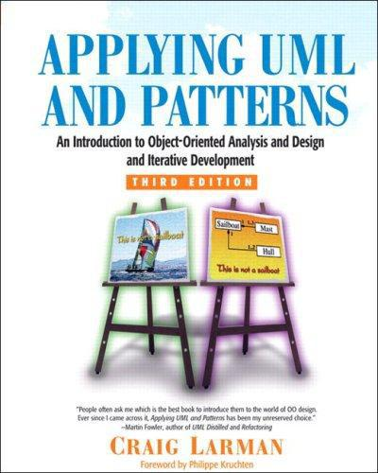
Main Textbook
“People often ask me which is the best book to introduce them to OO design.
... Applying UML and Patterns has been my unreserved choice.”
-- Martin Fowler
Was 700 Baht at KU Books (discount for this course).

Slide 4
Main Textbook
If you don't read the book,
you will not pass this course.

Slide 5

Other Books
For OO Design Principles, we will use some chapters.
Amusing case studies make it easy to remember the principles.

Slide 6
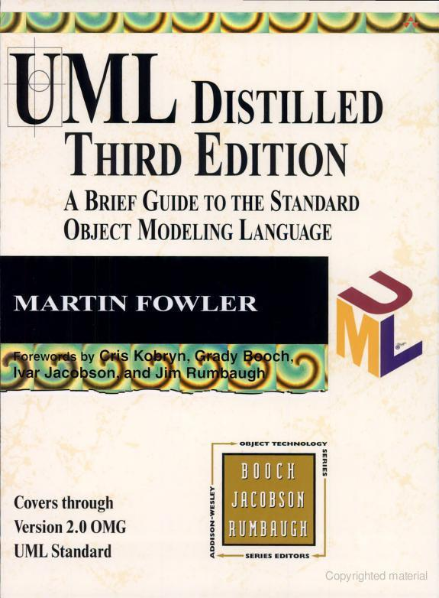
Other Books
For learning UML.
Chapter 2 is good intro to software process.

Slide 7
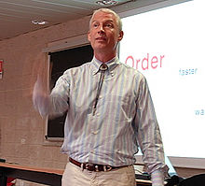
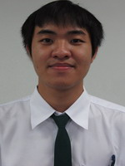
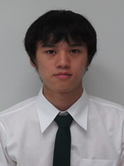
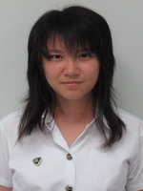
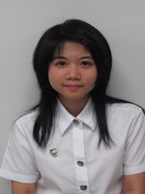
Using the Textbook
Easy to read, but written for developers
Agile UP Inception is not Waterfall Requirements phase... involve Stakeholders ... Risk ...
what
???
Craig Larman

Slide 8
Textbook
Strengths:
  Excellent for O-O Analysis and Design
  Emphasizes iterative development
  Author conveys real-world experience
Weaknesses:
  Fuzzy about process and how docs fit together.
  Bias towards Agile methods.
  Some gaps you have to research for yourself.
  Redundant

Slide 9
Software Process
Requirements, Analysis, and Design are part of any software process.
Hence, it helps to know where they fit in and when to do them.
Larman favors an Agile UP (Unified Software Development Process).

Slide 10
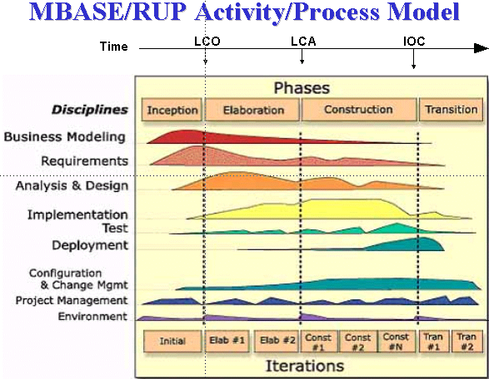
UP Model
Phases, iterations, 'disciplines' for kinds of activities

Slide 11
Characteristics of U.P.
  Plan based, but accommodate change
  Architecture centric
  Identify & address risks early
  implement requirements based on business value, architecture, and risk
  handle risky requirements early
  prioritize requirements that have a big impact on software architecture
  time-boxed iterations with milestones
  UP is a "framework". Tailor it for your project.

Slide 12
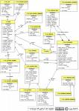

Activities and Artifacts
UP can be agile, but prefers tangible work products
Roles
("developer")
Activity
Input
Output
IEEE xxxx
1. blah blah
2. blah blah
3. blah blah
Tools, technology
Guidance, standards, procedures

Slide 13
Key Artifacts
Vision Statement
Business Case
Software Requirements Specification (SRS)
  Functional Requirements (Use Cases)
  Other requirements, "URPS+"
  Acceptance Criteria
Software Development Plan
Iteration Plans
Project Measurements (many kinds)
Software (of course)

Slide 14
Royce recognized that regression to previous steps often happens
The Royce Waterfall Model (1970)
SYSTEM
Larman loves to bash the waterfall process.
REQUIREMENTS
SOFTWARE
REQUIREMENTS
PRELIMINARY
PROGRAM
DESIGN
ANALYSIS
PROGRAM
DESIGN
CODING
TESTING
OPERATIONS

Slide 15
Waterfall Loopback in Reality
Requirements
Analysis
Design
Royce found that backtracking multiple phases was usually necessary.
The most common backtracks are shown.
Implementation
Acceptance Test
Delivery and Maintenance

Slide 16
Importance of Good Requirements
"The hardest single part of building a software system is deciding what to build.
No other part of the conceptual work is as difficult as establishing the detailed technical requirements…. No other part of the work so cripples the resulting system if done wrong. No other part is as difficult to rectify later..."
"No Silver Bullet" by Frederick Brooks. Computer, 1987

Slide 17
Intrinsic Complexity of Software
"There is no single development, in either technology or in management technique, that promises even one order of magnitude improvement in productivity, in reliability, in simplicity."
"No Silver Bullet" by Frederick Brooks. Computer, 1987
See also page 5-6 for Brooks comments about object-oriented approach.

