Slide 1
Multi-dimensional Arrays
James Brucker

Slide 2
1-Dimensional Arrays
An array is a sequence of values of same type
In Java, array is an object and knows its own length
int[] p =
new int[5];
<reference>
int[]
length=5
2
4
6
8
10

Slide 3
2-Dimensional Arrays
A 2-dimensional array is an array of arrays
Example: array of 4 elements (rows),
each element is an array of 5 int.
int[]
length=5
1
2
3
4
5
int [][] m =
new int[4][5];
for(k=0;k<5;k++){
m[0][k] = k;
m[1][k] = 2*k;
}
int[][]
length=4
int[]
length=5
0
2
4
6
8

Slide 4
2-dimensional Array Syntax
1. Define a two-dimensional array reference:
int [][] score;
2. Create an array object with 4 "rows" of length 5 each:
score = new int[4][5];
1-2. Perform both steps at once:
int [][] score = new int[4][5];
3. Assign value to "row" j, element (column) k
score[j][k] = 999;

Slide 5
Example: student scores
score[j] = the scores for j-th student (an array)
/* score[j][k] = score of student j on lab k */
int NSTUDENT = 50; // we have 50 students
int NLAB = 10; // there are 10 labs
int [][] score = new int[NSTUDENT][NLAB];
/* read the lab scores */
for(int student=0; student< NSTUDENT; student++) {
for(int lab=0; lab < NLAB; lab++)
score[student][lab] = scanner.nextInt();
}

Slide 6
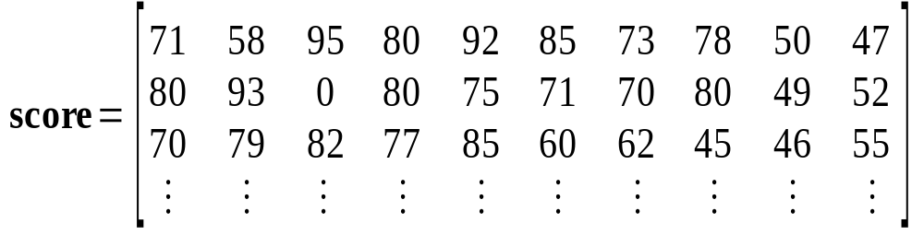
Visualize the Lab Scores
score[][3] = (column 3) scores for all students on lab 3.
score[2][] = Scores for student 2 (an array of int)
score[2][0] = 70, score[2][1] = 79, ...

Slide 7
2-D Array in Memory
score[0] --> score[0][1], score[0][2], ..., score[0][9]
score[1] --> score[1][1], score[1][2], ..., score[1][9]
score[2] --> score[2][1], score[2][2], ..., score[2][9]
score[2] is an array of int (int[10])
score is an "array of arrays"

Slide 8
Using the Student Lab Scores
Sum the scores for student n:
int n = 8; // 9-th student (index starts at 0)
int sumScore = 0;
for(int lab=0; lab<NLAB; lab++)
sumScore = sumScore + score[n][lab];
Find the average score on lab 5:
int sum = 0;
int lab = 5;
for(int j=0; j<NSTUDENT; k++)
sum = sum + score[j][lab];
float average = sum/NSTUDENT;

Slide 9
Array length
Two-dimensional arrays have a .length
int [][] a = ...;
a.length is the number of rows in a
a[0].length is the length of row 0
a[1].length is the length of row 1
score.length is 50 (rows, or students)
score[0].length is 10

Slide 10
Exercise: use .length
How many students in the score 2-D array?
int[][] score = readAllScores( );
// all student scores
// How many students are in the array?
int numberOfStudents = score.__________ ;
How many lab scores does student n have?
int n = 8; // 9-th student
int sum = 0;
for(int lab=0; lab < ___________; lab++)
sum = sum + score[n][lab];

Slide 11
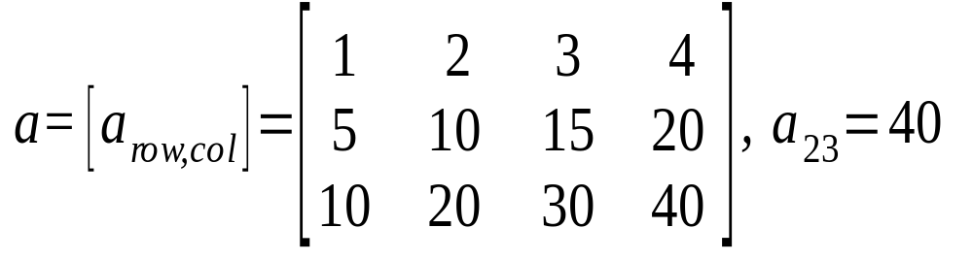
Array as Matrix
columns
rows
int [][] a = new int[3][4];
a[1][2] = 15;
a[0][3] = 4;
System.out.println( a.length ); // = 3
System.out.println( a[1].length ); // = 4

Slide 12
Common Array Usage
To process every element in an array, a common usage is two nested "for" loops like this:
/* sum all elements in the array */
int sum = 0;
for(int row=0; row < score.length; row++) {
for(int col=0; col < score[row].length; col++) {
/* process element a[row][col] */
sum = sum + score[row][col];
}
/* finished processing of this row */
}

Slide 13
Initializing a 2-D array
Example: set all elements to 1
Example: initialize b[row][col] = row+col
for(int j=0; j<a.length; j++) /* rows */
for(int k=0; k<a[j].length; k++) /* cols */
a[j][k] = 1;
for(int j=0; j<b.length; j++) { /* rows */
for(int k=0; k<b[j].length; k++) { /* cols */
// process element b[j][k]
b[j][k] = j + k;
}
}

Slide 14
"fill": initialize a 2-D array
Arrays.fill( arr[], value ) sets all elements of a 1-dimensional array to a desired value:
/* set all elements of a to true */
boolean [] answer = new boolean[100];
Arrays.fill( answer, true );
// answer[0] = answer[1] = ... answer[99] = true
Let's write a fill() method for 2-D arrays.
public static void fill( int[][] arr, int value ) {
if ( arr == null ) return;
for(int row=0; row < arr.length; row++) {
for(int col=0; col < arr[row].length; col++)
arr[row][col] = value;
}
}

Slide 15
"fill" syntax explained
The fill() method for 2-D int arrays.
fill( score, 0 );
void: this method doesn't return any value
int[][]: this parameter is a 2-D array of int
public static void fill( int [][] arr, int value ) {
if ( arr == null ) return;
for(int row=0; row < arr.length; row++) {
for(int col=0; col < arr[row].length; col++)
arr[row][col] = value;
}
}
avoid a NullPointerException by testing whether the array reference is null.

Slide 16
Make "fill" Polymorphic
We want "fill()" to work for all types of arrays: int[][] array, float[][] array, String[][] array. Write multiple implementations...
public static void fill( float [][] arr, float value ) {
if ( f == null ) return;
for(int row=0; row < f.length; row++) {
for(int col=0; col < arr[row].length; col++)
f[row][col] = value;
}
}
public static void fill( String [][] s, String value ) {
if ( s == null ) return;
for(int row=0; row < s.length; row++) {
for(int col=0; col < s[row].length; col++)
s[row][col] = value;

Slide 17
What is the name of this property?
You can have several methods with the same name if (a) the number of parameters is different, or
(b) the datatype of the parameters is different.
void fill( int [][] arr, int value);
void fill( long [][] arr, long value );
void fill( float [][] arr, float value );
Polymorphism: "many formed" (adj, polymorphic)
"poly" means many,
"morph" means form

Slide 18
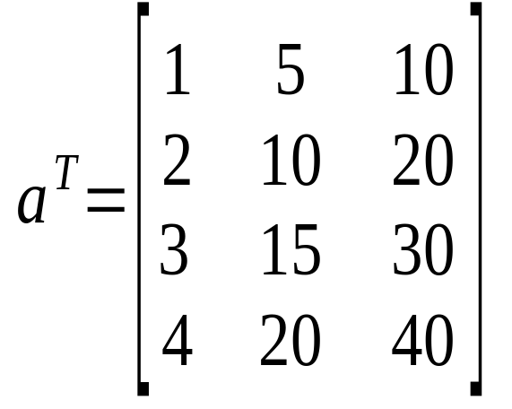
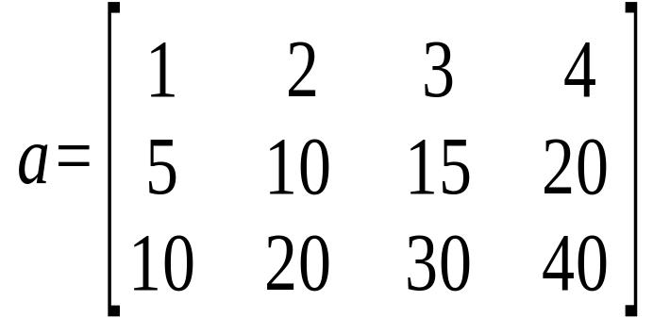
Transpose an Array
A common task to to switch the rows and columns of an array.
transpose
If a is a 3 x 4 array,
then b = transpose(a) is a 4 x 3 array,
such that b[j][k] = a[k][j] for all j, k.

Slide 19
Transpose an Array (2)
A transpose method must return a new array.
int[][]: the return value is a 2-D array of int
int[][] a: this parameter is a 2-D array of int
public static int [][] transpose( int [][] a ) {
int rows = a.length;
int cols = a[0].length;
int [][] atrans = new int[cols][rols];
.
.
.
.
return atrans;
}
new array for the transpose of a
return a reference to an int[][] array.

Slide 20
Transpose an Array (3)
Inside the method we use the standard pattern:
for(int row=0; row < number_of_rows; row++)
for(int col=0; col < number_of_cols; col++)
process element a[row][col]
public static int [][] transpose( int [][] a ) {
int rows = a.length;
int cols = a[0].length;
int [][] atrans = new int[cols][rols];
for(int row = 0; row < rows; row++) {
for(int col=0; col < cols; col++)
atrans[col][row] = a[row][col];
}
return atrans;
}
return a reference to the new array.

Slide 21
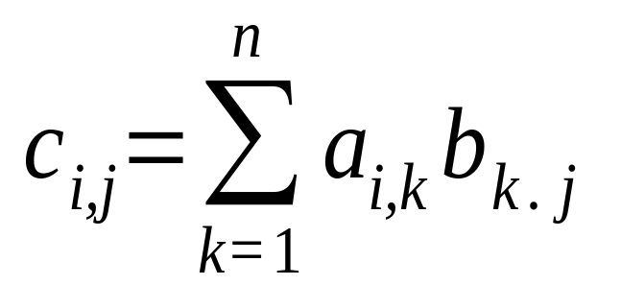
Array Multiplication
Let
A = [ a_{i j} ] = array of size m x n
B = [ b_{i j} ] = array of size n x p
What is C = A * B ?
What are the dimensions of C? m x p
Formula for computing C = [ c_{i j} ]

Slide 22
Example: Contamination
An environmental engineer is assessing the levels of contaminant in the soil at a polluted site. The contaminated area has been divided into a grid and the level of contaminant (C) has been measured in each rectangle in the grid.
This data can be stored as a 2D array and analysed
grid of sample locations
contaminated site

Slide 23
Contamination Example (2)
A student collects the data and enters it in an array...
double [][] c = {
{ 0.002, 0.005, 0.004, 0.007, 0.006 },
{ 0.003, 0.001, 0.008, 0.009, 0.010 },
{ 0.002, 0.003, 0.006, 0.009, 0.008 },
{ 0.001, 0.002, 0.005, 0.008, 0.007 },
{ 0.001, 0.002, 0.004, 0.005, 0.003 },
{ 0.002, 0.001, 0.004, 0.003, 0.002 } };
Q: What are the dimensions of the C array?
Q: Why do we have nested parenthesis?
double [][] c = { { a, b, c}, { d, e, f}, ... { m, n, o} } ;

Slide 24
Contamination Example (2)'
You can also initialize each row separately...
double [][] c = new double[6][]; // 6 rows
c[0] = { 0.002, 0.005, 0.004, 0.007, 0.006 };
c[1] = { 0.003, 0.001, 0.008, 0.009, 0.010 };
c[2] = { 0.002, 0.003, 0.006, 0.009, 0.008 };
c[3] = { 0.001, 0.002, 0.005, 0.008, 0.007 };
c[4] = { 0.001, 0.002, 0.004, 0.005, 0.003 };
c[5] = { 0.002, 0.001, 0.004, 0.003, 0.002 };
This method works even if the rows are different sizes.

Slide 25
Contamination Example (3)
We have another array of data with the soil depth (in cm) in each grid cell (depth of soil down to bedrock).
double [][] depth = { // dept in centimeters
{ 285, 310, 320, 315, 300 },
{ 275, 305, 310, 320, 295 },
{ 270, 300, 300, 310, 280 },
{ 260, 290, 280 ,270, 255 },
{ 255, 285, 270, 265, 250 },
{ 250, 280, 265, 260, 240 } };
What is the depth of this cell?

Slide 26
Contamination Example (4)
The size of each cell is 2 meter by 2 meter.
So the area of each cell is 4 m² = 40,000 cm².
the formula for calculating from concentration (c) is:
the volume of one cell is 40,000 * depth.
the mass of pollutant in cell [j][k] is:
mass in cell [j][k] = c[j][j] * volume
= c[j][k]* ( 40000 * depth[j][k] );
we need to sum this over all cells in the grid.
mass = concentration * volume ;

Slide 27
Contamination Example (5)
Use nested for loops to sum the pollution over all grid cells...
double [][] c = { /* concentration data */ };
double [][] depth = { /* grid depth data */ };
double area = 40000; // surface area per cell
double sum = 0.0;
for (int row=0; row < c.length; row++) {
for (int col=0; col < c[row].length; col++)
sum += c[row][col] * area * depth[row][col];
}
// sum = total mass of pollutant

Slide 28
Building Materials
A company makes 3 grades of cement. Each grade uses a different proportion of 4 raw materials.
Input: the number of tons (1000 kg) of each product that will be produced.
Output: how many tons of filler, binder, hardener, and sealant are needed?
Filler Binder Hardener Sealant
Product 1 0.80 0.18 0.02 0.00
Product 2 0.74 0.20 0.02 0.04
Product 3 0.64 0.22 0.04 0.10

Slide 29
Building Materials (2)
Let amount of each product to produce be:
prod[1] = tons of Product 1
prod[2] = tons of Product 2
prod[3] = tons of Product 3
Output: tons of filler, binder, hardener, and sealant
filler = 0.80*prod[1] +0.74*prod[2] +0.64*prod[3]
binder = 0.18*prod[1] +0.20*prod[2] +0.22*prod[3]
harden = 0.02*prod[1] +0.02*prod[2] +0.04*prod[3]
Filler Binder Hardener Sealant
Product 1 0.80 0.18 0.02 0.00
Product 2 0.74 0.20 0.02 0.04
Product 3 0.64 0.22 0.04 0.10

Slide 30
Building Materials (3)
/** Compute the amount of raw materials needed to
* produce a given quantity of 3 products.
* @param product is an array of quantities of
* the 3 products.
* @return amount of raw materials needed.
*/
public double [] materials( double [] product ) {
// mat = matrix of raw material per unit prod
// mat[k] = { filler, binder, harden, sealant}
// for product k.
double [][] mat = { {0.80, 0.18, 0.02, 0.0 },
{0.74, 0.20, 0.02, 0.04 },
{0.64, 0.22, 0.04, 0.10 } };

Slide 31
Building Materials (4)
double [][] mat = { {0.80, 0.18, 0.02, 0.0 },
{0.74, 0.20, 0.02, 0.04 },
{0.64, 0.22, 0.04, 0.10 } };
// how many raw materials are there?
int materials = mat[0].length;
// define an array for returned values
double [] quantity = new double[ materials ];
// compute the quantity of each
// raw material: sum over all products
for(int m= 0; m < materials; m++) {
double sum = 0;
for(int k= 0; k < product.length; k++)
sum = sum + product[k]*mat[k][m];
quantity[m] = sum;
}

Slide 32
The Truth about 2-D Arrays
Java doesn't have 2-dimensional array!

Slide 33
2-D array is an array of 1-D arrays
2-D array in Java is really an array of arrays.
Each row of the array is an array reference.
final int N = 10;
double [][] a;
a = new double[N][ ]; // create rows (an array)
for(int k=0; k<N; k++)
a[k] = new double[k+1]; // create columns
a[0] =
a[0] is an array: = new double [1]
a[1] =
a[1] is an array: = new double [2]
a[2] =
a[2] is an array: = new double [3]
a[3] =
a[2] is an array: = new double [1]

Slide 34
Ragged Array Example
We record the rainfall month for the days when it rains.
How would you read this data into a 2-D array?
How would you compute the total rainfall each month?
Rainfall data
jan 5 1.5 2.3 0.5 2.0 0.1
feb 4 1.1 0.3 0.3 1.0
mar 3 1.0 1.3 0.3
apr 0
may 0
jun 0
jun 0
jul 1 1.5
aug 4 0.8 1.2 1.8 0.9
sep 10 2.4 1.8 3.0 2.0 1.5 2.0 1.8 3.2 1.1 0.9
No rain

Slide 35
Output from Rainfall Problem
Month Total Rain Number of Rain days
Jan 6.4 5
Feb 2.7 4
Mar ... ...

Slide 36
Algorithm for Rainfall Problem
Open file of rainfall data
Create arrays to hold names of rows and rainfall data
month [] = row names
rain[][] = rain each day of each month
more data?
read month[k]
read number of data points this month.

Slide 37
Examples of 2-D Arrays

Slide 38
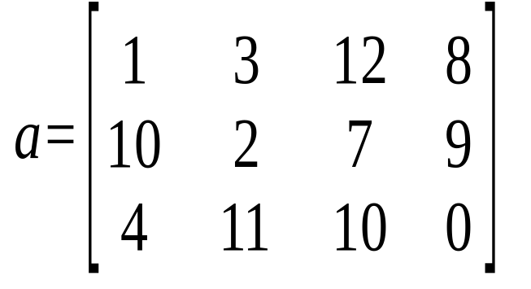
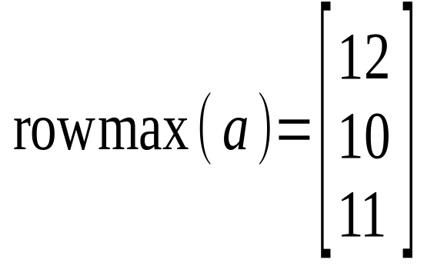
rowmax: find the max in each row
rowmax( int[][] a) returns the max value from each row
in each row, find the maximum element like this:
/* find the largest value in this row */
max = a[row][0];
for(int col=1; col < a[row].length; col++)
if ( a[row][col] > max ) max = a[row][col];
/* done processing this row. save max value. */
rowmax[ row ] = max;

Slide 39
rowmax: find the max of each row (2)
rowmax returns an array: one element for each row of a
public static int [] rowmax( int [][] a ) {
int max;
int rows = a.length;
int [] rowmax = new int[ rows ];
for(int row = 0; row < rows; row++) {
/* find the largest value in this row */
max = a[row][0];
for(int col=1; col < a[row].length; col++)
if ( a[row][col] > max ) max = a[row][col];
/* record the max value for this row. */
rowmax[ row ] = max;
}
return rowmax;
}

Slide 40
Pascal's Triangle
Pascal's Triangle is a pyramid of binomial coefficients.
Each element is the sum of 2 elements above it.
1
1 1
1 2 1
1 3 3 1
1 4 6 4 1
1 5 10 10 5 1
Pascal's triangle can be applied to combinatorial problems. It can also be used in algebra:

Slide 41
Pascal's Triangle (2)
Implement Pascal's Triangle as a 2-D array of size n.
1. Create a 2-D array with n rows:
2. Create each row (say, row number row)
3. Compute elements using Pascal's rule
int [][] p = new int[n];
p[row] = new int[row+1];
p[row][0] = p[row][row] = 1;
p[row][k] = p[row-1][k] + p[row-1][k-1];

Slide 42
Pascal's Triangle (3)
Implement Pascal's Triangle as a 2-D array.
/** generate Pascal's triangle of size n rows */
int [][] Pascal( int n ) {
// create array for row references
int [][] p = new int[n];
// create row = 0, 1, ..., n-1 of triangle
for(int row=0; k < n; k++) {
p[row] = new int[row+1];
p[row][0] = 1;
for(int k=1; k<p[row]; k++)
p[row][k] = c[row-1][k] + p[row-1][k-1];
p[row][row] = 1;
}
return p; // return reference to 2-D array
}

Slide 43
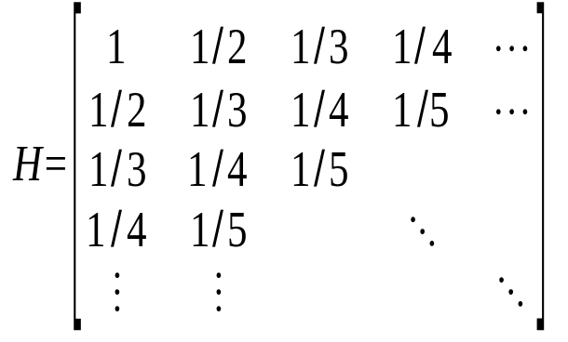
The Hadamand Matrix
// define and initialize a Hadamand array
final int SIZE = 10;
float [][] a = new int[SIZE][SIZE];
for(int j = 0; j < SIZE; j++) {
for (k=0; k<SIZE; k++) a[j][k] = 1.0/(1.0 + j + k);
}

Slide 44
Vector-Matrix Multiplication
How would you multiply a 2-dimensional array a by a 1-dimensional array x?
/* return a vector that is the product of a*x (matrix * vector) */
public static double [] multiply( double[][] a, double [] x) {
int nrows = a.length;
int ncols = x.length;
double [ ] y = new double[ nrows ];
for(int i = 0; i < nrows; i++ ) {
double sum = 0.0;
for(int j = 0; j < ncols; j++)
sum += a[i][j]*x[j];
y[i] = sum;
}
return y;
}

