Slide 1
Using Github and Github Organization in Programming 1

Slide 2
Github for What?
Submit some labs and quizzes
Submit Programming Project
Used for everything in OOP2.

Slide 3
What to do
Create a Github Account
  Put your REAL NAME in profile
  Add a PHOTO that clearly shows your face
  Include a public Email. Prefer KU-Gmail
  Write a short profile about yourself
Sign-up form: https://goo.gl/cwrBbW
Receive an e-mail invitation to join OOP2018
Click to join Github Organization.

Slide 4

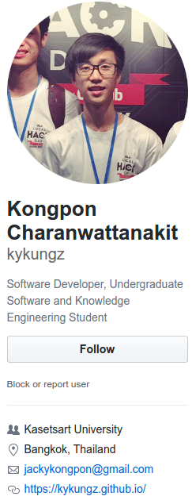
Github Account
Students in last year's OOP course.
1. Real name
2. Photo
3. Email
4. Description of you

Slide 5
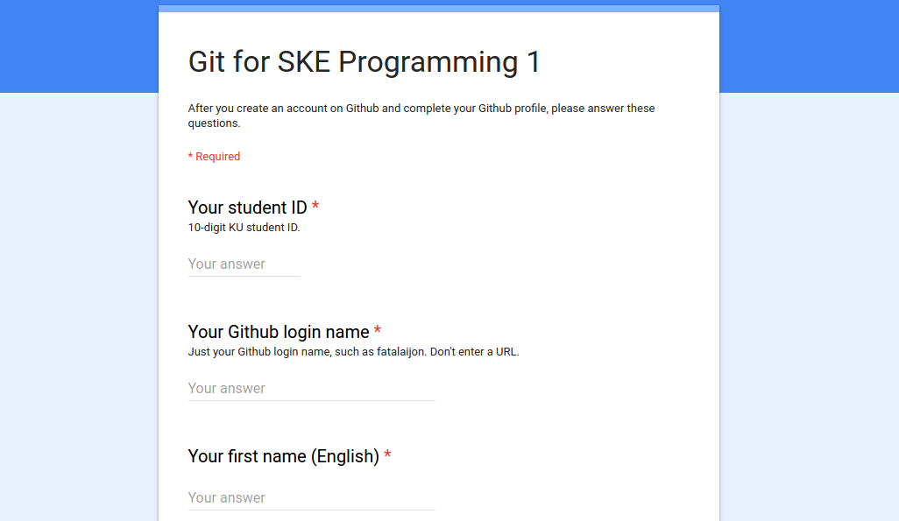
Complete a sign-up form: https://goo.gl/cwrBbW
Tell us your Github login!
Answer some simple questions about git.

Slide 6
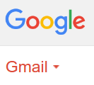
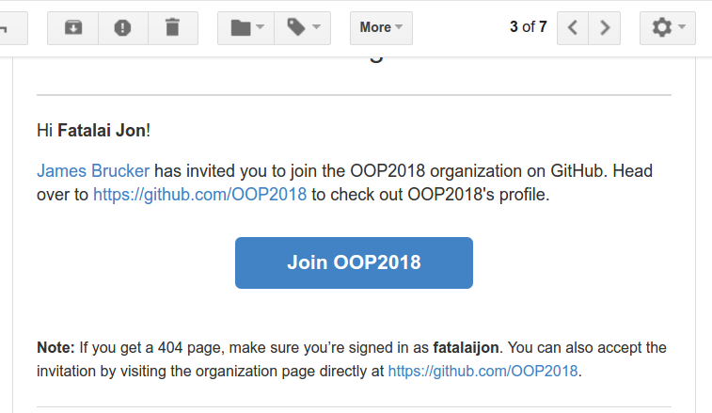
Receive invitation to join OOP2018
You must join this organization to receive starter code for assignments and quizzes.

Slide 7
You're a member of "OOP2018"
Github Organization for students in this course, and next semester, too.
Example: Github organization from OOP last year.

Slide 8
Why a Github Organization?
1. We use the organization to create assignments for you.
2. You will receive a repository containing starter code and instructions for some assignments (or quiz).
3. Just clone the repository and go to work.
Faster than creating your own repository, and avoids errors.

Slide 9
What's Next?
Next time:
an assignment using git with Github Classroom
you visit a URL to receive the assignment
  Github Classroom creates a git repo for you
  you clone it (copy) to your computer
  you do the work (programming)
  "git commit" your work locally
  "git push" your work to Github
  Finished! (Check your work on Github)
you can "git push" again to fix your project

Slide 10
Assignment
https://cpske.github.io/programming1/git/git-assignment

Slide 11
Personal Github vs Github Organization
Some assignments you will upload to your own Github account.
Example: create a repo named ske-restaurant on Github, and "push" your HW1 (SKE Restaurant code) to this repo.
On your local computer, the project name can be anything you want.
It does not have to match "ske-restaurant".

Slide 12
Personal Github vs Github Organization
For other assignments, we create a repository for you using the Github Organization.
The repository is located in Organization account instead of your account. But you can still "push" to it.
URL looks like:
https://github.com/OOP2018/yourname-assignment1
Example: T.B.A.

