Slide 1
Using Github

Slide 2
Github for What?
Online project hosting site.
"Remote" git repository with access control
Issue Tracking
Documentation and web pages (github.io)
Integrates with other services
  Continuous Integration, e.g. CircleCI

Slide 3
Github in this Course
Submit some labs and quizzes
Submit Programming Project
Used for everything in OOP2.

Slide 4
What to do
Create a Github Account
  Put your REAL NAME in profile
  Add a PHOTO that clearly shows your face
  Include a public Email. Prefer KU-Gmail
  Write a short profile about yourself
Sign-up form: https://goo.gl/cwrBbW
Receive an e-mail invitation to join OOP2018
Click to join Github Organization.

Slide 5


Github Account
Students in last year's OOP course.
1. Real name
2. Photo
3. Email
4. Description of you

Slide 6
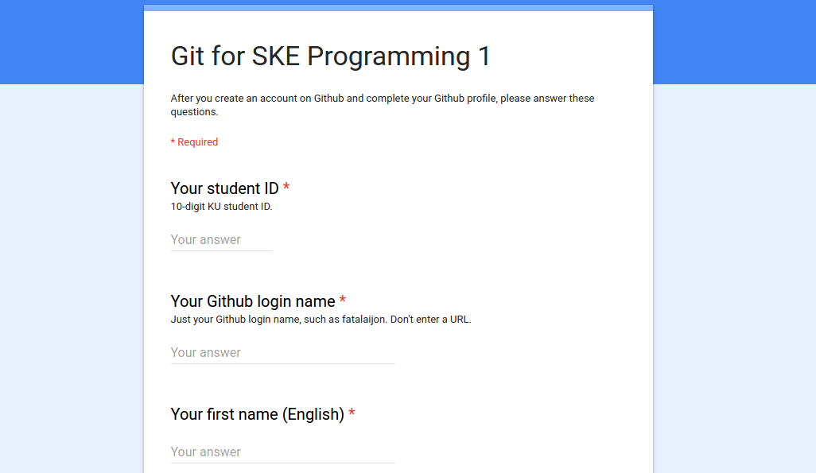
Complete a sign-up form: https://goo.gl/cwrBbW
Tell us your Github login!
Answer some simple questions about git.

Slide 7
How to Use Github

Slide 8
2 Situations + Special Case
Case 1: You already have project code on your local computer.
Case 2: Project exists on Github. You want to copy it to your computer.
Special Case:
Case 3: A new project (no files yet).

Slide 9
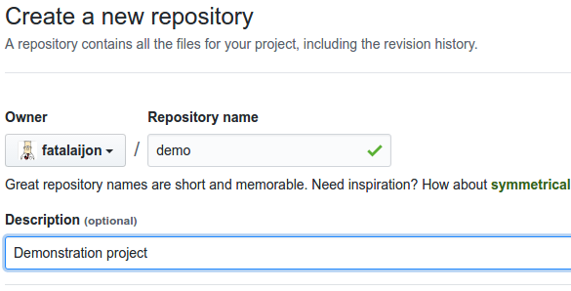
Case 1: Starting from Local Project
You already have a project on your computer
1. Create a local "git" repository.
cmd> git init
cmd> git add .gitignore src
cmd> git commit -m "initial code checkin"
2. Create an empty repo on Github.

Slide 10
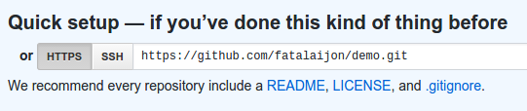

Case 1: adding Github as remote
3. Copy the URL of new Github repository (https or ssh).
4. In your local project, add Github as a remote repository named "origin":
cmd> git remote add origin
https://github.com/fatalaijon/demo.git
5. Copy the local repository to Github
cmd> git push -u origin master
You only need "-u origin master" the first time you push to Github. Next time, just type "git push".

Slide 11

Case 2: Starting from Github
A project already exists on Github. You want to "clone" it your local computer to do work.
1. Get the Github project URL
https://github.com/fatalaijon/demo.git
or: go to project on Github and click on
then copy the URL.
2. In your workspace, type:
cmd> git clone https://github.com/...
NOTE: "git clone" creates a new directory for the repository (named demo). If the directory already exists, clone won't work.

Slide 12
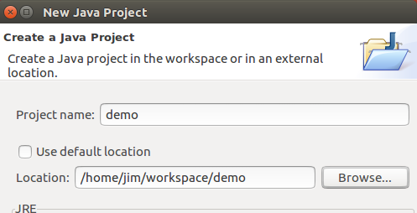
Case 2: Finishing up
3. Start your IDE and create a new project using the code in the directory you just cloned.
That's it!
Github is automatically the remote "origin".
Just "git push" your commited work to github.

Slide 13
You can use a different project name
The name of local directory containing the clone can be different from the Github repository name.
1) Rename it yourself.
or
2) Specify directory when you "clone":
cmd> git clone remote-url myproject
cmd> git clone https://github.com/fatalai jon/demo.git mydemo

Slide 14
Comparison of 2 Cases

Slide 15
Git Workflow
After you have a repository + Github, what do you do?

Slide 16
Assignment
https://cpske.github.io/programming1/git/git-assignment

